Slide 1
T-Mobile Invoice Methods

Slide 2
Table of Contents
Table of Contents
Ariba Network Overview
Account
Set Up
Purchase Orders
Invoice Information
Invoice Methods
Invoice Management
Customer Specifications
Invoice Rules
PO Flip
Non-PO Invoice
Invoice from a Service Sheet
Credit Memo from a Service Invoice
Credit Memo
Copy Invoices
Search for Invoice
Check Invoice Status
Invoice History
Modifying Invoices
Invoice Reports
Invoice Archival
Other Documents
Invoice Methods
Help Resources

Slide 3
T-Mobile Invoice Requirements
Table of Contents
Ariba Network Overview
Sufficient goods receipts for the amounts being invoiced on each PO line must be present before an invoice can be created.
The valid T-Mobile email address of the person who requested the goods/services MUST be entered on the invoice
Suppliers are required to include a Remit To address on invoice
Suppliers must enter taxes and freight at the header level
Account
Set Up
Purchase Orders
Other Documents
Invoice Methods
Help Resources

Slide 4
T-Mobile Invoice Restrictions
Table of Contents
Invoice numbers are restricted to the following
Alphanumeric characters only up to 16 digits
Letters must be capitalized
Cannot include leading zeros
Underscores are not permitted
Dashes are not permitted
Special characters are not permitted. Examples: !@#$%^&*
Line item discounts are not allowed
Ariba Network Overview
Account
Set Up
Purchase Orders
Additional restrictions
Part numbers are limited to 35 characters
Payment terms cannot be altered
Invoice attachment file names should be limited to 45 alphanumeric characters
Invoices can be back dated up to 120 days. However, payment is issued per your company’s payment terms based on the date the invoice is received by T-Mobile.
Debit and Credit Line Items cannot be submitted on the same invoice. If a Credit Line is needed please create a Line-Item Credit Memo.
Other Documents
Invoice Methods
Help Resources

Slide 5
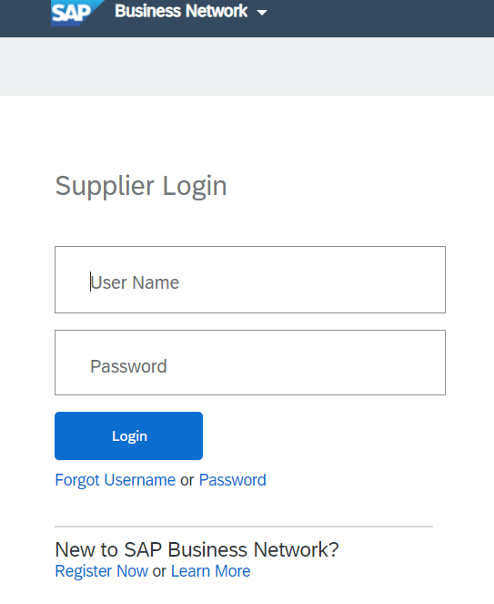
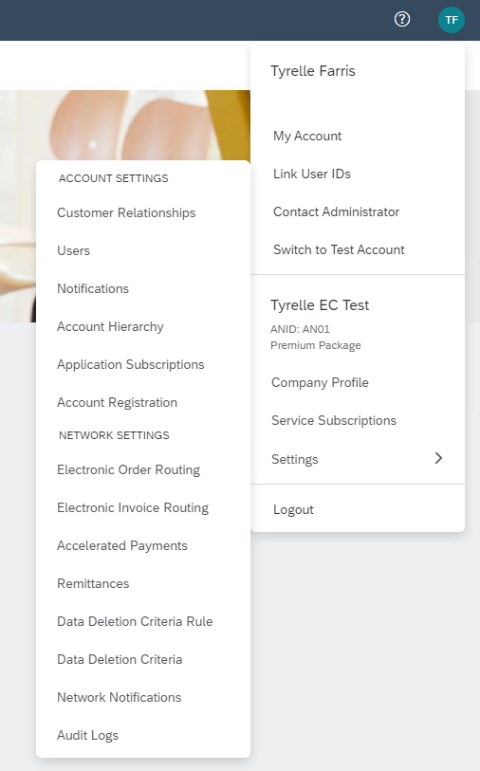
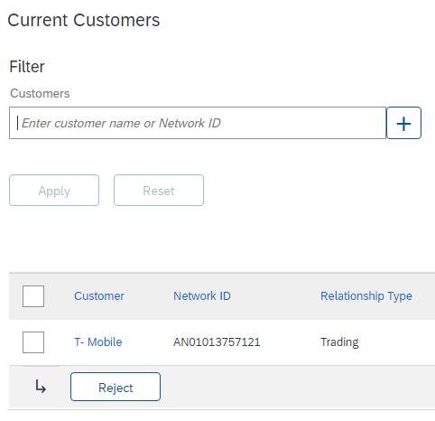
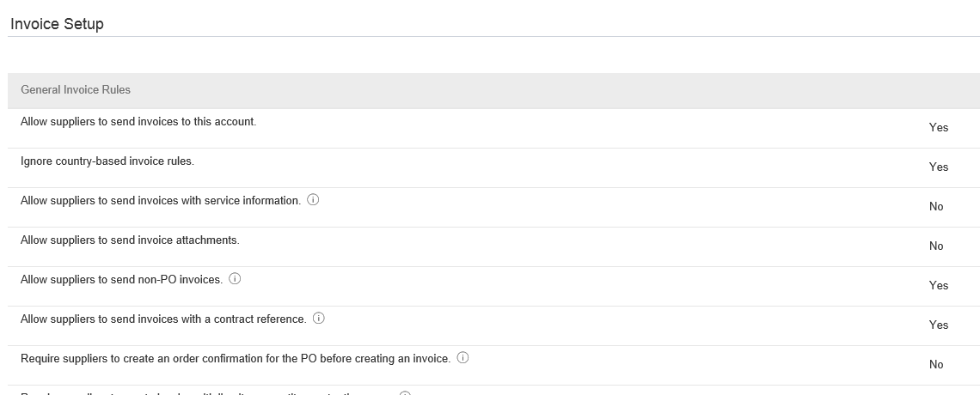
Review T-Mobile Invoice Rules
Table of Contents
2
1
3
Ariba Network Overview
These rules determine what you can enter when you create invoices.
Login to your Ariba Network account via supplier.ariba.com
Click the initials in the top-right corner of your home page to view the Company Settings Dropdown menu.
Click on Settings under Company Settings and select Customer Relationships.
A list of your Customers is displayed. Click the name of your customer (T-Mobile ).
Scroll down to the Invoice Setup section and view the General Invoice Rules.
Click Close when finished.
3
Account
Set Up
Purchase Orders
Other Documents
4
5
6
Invoice Methods
Help Resources

Slide 6
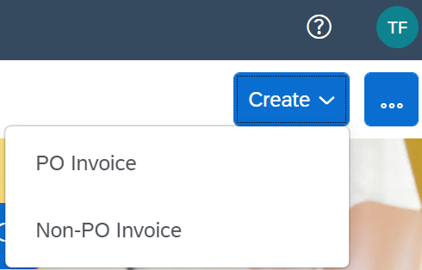
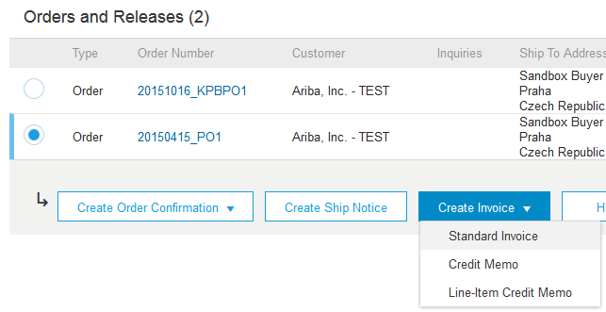
Invoice Against a PO
Table of Contents
1
Ariba Network Overview
To create a PO based invoice (or an invoice derived from a PO that you received via Ariba Network):
From the home screen within your Ariba Network account, select the Create dropdown menu in the top-right corner and click PO Invoice.
Select the PO Number that you are trying to invoice against.
Click on the Create Invoice button and then choose Standard Invoice and the Create Invoice screen will open (See next slide).
Account
Set Up
Purchase Orders
2
3
Other Documents
Invoice Methods
Help Resources

Slide 7
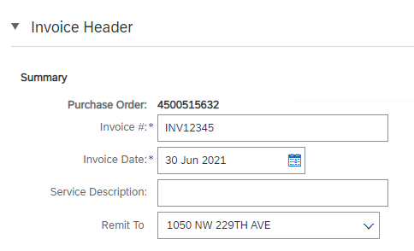
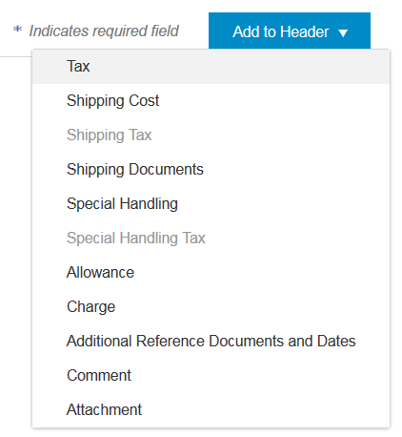
Invoice Against a PO Header
Table of Contents
Ariba Network Overview
Invoice is automatically pre-populated with the PO data. Complete all fields marked with an asterisk and add tax as applicable.
Enter an Invoice # (This is your unique number for invoice identification), The Invoice Date will auto-populate.
Select Remit-To address from the drop down box if you have created more than one Remittance Address for your AN account.
Tax and Shipping should be entered at the Header level by selecting the appropriate radio button.
You can also add additional information to the Header of the invoice such as: Special Handling, Payment Term, Comment, Attachment and Shipping Documents, by clicking Add to Header.
Scroll down to the Line Items section to select the line items being invoiced.
Note: Attachment file size should not exceed 40MB.
1
2
Account
Set Up
3
4
Purchase Orders
3
Other Documents
5
Invoice Methods
Help Resources

Slide 8
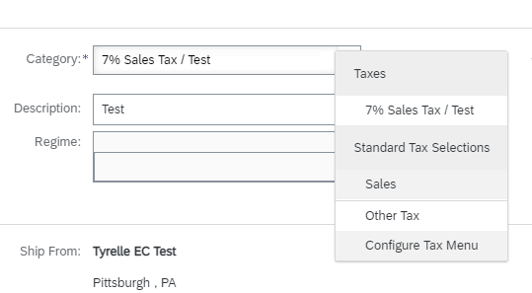
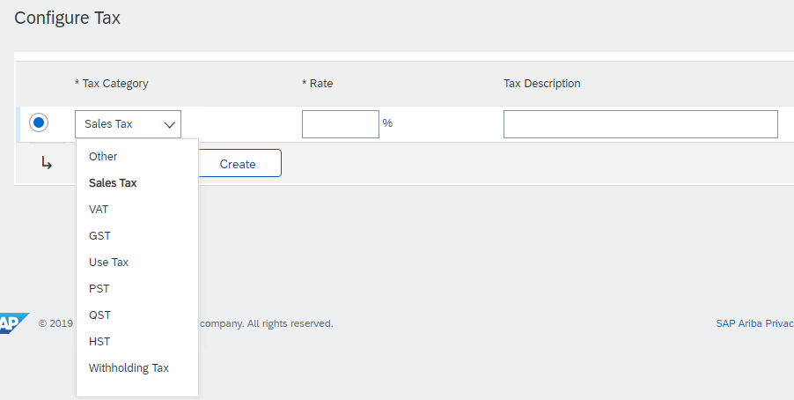
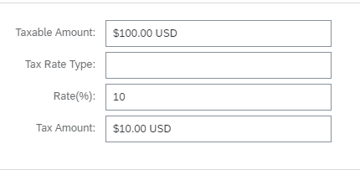
Invoice Against a PO Header Level Tax
Table of Contents
1
Ariba Network Overview
Select the appropriate Tax Category from the Category dropdown menu.
If you do not see your needed Sales Type you can either select Other Tax or Configure Tax Menu to get your desired Tax type.
To configure a new Tax type click Configure Tax Menu and then click Create on the following page.
Next you will select the appropriate Tax Category from the dropdown menu and enter the necessary Rate. Click OK once completed.
Once the appropriate Tax Category is added you can update the Tax Amount by either entering your Taxable Amount or entering your Tax Amount.
Note: You do not need to enter both figures, the system will automatically calculate based on the Rate and you entering one of the two amounts.
Once these steps are completed scroll down the page to the Shipping Section.
2
Account
Set Up
3
2
Purchase Orders
3
3
Other Documents
Invoice Methods
4
Help Resources

Slide 9
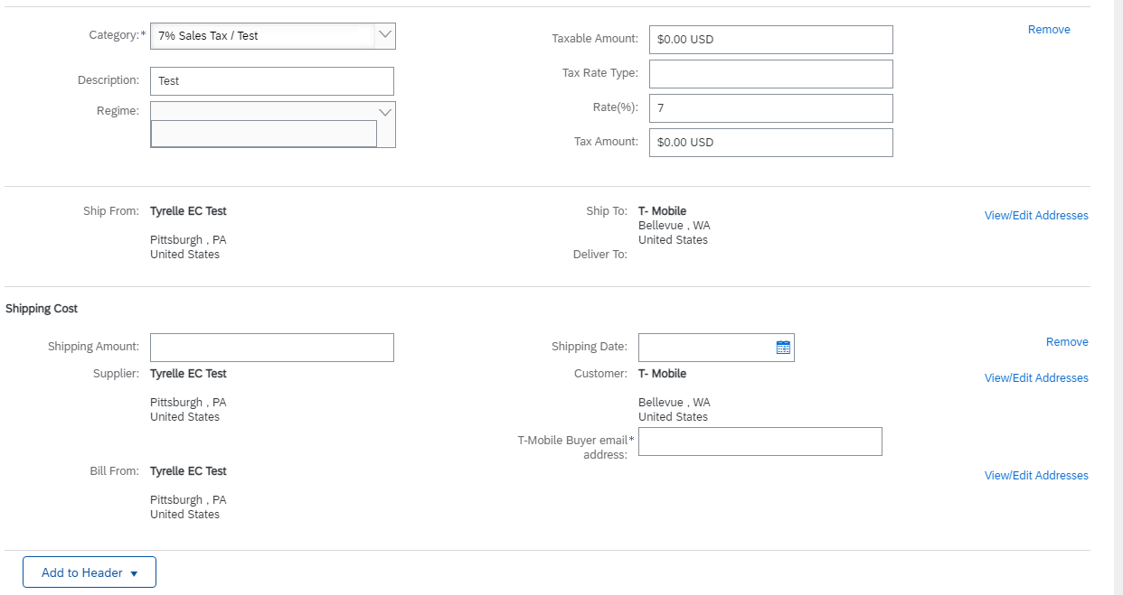
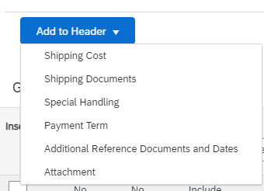
Invoice Against a PO Header Level Shipping and Shipping Cost
Table of Contents
Ariba Network Overview
The Ship From and Ship To section will be updated according to the information in your account (Ship From) and the information contained in the PO (Ship To).
If you do not see a Shipping Cost section and one is applicable, click the Add to Header button in the bottom-left corner and select Shipping Cost.
Once added you will see a Shipping Amount and Shipping Date field appear in the Invoice. Enter the appropriate amounts for each of those fields.
Be sure to enter a valid T-Mobile Buyer email address during this step, this information is require.
1
Account
Set Up
3
3
4
Purchase Orders
2
Other Documents
2
Invoice Methods
Help Resources

Slide 10
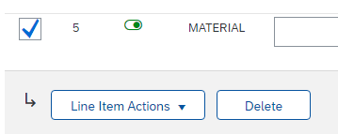
Invoice Against a PO Line Items
Table of Contents
Line Items section shows the line items from the Purchase Order.
Review or update Quantity for each line item you are invoicing.
If you wish to exclude a line item from the invoice, click on the line item’s green slider.
Note: You can also exclude the line item by clicking the check box to the left and clicking ‘Delete’.
Notes:
You can generate another invoice later to bill for the excluded item.
Credit and Debit lines cannot be submitted on the same invoice. If Credit lines are needed please create a Line-Item Credit Memo.
Ariba Network Overview
Account
Set Up
1
Purchase Orders
3
Other Documents
2
1
Invoice Methods
3
Help Resources

Slide 11
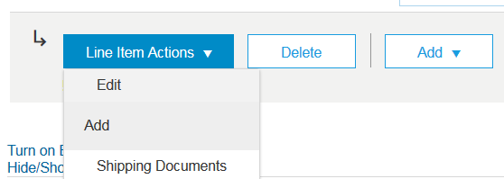
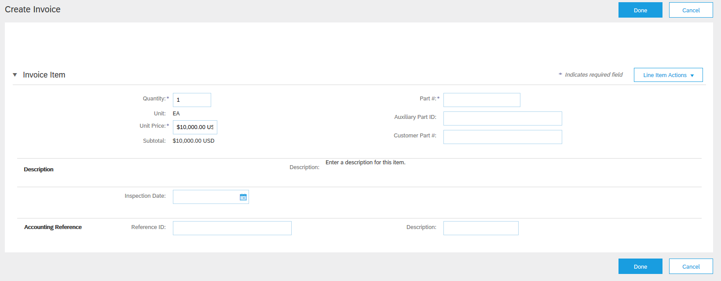
Invoice Against a PO Detail Line Items
Table of Contents
Ariba Network Overview
Additional information can be viewed at the Line Item Level by editing a Line Item.
6
6
Account
Set Up
Purchase Orders
Other Documents
Invoice Methods
Help Resources

Slide 12
Invoice Against a PO Line Item Comments
Table of Contents
Ariba Network Overview
To add comments at the line items select Line Items, then click at Line Item Actions >Add > Comments.
Upon refresh or Update, the Comments field will display. Enter applicable Comments in this field.
Click Next.
Account
Set Up
Purchase Orders
3
Other Documents
1
Invoice Methods
2
Help Resources

Slide 13
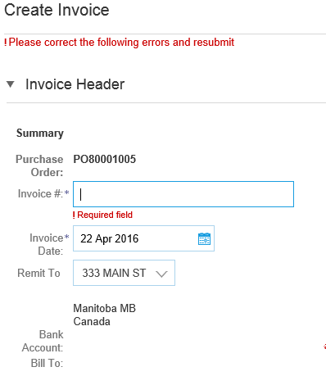
Invoice Against a PO Review, Save, or Submit to Customer
Table of Contents
4
Ariba Network Overview
Review your invoice for accuracy from the Review page. Scroll down the page to view all line item details and invoice totals.
If no changes are needed, click Submit to send the invoice to T-Mobile .
If changes are needed, click Previous to return to previous screens and make corrections before submitting.
Alternatively, Save your invoice at anytime during invoice creation to work on it later.
You may resume working on the invoice by selecting it from Invoices>Drafts on your Home page.
Note: You can keep draft invoices for up to 7 days.
3
2
Account
Set Up
1
Note: In the event of errors, there will be a notification in red where information must be corrected
Purchase Orders
Other Documents
Invoice Methods
5
Help Resources

Slide 14
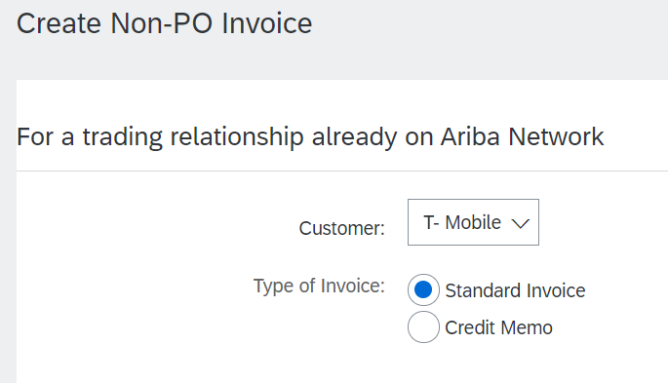
Invoice Without a Purchase Order Non-PO Invoice
Table of Contents
Ariba Network Overview
To create an invoice without a PO:
Select Invoices on the Navigation Menu.
Select Create Non-PO Invoice.
Select your Customer from the dropdown menu.
Select Standard Invoice.
If you need to invoice a new customer click Invoice New Customer.
Note: T-Mobile suppliers do not need a customer code to enter a Non-PO Invoice.
Click Next.
1
Account
Set Up
Purchase Orders
2
Other Documents
5
3
Invoice Methods
4
Help Resources

Slide 15
Invoice Without a Purchase Order Non-PO Invoice
Table of Contents
Ariba Network Overview
Complete all required fields marked with an asterisk (*).
Customer Contact: The valid T-Mobile email address of the person who requested the goods/services MUST be entered on the invoice for proper routing and approval.
Use Add Item button to select the type of line item being added to the Invoice.
Note: You will be able to choose General Service, Labor Service or Material line item types.
1
Account
Set Up
Purchase Orders
2
Other Documents
3
Invoice Methods
Help Resources

Slide 16
Invoice Without a Purchase Order Non-PO Invoice
Table of Contents
Ariba Network Overview
Complete all required fields marked with an asterisk (*).
Invoice Number Requirements: Drop leading zeros, exclude spaces, exclude special characters, and use all capitals. If longer than 16 characters, trim from the left leaving the last 16 of the invoice number.
Customer Contact: The valid T-Mobile email address of the person who requested the goods/services MUST be entered on the invoice for proper routing and approval.
Add Sales tax as appropriate at header level. Enter tax % in the Rate (%) field. Ariba Network will calculate and populate the Tax Amount field. If no tax, enter 0 in Rate(%) field or click on Remove to eliminate the section
1
Account
Set Up
Purchase Orders
2
Other Documents
Invoice Methods
3
Help Resources

Slide 17
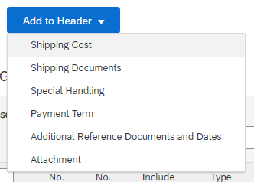
Invoice Without a Purchase Order Non-PO Invoice
Table of Contents
Ariba Network Overview
You can also add additional information to the Header of the invoice such as: Shipping Cost, Shipping Documents, Amount Details, Special Handling, Payment Term, Additional Reference Document and Dates, Attachment
Please note: If PDF copy of invoice is available or supporting documents, please attach. Click on Attachment and follow steps to Choose File and Add Attachment. There is a 10MB size limitation
Please note: If any additional information is added to the header by accident, click on Remove to eliminate the section
4
Account
Set Up
Purchase Orders
Other Documents
Invoice Methods
Help Resources

Slide 18
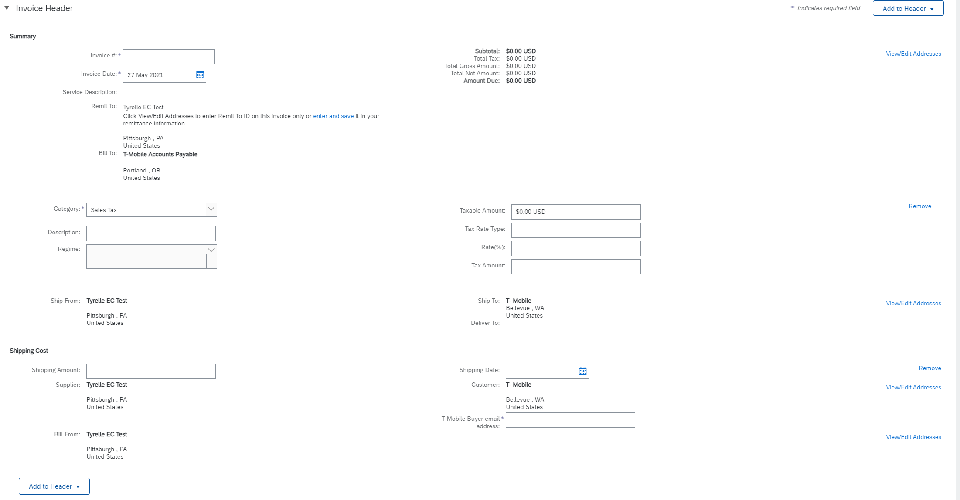
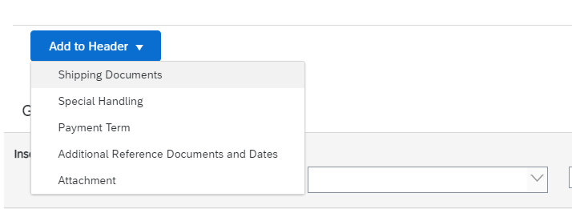
Invoice Without a Purchase Order Non-PO Invoice
Table of Contents
Ariba Network Overview
Add Tax and Shipping as appropriate at header level.
You can also add additional information to the Header of the invoice such as: Special Handling, Payment Term, Comment, Attachment, Shipping Documents.
Continue down to the Line Item Section and completed the Line Item Details as necessary for your Invoice (See Next Slide)
Account
Set Up
1
1
Purchase Orders
Other Documents
1
Invoice Methods
2
Help Resources

Slide 19
Invoice Without a Purchase Order Non-PO Invoice (Material Item Type)
Table of Contents
Ariba Network Overview
Complete the required fields in your Line Item
Necessary Fields: Description, Quantity, Unit, Unit Price, Subtotal
Notes:
The line details vary depending on the Line Item Type. See the following slides for General Service and Labor Service type screenshots.
Credit and Debit Lines cannot be submitted on the same invoice. If Credit lines are needed please create a Line-Item Credit Memo.
Review and then Save or Submit as Standard Invoice.
Note: Clicking Save will not submit the invoice. If you save be sure to click Next and then Submit once you are ready for the Invoice to be sent.
Account
Set Up
Purchase Orders
Other Documents
1
Invoice Methods
2
Help Resources

Slide 20
Invoice Without a Purchase Order Non-PO Invoice (General Service Item Type)
Table of Contents
Ariba Network Overview
Complete the required fields in your Line Item
Necessary Fields: Description, Quantity, Unit, Unit Price, Subtotal, Service Start Date, Service End Date
Note: Credit and Debit Lines cannot be submitted on the same invoice. If Credit lines are needed please create a Line-Item Credit Memo.
Review and then Save or Submit as Standard Invoice.
Note: Clicking Save will not submit the invoice. If you save be sure to click Next and then Submit once you are ready for the Invoice to be sent.
Account
Set Up
Purchase Orders
Other Documents
1
Invoice Methods
2
Help Resources

Slide 21
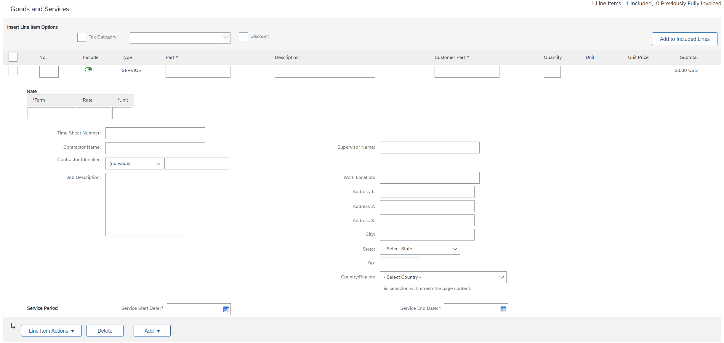
Invoice Without a Purchase Order Non-PO Invoice (Labor Service Item Type)
Table of Contents
Complete the required fields in your Line Item
Necessary Fields: Description, Quantity, Term, Rate, Unit, Service Start Date, Service End Date
Note: Credit and Debit Lines cannot be submitted on the same invoice. If Credit lines are needed please create a Line-Item Credit Memo.
Review and then Save or Submit as Standard Invoice.
Note: Clicking Save will not submit the invoice. If you save be sure to click Next and then Submit once you are ready for the Invoice to be sent.
Ariba Network Overview
Account
Set Up
Purchase Orders
1
2
Other Documents
Invoice Methods
Help Resources

Slide 22
Invoice from a Service Sheet Locate Approved Service Sheet
Table of Contents
Ariba Network Overview
1
Account
Set Up
1
Purchase Orders
2
2
2
Other Documents
Click Fulfillment and select Service Sheets from the dropdown menu.
Select the checkbox next to your approved Service Sheet and click the Create Invoice button to open up the Create Invoice screen OR click the Service Sheet # to open the Service Sheet for review before invoicing.
Note: Service Invoices should be applied against a single approved service sheet only.
Invoice Methods
Help Resources

Slide 23
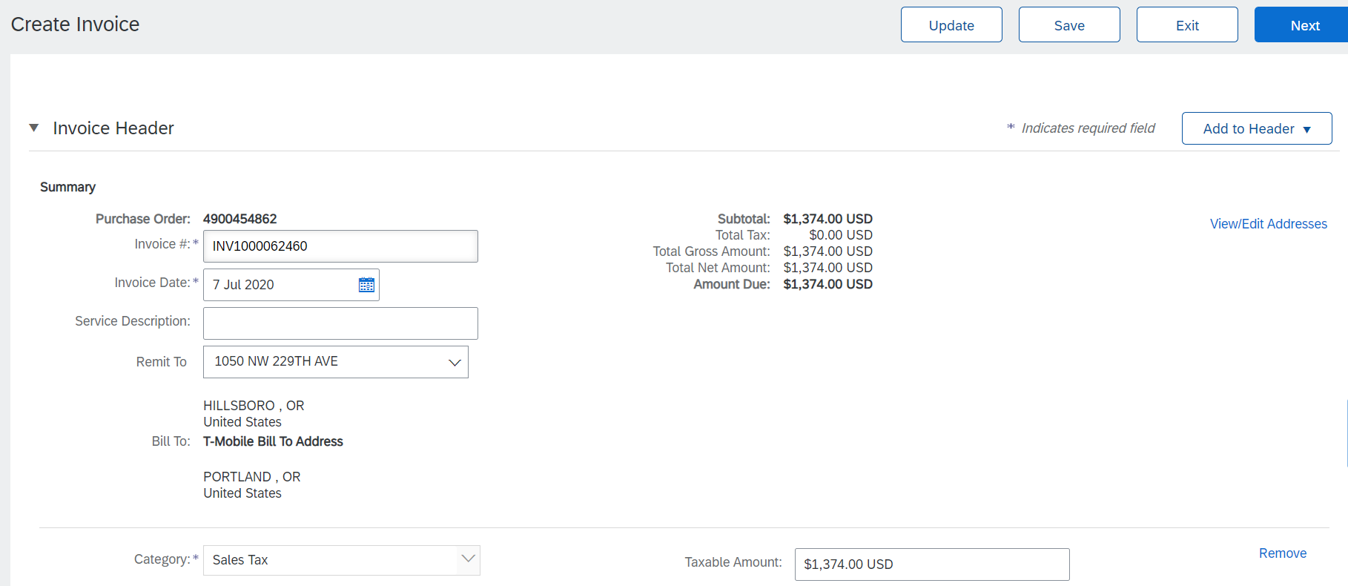
Invoice from a Service Sheet Invoice via Service Sheet #
Table of Contents
Ariba Network Overview
Invoice by clicking the Service Sheet # on the Service Sheets screen allow you review the Service Sheet.
Then click the Create Invoice button to open up the Create Invoice screen for invoicing.
Account
Set Up
1
2
Purchase Orders
Other Documents
Invoice Methods
Help Resources

Slide 24
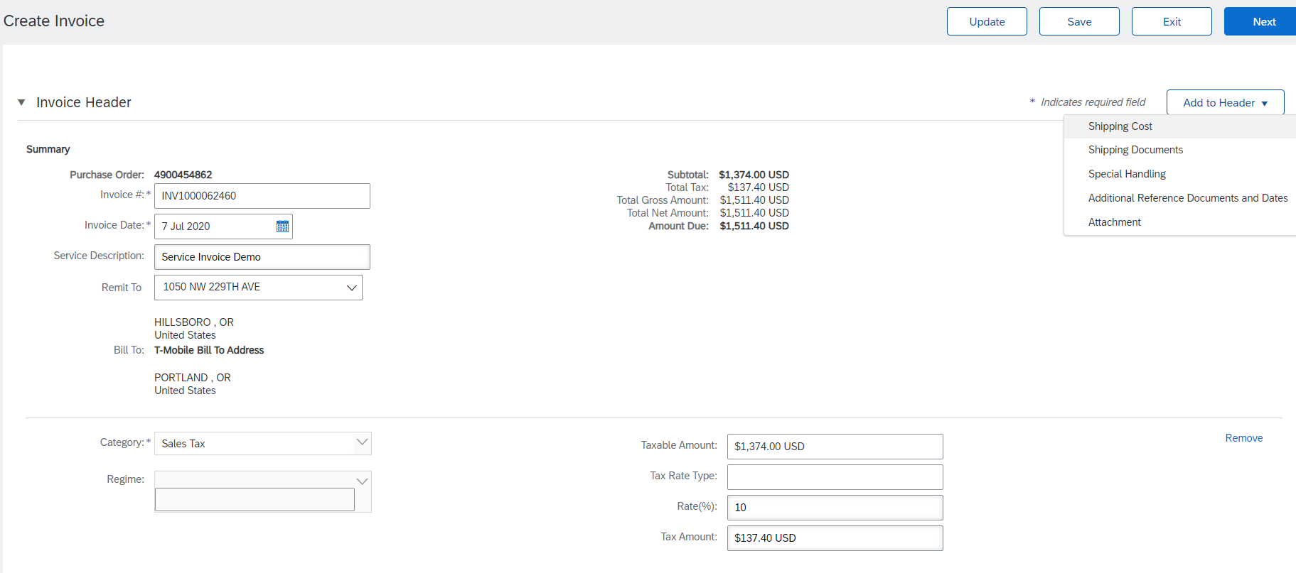
Invoice from a Service Sheet Invoice Header Information
Table of Contents
Invoice information will automatically pre-populate from the Service Sheet.
Complete all required fields marked with an asterisk (*). For examples:
Invoice Number # field: input with naming convention i.e. INV concatenated with Service Sheet # (INV1000062460)
Enter either tax rate in the Tax Rate (%) field or tax amount in the Tax Amount field.
Add to Header button allows for shipping cost, shipping documents, amount details, special handling, and additional reference documents and dates. Comments and attachments may also be added at header.
Amount Due is automatically calculated including Invoice Gross Amount, Tax Amount, and shipping cost, special handling fee, if any added to header.
Ariba Network Overview
3
Account
Set Up
1
4
Purchase Orders
Other Documents
2
Invoice Methods
2
Help Resources
Note: Some required fields such as Invoice Date, Tax Category will automatically populate.

Slide 25
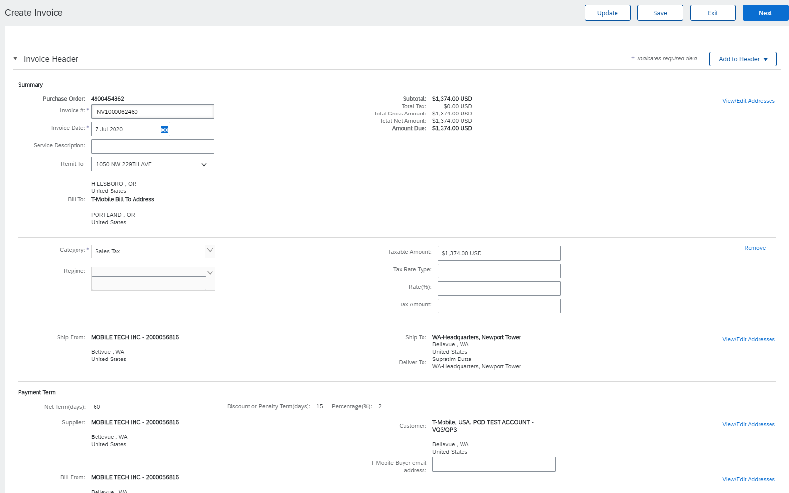
Invoice from a Service Sheet Header Level Detail
Table of Contents
Ariba Network Overview
Header Level information can be entered after the screen refreshes. Complete each section as needed before proceeding to the Line Section.
Note: Check for fields marked with an asterisk (*) and enter information as required. Some required fields such as Invoice Date, Tax Category will automatically populate.
Account
Set Up
Purchase Orders
Other Documents
Invoice Methods
Help Resources

Slide 26
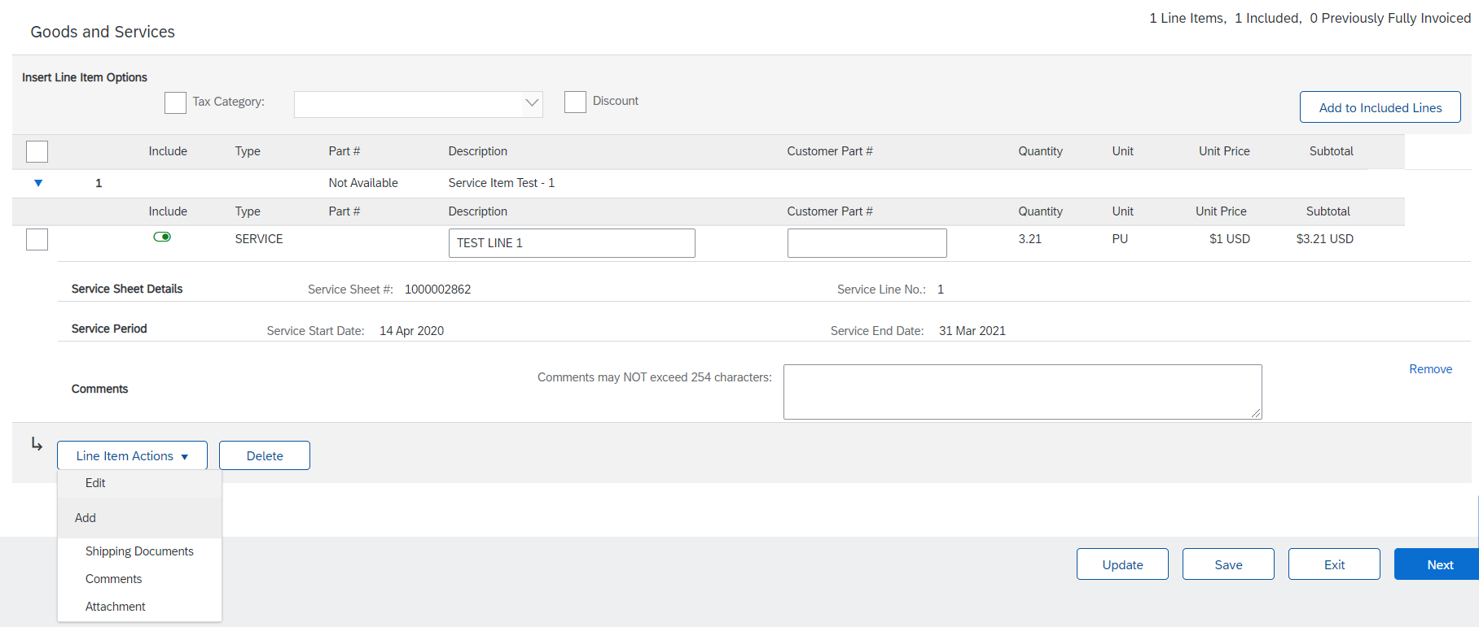
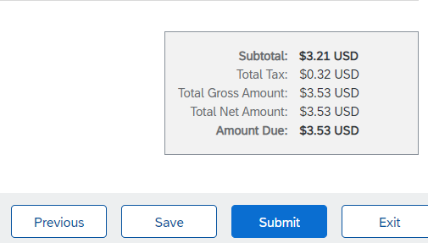
Invoice from a Service Sheet Line Item Details
Table of Contents
Invoice information will automatically pre-populate from the Service Sheet.
Add line level information, including comments and attachments, by selecting the Line and clicking the Line Item Actions button. The screen will automatically refresh and you will be able to fill in the detail.
Review and Update each service line item as needed until all items are complete. Line Item Details contain information such as Service Line No., Service Sheet #, Service Period, Quantity, Unit, Unit Price, Subtotal, etc.
Click Next to proceed to review screen.
Ariba Network Overview
Account
Set Up
2
2
2
Purchase Orders
2
1
3
Other Documents
Note: Do not submit a service invoice over 65 Service Line Items.
Invoice Methods
4
Help Resources

Slide 27
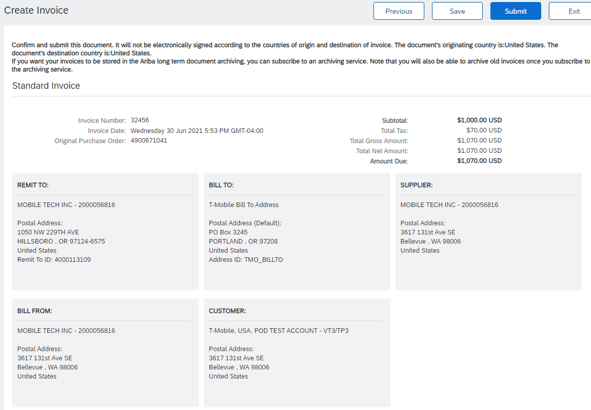
Invoice from a Service Sheet Line Item Details
Table of Contents
1
2
Ariba Network Overview
From the Review Screen, check your Invoice for accuracy. If there are errors, click Previous to return to the Create Invoice screen and make corrections.
To submit to your customer after corrected, click the Submit Button.
1
Account
Set Up
Purchase Orders
Other Documents
Invoice Methods
Help Resources
Note: Do not submit a service invoice over 65 Service Line Items.

Slide 28
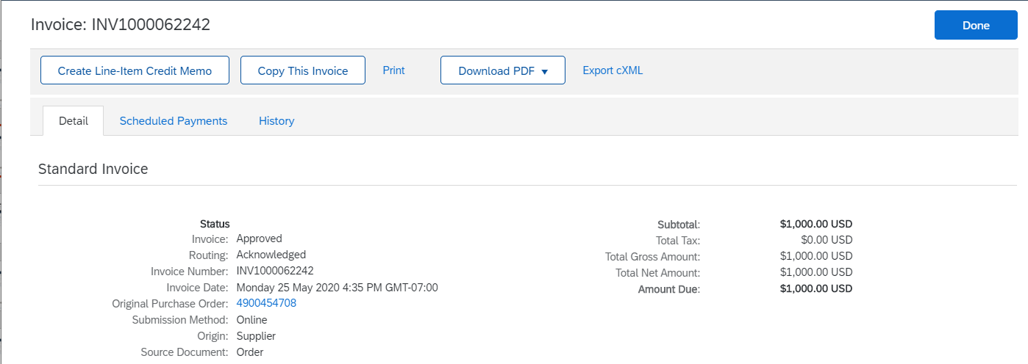
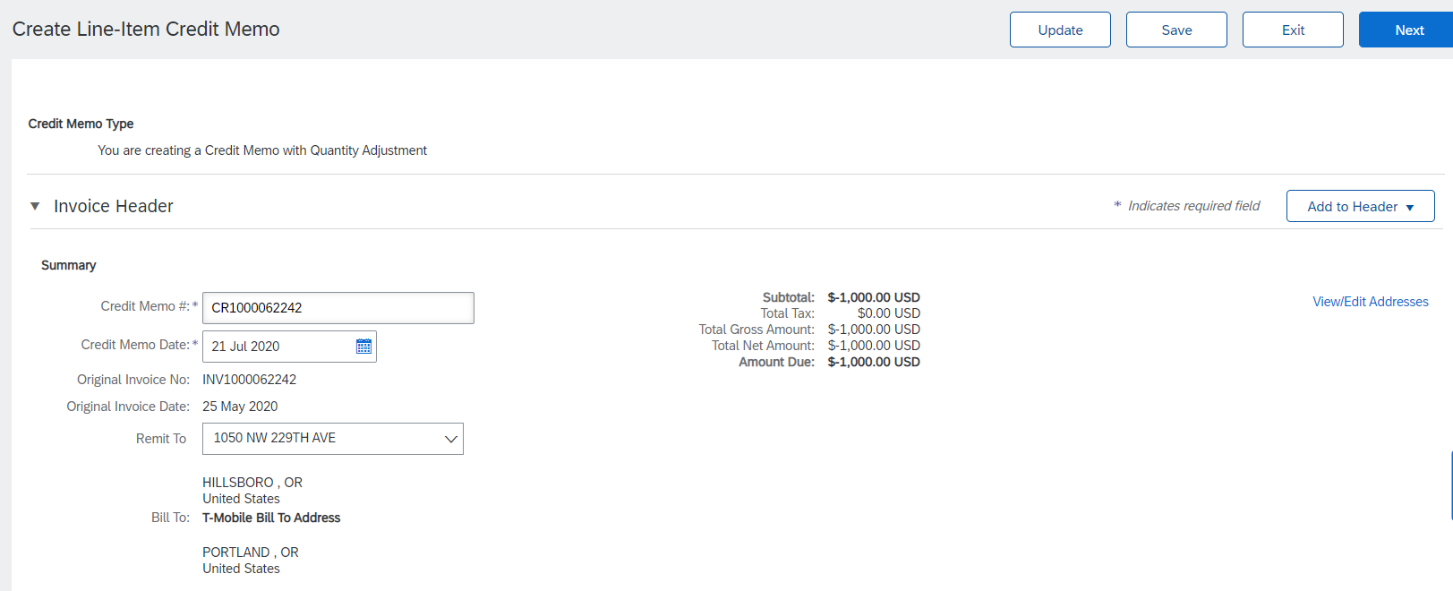
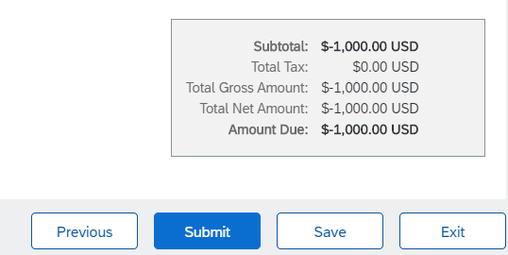
Create a Credit Memo from a Service Invoice Line-Item Credit Memo
Table of Contents
Note: Do not create a credit memo for invoice reversals. Please contact APInfo@T-Mobile.com for additional assistance.
To create a line level credit memo against a service invoice:
Click the Invoices tab and select Invoices from the dropdown menu.
Select your previously created service invoice.
Click on the radio button next to the approved Service Invoice #, OR
Click on the Service Invoice # to open up the Service Invoice for review
Click the button on the Invoice(s) screen to Create Line-Item Credit Memo.
Do not modify the lines or the line details. Credit memos against service invoices should be for the entire original invoice.
Make sure that all required fields are filled in
Click Next.
Review Credit Memo.
Click Submit.
Ariba Network Overview
1
Account
Set Up
2
2
Purchase Orders
3
3
4
Other Documents
Invoice Methods
6
7
Help Resources
5

Slide 29
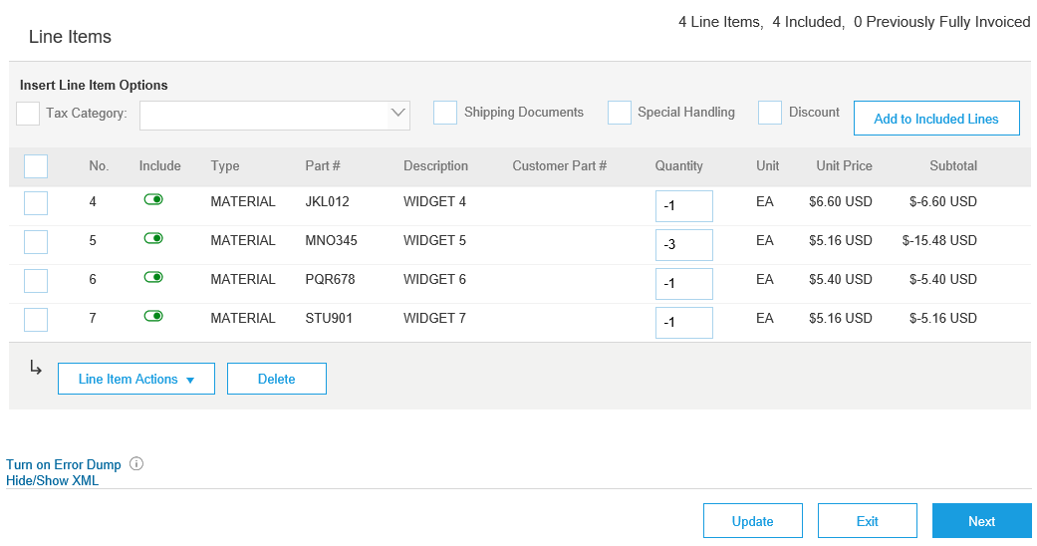
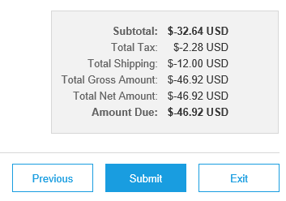
Create a Credit Memo Line Level Detail
Table of Contents
To create a line level credit memo against an invoice:
Select the Invoices tab.
Select your previously created Invoice.
Click the button on the Invoices screen to Create Line-Item Credit Memo.
Complete information in the form of Credit Memo (the amount and taxes will automatically be negative). Make sure that all required fields marked with asterisks (*) are filled in.
Click Next.
Review Credit Memo.
Click Submit.
1
Ariba Network Overview
Account
Set Up
2
Purchase Orders
3
4
Other Documents
6
Invoice Methods
5
7
Help Resources

Slide 30
Credit Invoice without a PO Non-PO Credit Invoice
Table of Contents
1
Ariba Network Overview
To create an invoice without a PO:
Select Invoices on the Navigation Menu.
Select Create Non-PO Invoice.
Select your Customer from the dropdown menu.
Select Standard Invoice. Do not select credit memo
Click Next.
Note: T-Mobile suppliers do not need a customer code to enter a Non-PO Invoice.
Account
Set Up
Purchase Orders
2
Other Documents
5
3
Invoice Methods
4
Help Resources

Slide 31
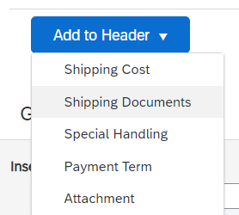
Credit Invoice without a PO Non-PO Credit Invoice
Table of Contents
5
Ariba Network Overview
Complete all required fields marked with an asterisk (*).
Customer Contact: The valid T-Mobile email address of the person who requested the goods/services MUST be entered on the invoice for proper routing and approval.
Use Add Item button to add the details of the item(s) being invoiced. Be certain to provide complete details of the items or services being credited, including any PO number related to the credit. Enter a negative quantity. The negative quantity will cause T-Mobile’s system to view this invoice as a credit.
Add Tax and Shipping as appropriate at header level.
Note: Tax ONLY credits should be listed at the line level and not in the header
You can also add additional information to the Header of the invoice such as: Special Handling, Payment Term, Comment, Attachment, Shipping Documents.
Click Next to continue.
1
Account
Set Up
2
Purchase Orders
Other Documents
3
4
Invoice Methods
Help Resources

Slide 32
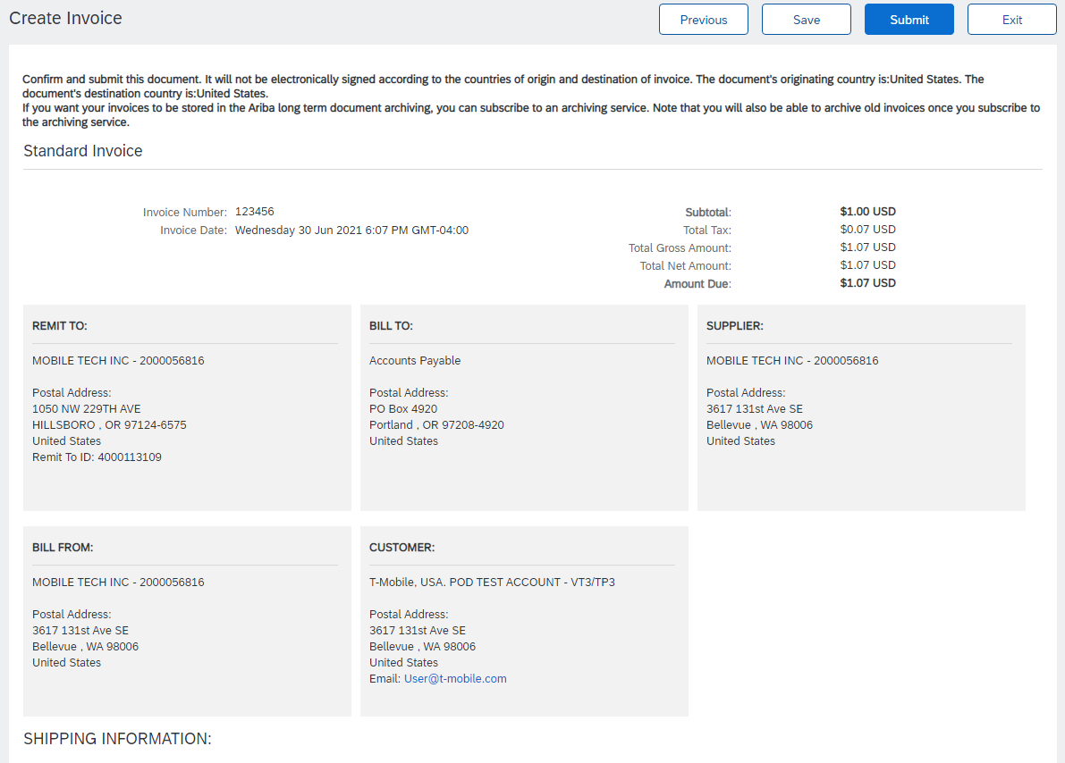
Credit Invoice without a PO Non-PO Credit Invoice
Table of Contents
2
Ariba Network Overview
1
Account
Set Up
Review your invoice details.
Click Save or Submit
Purchase Orders
Other Documents
Invoice Methods
Help Resources

Slide 33
Copy an Existing Invoice
Table of Contents
To copy an existing invoice in order to create a new invoice:
Select the Invoices tab.
Either select the radio button for the invoice you want to copy, and click Copy.
Enter a new Invoice Number.
Edit the other fields as necessary.
Click Next to review the invoice and save or submit it.
1
Ariba Network Overview
Account
Set Up
2
2
Purchase Orders
5
Other Documents
3
4
Invoice Methods
Help Resources

Slide 34
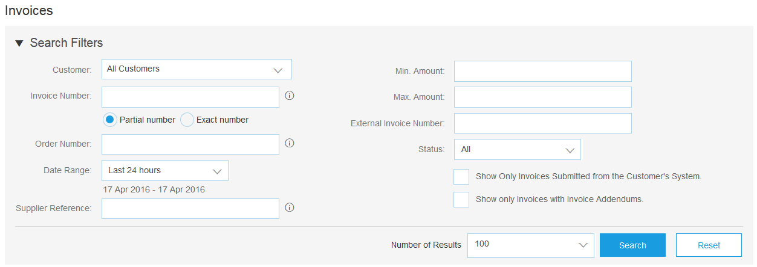
Search for Invoice
Table of Contents
Quick Search:
From the Home tab, select Invoices in the Document type to search.
Select T-Mobile from customer dropdown menu.
Enter Document #, if known. Select Date Range, up to 90 days for Invoices and Click Search.
Refined Search: Allows a refined search of Invoices within up to 90 last days.
Click Search Filters from the Invoices tab.
Enter the criteria to build the desired search filter.
Click Search.
Ariba Network Overview
2
3
1
Account
Set Up
Purchase Orders
4
Other Documents
5
Invoice Methods
6
Help Resources

Slide 35
Check Invoice Status Routing Status To Your Customer
Table of Contents
Ariba Network Overview
Check Status:
If you configured your Invoice Notifications as noted earlier in this presentation, you will receive emails regarding invoice status.
You can also check invoice status from the Invoices tab by selecting the invoice link.
Routing Status
Reflects the status of the transmission of the invoice to T-Mobile via the Ariba Network.
Obsoleted – You canceled the invoice
Failed – Invoice failed T-Mobile invoicing rules. T-Mobile will not receive this invoice
Queued – Ariba Network received the invoice but has not processed it
Sent – Ariba Network sent the invoice to a queue. The invoice is awaiting pickup by the customer
Acknowledged – T-Mobile invoicing application has acknowledged the receipt of the invoice
Account
Set Up
Purchase Orders
Other Documents
Invoice Methods
Help Resources

Slide 36
Check Invoice Status Review Invoice Status With Your Customer
Table of Contents
Invoice Status
Reflects the status of T-Mobile ’s action on the Invoice.
Sent – The invoice is sent to the T-Mobile but they have not yet verified the invoice against purchase orders and receipts
Cancelled – T-Mobile approved the invoice cancellation
Paid – T-Mobile paid the invoice / in the process of issuing payment. Only if T-Mobile uses invoices to trigger payment.
Approved – T-Mobile has verified the invoice against the purchase orders or contracts and receipts and approved if for payment
Rejected – T-Mobile has rejected the invoice or the invoice failed validation by Ariba Network. If T-Mobile accepts the invoice or approves it for payment, invoice status updated to Sent (invoice accepted) or Approved (invoice approved for payment)
Failed – Ariba Network experienced a problem routing the invoice
Ariba Network Overview
Account
Set Up
Purchase Orders
Other Documents
Invoice Methods
Help Resources

Slide 37
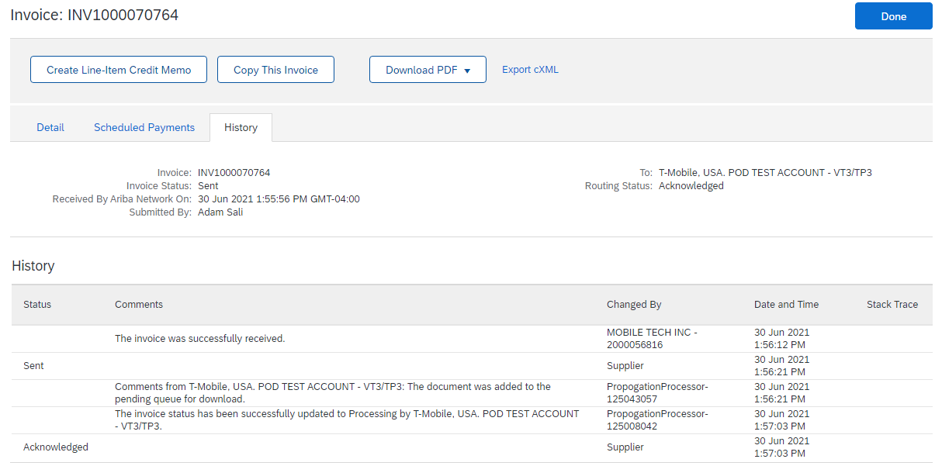
Review Invoice History Check Status Comments
Table of Contents
Ariba Network Overview
Access any invoice:
Click on the History tab to view status details and invoice history.
History and status comments for the invoice are displayed.
Transaction history can be used in problem determination for failed or rejected transactions.
When you are done reviewing the history, click Done.
1
Account
Set Up
4
Purchase Orders
Other Documents
2
3
Invoice Methods
Help Resources

Slide 38
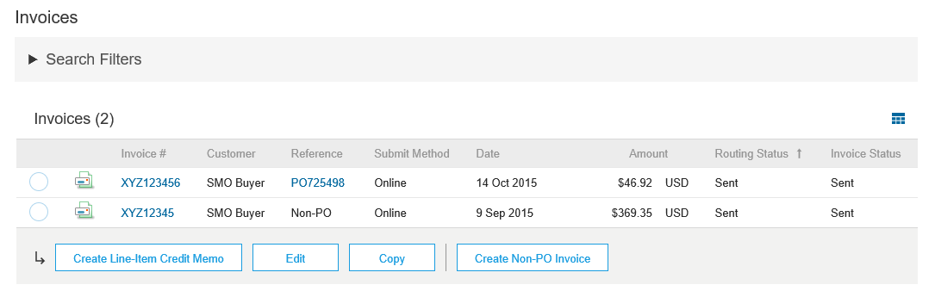
Modify an Existing Invoice Edit, and Resubmit
Table of Contents
Ariba Network Overview
Click the Invoices tab.
In the Invoice # column, click a link to view details of the invoice.
Click the Invoice # for the failed, canceled, or rejected invoice that you want to resubmit and click Edit.
Click Submit on the Review page to send the invoice.
1
Account
Set Up
2
Purchase Orders
3
Other Documents
4
Invoice Methods
Help Resources

Slide 39
Download Invoice Reports Learn About Transacting
Table of Contents
Reports help provide additional information and details on transactions on the Network in a comprehensive format.
Ariba Network Overview
1
Click the Reports tab from the menu at the top of the page.
Click Create.
Account
Set Up
2
Purchase Orders
Invoice reports provide information on invoices you have sent to customers for tracking invoices over time or overall invoice volume for a period of time.
Failed Invoice reports provide details on failed and rejected invoices. These reports are useful for troubleshooting invoices that fail to route correctly.
Reports can be created by Administrator or User with appropriate permissions.
Other Documents
Invoice Methods
Help Resources

Slide 40
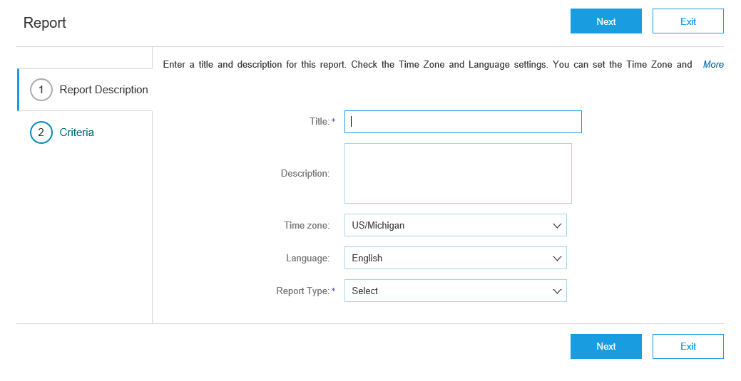
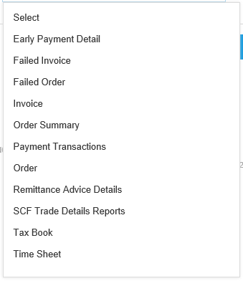
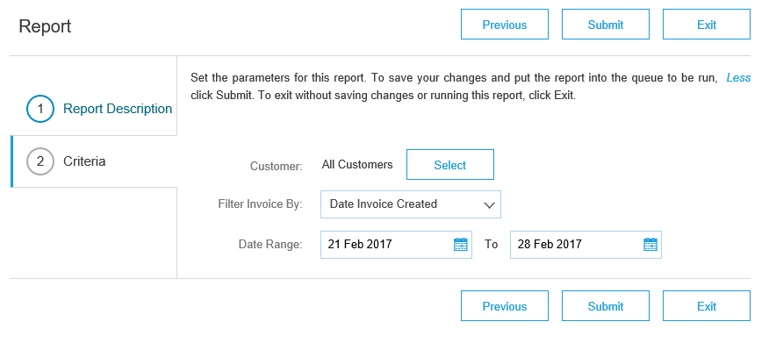
Invoice Reports
Table of Contents
4
3
Ariba Network Overview
Enter required information. Select an invoice Report Type — Failed Invoice or Invoice.
Click Next.
Specify Customer and Created Date in Criteria.
Click Submit.
You can view and download the report in CSV format when its status is Processed.
Account
Set Up
3
Purchase Orders
Note: For more detailed instructions on generating reports, refer to the Help Center of your account.
5
Other Documents
6
Invoice Methods
Help Resources

Slide 41
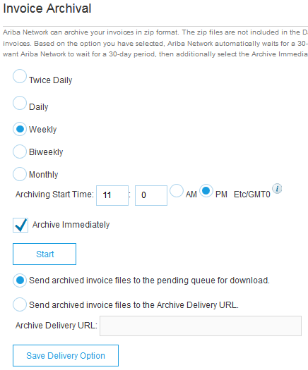
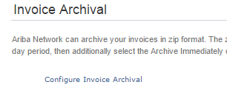
Invoice Archival
Table of Contents
1
Configuring invoice archiving allows you to specify the frequency, immediacy, and delivery of zipped invoice archives. If you wish to utilize it, please follow these steps:
Click the initials in the top-right corner of your home page to view the Company Settings Dropdown menu.
Click on Settings under Company Settings and select Electronic Order Routing.
Select the tab Tax Invoicing and Archiving.
Scroll down to Invoice Archival and select the link for Configure Invoice Archival.
Select frequency (Twice Daily, Daily, Weekly, Biweekly or Monthly), choose Archive Immediately to archive without waiting 30 days, and click Start.
If you want Ariba to deliver automatically archived zip files to you, also enter an Archive Delivery URL (otherwise you can download invoices from your Outbox, section Archived Invoices).
Note: After Archive Immediately started you can either Stop it or Update Frequency any time.
You may navigate back to the Tax Invoicing and Archiving screen in order to subscribe to Long-Term Document Archiving for an integrated archiving solution. (More details within the Terms and Policies link.)
Ariba Network Overview
3
2
2
Account
Set Up
5
Purchase Orders
4
Other Documents
Invoice Methods
6
Help Resources

Slide 42
Thank you.

