Slide 1
Ariba Network CSV Invoice upload guide
Ariba Network CSV Invoice upload guide
October, 2022
Apr, 2023
Internal
Internal

Slide 2
Agenda
CSV Invoice overview
CSV Invoices scope
Data Requirements
CSV fields mapping
CSV template use
Downloading CSV template
Uploading CSV Invoice
Tracking Invoice status
Troubleshooting CSV Invoices
CSV template Change log
Contacts and Support

Slide 3
CSV Invoice Overview

Slide 4
CSV Invoice Overview
CSV stands for Comma Separated Value/Variable file. It represents structured way of data stored as plain text file.
CSV Invoice Upload Supports the transfer, transformation and loading of comma delimited files (CSV) representing a Supplier’s invoices to be rendered as cXML invoices for their Customers. Provides an effective means for Suppliers with a large number of invoices to submit these to their Ariba customers electronically when they do not have the immediate means to provide these via cXML or EDI directly.

Slide 5
CSV Invoice Scope

Slide 6
CSV Invoice Scope
Cargill supports the following CSV invoice types:
PO Invoices: invoices against purchase order where the purchase order was received through Ariba Network.
Line Level Credit Memo Invoices: invoices issued with negative amount against previously issued PO invoices.
Material Invoices: Invoices against Material PO
Service Invoices: Invoices that contain reference to an existing Service document in the Customer’s system
Invoices submitted through CSV upload have the following requirements:
Cannot be greater than 10,000 lines in total
Cannot be greater than 2500 invoices per file
One invoice can have maximum of 5000 line items.
File cannot exceed 40MB in size.

Slide 7
Data requirements

Slide 8
Invoice Data Requirements
invoiceID must be always present.
invoiceDate format must be: MM/DD/YYYY.
PO based invoices MUST use the orderID field to capture the PO number.
In order to differentiate between material & Service invoice we use lineItemType Field.
Tax details, are required only if it matches the condition "isTaxInLine"=Y.
The contact roles, remitTo, billTo, from, billFrom, shipTo, shipFrom, soldTo are mandatory fields.
Shipping details are required only if it matches the condition isShippingInLine=Y.
serviceStartDate, serviceEndDate is required for Service Invoices.
originalInvoiceNumberReference is mandatory for credit Memo.
Line Item Subtotal Amount will be Automatically calculated.

Slide 9
Additional Data Requirements
Required fields:
InvoiceLineNumber, lineReferenceNumber, quantity, supplierPartID, itemDescription, unitOfMeasure, unitPrice, originalInvoiceNumberReference, xmllang, currency.
Optional fields:
comments, paymentMethod, supplierPartID, Classification, lineTaxCategory, lineTaxPercentageRate, lineTaxDescription, taxPointDate.
punchinItemFromCatalog, AribaNetworkPaymentTermsExplanation
term, isLineFromPO, parentPOLineNumber, extLineNumber, parentExtLineNumber.
supplierVatID.

Slide 10
CSV File Recommendations
File Requirements
Alterations or updates to the original CSV file format downloaded from the Network will cause the CSV to fail during the upload process.
You must keep the CSV file you download in its native format.
Do not convert to an Excel file, save as a workbook, add macros, delete/add columns or edit the column names in any way.
The application Ron’s editor is an example of a CSV File editor.
You can download a free trial at: http://www.ronsplace.eu/Products/RonsEditor?utm_source=killink
Note that this is not an Ariba software and is not supported by Ariba.

Slide 11
CSV template details

Slide 12
CSV Sample / Field Mapping
The embedded CSV sample template provides:
Data sample of valid CSV invoices processed successfully by the Customer.
The embedded field overview provides:
Mapping information on field content and requirements.
For accounting and payment questions:
Contact Cargill: https://www.cargill.com/page/worldwide
For CSV upload related questions or errors:
Contact Ariba Technical Support

Slide 13
CSV template use

Slide 14
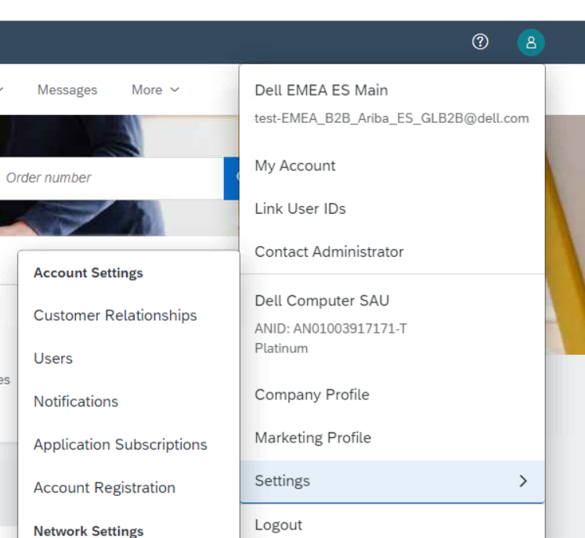
Downloading the CSV Template
From the Home Page of your production AN account, Click the Company Settings tab.
Click Customer Relationships.
AN will display a list of all customers that you have a relationship with on the Ariba Network.
Click on Cargill link within your list.

Slide 15
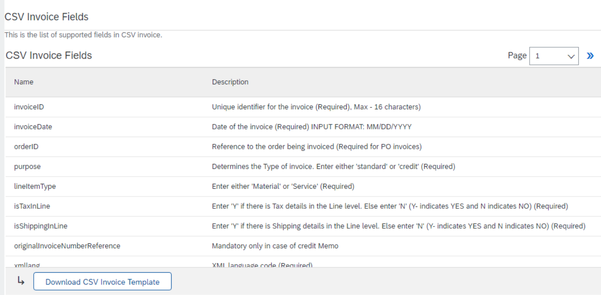
Downloading the CSV Template (continued)
Click the Download CSV Invoice Template button. You will be prompted to Open or Save the file.
Save the file to your local hard drive.
Once you are finished saving the template file, click the Done button to exit this section.
You will be back at your Customer Relationship page.

Slide 16
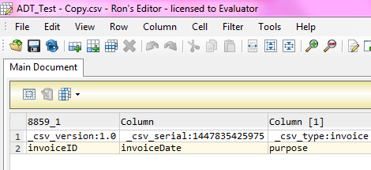
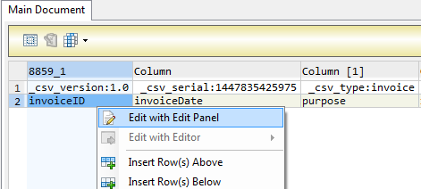
Populate the CSV Invoice Template
Ron’s CSV Editor
Populate each available invoice field as appropriate – starting in Row 3, Cell A
Note that . Rows 1 and 2 are CSV File information rows and cannot be removed or modified in any way. If these fields are changed or removed, the file will fail at upload.
To populate value for each field select that cell, right click and chose option ‘Edit with Edit Panel.
When you have completed populating all fields for your particular invoice, Save the file to your local drive.
Standard Rows – Do Not Change
Begin Invoice Data

Slide 17
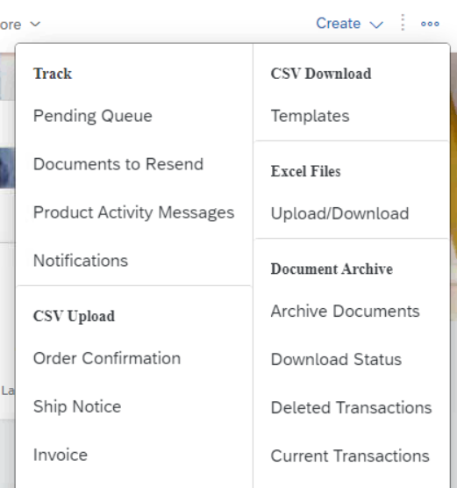
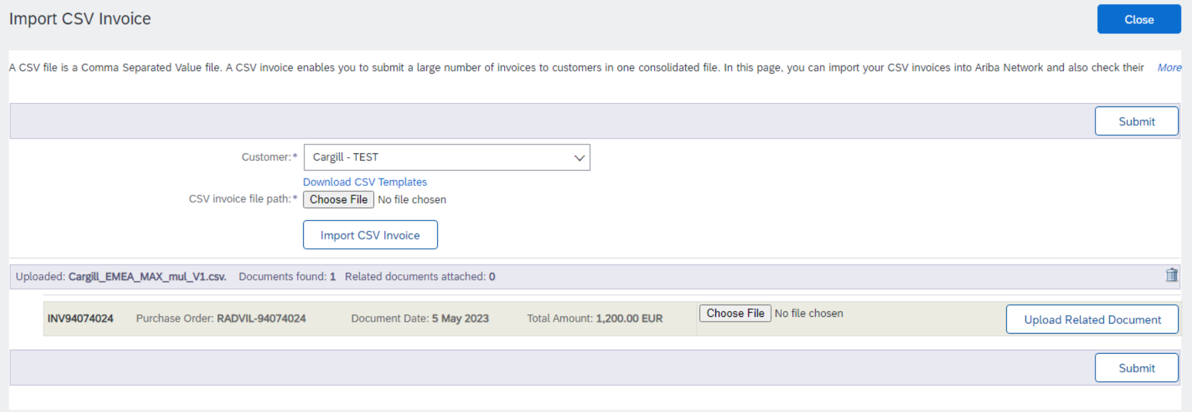
Upload the CSV Invoice
From the Home Page, locate the CSV Documents link on the right side of the page.
Click Invoice CSV.
You will see an Import CSV Invoice box.
Ensure Customer is selected in the Customer drop-down box.
Note: Each customer using the CSV Invoice method has a customized template. You cannot use any other customer's template for Cargill.
Click the Choose File button and find the CSV File you have created and saved.
Once the file path is shown, click the Import CSV Invoice button.

Slide 18
Upload the CSV Invoice
Once you click on Import CSV Invoice, the CSV file will be uploaded , click on Submit button.

Slide 19
Upload the CSV Invoice
Once you click on Submit, the CSV Invoice will be successfully imported. Click on Close button

Slide 20
Tracking CSV Invoice status
Checking Invoice Status
From your Home Page, click on the Outbox tab.
You will again, see a listing of all of the invoices you have sent.
Each invoice number is a link to open and view that invoice.
There are two status types provided:
Routing Status: show the routing status of the invoice through the Ariba network to Cargill.
Invoice Status: shows the status of the invoice itself specifically through it’s payment process.

Slide 21
Tracking CSV Invoice status
Routing Status
Obsoleted: You canceled the invoice.
Failed: The invoice failed the Cargill invoicing rules as set within their Ariba Network account.
Queued: Ariba Network received the invoice from a suppliers Network account, but has not sent it to the Cargill network account.
Sent: Ariba Network sent the invoice to Cargill Ariba Network account. The invoice is awaiting download into the Cargill invoicing application.
Acknowledged: The invoice has been sent from the Cargill network account into their invoicing application.

Slide 22
Tracking CSV Invoice status
Invoice Status
Sent : Cargill has received the invoice.
Rejected: Cargill has rejected the invoice. If Cargill subsequently accepts the invoice or approves it for payment, invoice status updated to Sent indicating invoice was accepted .
Failed: Ariba Network experienced a problem routing the invoice.
Approved: Cargill has approved the invoice for payment.

Slide 23
Troubleshooting CSV Invoices

Slide 24
Troubleshooting CSV Invoices
General Checks
Be sure that the application that is being used to create the file is a true CSV editing application.
Be sure that all value fields such as unit price, tax, subtotal, gross, etc., are entered properly, (for example 2.25 or .58).
Ensure that the file does not contain any special characters, (dollar sign, asterisk, quotation marks, etc.).
Ensure that none of the file data within the first three rows of the template sample has been modified from its original state.
Ensure you are using the correct version of the CSV template for Cargill.
IMP - Once the invoices are uploaded using the CSV channel , Supplier will see the message saying –‘ csv file uploaded successfully’ but may not immediately see the invoice on the Network GUI .This is because the server may take sometime to update the UI screen . In case the Supplier need to refer the invoice immediately but doesn’t find it on the UI , they may use the invoice search option to find the uploaded CSV invoice. The server will process the request and fetch the invoice from the Database.

Slide 25
Troubleshooting CSV Invoices
When is the problem occurring?
Is it at the point of uploading the file?
Is it after the file is uploaded and invoices show a failed status?
Is it after the file is uploaded and invoices show a rejected status?
If the problem happens at #1
The file itself does not meet the basic CSV requirements. You will see specific error messaging on the screen to help identify which field needs to be reviewed/changed. This could be:
Missing header information or missing data in a required field
Incorrect formatting in any field
The problem within the file must be corrected and the entire file must be uploaded again – nothing was loaded from the CSV file.
If the error happens at #2
The invoices (as opposed to the file) failed the invoice rule validation. When the invoices are converted from the .csv file to actual individual invoice documents on the AN, they are then validated based on the Invoice Rules set in Customer Ariba Network account.
Check the ‘History’ tab on the individual invoice to see which rule was violated and caused the invoice to fail.
The problem within the file must be corrected BUT only those invoices that failed need to be resent.
If the error happens at #3
The invoices passed .csv validation and Ariba Network validation but were rejected by Customer (either by their invoicing system automatically or by an end user manually).
Check the History tab on the individual invoice for additional details.
The problem with the individual invoices must be corrected and only those invoices that were rejected need to be resent. Invoice numbers must be modified.

Slide 26
CSV template Change log

Slide 27
Moving from one version to another
Important notice: Whenever new version of csv template is released or mapping rules are modified there is new unique template serial number generated by Ariba Network. This number is part of the template and being sent back with upload (sample: _csv_serial:1423025640524). If csv template header’s are not changed it is still possible to use the old version of the template however supplier is notified every time outdated version is used.
In case csv template change consists of headers update or add of new columns suppliers have to download new version and start using this one.
Otherwise upload will fail with mapping failure message.

Slide 28
Contacts and Support

Slide 29
Training and Resources
Cargill Supplier Information Portal
Supplier Information Portal contains specific documentation and training material.
From the home page of your account, click the Company Settings and then click the Customer Relationships tab.
The portal link is located next to your customers name in the middle of the screen
Review the presentations to learn more about transacting with Customer
Remove if portal will not be rolled out

Slide 30
Ariba Network Standard Documentation
Go to: http://supplier.ariba.com
Click on the Help Center in the upper right hand corner of the page.
Bottom right hand corner has access to Documentation. Click to view Product Documentation.

Slide 31
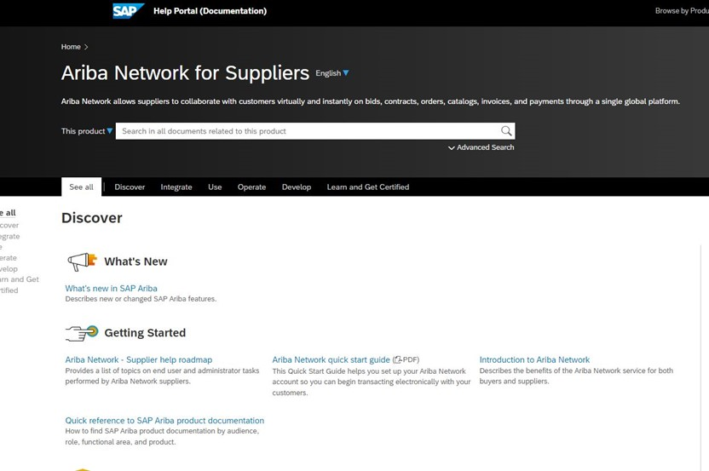
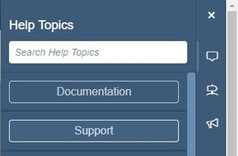
Ariba Network Standard Documentation
Standard Documentation can also be accessed from your account. Click on Help Center button on Home page of your account,
Click Documentation on bottom right hand corner to view Ariba Network Administrator’s documentation.

Slide 32
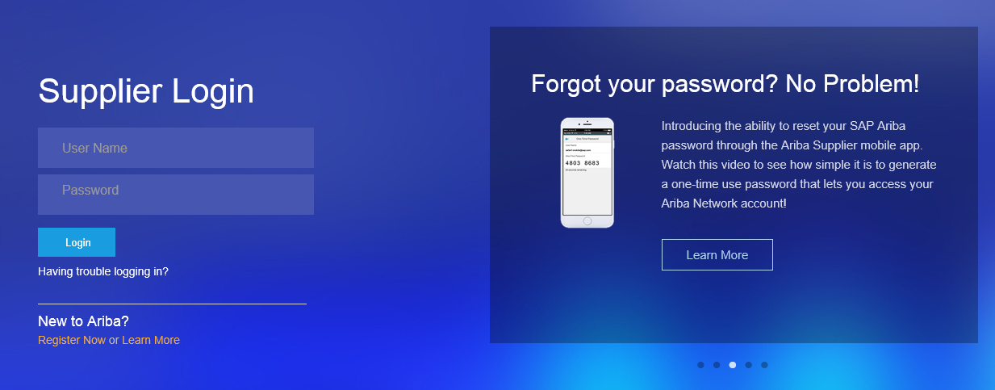
Supplier Support
Go to http://supplier.ariba.com
If you forgot your username or password click on the link Having trouble logging in?

Slide 33
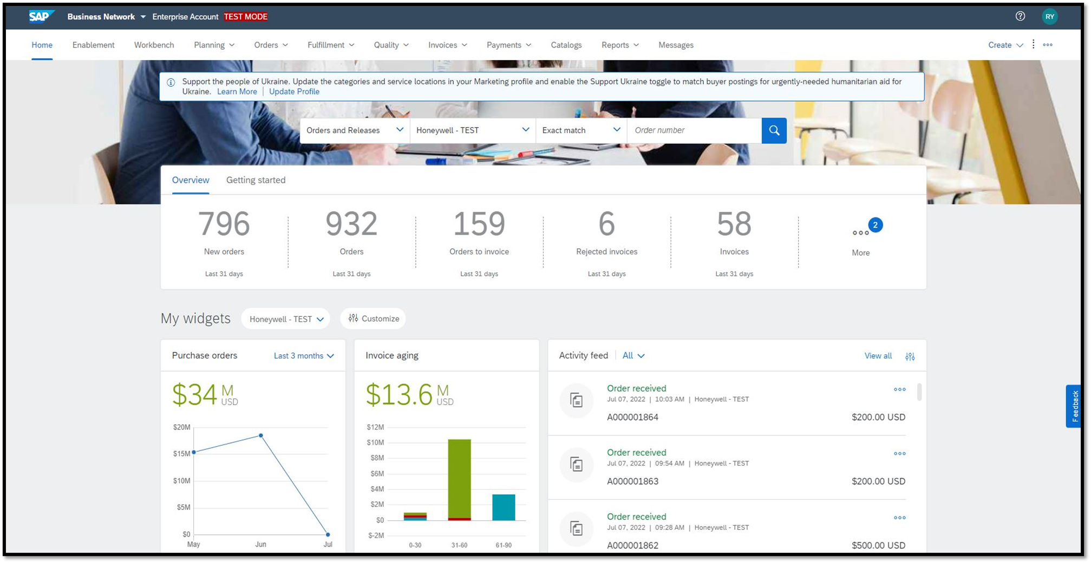
Click on this symbol from anywhere within your Ariba Network supplier account or at the login page

Slide 34
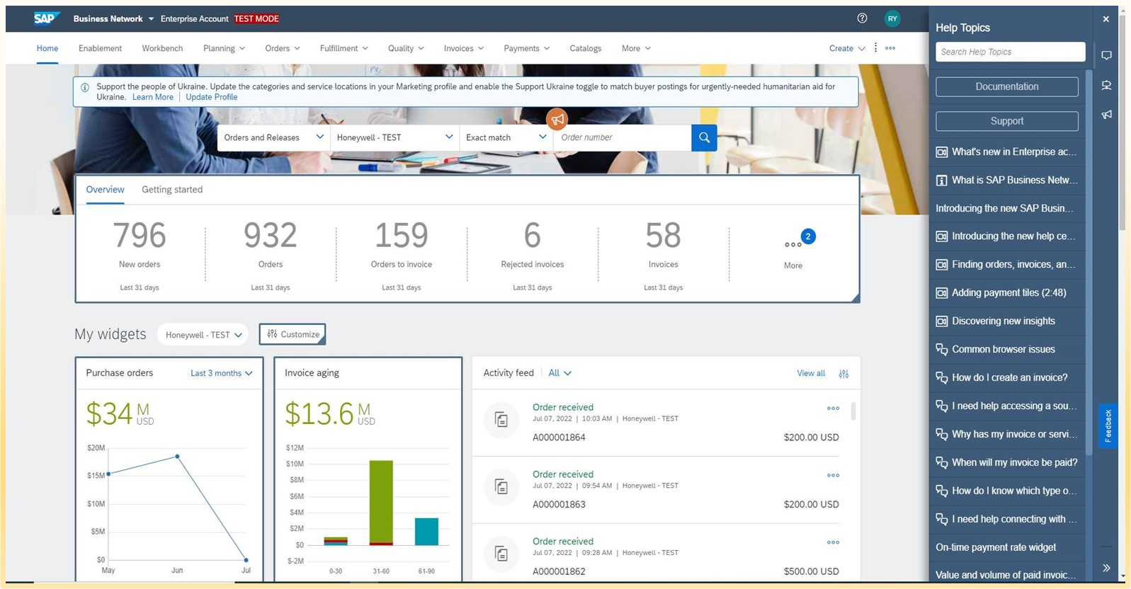
Click on “Support”

Slide 35
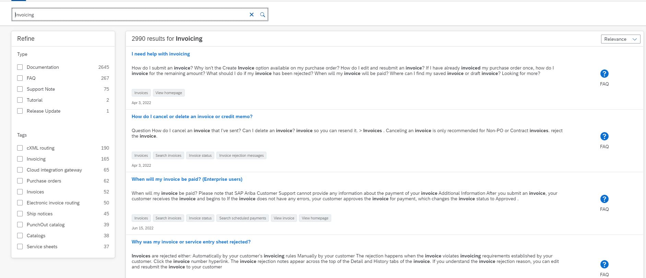
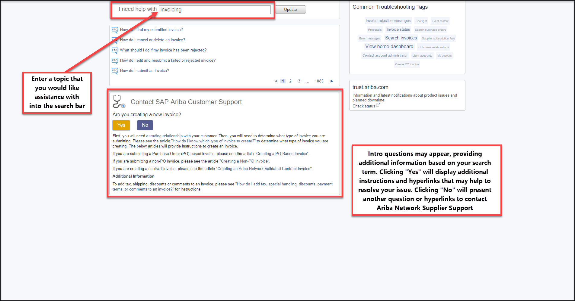
Enter a topic that you would like assistance with into the search bar
Intro questions may appear, providing additional information based on your search term.

Slide 36
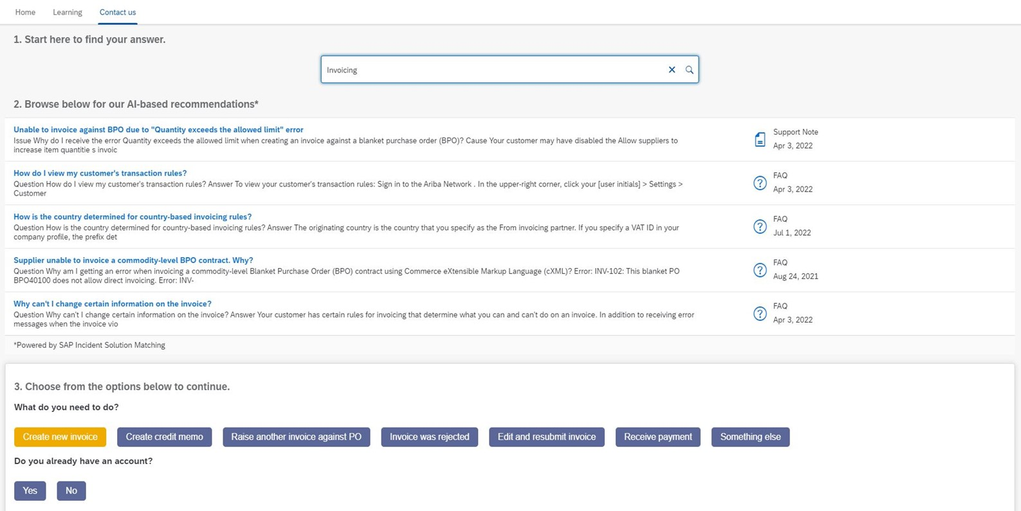
Clicking “Yes” will display additional instructions and hyperlinks that may help to resolve your issue.

Slide 37
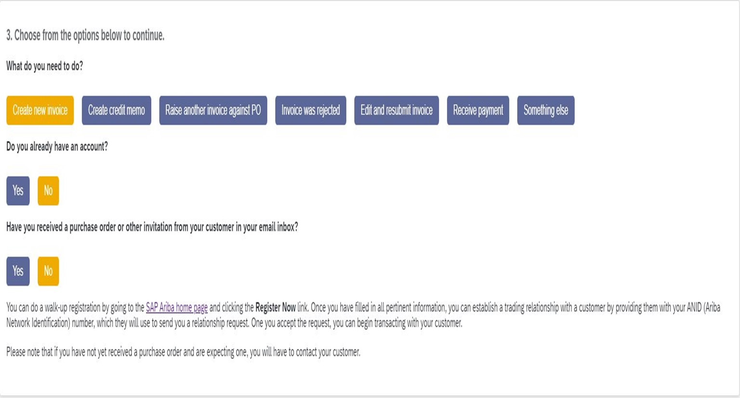
Clicking “No”will present another question or hyperlinks that will help to proceed in different way.

Slide 38
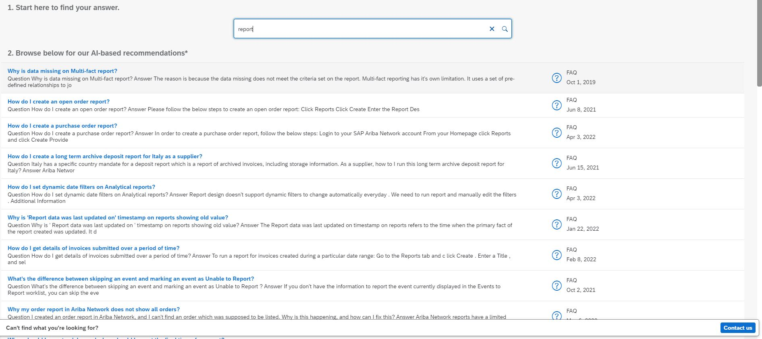
Certain search terms may not provide any intro questions and links to proceed further.

Slide 39
Thank you.
© 2023 SAP SE or an SAP affiliate company. All rights reserved. See Legal Notice on www.sap.com/legal-notice for use terms, disclaimers, disclosures, or restrictions related to this material.

