Slide 1
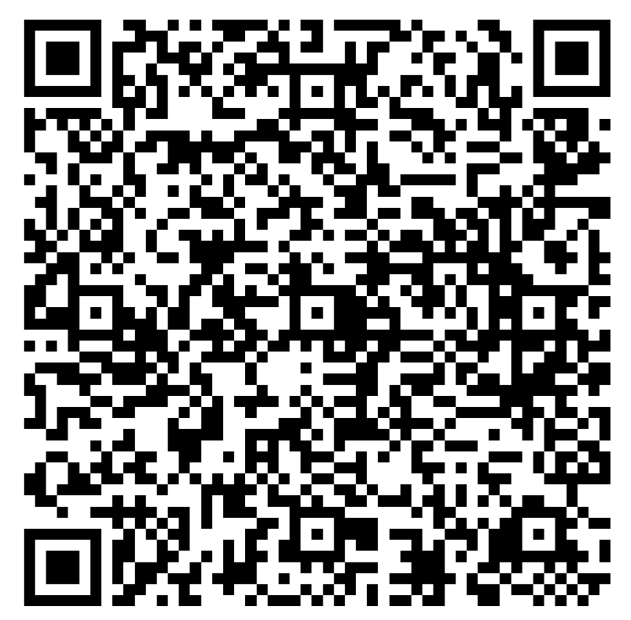
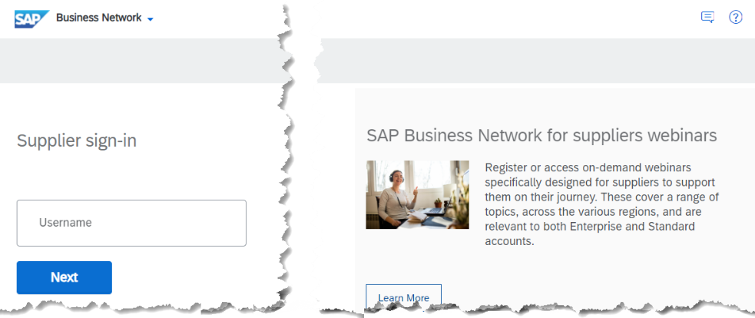
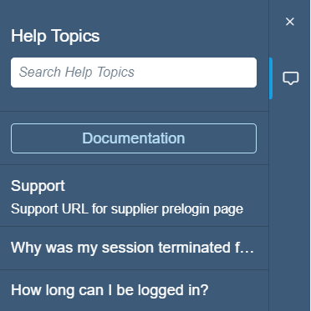
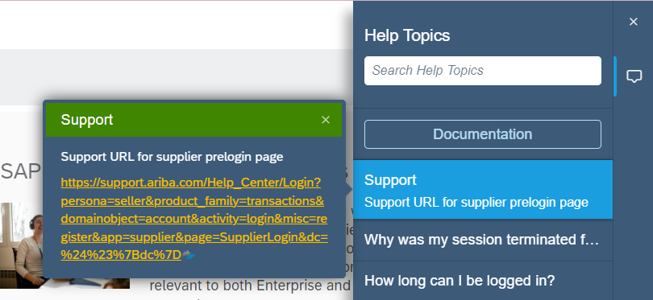
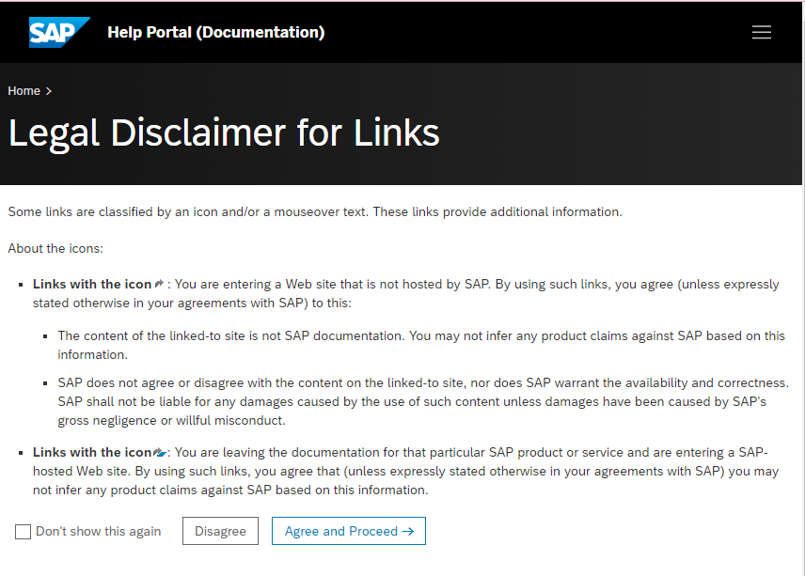
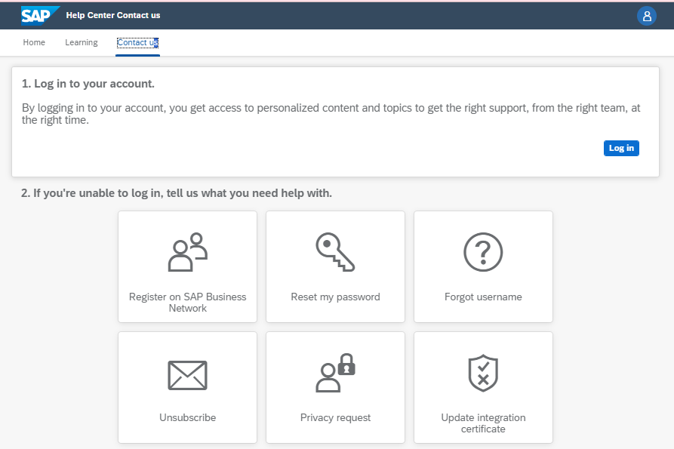
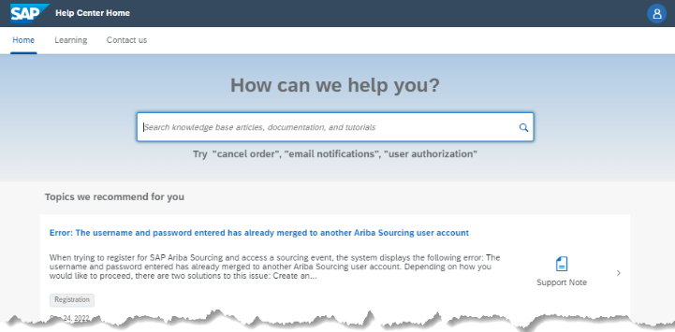
Anonymous 5-question Survey QR code or Click Me
SAP Business Network – Access Help without Logging In
Access SAP Business Network for to access Help Centre
Step 1: Click on the Question Mark on the SAP Business Network Supplier Sign In Page
Step 2: Click on Support
Step 3: Click on the Link
Step 4: Read the Legal Disclaimer and Respond, clicking on Agreed and Proceed implies acceptance of the Disclaimer. Clicking on Disagree will close options to continue
Step 6: Select the Help Option from the list below then complete the form as required ensuring that all items with Asterisks is completed
Step 5: Click on Contact Us
2024 SAP SE or an SAP affiliate company. All rights reserved.
Version 2

