Slide 1
Standard Account Upgrade
SAP
January 10, 2024

Slide 2
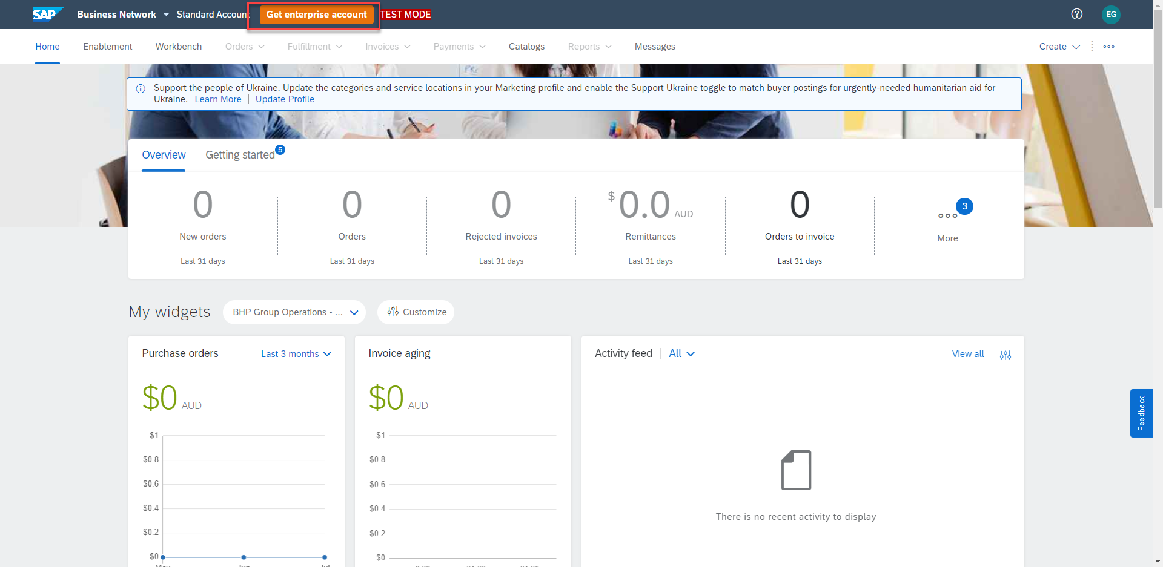
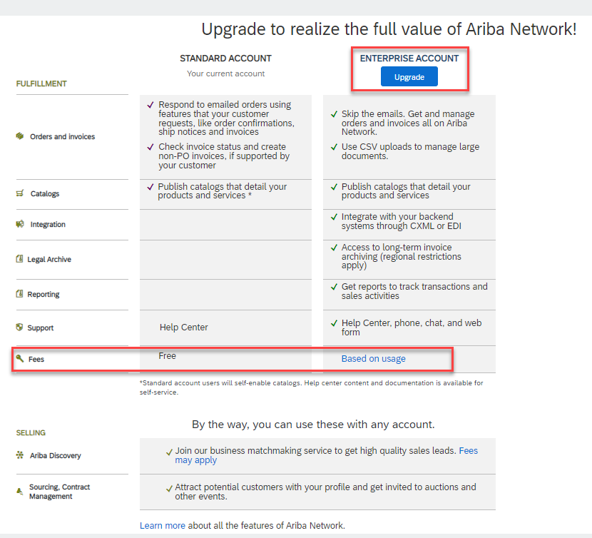
Standard to Enterprise Account Upgrade Steps
From Workbench supplier would click ‘Get Enterprise Account’
Review comparison
Click ‘Upgrade’
Check box confirming upgrade
Click ‘Upgrade’
1
2
3
4
5
Notes:
Online supplier training and collateral found here: http://www.ariba.com/go/ariba-network-light-account

Slide 3
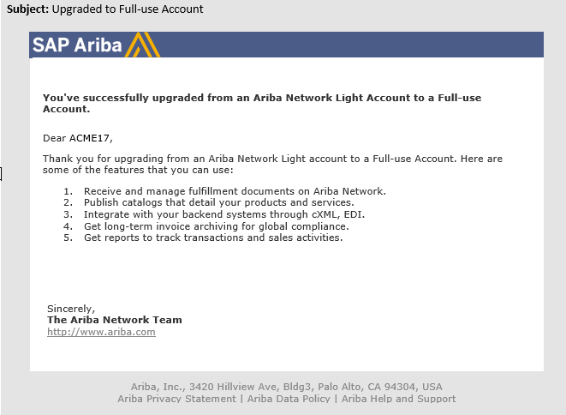
Upgrade Notification
Notes:
Online supplier training and collateral found here: http://www.ariba.com/go/ariba-network-light-account

Slide 4
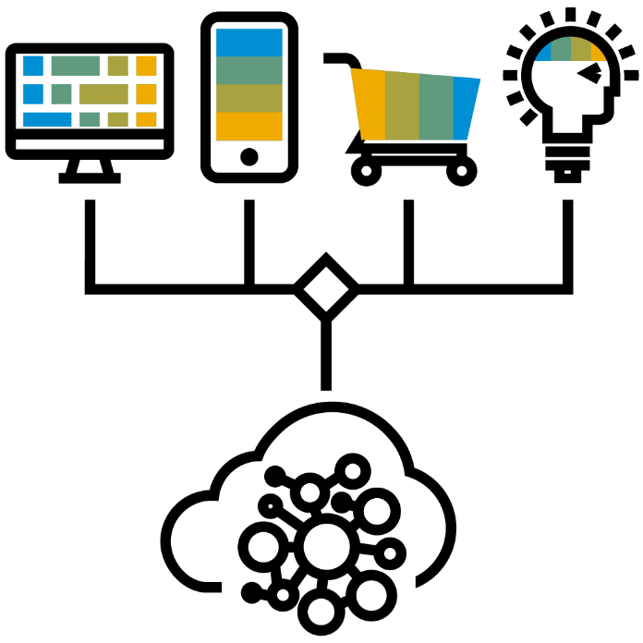
Supplier Benefits of using the SAP Business Network
Large Business Network
Secure Cloud
Faster ordering and invoicing process
Various transaction methods
Multiple Users
Integration value & benefits
Catalogs
Supplier Mobile App
Notes:
Online supplier training and collateral found here: http://www.ariba.com/go/ariba-network-light-account

Slide 5
Thank you.
SAP Business Network Billing Resources

