Slide 1
Guided Buying – Introduction to Transfer of Ownership feature
Vasco Graveto and Manisha Singh
November, 2024

Slide 2
Agenda
Transfer of Ownership Feature
Introduction to the functionality
Configuration of the feature
How to edit and best practices
Approval Flow Configuration
Creation of Tile in Guided Buying
Web Service Task
Official documentation
Knowledge articles
Q & A

Slide 3
Introduction of Transfer of Ownership functionality

Slide 4
Introduction of TOO functionality
What is it?
This feature is used in the Guided Buying context in order to transfer documents from one user to another, it can be used by any user as long as there is a tile configured in GB and the user has access to view/use it.
It has the power of changing both the Requester and the Preparer of any of the supported documents for transfer with some exceptional behavior for certain documents, along with that you can change multiple documents in one single form, all you need to do is select from the data table the documents you want to be transferred.
Reasons you might want to use this feature:
The user leaves the organization
The user moves to a new role in the organization
The user is on an extended leave of absence
The user’s responsibilities change

Slide 5
Configuration of Transfer of Ownership functionality

Slide 6
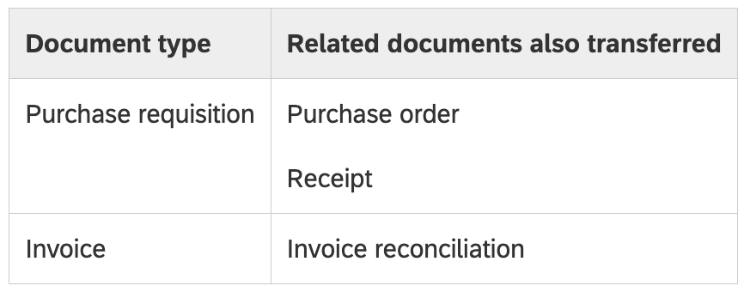
Configuration of TOO functionality
Parameters:
PARAM_ENABLE_TRANSFER_OF_OWNERSHIP needs to be turned ON in Guided Buying
Application.TransferOwnershipRequest.Enabled needs to be turned ON in Ariba Procurement
Supported documents for transfer:
Tips and expected behaviors:
TOO document can be withdrawn by the Owner before the approval has been completed
When withdrawn the document will be retrieved to the Composing status where it can be edited or deleted.
If the TOO document is Denied it can be modified by the owner and resubmitted if necessary.

Slide 7
Configuration of TOO functionality
Where to begin creating the template?
The template HAS to be created by Copying the Global Template named Self-Service Transfer of Ownership, it can be easily detected by the globe icon next to the name when viewed under the Published tab or by checking if it is created by the system.
To access the template follow these steps while in Guided Buying using an Admin User:
Admin > Manage Forms with Approval Graph > Published > Self-Service Transfer of Ownership > View this Form > Make a Copy

Slide 8
How to edit template and best practices of Transfer of Ownership

Slide 9
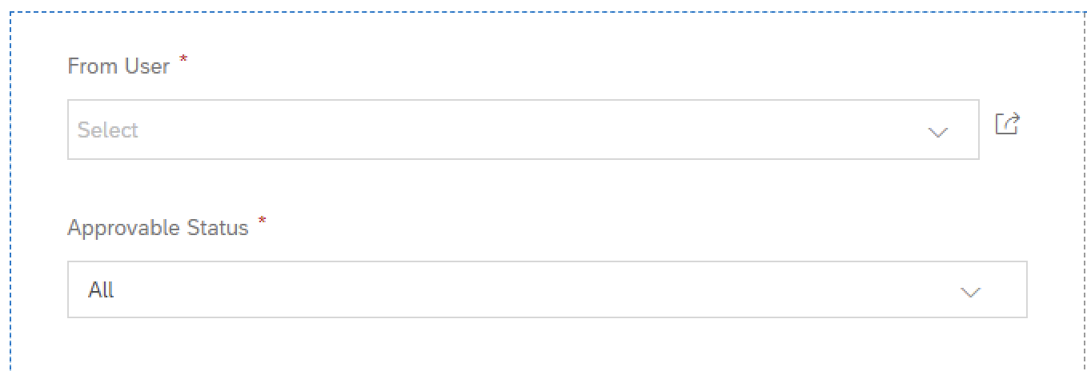
How to edit template and best practices
OOTB Panels (These widgets CANNOT be modified):
From User: This widget is used to select the user who is the owner of the document that will be transferred
Approvable Status: This dropdown selects in which state you want the documents to be shown in the data table
To User: This widget is used to select the user who will receive the ownership of the document that will be transferred.
Approvable Type: This dropdown will let you choose which type of document you wish to be shown in the data table
Date Range: This dropdown will let you choose between 5 time ranges in which the documents were created.

Slide 10
How to edit template and best practices
OOTB Panels (These widgets CAN be modified):
Reason For Transfer: This dropdown lets you choose from 5 different reasons including “Others” to justify the transfer.
Additional Comments: This text widget lets you justify if you’ve selected the previous “Others” option
Data Table where information will be shown after pressing. :

Slide 11
How to edit template and best practices
What more can be done to the form template?
Add new widgets and panels.
Change the OOTB Editable panels shown before.
Choosing which type of Approval Flow you want.
Configure the Custom Approval Flow in case you choose this type of flow
Best practices and KBA’s to solve certain issues:
KB0639059 - How to add additional status in the transfer of ownership form?
KB0634067 - Why the requisition wasn't transferred after the transfer of ownership form was approved?
KB0584450 - Why the requisition title don't appear in the Transfer of Ownership form?
KB0568165 - Why is "not authorized" error being thrown when creating Transfer of Ownership Forms?

Slide 12
Approval Flow Configuration of Template

Slide 13
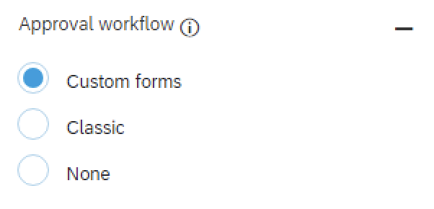
Approval Flow Configuration of Template
Types of Approval Flow and how to configure each:
There is 3 types of Approval Flow, but in order for the Transfer to work you need to select between the Classic or the Custom approval flow
Classic: Needs to be configured under Approval Processes in Ariba Procurement. (Manage > Approval Processes)
Custom: Is configured inside the form and by default has both the “Supervisor of To User” and “Supervisor of From User”

Slide 14
How to edit template and best practices
Custom Approval Flow:
Documentation of Custom Approval Flow
Documentation of Classic Approval Flow
Keep in mind that once the form is made into Classic approval flow there is no way of reverting back to Custom, along with that a new Search type and Approval Type will be created in the system, neither of these can be deleted after
Classic Approval Flow:

Slide 15
Creation of Tile for Transfer of Ownership form

Slide 16
Creation of Tile for TOO
The Tile for TOO can be created in both the Home Page or inside a Landing Page, follow below steps:
In the Home Page:
Admin > Manage using UI > Hover the cursor on “+” > Click Add new Tile > Scroll down to “TOO Form” > Search for the form (Keep in mind that the search is case sensitive)
Inside a Landing Page:
Admin > Manage using UI > Open the Landing Page > Hover the cursor on “+” > Click Add new Tile > Scroll down to “TOO Form” > Search for the form (Keep in mind that the search is case sensitive)

Slide 17
Webservice Task (Export TOO Status to ERP)

Slide 18
Webservice Task (Export TOO Status to ERP)
Transfer the status of completed TOO request to the ERP
The Transfer Of Ownership Export web service sends the status of completed transfer of ownership requests to the external ERP system. Your administrator or integration manager must configure the end points for this web service in the Integration Administration workspace of your buying solution from SAP Ariba.
To ensure that the new owner is updated in the external ERP system when the transfer of ownership of a purchase requisition is completed, do one of the following:
Submit the purchase requisition if it in the Composing status.
Withdraw the purchase requisition if it's in the Submitted status, and submit it again.
Create a change order if the purchase requisition is in the Ordered status.
The Transfer of Ownership Export can be configured following the below steps while in Ariba Procurement with an Admin User:
Manage > Core Admin > Integration Manager > Integration Configuration > Search “Transfer of Ownership”
The Transfer of Ownership Export can be found following the below steps while in Ariba Procurement with an Admin User:
Manage > Core Admin > Site Manager > Data Import/Export > Webservice Status > Search “Transfer of Ownership”

Slide 19
Official documentation
Self-Service Transfer of Ownership
Exporting the Status of Completed Transfer of Ownership Requests to the External ERP System
Publishing a Transfer of Ownership Form Using the Global Template
Adding Transfer of Ownership Tiles
Adding Custom Approval Flow
Adding Classic Approval Flow

Slide 20
Knowledge Articles (KBA)
KB0639059 - How to add additional status in the transfer of ownership form?
KB0634067 - Why the requisition wasn't transferred after the transfer of ownership form was approved?
KB0584450 - Why the requisition title don't appear in the Transfer of Ownership form?
KB0568165 - Why is "not authorized" error being thrown when creating Transfer of Ownership Forms?
KB0632968 - Why does Data source chooser of Users show incorrect data?

Slide 21
Q & A

Slide 22
Thank you!
© 2024 SAP SE or an SAP affiliate company. All rights reserved. See Legal Notice on www.sap.com/legal-notice for use terms, disclaimers, disclosures, or restrictions related to this material.

