Slide 1
Cloud Integration Gateway Mapping Tool Session
Thales Nascimento, Valmir Palacio
September 02, 2020

Slide 2
Agenda
5
Introduction
30
Hands-on
10
Common Questions
15
Q & A
Q & A Panelist

Slide 3
CIG Mapping Tool
The mapping tool was introduced as a self service in CIG to cope up with huge demand of custom mappings. Using this feature buyers can do the following:
Edit and create mappings.
Deploy, un-deploy and manage custom mapping version.
Test and validate the custom mappings using the Mapping test tool.
Use the mapping test tool to compare the results between standard and custom mappings.
View and edit previous versions of the mappings.
Add description to each version to keep control of the customization and changes.
Migrate Custom mappings from the mapping tool to a newer addon version.

Slide 4
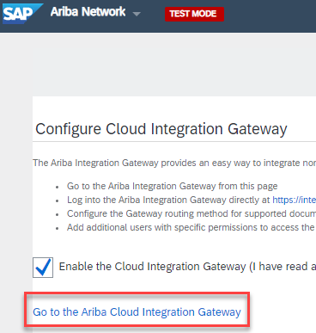
How to access the tool
Access CIG through any of the Ariba Solutions.
Click My Configurations > Mappings.

Slide 5
CIG Mappings
There are 3 level of mappings:
Standard Mapping: The mappings that are delivered out of the box. These are the mapping transformation that are delivered for each and every document type available in CIG for all customers.
Manual Extension Mappings: Mappings that are developed by CIG Engineering team under special circumstances.
Custom Mappings: The mappings that are created by customers using the CIG Mapping Tool.
Standard Mapping
Manual Extension
Custom Mapping
Priority of execution:

Slide 6
Hands-on
Thales : Support Engineer, Cloud Integration

Slide 7
Creating Mappings for Purchase Order
In this example we are mapping a Purchase Order (OrderRequest) that is created in SAP ERP and is sent to CIG as an IDOC to be transformed to a cXML and sent to Ariba Network for follow up activities.
1:1 Mappings
Map a field from source to target.
Example: Map E1EDK01/BSART to OrderRequest/OrderRequestHeader/Extrinsic
Constants
Add a static value to a target field.
Example: Add a static value “DocumentType” to OrderRequest/OrderRequestHeader/Extrinsic/@name

Slide 8
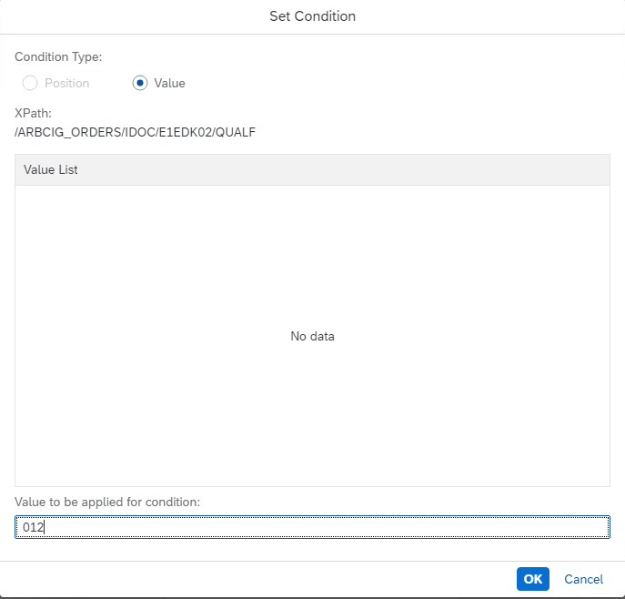
Source and Target conditions
Buyers can add conditions for the mappings to be considered or not. These conditions can be applied both in Source and Target structures.
Example: If E1EDK02/QUALF = 012, map BELNR to OrderRequestHeader/@parentAgreementID

Slide 9
Custom Fields and custom types
There are standard OOTB fields in the CIG mapping schema that we can see and map through the mapping tool and there are fields that are not available in the schema, like below:
Custom fields that buyer created from scratch in Ariba Procurement.
Standard fields that are available in Ariba Procurement but are not externalized in the cXML by default or that are not available in the CIG mapping tool schema.
How can we handle this kind of field in the CIG mapping tool?
We can send the value in a custom field and use the @name to describe what is the field that we are externalizing instead of sending the actual field in the cXML for example. We have different types of custom field available in CIG OOTB that you can use, based on your requirement.

Slide 10
CustomValues
List of Custom fields available in the mapping tool as of now:
CustomBoolean
CustomDate
CustomInteger
CustomMoney
CustomString
Any Custom field, e.g. CustomMyField, should be changed for any of the values above for them to be mapped on the Mapping Tool.
When mapping custom fields we have to add a source condition on the @name, since this tag will carry the identification of the field, we may have many custom fields each one identified by it’s own @name.
FAQ Article: Why my custom fields are not available in CIG Mapping Tool for mapping?

Slide 11
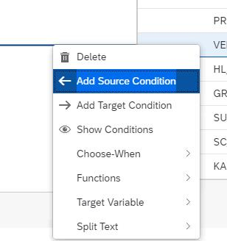
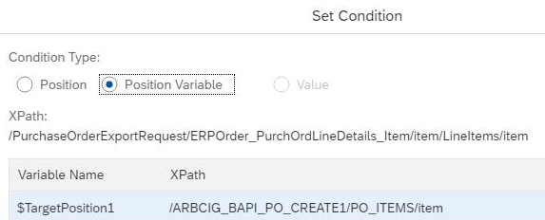
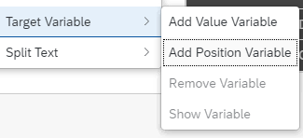
Mappings at item level (Loop)
When mapping structures at item level, we often have to create a loop for the values to not be concatenated in the target field for all items. This is necessary because the item structure repeats so, if we are mapping to another item structure, the position variable will make sure that each item in the source structure is mapped to the item in the target structure accordingly.
We will add a loop to the CustomString since we are mapping two item structures and the values are concatenating.

Slide 12
Common Questions
Valmir : Support Engineer, Cloud Integration

Slide 13
How to handle complex mappings?
If the requirement is too complex to be met with the features and functions available in the mapping tool, we can handle the logic in the SAP ERP using BAdI. For inbound documents in the ERP we can map the information to extension segments and for outbound documents sent from ERP to CIG, we can perform the required transformation in the data before sending to CIG.
I need to perform a complex mapping, why should I handle this using BAdI?
We can create complex logics using BAdI.
Having the logic in your own environment decreases the dependency when you have to make any changes.
EXTENSIONIN segments are available to be used to store information that will be handled in the BAdI.
FAQ Article: How can I map extension segments in the CIG Mapping Tool?

Slide 14
What else can we do with the tool?
Some of the functions and other capabilities that the mapping tool have:
Translation Function: Used for translation.
Number Format Function: Used to add leading zeros and change decimal places
Split Text: Used to Split a description in multiple fields.
Concat Function: Concatenate multiple field values.
Substring function: Used to map only a few characters of a field.
Additional Information and individual articles of each function: 2835469 - FAQ CIG Mapping Tool - Cloud Integration Gateway.

Slide 15
Where can we get more information?
List of available channels that we can use to get more information about the CIG Mapping tool:
CIG Help Portal: SAP official documentation about the product.
Ariba Knowledge Base: Repository of articles created in a daily basis by the team.
Documentation for the SAP Ariba Cloud Integration Gateway Mapping Tool.
Access SAP Ariba CIG (CIG) Community: Ask our experts a question, engage with other community members, follow latest blogs and stay up-to-date with the latest announcements and features.

Slide 16
Bharath Balakrishnan: TSE, Cloud Integrations
Eduardo Junior : TSE, Cloud Integrations
Thales Nascimento: TSE, Cloud Integrations
Valmir Palacio: TSE, Cloud Integrations
Cinthia Guzman Rodrigues: Engineering, Cloud Integrations

Slide 17
Reference Documentation / Support Articles
CIG Community
https://community.sap.com/topics/ariba-cloud-integration-gateway
CIG Help Portal
https://help.sap.com/viewer/product/ARIBA_CIG/latest/en-US?task=whats_new_task
CIG Mapping Tool Master KBA:
https://launchpad.support.sap.com/#/notes/2835469
https://support.ariba.com/item/view/183473
Documentation for the SAP Ariba Cloud Integration Gateway Mapping Tool
https://support.ariba.com/item/view/184627
BAdIs – Sap Help Portal
https://help.sap.com/viewer/12aa7f056c531014aa5bca7aee037e55/latest/en-US/e6d54d3c596f0b26e10000000a11402f.html

Slide 18
David Johnson, Sr Program Manager, Platform​ Alvaro Lorenzoni, Support Manager, Cloud Integrations Thales Nascimento, TSE, Cloud Integrations Valmir Palacio, TSE, Cloud Integrations

