Slide 1
Understanding, Creating and Publishing PunchOut® Catalogs
Customer Logo

Slide 2
Agenda
The Catalog Upload Process
The SAP Business Network and Customer Validation
What is PunchOut?
How does it work?
Configuring a SAP Business Network (SBN) Account for PunchOut
Creating the default PunchOut Connection
Native cXML Transaction Setup
Configuring your Customer Specific PunchOut URL connection
Creating a customer-specific PunchOut connection
Setting up Default Level 1 Index File Template Details
Creating and Publishing PunchOut Level 1 Catalogs Online
Templates and Catalog File Creation
For Level 1 and Level 2 PunchOut Catalogs
Uploading and Publishing PunchOut Catalogs
Replacing Existing Catalogs
Testing Connectivity
Troubleshooting
Appendix
Creating a CIF from an Excel Catalog File

Slide 3
The Catalog Upload Process

Slide 4
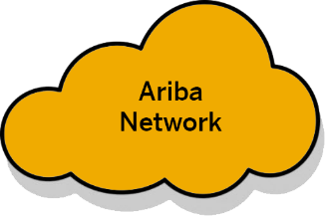
The PunchOut Catalog Upload Process
Supplier
SAP
Business
Network
Buyer
Notified a new or updated Catalog is published from Supplier
Start
New or Updated Supplier Catalog File (from Template) uploaded and published to the Customer on the SAP Business Network (SBN)
Network validation (errors reported back to Supplier during upload)
Fail
Catalog File downloaded from the Network to Buyer-specific Catalog
Troubleshoot PunchOut issues
Catalog Loaded in Ariba Procurement application
Fail
PunchOut testing
Pass
Catalog Activated and available for Users

Slide 5
What is PunchOut?

Slide 6
What is PunchOut?
Unlike static catalogs where all the product information resides in the Ariba Procurement catalog database, PunchOut catalogs utilize a supplier’s website/store. This allows the Ariba shopper to ‘punch out’ to the site, shop, then return their selected items to their Ariba Procurement application where they will complete the requisition process.
For Level 1 (L1) PunchOut catalogs, the User does all their shopping on the Supplier’s website. In a Level 2 (L2) scenario, the User shops using the Ariba Procurement catalog database and the Supplier’s site.

Slide 7
How does it work?

Slide 8
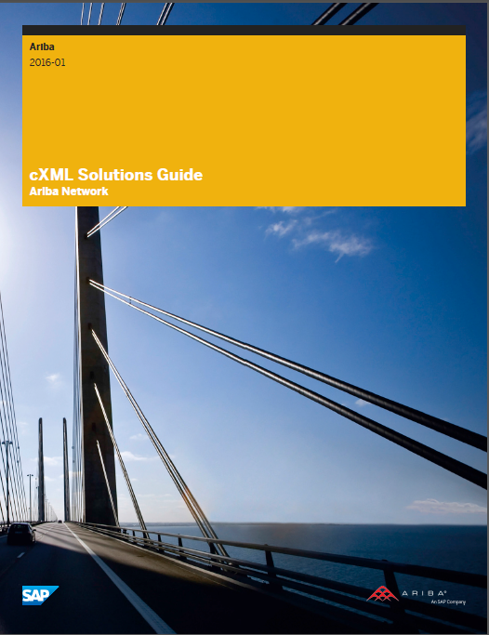
How does it work?
PunchOut uses the cXML protocol, based on XML and created by SAP Ariba.
cXML is freely available and is well documented for Suppliers.
Details for PunchOut catalog syntax, DTD listings, guides and other information is available for download at:
www.cxml.org
Catalog-specific information is available in the chapters titled “PunchOut site planning” and “PunchOut transactions” in the cXML Solutions Guide and the chapter titled “PunchOut transactions” in the cXML User’s Guide.

Slide 9
How does it work?
A special CIF catalog file called a PunchOut Index file is loaded into the SAP Business Network. This file has added fields that instruct the system to allow the catalog to connect with the Supplier’s site for shopping.
PunchOut uses cXML to connect and transfer information from the Ariba Procurement application to the Supplier and back. There are 3 cXML documents used by PunchOut to accomplish this:
PunchOut Setup Request (POSR)—The POSR identifies the buyer, and sends authentication (basically name and password) to the supplier’s website to establish a connection
PunchOut SetupResponse—The Response document from the Supplier tells the Ariba Procurement application what website, or items on the site to display for the Ariba buyer to shop
PunchOut Order Message (POOM)—The POOM converts the Shopping Cart on the Suppliers’ site, and sends the cart or items back to Ariba Procurement to be submitted for purchase

Slide 10
How does it work?
The steps on the next few slides shows how a simple L1 PunchOut works.
The User chooses the Supplier’s catalog link in the Ariba catalog and is taken to the Suppliers site, where they shop. The User then returns the selected items back to their Ariba Procurement application.
Once the items are back in Ariba Procurement, the User can submit the Cart to become a Requisition, and ultimately a Purchase Order, which is sent off to the Supplier.

Slide 11
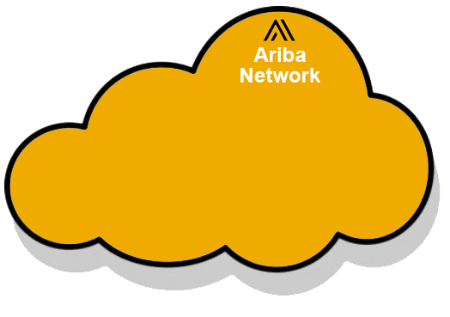
How does it work?
SAP
Business Network
À
Buyer User
www.supplier.com
The User finds the Supplier’s link in the Ariba Catalog and clicks “Buy from Supplier.”

Slide 12
How does it work?
2
SAP
Business Network
À
2
Buyer User
www.supplier.com
The PunchOut Setup Request (POSR) is routed from Ariba to the SAP Business Network.

Slide 13
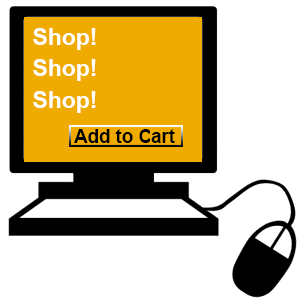
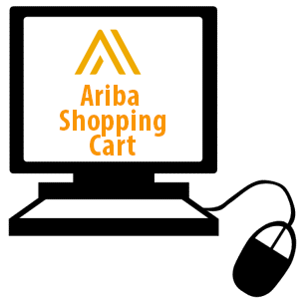
How does it work?
2
Authenticated!
URL determined
Cart→POOM
SAP
Business Network
À
2
Supplier
Shared Secret
PunchOut URL
Supplier
Response:
200 “Success”
URL
2
2
2
Buyer User
Ready to submit Ariba Cart and buy!
Click “Submit”
www.supplier.com
The Supplier converts their Shopping Cart to cXML, closes the connection and sends a PunchOut Order Message (POOM) back directly to the Ariba application, which then adds the items from the Supplier into the User’s Ariba Shopping Cart.
The PunchOut Setup Request (POSR) is routed from Ariba to the AN.
The User finds the Supplier’s link in the Ariba Catalog and clicks “Buy from Supplier.”
The POSR is then routed and presented to the Supplier’s specified PunchOut URL.
The Network validates the Response, then sends the URL of the Supplier’s Catalog to the Buyer’s Ariba application to display to the User.
The User shops the Supplier’s Catalog (now in the Ariba window), and adds items to their Cart. When they are done, they submit the Cart back to Ariba.
The Supplier then evaluates any other information, and sends back a PunchOut Order Response, with the URL of the catalog to display to the User.
In the AN Supplier record, the Supplier’s Shared Secret is looked up, and added to the POSR, then it looks up the Supplier’s PunchOut URL.
The Supplier authenticates the POSR using the <From> ANID (as a User Name) and their own Shared Secret (as the Password).
The SAP Business Network looks up the ANID in the <To> element of the POSR, and finds the Supplier record.

Slide 14
How does it work?
2
Authenticated!
URL determined
Cart→POOM
SAP
Business Network
À
2
Supplier
Shared Secret
PunchOut URL
Response:
200 “Success”
URL
2
2
2
Buyer User
Ready to submit Ariba Cart and buy!
Click “Submit”
www.supplier.com
www.shop.com
The Supplier converts their Shopping Cart to cXML, closes the connection and sends a PunchOut Order Message (POOM) back directly to the Ariba application, which then adds the items from the Supplier into the User’s Ariba Shopping Cart.
The PunchOut Setup Request (POSR) is routed from Ariba to the AN.
The User finds the Supplier’s link in the Ariba Catalog and clicks “Buy from Supplier.”
The POSR is then routed and presented to the Supplier’s specified PunchOut URL.
The Network validates the Response, then sends the URL of the Supplier’s Catalog to the Buyer’s Ariba application to display to the User.
The User shops the Supplier’s Catalog (now in the Ariba window), and adds items to their Cart. When they are done, they submit the Cart back to Ariba.
The Supplier then evaluates any other information, and sends back a PunchOut Order Response, with the URL of the catalog to display to the User.
In the Business Network Supplier record, the Supplier’s Shared Secret is looked up, and added to the POSR, then it looks up the Supplier’s PunchOut URL.
The Supplier authenticates the POSR using the <From> ANID (as a User Name) and their own Shared Secret (as the Password).
The AN looks up the ANID in the <To> element of the POSR, and finds the Supplier record on the Network.

Slide 15
How does it work?
2
2
Authenticated!
URL determined
Cart→POOM
SAP
Business Network
À
2
Supplier
Shared Secret
PunchOut URL
Response:
200 “Success”
URL
2
2
2
Buyer User
Ready to submit Ariba Cart and buy!
Click “Submit”
www.supplier.com
www.shop.com
The Supplier converts their Shopping Cart to cXML, closes the connection and sends a PunchOut Order Message (POOM) back directly to the Ariba application, which then adds the items from the Supplier into the User’s Ariba Shopping Cart.
The PunchOut Setup Request (POSR) is routed from Ariba to the AN.
The User finds the Supplier’s link in the Ariba Catalog and clicks “Buy from Supplier.”
The POSR is then routed and presented to the Supplier’s specified PunchOut URL.
The Network validates the Response, then sends the URL of the Supplier’s Catalog to the Buyer’s Ariba application to display to the User.
The User shops the Supplier’s Catalog (now in the Ariba window), and adds items to their Cart. When they are done, they submit the Cart back to Ariba.
The Supplier then evaluates any other information, and sends back a PunchOut Order Response, with the URL of the catalog to display to the User.
In the AN Supplier record, the Supplier’s Shared Secret is looked up, and added to the POSR, then it looks up the Supplier’s PunchOut URL.
The Supplier authenticates the POSR using the <From> ANID (as a User Name) and their own Shared Secret (as the Password).
The AN looks up the ANID in the <To> element of the POSR, and finds the Supplier record on the Network.

Slide 16
How does it work?
2
Authenticated!
URL determined
Cart→POOM
Business Network
À
SAP
Business Network
2
Response:
200 “Success”
URL
2
2
2
Buyer User
Ready to submit Ariba Cart and buy!
Click “Submit”
www.supplier.com
www.shop.com
The Supplier converts their Shopping Cart to cXML, closes the connection and sends a PunchOut Order Message (POOM) back directly to the Ariba application, which then adds the items from the Supplier into the User’s Ariba Shopping Cart.
The PunchOut Setup Request (POSR) is routed from Ariba to the AN.
The User finds the Supplier’s link in the Ariba Catalog and clicks “Buy from Supplier.”
The POSR is then routed and presented to the Supplier’s specified PunchOut URL.
The Network validates the Response, then sends the URL of the Supplier’s Catalog to the Buyer’s Ariba application to display to the User.
The User shops the Supplier’s Catalog (now in the Ariba window), and adds items to their Cart. When they are done, they submit the Cart back to Ariba.
The Supplier then evaluates any other information, and sends back a PunchOut Order Response, with the URL of the catalog to display to the User.
In the AN Supplier record, the Supplier’s Shared Secret is looked up, and added to the POSR, then it looks up the Supplier’s PunchOut URL.
The Supplier authenticates the POSR using the <From> ANID (as a User Name) and their own Shared Secret (as the Password).
The AN looks up the ANID in the <To> element of the POSR, and finds the Supplier record on the Network.

Slide 17
How does it work?
2
2
Authenticated!
URL determined
Cart→POOM
SAP
Business Network
À
2
Response:
200 “Success”
URL
2
2
2
Buyer User
Ready to submit Ariba Cart and buy!
Click “Submit”
www.supplier.com
www.shop.com
The Supplier converts their Shopping Cart to cXML, closes the connection and sends a PunchOut Order Message (POOM) back directly to the Ariba application, which then adds the items from the Supplier into the User’s Ariba Shopping Cart.
The PunchOut Setup Request (POSR) is routed from Ariba to the AN.
The User finds the Supplier’s link in the Ariba Catalog and clicks “Buy from Supplier.”
The POSR is then routed and presented to the Supplier’s specified PunchOut URL.
The Network validates the Response, then sends the URL of the Supplier’s Catalog to the Buyer’s Ariba application to display to the User.
The User shops the Supplier’s Catalog (now in the Ariba window), and adds items to their Cart. When they are done, they submit the Cart back to Ariba.
The Supplier then evaluates any other information, and sends back a PunchOut Order Response, with the URL of the catalog to display to the User.
In the AN Supplier record, the Supplier’s Shared Secret is looked up, and added to the POSR, then it looks up the Supplier’s PunchOut URL.
The Supplier authenticates the POSR using the <From> ANID (as a User Name) and their own Shared Secret (as the Password).
The AN looks up the ANID in the <To> element of the POSR, and finds the Supplier record on the Network.

Slide 18
How does it work?
2
2
Authenticated!
URL determined
Cart→POOM
SAP
Business Network
À
2
Response:
200 “Success”
URL
2
2
2
Buyer User
Ready to submit Ariba Cart and buy!
Click “Submit”
www.supplier.com
www.shop.com
The Supplier converts their Shopping Cart to cXML, closes the connection and sends a PunchOut Order Message (POOM) back directly to the Ariba application, which then adds the items from the Supplier into the User’s Ariba Shopping Cart.
The PunchOut Setup Request (POSR) is routed from Ariba to the AN.
The User finds the Supplier’s link in the Ariba Catalog and clicks “Buy from Supplier.”
The POSR is then routed and presented to the Supplier’s specified PunchOut URL.
The SAP Business Network validates the Response, then sends the URL of the Supplier’s Catalog to the Buyer’s Ariba Procurement application to display to the User.
The User shops the Supplier’s Catalog (now in the Ariba window), and adds items to their Cart. When they are done, they submit the Cart back to Ariba.
The Supplier then evaluates any other information, and sends back a PunchOut Order Response, with the URL of the catalog to display to the User.
In the AN Supplier record, the Supplier’s Shared Secret is looked up, and added to the POSR, then it looks up the Supplier’s PunchOut URL.
The Supplier authenticates the POSR using the <From> ANID (as a User Name) and their own Shared Secret (as the Password).
The AN looks up the ANID in the <To> element of the POSR, and finds the Supplier record on the Network.

Slide 19
How does it work?
2
Authenticated!
URL determined
Cart→POOM
SAP
Business Network
À
2
Response:
200 “Success”
URL
2
2
2
Buyer User
Ready to submit Ariba Cart and buy!
Click “Submit”
www.supplier.com
www.shop.com
The Supplier converts their Shopping Cart to cXML, closes the connection and sends a PunchOut Order Message (POOM) back directly to the Ariba application, which then adds the items from the Supplier into the User’s Ariba Shopping Cart.
The PunchOut Setup Request (POSR) is routed from Ariba to the AN.
The User finds the Supplier’s link in the Ariba Catalog and clicks “Buy from Supplier.”
The POSR is then routed and presented to the Supplier’s specified PunchOut URL.
The Network validates the Response, then sends the URL of the Supplier’s Catalog to the Buyer’s Ariba application to display to the User.
The User shops the Supplier’s Catalog (now in the Ariba Procurement window), and adds items to the Supplier’s Cart. When they are done, they submit the Cart back to Ariba Procurement application.
The Supplier then evaluates any other information, and sends back a PunchOut Order Response, with the URL of the catalog to display to the User.
In the AN Supplier record, the Supplier’s Shared Secret is looked up, and added to the POSR, then it looks up the Supplier’s PunchOut URL.
The Supplier authenticates the POSR using the <From> ANID (as a User Name) and their own Shared Secret (as the Password).
The AN looks up the ANID in the <To> element of the POSR, and finds the Supplier record on the Network.

Slide 20
How does it work?
2
Authenticated!
URL determined
Cart→POOM
SAP
Business Network
À
2
Response:
200 “Success”
URL
2
2
Buyer User
Ready to submit Ariba Cart and buy!
Click “Submit”
2
www.supplier.com
www.shop.com
The Supplier converts their Shopping Cart to cXML, closes the connection and sends a PunchOut Order Message (POOM) back directly to the Ariba Procurement application, which then adds the items from the Supplier into the User’s Ariba Procurement Shopping Cart.
The PunchOut Setup Request (POSR) is routed from Ariba to the AN.
The User finds the Supplier’s link in the Ariba Catalog and clicks “Buy from Supplier.”
The POSR is then routed and presented to the Supplier’s specified PunchOut URL.
The Network validates the Response, then sends the URL of the Supplier’s Catalog to the Buyer’s Ariba application to display to the User.
The User shops the Supplier’s Catalog (now in the Ariba window), and adds items to their Cart. When they are done, they submit the Cart back to Ariba.
The Supplier then evaluates any other information, and sends back a PunchOut Order Response, with the URL of the catalog to display to the User.
In the AN Supplier record, the Supplier’s Shared Secret is looked up, and added to the POSR, then it looks up the Supplier’s PunchOut URL.
The Supplier authenticates the POSR using the <From> ANID (as a User Name) and their own Shared Secret (as the Password).
The AN looks up the ANID in the <To> element of the POSR, and finds the Supplier record on the Network.

Slide 21
How does it work?
2
Authenticated!
URL determined
SAP
Business Network
À
2
Response:
200 “Success”
URL
2
2
Buyer User
Ready to submit Ariba Cart to become a Requisition and buy!
Click “Submit”
www.supplier.com
www.shop.com
The PunchOut Setup Request (POSR) is routed from Ariba to the AN.
The User finds the Supplier’s link in the Ariba Catalog and clicks “Buy from Supplier.”
The POSR is then routed and presented to the Supplier’s specified PunchOut URL.
The Network validates the Response, then sends the URL of the Supplier’s Catalog to the Buyer’s Ariba application to display to the User.
The User shops the Supplier’s Catalog (now in the Ariba window), and adds items to their Cart. When they are done, they submit the Cart back to Ariba.
The Supplier then evaluates any other information, and sends back a PunchOut Order Response, with the URL of the catalog to display to the User.
In the AN Supplier record, the Supplier’s Shared Secret is looked up, and added to the POSR, then it looks up the Supplier’s PunchOut URL.
The Supplier authenticates the POSR using the <From> ANID (as a User Name) and their own Shared Secret (as the Password).
The AN looks up the ANID in the <To> element of the POSR, and finds the Supplier record on the Network.

Slide 22
Configuring a SAP Business Network (SBN) Account for PunchOut

Slide 23
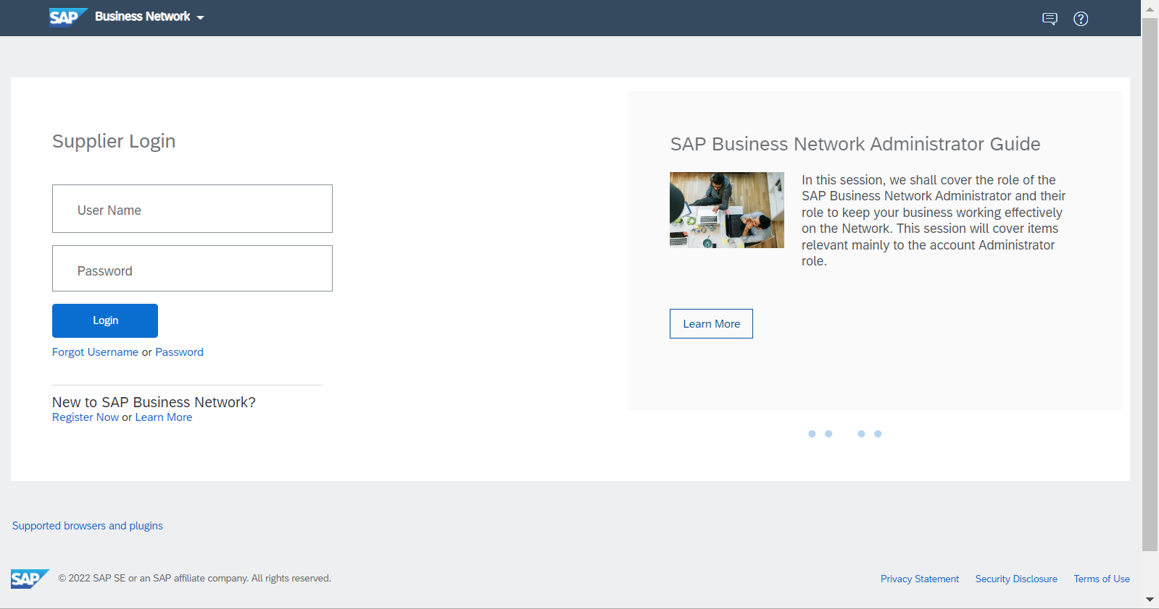
Configuring a SAP Business Network Account for PunchOut
Login to your Business Supplier Account (https://supplier.ariba.com)
Assistance from your IT Manager may be needed for the following slides.

Slide 24
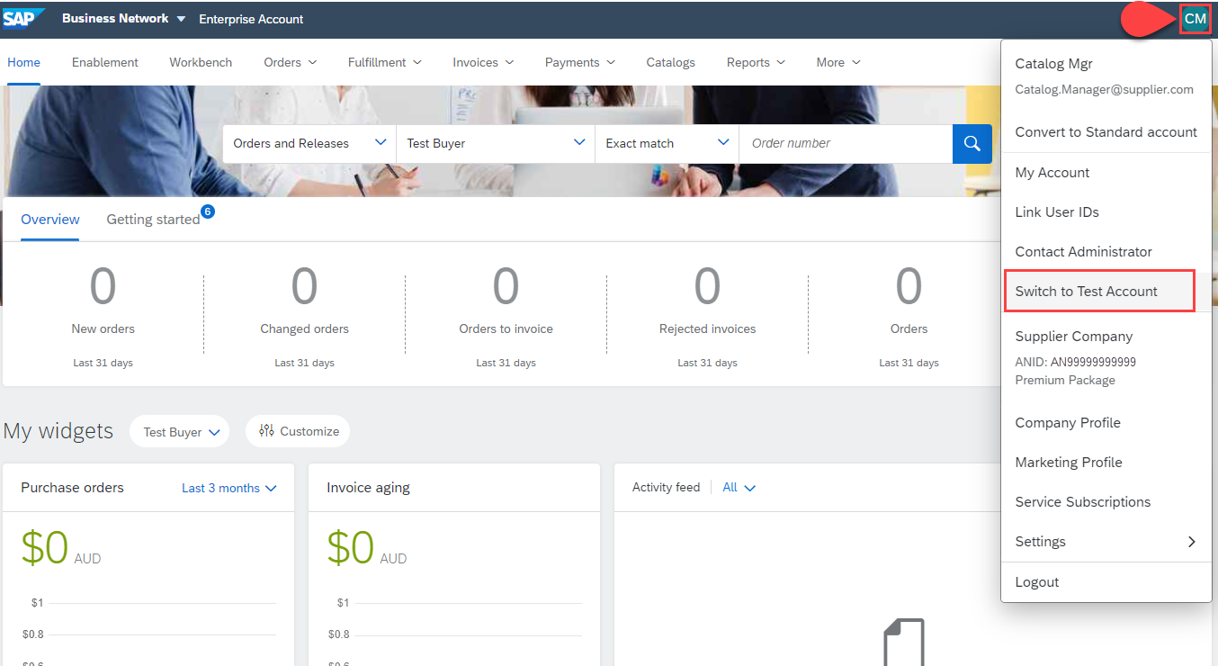
Configuring a SAP Business Network Account for PunchOut
Switch to your Test Account
Your Network Account needs to be set up in both your Test and Production environments
Find your initials in the upper right corner and click for the pull down menu, then click “Switch To Test Account”
If you don’t see a “Switch to Test Account” link, your Test account has not yet been set up. Contact your SAP Business Network Administrator
You will get a warning. “You are about to switch to Test Mode.” Click “OK”

Slide 25
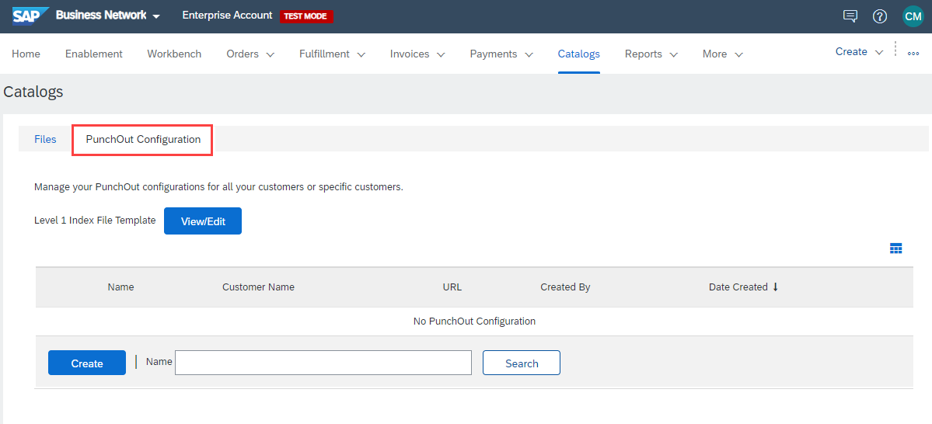
Configuring a SAP Business Network Account for PunchOut
Go to Catalog tab, choose Customer Catalogs, and click PunchOut Configuration.
This area allows you to create your default PunchOut connection as well as a unique connection with your customer (if applicable).
Please note the next steps need to be completed in your Test and Production environments.

Slide 26
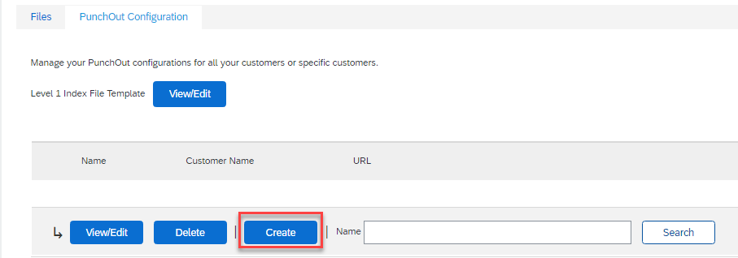
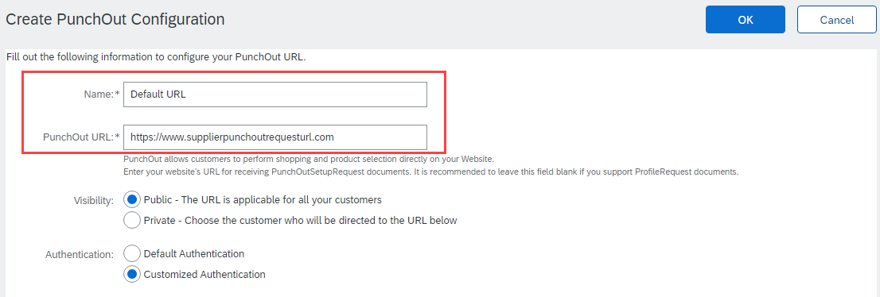
Configuring a SAP Business Network Account for PunchOut
To create your default PunchOut Catalog:
Click on Create
In the Name field, write “Default URL” as seen in the image.
Add your company’s complete PunchOut Request URL within the PunchOut URL field.
This is the default URL that will be used for all of your customers, each time they initiate a PunchOut session.
Note: Refer to the section Configuring your Customer Specific PunchOut URL connection, to use a unique URL.

Slide 27
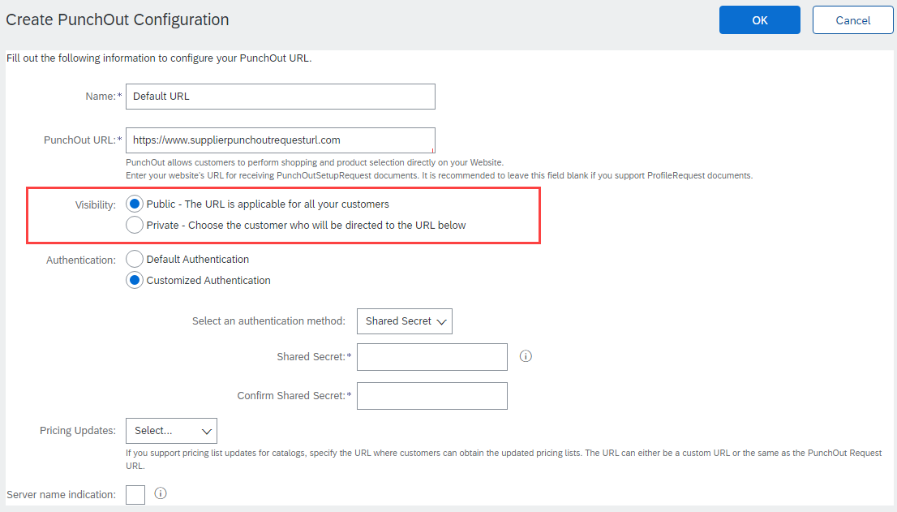
Configuring a SAP Business Network Account for PunchOut
Select Public visibility as this default URL will be used to received the PunchOutSetUpRequest. This link can be used to connect with all customers.
Note 1: This setting will not impact which customers can access the punchout site.
Note 2: To configure a customer specific punchout connection, using a specific URL link, please refer to Configuring your Customer Specific PunchOut URL connection..

Slide 28
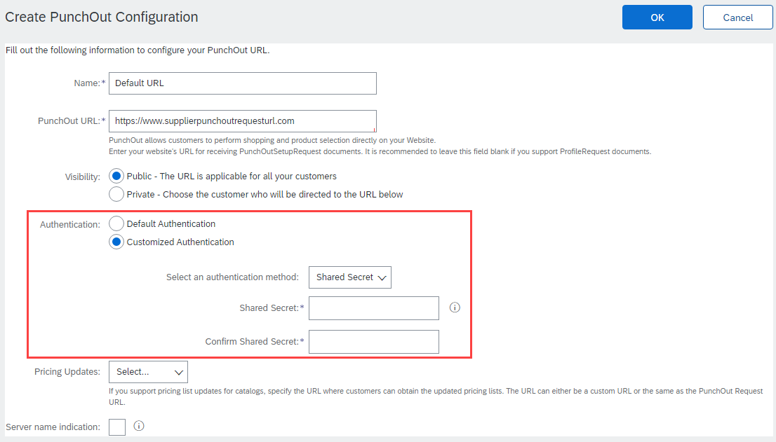
Configuring a SAP Business Network Account for PunchOut
Next, select an Authentication option. The Preferred method is Shared Secret.
Customized Authentication: This shared secret is used purely for PunchOut catalog connectivity. These credentials will be sent to your PunchOut site to authenticate requests from ALL Buyers.
Default Authentication: This Account Level authentication is used for all cXML transactional documents and is maintained in another section of your Supplier account. More detail regarding this topic and setup is covered in section Native cXML transaction setup PunchOut Index File Template.
If using the customized option, type in your Shared Secret, and confirm it.

Slide 29
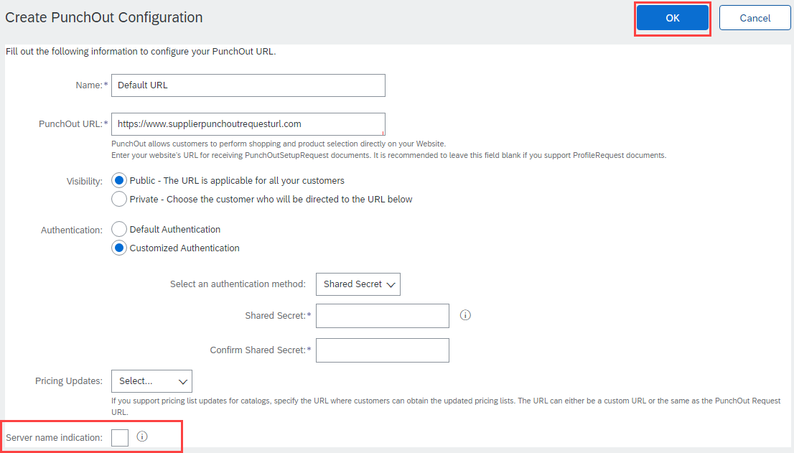
Configuring a SAP Business Network Account for PunchOut
Uncheck if your URL is not Server Name Indication (SNI) enabled.
Click OK

Slide 30
Native cXML transaction setup

Slide 31
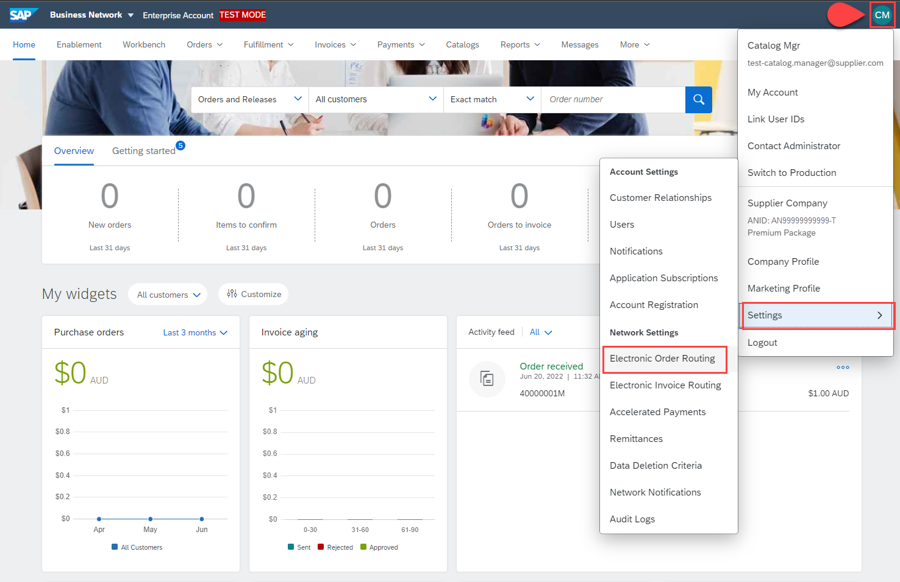
Native cXML transaction setup
This option refers to the account level Default Authentication. This option would be used for all cXML transactional documents across all customers.
To access this authentication setup:
Click your initials
Select Settings
Click Electronic Order Routing

Slide 32
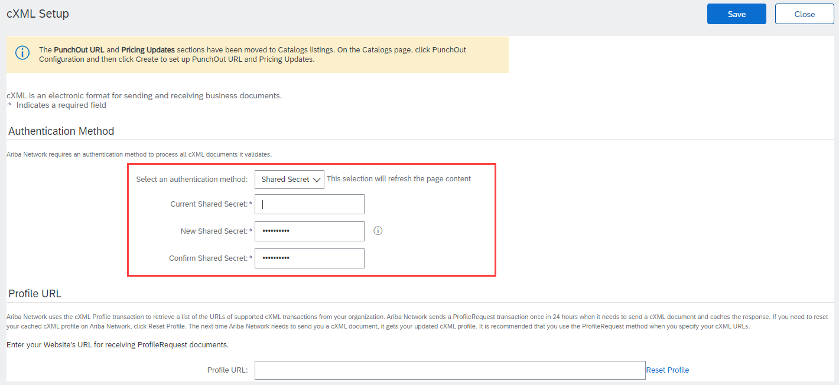
Native cXML transaction setup
Click Configure cXML (native) Integration
Select your Authentication Method. The Preferred method is Shared Secret.
Type in your Shared Secret credentials.
This Shared Secret will be sent to your systems to authenticate requests.
Click OK

Slide 33
Configuring your Customer Specific PunchOut URL connection

Slide 34
Configuring your Customer Specific PunchOut URL connection
In some cases, you may wish to use a unique PunchOut URL, that is different to your Default URL, for a specific customer.
To configure your customer specific PunchOut URL connection, please follow these steps.
Login to your SAP Business Network Supplier Account (https://supplier.ariba.com)
Assistance from your IT Manager may be needed for the following slides.

Slide 35
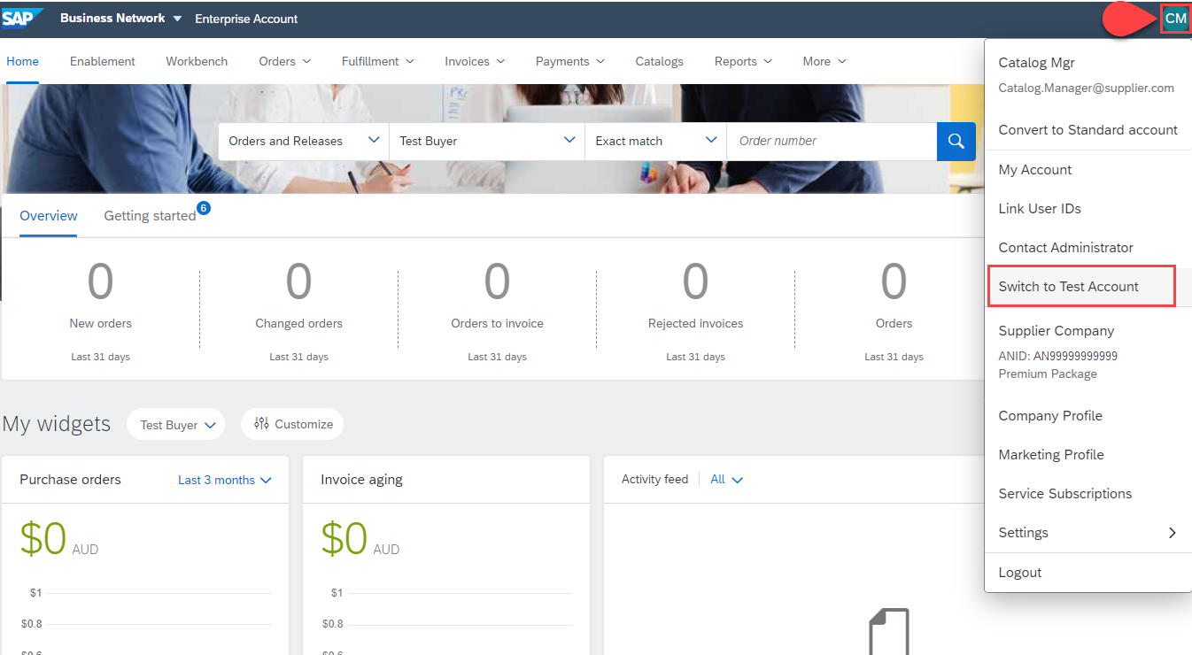
Configuring your Customer Specific PunchOut URL connection
Switch to your Test Account
Your Network Account needs to be set up in both your Test and Production environments
Find your initials in the upper right corner and click for the pull down menu, then click “Switch To Test Account”
If you don’t see a “Switch to Test Account” link, your Test account has not yet been set up. Contact your SAP Business Network Administrator
You will get a warning. “You are about to switch to Test Mode.” Click “OK”

Slide 36
Configuring your Customer Specific PunchOut URL connection
Go to Catalog tab, choose Customer Catalogs, and click PunchOut Configuration.
Please note the next steps need to be completed in your Test and Production environments.

Slide 37
Configuring your Customer Specific PunchOut URL connection
To create your customer specific PunchOut Catalog connection:
Click on Create
In the Name field, write your customer’s company name.
Add your company’s complete unique PunchOut Request URL within the PunchOut URL field. This is the location where your customer’s specific PunchOut requests will be sent to. This field is checked, and its value used each time your customer punches out to your site.

Slide 38
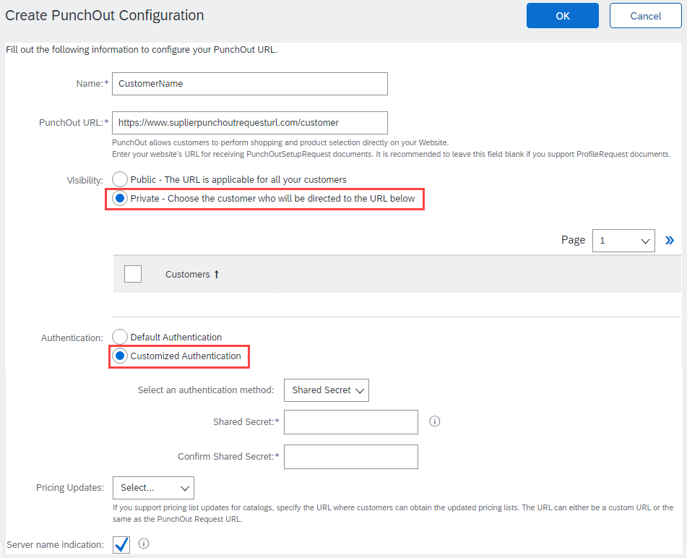
Configuring your Customer Specific PunchOut URL connection
Select Private visibility as this URL is applicable to only your specific customer.
Note: A table will appear and show all existing customer relationships.
Next, select Customized Authentication option. The Preferred method is Shared Secret. This Shared Secret will be sent to you to authenticate requests from your Buyers. Type in your Shared Secret, and confirm it.

Slide 39
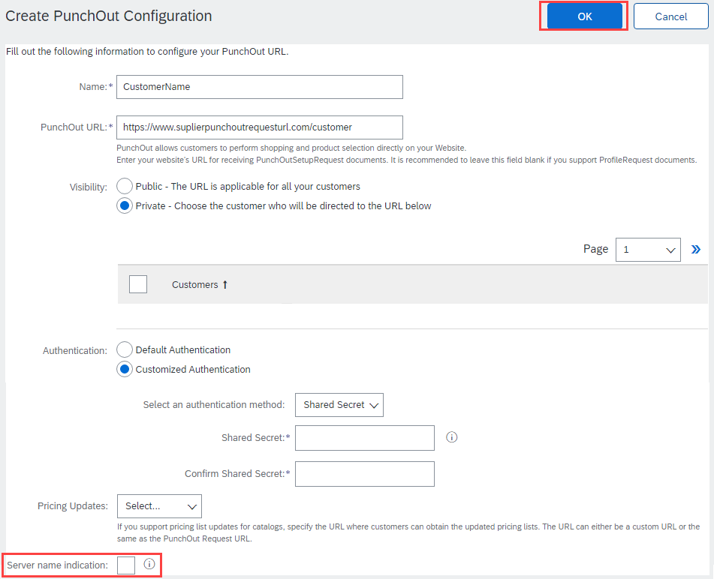
Configuring your Customer Specific PunchOut URL connection
Uncheck if your URL is not Server Name Indication (SNI) enabled.
Click OK

Slide 40
Setting up Default Level 1 Index File Template Details

Slide 41
Setting up Default Level 1 Index File Template Details
In Level 1 PunchOut, the catalog file is a simple, one line Index file. This is because a Level 1 Catalog appears on the catalog interface just as a link to the Supplier’s website.
The PunchOut icon tells the User that this is an external catalog, as well as the “Buy From Supplier” button.

Slide 42
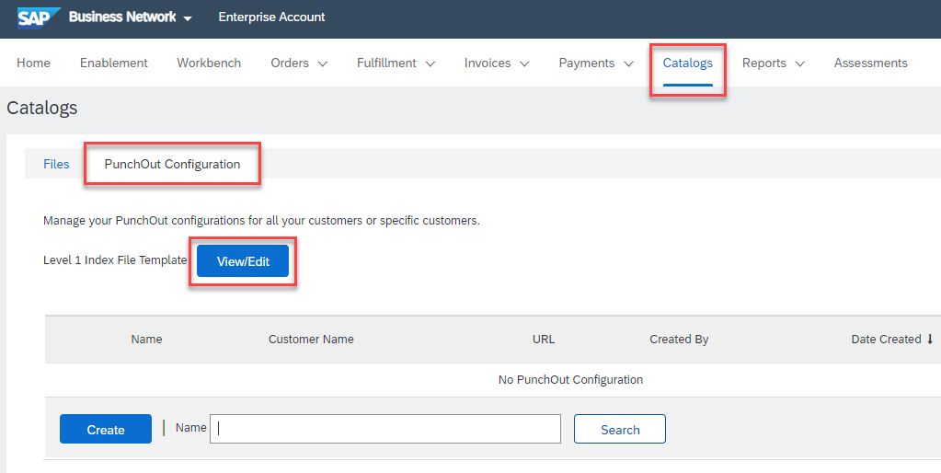
Setting up Default Level 1 Index File Template Details
Enter default PunchOut details by specifying standard information and company logos to be applied to all future PunchOut Level 1 catalog templates.
Go to Catalogs tab, choose Customer Catalogs, and then click the PunchOut Configuration tab.
Click View/Edit to start populating your default Level 1 Index File Template Form details.

Slide 43
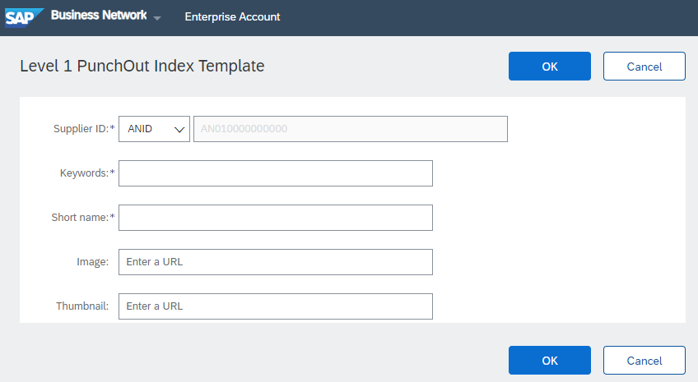
Setting up Default Level 1 Index File Template Details
This is where default information can be specified.
This information will be visible to any customers when you use the PunchOut Level 1 Template.
Information about each field is captured on the next page.
Once populated you can click the OK button to save your changes.

Slide 44
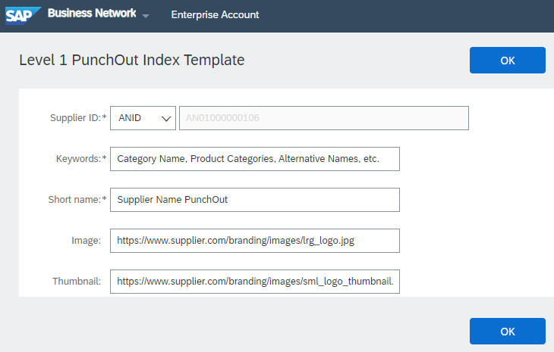
Setting up Default Level 1 Index File Template Details
Supplier ID - Required
Description: This will default to your ANID or can be changed to your DUNS, if it is maintained in your supplier profile.
Note: If you publish the Catalog in your test account, add a suffix –T to your ANID or DUNS number like this: AN99999999999-T
Keywords - Required
Description: Additional keywords to help users find items, this information will also populate the Item Description field when creating a customer catalog online.
Type of data: String
Maximum length: 255
Example: Pens, Pencils, Paper, Copier
Short Name - Required
Description: In L1 PunchOut, this is what will actually display to the User on the UI
Type of data: String
Example: <SupplierName> PunchOut
Maximum length: 50 characters
Image – Optional but Preferred
Description: In L1 PunchOut, this can be your company logo that will display to the User on the UI
Type of data: URL that begins with https://, as required by SAP.
Example: https://www.supplier.com/branding/images/lrg_logo.jpg
Thumbnail - Optional
Description: In L1 PunchOut, this can be your company logo that will display to the User on the UI
Type of data: URL that begins with https://, as required by SAP
Example: https://www.supplier.com/branding/images/sml_logo_thumbnail.jpg

Slide 45
Creating and Publishing PunchOut Level 1 Catalogs Online
*Within your SAP Business Network Account, not using the Excel file.

Slide 46
Creating and Publishing PunchOut Level 1 Catalogs Online
Login to Ariba Network
Go to: https://supplier.ariba.com
Log in with your Username and Password

Slide 47
Creating and Publishing PunchOut Level 1 Catalogs Online
Switch to your Test Account
Your Catalog should be loaded and tested in your Test Account prior to loading the catalog in Production. (Note: If you are instructed to load a Catalog to a Production account, just skip this step)
Find your initials in the upper right corner and click for the pull-down menu, then click “Switch To Test Account”
If you don’t see a “Switch to Test Account” link, your Test account has not yet been set up. Contact your SAP Business Network Administrator
You will get a warning. “You are about to switch to Test Mode.” Click “OK”

Slide 48
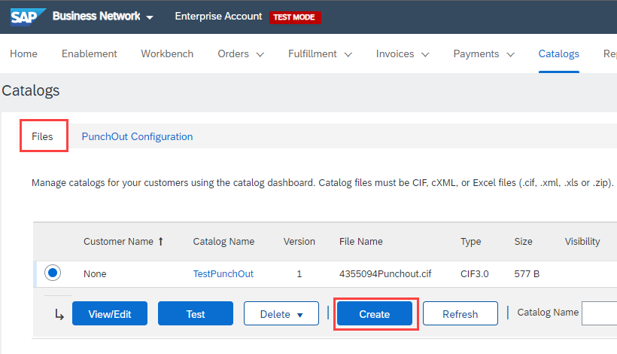
Creating and Publishing PunchOut Level 1 Catalogs Online
Navigate to the Catalogs Tab and click “Customer Catalogs” tab.
Click “Files” tab.
On the Catalogs screen, click the “Create” button.

Slide 49
Creating and Publishing PunchOut Level 1 Catalogs Online
When creating a Catalog within your SAP Business Network account, there are four steps you will follow:
Populate—During this step, you enter specific information related to your catalog, such as the Catalog name (this becomes the “Subscription Name” in the Buyer’s local Catalog) descriptive text, and classify it so that buying organizations that are looking for specific products and services can find your Catalog.
Setting Visibility—Allows you to specify whether the Catalog version is “Public” or “Private” and determines which of your Customers can access it
Validating—The Network checks the Catalog for errors, checks for zero price values and does a high-level validation of UNSPSC codes and Units of Measure
(Note: Customer-specific validation rules for UNSPSC and UOM codes, and zero price values can be more detailed and much more strict than the high-level Network validations, therefore your Catalog may pass the Network validations but fail the Customer-specific validations for these same items)
Publishing—Freezes the current version and notifies your Customer of the Catalog’s availability

Slide 50
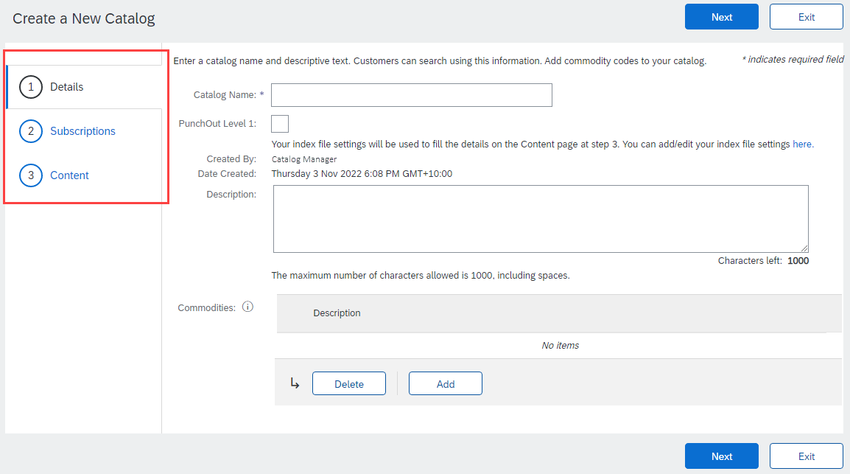
Creating and Publishing PunchOut Level 1 Catalogs Online
You are now on the Create a New Catalog screen
To create the Catalog, there is a 3-step Wizard:
Details—General information about the Catalog
Subscriptions—Who you are publishing the Catalog to
Content—Uploading the actual Catalog file

Slide 51
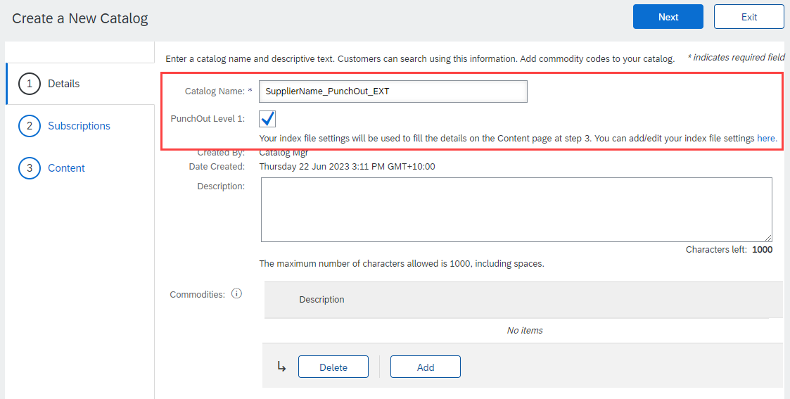
Creating and Publishing PunchOut Level 1 Catalogs Online
Details
Catalog Name: This becomes the “Subscription Name” for this Catalog that will not change. The format for this Name is set by your customer. Use this format (no special characters are allowed, you can use a dash (-) or underscore(_)):
<Put the specific format required by the Customer here>
Example: SupplierName_PunchOut_EXT
PunchOut Level 1: Check this box to apply the default template details.
Description: (Optional) Brief description of the content of your Catalog
Commodities: (Optional) The UNSPSC code(s) that corresponds to the items family/ group of your Catalog. Use the “Add” button to find the code
When you complete this screen, click “Next”
Notes:
.

Slide 52
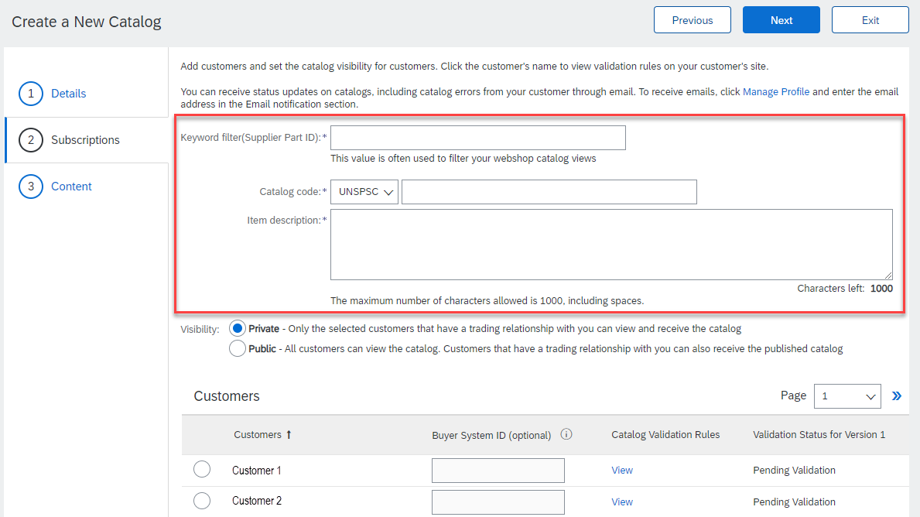
Creating and Publishing PunchOut Level 1 Catalogs Online
Subscriptions
Populate the fields which will be used to help generate the catalog index file.
Supplier Part ID - Required
Description: This can be a default value such as AAA, or a customer specific value if your PunchOut solution validates on additional information.
Note: If you provide more than one catalog for the same customer, please see the Appendix – Template and Catalog File Creation section.
Maximum length: 255
Catalog Code - Required
Description: Classification of the main product or service you sell. It is recommended to use a high level commodity code that best represents the overall category of products/services sold to your customer. This will determine where your Supplier link appears in the catalog hierarchy—not what the actual items are. Note: The domain can be changed to; UNSPSC, ECLASS, and Custom. Consult with your customer specific materials for their accepted commodity codes.
Item Description - Required
Description: In L1 PunchOut, use keywords from product categories and services available on the Supplier’s site. These keywords are searched and display the Supplier’s PunchOut link when matched.
Along with the prepropulated keywords, you will have an additional 745 characters to add additional information about the content you provide.
Maximum length: 1000

Slide 53
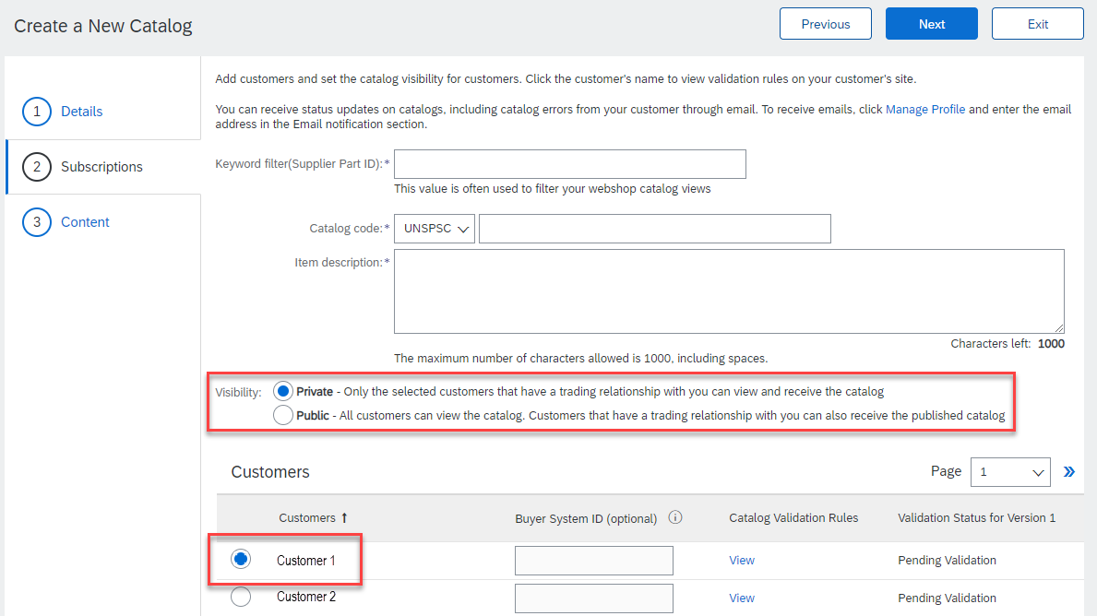
Creating and Publishing PunchOut Level 1 Catalogs Online
Subscriptions
You determine which Customers subscribe to your Catalog—specific Customer(s) or to all Customers on the Network
Set the Visibility to “Private”. You can select a single customer.
To select your Customer, click the radio button next to their name in the "Customers" list.
If the Customer does not appear, it means that your company has not established a relationship with your Customer yet. This is required prior to publishing a Catalog to them.
When you complete this screen, click “Next”.

Slide 54
Creating and Publishing PunchOut Level 1 Catalogs Online
Content
The system will display a brief summary of the contents.
If everything is correct click the “Validate and Publish” button.
The catalog will then be validated by the system, and then published to selected customers. You will be able to see the catalog subscription under the Catalog Files tab.

Slide 55
Creating and Publishing PunchOut Level 1 Catalogs Online
Network Catalog Validation
After the Network completes validation, it changes the Catalog status from “Validating” to one of the following statuses:
Validated, Published or Pending Buyer Validation—your Catalog is error-free.
Errors Found by SAP Business Network—the Network detected Catalog content that violates validation rules.
Bad Format—your Catalog failed the file validation check. Audit the file for problems in format.
A Catalog with an error status means you need to review the error results and correct them before going on.

Slide 56
Creating and Publishing PunchOut Level 1 Catalogs Online
Correcting Validation Errors
To see the error detail, click on the “Errors Found” hyperlink:

Slide 57
Creating and Publishing PunchOut Level 1 Catalogs Online
Viewing Validation Errors
The Network displays Description, Field and Line Number for each error
In this case, the Network is telling us that the Commodity Code is not found.
To correct any issues that didn’t pop up during the process described in slides 51-54, a new version of the catalog will need to be created either online or through a catalog template.

Slide 58
Creating and Publishing PunchOut Level 1 Catalogs Online
Customer Approval
When your Catalog passes the Network upload validation, your Customer is then notified to audit, validate and approve your Catalog. The Network may show any of these statuses: “Published”, “Validated by Customer” or “Pending Buyer Validation”—note that these are all valid statuses
Each Customer may have specific validation rules—and these rules may be more strict than the standard Network rules. This means that your Catalog could pass the Network validation, but fail the Customer-specific rules and be returned to you
If your Customer finds anything in your Catalog file that requires your attention, you will be notified by e-Mail
Each Catalog must pass both the Network validation, and the Customer audit before it can be loaded into the Customer’s buying application and be available for their Users.

Slide 59
Template and Catalog File Creation for a Level 1 PunchOut Catalog

Slide 60
PunchOut L1 Template
A PunchOut Template is a special CIF Template that creates a PunchOut Index file. There is an addition field which changes a CIF file to a PunchOut Index file called PunchOut Enabled.
Here is a sample L1 PunchOut Template in Excel format.
The Template is color coded and has Tool Tips that provide information about how to treat each field.
Each Template includes specific instructions, including custom fields or other requirements set by your Customer.

Slide 61
Templates and Catalog Creation – L1 PunchOut
In Level 1 PunchOut, the catalog file is a simple, one line Index file. This is because a L1 Catalog appears on the catalog interface just as a link to the Supplier’s website.
The PunchOut icon tells the User that this is an external catalog, as well as the “Buy From Supplier” button.

Slide 62
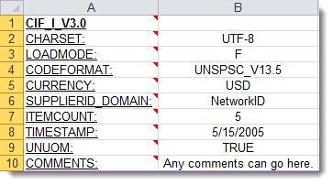
Creating a L1 PunchOut Catalog
The Header Section
CIF_I_V3.0—Specifies the Catalog format (CIF 3.0). Do not change this value
CHARSET—UTF-8 Specifies the data coding type. Do not change this value, unless instructed by your Catalog Expert
LOADMODE—F (Full) or I (Incremental)
CODEFORMAT—Specifies the commodity coding (UNSPSC: United Nations Standard Products and Services Code) in the field “SPSC Code”
CURRENCY—Specifies the currency used for the prices. The value “USD” (United States Dollar) is here by default and can be changed to a difference currency
SUPPLIERID_DOMAIN—Specifies the Domain used. The preferred value is the Supplier’s Business Network ID Number—“NetworkID”. Other values include “DUNS”, “internalsupplierid” or other custom values
ITEMCOUNT—Specifies the number of items of the Catalog. Enter the total number of all items between the DATA and ENDOFDATA markers
TIMESTAMP—Enter the date you created your Catalog.
UNUOM—If set to “TRUE”, the Unit Of Measure is set to UNUOM (United Nations Unit of Measure); if set to “FALSE”, the value is set to ANSI. (Ariba recommends UNUOM)
COMMENTS—This field is optional, but can be used for comments related to your Catalog. It is a good place to enter the Supplier Name, the Customer Name and Catalog Name
Note: The only fields that Suppliers should modify in the Template are indicated in red: CURRENCY, ITEMCOUNT, TIMESTAMP and COMMENTS. All the other fields are predefined in the Template for the Customer and should not be modified, unless instructed by a Catalog Expert.

Slide 63
Creating a L1 PunchOut Catalog
The Data Section
Supplier ID | Supplier Part ID | Manufacturer Part ID
AN99999999999 | PurchGrp500
Supplier ID - Required
Description: If the Header is set to “NetworkID”, then enter the Supplier’s Business Network ID, otherwise the appropriate value for the Domain used—DUNS, internalsystem, etc. Ask your Catalog Expert if you have questions. For PunchOut, be sure the Supplier can accept the Domain and value in their system for authentication
Type of data: String
Maximum length: 255
Example: AN99999999999
Note: If you publish the Catalog in your test account, add a suffix –T to your ANID or DUNS number like this: AN99999999999-T
Supplier Part ID - Required
Description: In L1 PunchOut this can be any value. It is required to be populated. You could set a keyword for your PunchOut system to evaluate here if you wish
NOTE: If you provide more than one catalog for the same customer, make sure the items across these catalogs do not share the same Part ID + Part Auxiliary ID as this duplicates will cause erratic behavior in the application.
Type of data: String
Maximum length: 255
Example: 2772882
Manufacturer Part ID - Optional
Description: In L1 PunchOut this can be any value. It is not required to be populated, but the field must remain. You could set a keyword for the Supplier to evaluate here if you wish
Type of data: String
Maximum length: 255
Example: TTSIBM412CID
F I E L D C O L O R C O D E S
 | Required
 | Optional
 | Optional, but preferred
 | Do not use

Slide 64
Creating a L1 PunchOut Catalog
Item Description | SPSC Code | Unit Price
Pen, Sharpie, staple, tape, folder, post-it, scissors, mouse | 4412 | 1.00
Item Description - Required
Description: In L1 PunchOut, use keywords from product categories and services available on the Supplier’s site. These keywords are searched and display the Supplier’s PunchOut link when matched
Note: To use a special character as a literal value, you need to “escape” it by putting a backslash (\) in front of it. For example, \" lets a double quote be seen as a quote instead of a delimiter for an entry. To escape a quote (") within a quoted field, use two quotes ("")
Type of data: String
Maximum length: 2000
Example: Printer, Laser, Inkjet, laptop, tablet, mouse, HP, Apple, Microsoft, Software
SPSC Code - Required
Description: Classification of the main product or service you sell. It is recommended to use a high level (Level 1 or 2) commodity code that best represents the overall category of products/services sold to your customer. For L1 PunchOut, this commodity code will only determine where the Supplier link appears in the catalog hierarchy—not what the actual items are. Type of data: String
Maximum length: 40
Example: 440000 (level 1) and 44120000 (level 2)
Note: Ariba supports UNSPSC Version 13.5. A code list is available in your Customer’s Supplier Information Portal
Unit Price - Required
Description: In Level 1 PunchOut, the price is not used, but must be populated. It is suggested that you set the value to 1.00
Type of data: Decimal
Example: 1.00
Note: To separate the integer from the decimal, you must use a ‘dot’ and not a comma. Also, do not use a comma to indicate ‘thousands’. Do not include any currency symbols such as $, £ or ¥.

Slide 65
Creating a L1 PunchOut Catalog
Unit of Measure | Lead Time | Manufacturer Name
EA
Unit of Measure - Required
Description: For L1 PunchOut, this is just populated to meet the system requirement—UOM is not used. It is suggested that you use EA
Type of data: String
Maximum length: 32
Example: EA
Lead Time - Do Not Use
Description: For L1 PunchOut, this is not used, but the field must remain
Type of data: Integer
Maximum length: 40
Example: 1
Manufacturer Name - Do Not Use
Description: For L1 PunchOut, this is not used, but the field must remain
Type of data: String
Maximum length: 255
Example: Epson

Slide 66
Creating a L1 PunchOut Catalog
Supplier URL | Manufacturer URL | Market Price
Supplier URL - Do Not Use
Description: For L1 PunchOut, this is not used, but the field must remain
Type of data: String
Maximum length: 255
Example: https://www.supply.com/Catalog/product18.htm
Manufacturer URL - Do Not Use
Description: For L1 PunchOut, this is not used, but the field must remain
Type of data: String
Maximum length: 255
Example: https://www.manu.com/Catalog/product18.htm
Market Price - Do Not Use
Description: For L1 PunchOut, this is not used, but the field must remain
Type of data: Decimal
Example: 4.32 or 1234.78

Slide 67
Creating a L1 PunchOut Catalog
Supplier Part Auxiliary ID | Short Name
Seattle | SupplierABC PunchOut
Supplier Part Auxiliary ID - Optional
Description: In L1 PunchOut, this can be used to convey a value for the Supplier to process, and send back the appropriate catalog URL
NOTE: If you provide more than one catalog for the same customer, make sure the items across these catalogs do not share the same Part ID + Part Auxiliary ID as this duplicates will cause erratic behavior in the application.
Type of data: String
Maximum length: 255
Example: 1234 French
Note: If any items have the same reference (Supplier Part ID column), this column allows you to differentiate them
Short Name - Required
Description: In L1 PunchOut, this is what will actually display to the User on the UI
Type of data: String
Example: <SupplierName> PunchOut
Maximum length: 50 characters

Slide 68
Creating a L1 PunchOut Catalog
Image | Keywords | PunchOut Enabled
https://www.mylogo12354.jpg | IT, communication, paper, pens | TRUE
Image - Required
Description: URL of the item’s image (preferred and in https: format as required by SAP), or filename of the image (sent in a zip file)
Supported image formats: JPG, JPEG, GIF, PNG, BMP—(JPG preferred)
Type of data: String
Maximum length: 255
Recommended Size: 250 x 250 pixels
Keywords - Required
Description: Additional keywords to help users find items
Type of data: String
Maximum length: 255
Example: Pens, Pencils, Paper, Copier
PunchOut Enabled - Required
Description: Tells the system that this file is a PunchOut Index file. Must be set to TRUE for the system to see this as a PunchOut item
Type of data: Boolean

Slide 69
Creating a L1 PunchOut Catalog
Special Notes for Images
In the Catalog file, you can refer to a Remote Image—using a URL—or you can refer to a Local Image, and send that image to your Customer to store
Using Remote Images is preferred
Be sure the URL in the Template is complete (including https:// as required by SAP)
Example: https://server/directory/imagefilename.jpg
Point to the image itself—not a program that serves up images
If you use Local Images
Be sure the filename in the Template is exact—including upper and lower case Example: FileName.jpg -or- lowercasename.jpg
Load images in a zip file format with the Customer Name and Supplier Name on the SBN Account

Slide 70
Creating a L1 PunchOut Catalog
Remove this slide if custom fields are not applicable.
Custom | Custom | Custom
Custom Field Name - Required
Description: lorum ipsum, Lorum ipsum
Type of data: String
Maximum length: 255
Example: 123
Note: Lorum ipsum Lorum ipsum
Custom Field Name - Optional
Description: lorum ipsum, Lorum ipsum
Type of data: String
Maximum length: 255
Example: 123
Note: Lorum ipsum Lorum ipsum
Custom Field Name - Optional
Description: lorum ipsum, Lorum ipsum
Type of data: String
Maximum length: 255
Example: 123
Note: Lorum ipsum Lorum ipsum

Slide 71
Template and Catalog File Creation for a Level 2 PunchOut Catalog
Remove following slides if L2 is not applicable.

Slide 72
PunchOut L2 Template
A PunchOut L2 Template is a special CIF Template that creates a PunchOut Index file. The addition of two fields changes a CIF file to a PunchOut Index file. The fields are:
PunchOut Enabled and
PunchOutLevel
Here is a sample L2 PunchOut Template in Excel format.
The Template is color coded and has Tool Tips that provide information about how to treat each field.
Each Template includes specific instructions, including custom fields or other requirements set by your Customer.

Slide 73
Creating a L2 PunchOut Catalog
In Level 2 PunchOut, the catalog file is a combination of static catalog information (this is used to search) and it also contains the PunchOut Enabled and PunchOut Level fields, to tell the system that this is a PunchOut catalog, and the User will be taken to the Supplier’s website to add items to their cart as they shop.
L2 PunchOut items appear on the Catalog interface just as a static item does, but has the “Buy from Supplier” button instead of “Add to Cart”.
The PunchOut icon tells you that this is an external catalog, as well as the “Buy From Supplier” button.

Slide 74
Creating a L2 PunchOut Catalog
The Header Section
CIF_I_V3.0—Specifies the Catalog format (CIF 3.0). Do not change this value
CHARSET—UTF-8 Specifies the data coding type. Do not change this value, unless instructed by your Catalog Expert
LOADMODE—F (Full) or I (Incremental)
CODEFORMAT—Specifies the commodity coding (UNSPSC: United Nations Standard Products and Services Code) in the field “SPSC Code”
CURRENCY—Specifies the currency used for the prices. The value “USD” (United States Dollar) is here by default and can be changed to a difference currency
SUPPLIERID_DOMAIN—Specifies the Domain used. The preferred value is the Supplier’s Business Network ID Number—“NetworkID”. Other values include “DUNS”, “internalsupplierid” or other custom values
ITEMCOUNT—Specifies the number of items of the Catalog. Enter the total number of all items between the DATA and ENDOFDATA markers
TIMESTAMP—Enter the date you created your Catalog.
UNUOM—If set to “TRUE”, the Unit Of Measure is set to UNUOM (United Nations Unit of Measure); if set to “FALSE”, the value is set to ANSI. (Ariba recommends UNUOM)
COMMENTS—This field is optional, but can be used for comments related to your Catalog. It is a good place to enter the Supplier Name, the Customer Name and Catalog Name
Note: The only fields that Suppliers should modify in the Template are indicated in red: CURRENCY, ITEMCOUNT, TIMESTAMP and COMMENTS. All the other fields are predefined in the Template for the Customer and should not be modified, unless instructed by a Catalog Expert.
F I E L D C O L O R C O D E S
 | Required
 | Optional
 | Optional, but preferred
 | Do not use

Slide 75
Business Network – File Size Limits
CIF Format : When using the catalog wizard, the catalog file can't exceed 95 MB or 400,000 lines.
Excel Format : The maximum size of zipped Excel file that you can upload is 1 MB (uncompressed). If your Excel files exceed these size, you can convert them to CIF manually and upload the CIF files. Business Network uploads the file, unzips it if necessary, converts it to CIF format, and starts validation. Conversion from Excel to CIF can take several minutes depending on the catalog size. As Excel files convert, their status is Validating.
cXML Format: If you use the cXML CatalogUploadRequest transaction, the zipped catalog file cannot exceed 10 MB, and the unzipped CIF file cannot exceed 95 MB (approximately 400,000 line items). To have this default size limit increased to 200 MB, contact SAP Ariba Customer Support.

Slide 76
Creating a L2 PunchOut Catalog
The Data Section
Supplier ID | Supplier Part ID | Manufacturer Part ID
AN99999999999 | 12345 | CFG 11562
AN99999999999 | 87690 | 87690-12
AN99999999999 | 479-56 | A100-BLK
Supplier ID - Required
Description: If the Header is set to “NetworkID”, then enter the Supplier’s Business Network ID, otherwise the appropriate value for the Domain used—DUNS, internalsystem, etc. Ask your Catalog Expert if you have questions. For PunchOut, be sure the Supplier can accept the Domain and value in their system for authentication
Type of data: String
Maximum length: 255
Example: AN99999999999
Note: If you publish the Catalog in your test account, add a suffix –T to your ANID or DUNS number like this: AN99999999999-T
Supplier Part ID - Required
Description: Part Number used by the Supplier. The Part Number must be unique for each item in the Catalog.
NOTE: If you provide more than one catalog for the same customer, make sure the items across these catalogs do not share the same Part ID + Part Auxiliary ID as this duplicates will cause erratic behavior in the application.
Type of data: String
Maximum length: 255
Example: 2772882
Manufacturer Part ID - Optional
Description: A Part Number that a Manufacturer uses
Type of data: String
Maximum length: 255
Example: TTSIBM412CID

Slide 77
Creating a L2 PunchOut Catalog
Item Description | SPSC Code | Unit Price
Pens, Bic, Ballpoint, Blue, 1 dozen | 43191504 | 3.48
Stapler, Swingline, Black | 55010125 | 18.72
Post-It, Yellow, 1”x2”, pad of 100 | 15874236 | 6.49
Folders, Letter, Manilla, 100 | 89745125 | 12.98
Item Description - Required
Description: Description of the product or service. Make your descriptions as clear and complete as possible (Item type, brand, model, color, etc.)
Note: To use a special character as a literal value, you need to “escape” it by putting a backslash (\) in front of it. For example, \" lets a double quote be seen as a quote instead of a delimiter for an entry. To escape a quote (") within a quoted field, use two quotes ("")
Type of data: String
Maximum length: 2000
Example: Printer, Laser, A4, Epson Stylus Color 740
SPSC Code - Required
Description: Classification of the product or service. Use a UNSPSC code if the Header specifies “UNSPSC” as the CODEFORMAT
Type of data: String
Maximum length: 40
Example: 45678900 (level 3) and 45678923 (level 4)
Note: Ariba supports UNSPSC Version 13.5. A code list is available in your Customer’s Supplier Information Portal
Unit Price - Optional
Description: Customer-specific price. For L2 PunchOuts the price can be left blank if the Buyer agrees
Type of data: Decimal
Example: 4.32 or 1234.78
Note: To separate the integer from the decimal, you must use a ‘dot’ and not a comma. Also, do not use a comma to indicate ‘thousands’. Do not include any currency symbols such as $, £ or ¥.

Slide 78
Creating a L2 PunchOut Catalog
Unit of Measure | Lead Time | Manufacturer Name
EA | 1 | Intelidata
EA | 1 | IDG Book
DZN | 3 | Bic
EA | 1 | Swingline
Unit of Measure - Required
Description: Unit of measure related to the Unit Price. Use a United Nations UOM if the UNUOM in the Header is set to “True”
Type of data: String
Maximum length: 32
Example: BX
Note: A file containing the Units of Measure is available in your Customer’s Supplier Information Portal
Lead Time - Optional
Description: Number of working days for the product to be shipped from the date you receive the Purchase Order
Type of data: Integer
Maximum length: 40
Example: 1
Manufacturer Name - Optional
Description: Name of the manufacturer
Type of data: String
Maximum length: 255
Example: Epson

Slide 79
Creating a L2 PunchOut Catalog
Supplier URL | Manufacturer URL | Market Price
https://www.supplier.com | https://www.manu.com | 12.95
https://www.supplier.com |  | 2296.56
https://www.supplier.com |  | 4.86
https://www.supplier.com |  | 12.86
Supplier URL - Optional
Description: A URL that links to a Supplier static page about the item (could be a MSDS, construction info, packaging info, etc.), in https: format as required by SAP.
Type of data: String
Maximum length: 255
Example: https://www.supply.com/Catalog/product18.htm
Manufacturer URL - Optional
Description: A URL that links to a Manufacturer’s static page about the item (could be a MSDS, construction info, packaging info, etc.), in https: format as required by SAP.
Type of data: String
Maximum length: 255
Example: https://www.manu.com/Catalog/product18.htm
Market Price - Do Not Use
Description: List or retail price.
Note: Does not show on the Ariba UI—this is an informational-only field for Suppliers
Type of data: Decimal
Example: 4.32 or 1234.78
Note: To separate the integer from the decimal, you must use a ‘dot’ and not a comma. Also, do not use a comma to indicate ‘thousands’. Do not include any currency symbols such as $, £ or ¥.

Slide 80
Creating a L2 PunchOut Catalog
Supplier Part Auxiliary ID | Language | Currency
1234-75 | en_US | USD
 | en_US | USD
 | en_US | USD
 | en_US | USD
Supplier Part Auxiliary ID - Optional
Description: Uniquely identifies a single item. For example, items in multiple languages or available in multiple units of measure
NOTE: If you provide more than one catalog for the same customer, make sure the items across these catalogs do not share the same Part ID + Part Auxiliary ID as this duplicates will cause erratic behavior in the application.
Type of data: String
Maximum length: 255
Example: 1234 French
Note: If any items have the same reference (Supplier Part ID column), this column allows you to differentiate them
Language - Optional (If blank, defaults to ‘en_US’)
Description: Specifies the language used to describe the item.
Type of data: String
Maximum length: 255
Example: en_US
Note: A listing of language codes is in your Customer’s Supplier Information Portal
Currency - Optional (Set in Header)
Description: Specifies the currency used for the prices
Type of data: String
Maximum length: 32
Example: USD, CAD (Canadian Dollar)
Note: A listing of currency codes is in your Customer’s Supplier Information Portal

Slide 81
Creating a L2 PunchOut Catalog
Short Name | Image
Soft Drink, Soda, Dr Pepper | 12354.jpg
Dairy, Milk, 1% milkfat | https://www.1.com/34.jpg
Coffee, Dark Roast, Starbucks | 587.Jpg
Soft Drink, Juice, Minute Maid | https://www.1.36.jpg
Short Name – Optional but Preferred
Description: Short description of the item. The Short Name is displayed first in the UI, and is in a larger type face and blue color. You can use the Short Name to describe a category or Item type, then give the specifics in the Item Description.
Type of data: String
Example: Nylon Glove, Blue
Maximum length: 50 characters
Note: If the “Short Name” field is left blank, the first 50 characters of the Item Description column will automatically fill the “Short Name” field.
Image - Optional but Preferred
Description: URL of the item’s image (preferred), or filename of the image (sent in a zip file)
Supported image formats: JPG, JPEG, GIF, PNG, BMP—(JPG preferred)
Type of data: String
Maximum length: 255
Recommended Size: 250 x 250 pixels

Slide 82
Creating a L2 PunchOut Catalog
Thumbnail
https://www.1.com/12354.jpg
https://www.1.com/34.jpg
https://www.1.com/587.Jpg
https://www.1.36.jpg
Detail: Thumbnail - Optional
Description: URL of an Icon-size image of the item (in https: format as required by SAP), or filename of the image (sent in the zip file)—can be different from the product’s full-size Image.
Supported image formats: JPG, JPEG, GIF, PNG, BMP—(JPG preferred)
Type of data: String
Maximum length: 255
Recommended Size: 85 x 85 pixels
Note: If the “Thumbnail” field is left blank, the file in the “Image” field will be resized and populate the Thumbnail.

Slide 83
Creating a L2 PunchOut Catalog
Special Notes for Images
In the Catalog file, you can refer to a Remote Image—using a URL—or you can refer to a Local Image, and send that image to your Customer to store
Using Remote Images is preferred
Be sure the URL in the Template is complete (including https:// as required by SAP)
Example: https://server/directory/imagefilename.jpg
Point to the image itself—not a program that serves up images
If you use Local Images
Be sure the filename in the Template is exact—including upper and lower case Example: FileName.jpg -or- lowercasename.jpg
Load images in a zip file format with the Customer Name and Supplier Name on the SBN Account

Slide 84
Creating a L2 PunchOut Catalog
PunchOut Enabled | PunchOutLevel
TRUE | Product
PunchOut Enabled - Required
Description: Tells the system that this file is a PunchOut Index file. Must be set to TRUE for the system to see this as a PunchOut item
Type of data: Boolean
PunchOutLevel - Required
Description: Tells the system that this item is a L2 PunchOut item that will take the User to the Supplier’s site at the Store Level (like a L1), the Aisle level (a category, that requires then to further refine the search on the Supplier’s site), the Shelf level (a refined category that results in only a few items that will all be displayed in the PunchOut) or the Product level (this takes the User to the exact item on the Supplier’s site that they searched for in Ariba). Product is the most common level
Values: Store, Aisle, Shelf, Product
Type of data: Boolean

Slide 85
Creating a L2 PunchOut Catalog
Remove this slide if custom fields are not applicable.
Custom | Custom | Custom
Custom Field Name - Required
Description: lorum ipsum, Lorum ipsum
Type of data: String
Maximum length: 255
Example: 123
Note: Lorum ipsum Lorum ipsum
Custom Field Name - Optional
Description: lorum ipsum, Lorum ipsum
Type of data: String
Maximum length: 255
Example: 123
Note: Lorum ipsum Lorum ipsum
Custom Field Name - Optional
Description: lorum ipsum, Lorum ipsum
Type of data: String
Maximum length: 255
Example: 123
Note: Lorum ipsum Lorum ipsum

Slide 86
Uploading and Publishing PunchOut Catalogs

Slide 87
Uploading and Publishing PunchOut Catalogs
Login to Ariba Network
Go to: https://supplier.ariba.com
Log in with your Username and Password

Slide 88
Uploading and Publishing PunchOut Catalogs
Switch to your Test Account
Your Catalog should be loaded and tested in your Test Account. (Note: If you are instructed to load a Catalog to a Production account, just skip this step)
Find your initials in the upper right corner and click for the pull down menu, then click “Switch To Test Account”
If you don’t see a “Switch to Test Account” link, your Test account has not yet been set up. Contact your SAP Business Network Administrator
You will get a warning. “You are about to switch to Test Mode.” Click “OK”

Slide 89
Uploading and Publishing PunchOut Catalogs
When uploading a Catalog on SAP Business Network, there are four steps you will follow:
Uploading—Transfers the Catalog file from your local drive to the SAP Business Network. During the upload process, you enter the Catalog name (this becomes the “Subscription Name” in the Buyer’s local Catalog) descriptive text, and classify it so that buying organizations that are looking for specific products and services can find your Catalog
Setting Visibility—Allows you to specify whether the Catalog version is “Public” or “Private” and determines which of your Customers can access it
Validating—The Network checks the Catalog for errors, checks for zero price values and does a high-level validation of UNSPSC codes and Units of Measure
(Note: Customer-specific validation rules for UNSPSC and UOM codes, and zero price values can be more detailed and much more strict than the high-level Network validations, therefore your Catalog may pass the Network validations but fail the Customer-specific validations for these same items)
Publishing—Freezes the current version and notifies your Customer of the Catalog’s availability

Slide 90
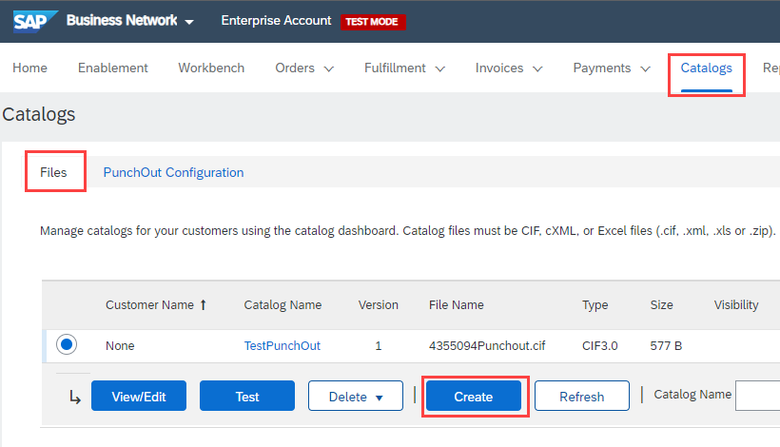
Uploading and Publishing PunchOut Catalogs
Navigate to the Catalogs Tab and click “Files” tab.
On the Catalogs screen, click the “Create” button.

Slide 91
Uploading and Publishing PunchOut Catalogs
You are now on the Create a New Catalog Screen
To create the Catalog, there is a 3-step Wizard:
Details—General information about the Catalog
Subscriptions—Who you are publishing the Catalog to
Content—Uploading the actual Catalog file

Slide 92
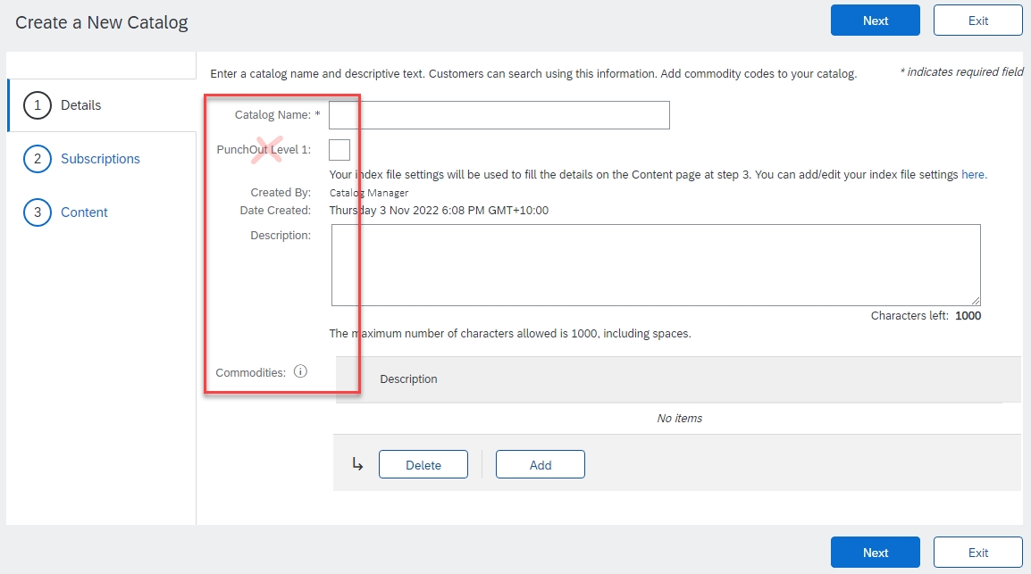
Uploading and Publishing PunchOut Catalogs
Details
Catalog Name: This becomes the “Subscription Name” for this Catalog that will not change. The format for this Name is set by your Customer. Use this format (no special characters are allowed, you can use a dash (-) or underscore(_)): <Put the specific format required by the Customer here>
Description: (Optional) Brief description of the content of your Catalog
Commodities: (Optional) The UNSPSC code(s) that corresponds to the items family/ group of your Catalog. Use the “Add” button to find the code
Do not select PunchOut Level 1 unless requested by your SAP Ariba Catalog Specialist.
When you complete this screen, click “Next”

Slide 93
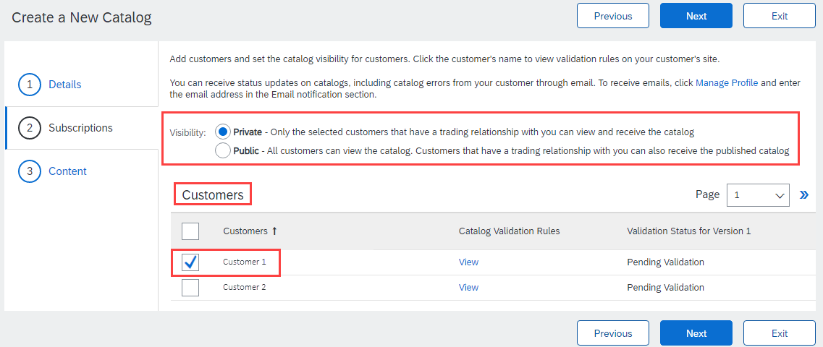
Uploading and Publishing PunchOut Catalogs
Subscriptions
You determine which Customers subscribe to your Catalog—specific Customer(s) or to all Customers on the Network
Set the Visibility to “Private”. You can select a single customer.
To select your Customer, check the box next to their name in the “Customers” list.
If the Customer does not appear, it means that your company has not established a relationship with your Customer yet. This is required prior to uploading a Catalog to them.
When you complete this screen, click “Next”

Slide 94
Uploading and Publishing PunchOut Catalogs
Content
Select your Catalog File, by clicking “Choose File” and navigating to where your file is saved.
Your Excel file must not exceed 1 Mb, however you can use zip compression.
If your Excel file is too large, you will need to convert it to a CIF. See the Appendix—“How to convert an Excel file to CIF”
After you have selected your Catalog file, click the “Validate and Publish” button.
As your Catalog loads, the status will read “Validating”. Click the “Refresh” button at the bottom of the screen to see the status change.

Slide 95
Uploading and Publishing PunchOut Catalogs
Network Catalog Validation
After the Network completes validation, it changes the Catalog status from “Validating” to one of the following statuses:
Validated, Published or Pending Buyer Validation—your Catalog is error-free.
Errors Found by SAP Business Network—the Network detected Catalog content that violates validation rules.
Bad Format—your Catalog failed the file validation check. Audit the file for problems in format
A Catalog with an error status means you need to review the error results and correct them before going on

Slide 96
Uploading and Publishing PunchOut Catalogs
Correcting Validation Errors
To see the error detail, click on the “Errors Found” hyperlink:

Slide 97
Uploading and Publishing PunchOut Catalogs
Viewing Validation Errors
The Network displays Description, Field and Line Number for each error
In this case, the Network is telling us that the Supplier Part ID / Supplier Part Auxiliary ID combination is not unique on line 14 and line 12 is missing a Supplier Part ID.
To correct any issues, go back to the original Excel Catalog file, make the corrections, then update the Catalog file, and upload the new version to replace the existing Catalog

Slide 98
Uploading and Publishing PunchOut Catalogs
Customer Approval
When your Catalog passes the Network upload validation, your Customer is then notified to audit, validate and approve your Catalog. The Network may show any of these statuses: “Published”, “Validated by Customer” or “Pending Buyer Validation”—note that these are all valid statuses
Each Customer may have specific validation rules—and these rules may be more strict than the standard Network rules. This means that your Catalog could pass the Network validation, but fail the Customer-specific rules and be returned to you
If your Customer finds anything in your Catalog file that requires your attention, you will be notified by e-Mail
Corrections should be made to the original Excel file, then the corrected Catalog file needs to be uploaded to the Network
Each Catalog must pass both the Network validation, and the Customer audit before it can be loaded into the Customer’s buying application and be available for their Users

Slide 99
Replacing Existing Catalogs

Slide 100
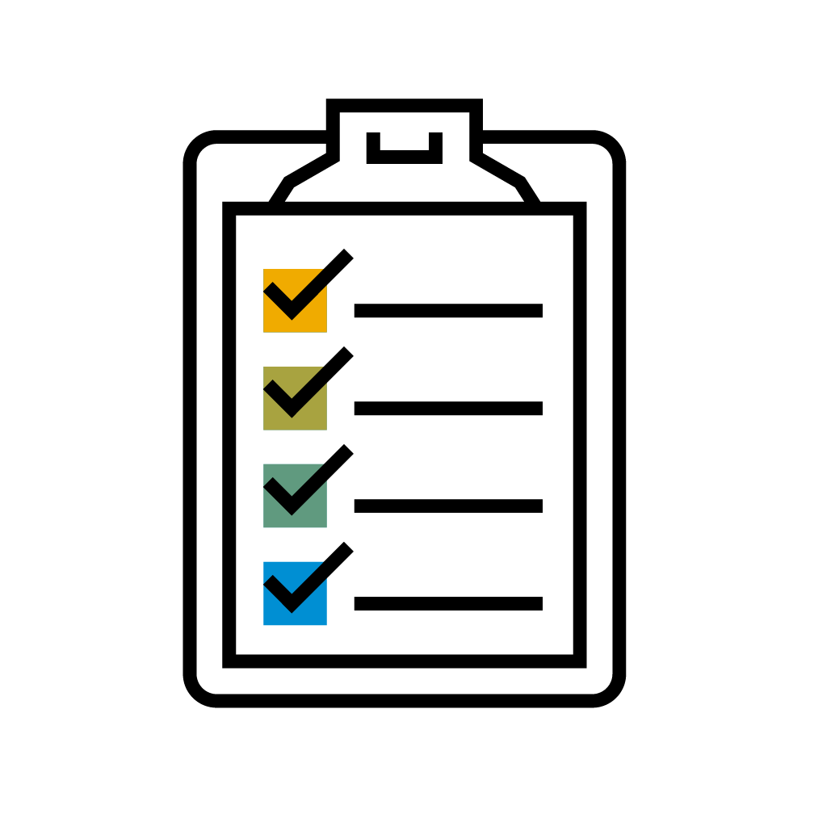
Replacing Existing PunchOut Catalogs
Due to the nature of L1 PunchOut Index files, it is rare that you would need to update them. Only a change to the logo, the Description to appear on the UI or additional keywords would require an update to a L1 Catalog.
For L2, updating will occur much like a static catalog. Since the Index file is used for searching the items in the Supplier’s catalog, before punching the User out to their website, it is important that the data in the L2 Index files be kept current.

Slide 101
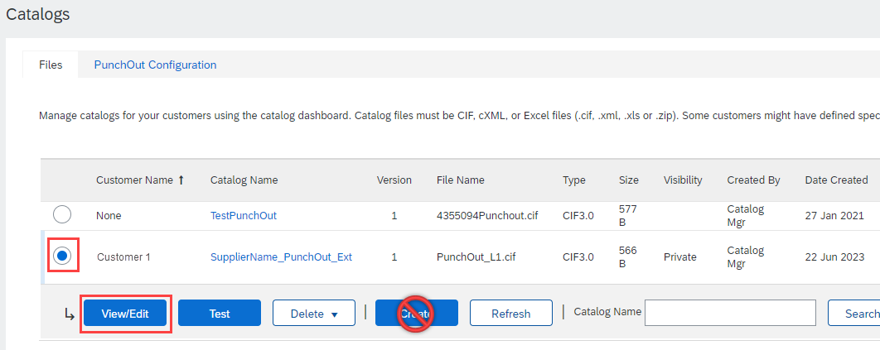
Replacing Existing PunchOut Catalogs
To replace an existing Catalog, the steps are almost the same as uploading a new Catalog for the Customer.
Log into your SAP Business Network account
Navigate to Catalogs
Update the Catalog—using “View/Edit”
When replacing an existing Catalog, do not use the “Create” button—it is important to keep the same Catalog Name. The file name can be different:

Slide 102
Replacing Existing PunchOut Catalogs
Find the existing Catalog you wish to replace with a new version
Click on the radio button to select the existing Catalog
Click “View/Edit”

Slide 103
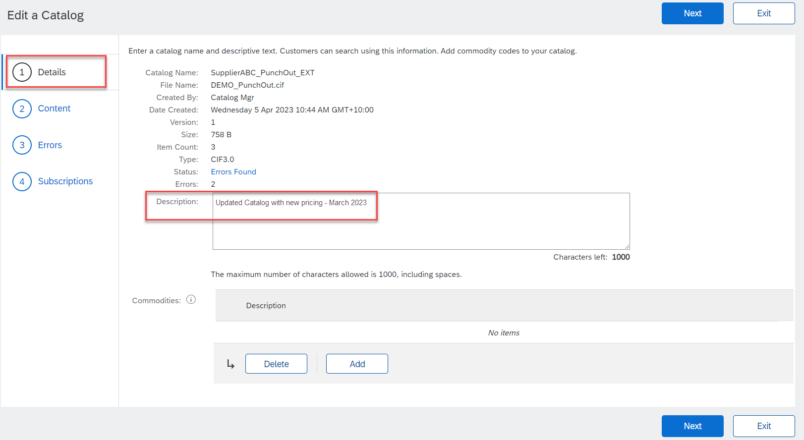
Replacing Existing PunchOut Catalogs
You are now taken to the Edit a Catalog Screen
You see the same 3 steps as a New Catalog
Details—Most of the fields are pre-populated with the existing information, but you can add a new Description for the updated Catalog
Click “Next”

Slide 104
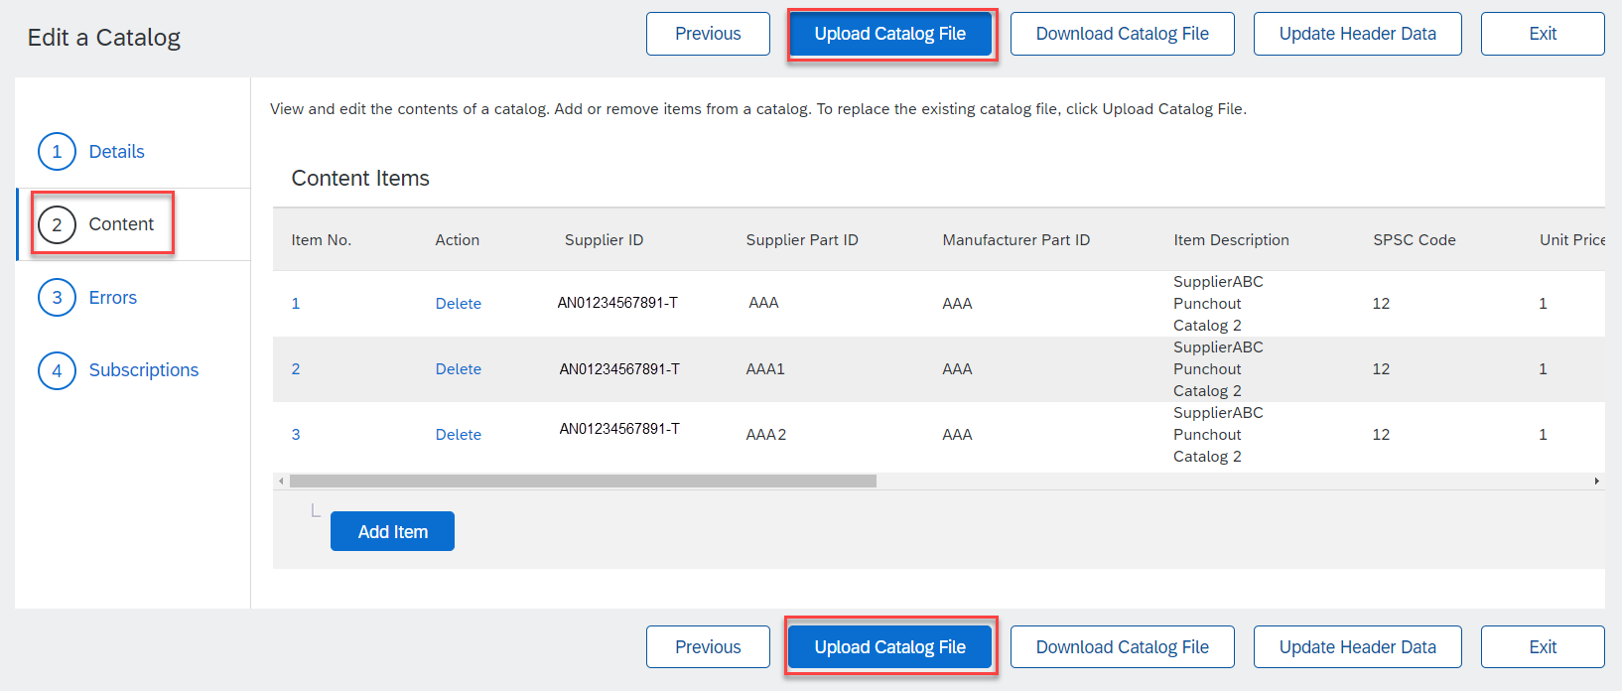
Replacing Existing PunchOut Catalogs
Content—The Network will display the current Catalog (if it is under 4Mb)
Click the Upload Catalog File button. This will replace the existing Catalog File with our updated Catalog

Slide 105
Replacing Existing PunchOut Catalogs
Select your Catalog file, by clicking the Choose File button and navigating to where your file is saved.
Your Excel file must not exceed 1 Mb, however you can use zip compression
If your Excel file is too large, you will need to convert it to a CIF. See the Appendix—“How to convert an Excel file to CIF”
After you have selected your Catalog file, click “Validate and Publish”
As your Catalog loads, you will be returned to the Catalog Home screen and the status will read “Validating”. Click the “Refresh” button at the bottom of the screen to see the status change. Be sure to wait for the validation to finish

Slide 106
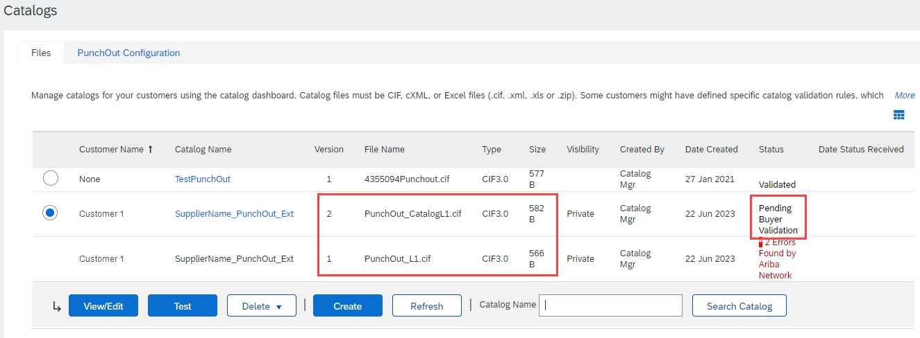
Replacing Existing PunchOut Catalogs
When your Catalog passes the Network upload validation, the Network may show any of these statuses: “Published”, “Validated by Customer” or “Pending Buyer Validation”—note that these are all valid statuses. The upload is complete.
Notice that the Catalog Name stayed the same, but the new File Name we loaded is reflected on the Network.
The Network does Catalog version control for you. See that our replacement Catalog is now Version 2, and is active. Note that the radio button has moved up to our new active version.

Slide 107
Replacing Existing PunchOut Catalogs
Customer Approval
When your Catalog passes the Network upload validation, your Customer is then notified to audit, validate and approve your Catalog.
Each Customer may have specific validation rules—and these rules may be more strict than the standard Network rules. This means that your Catalog could pass the Network validation, but fail the Customer-specific rules and be returned to you.
If your Customer finds anything in your Catalog file that requires your attention, you will be notified by e-Mail.
Corrections should be made to the original Excel file, then the corrected Catalog file needs to be uploaded to the Network.
Each Catalog must pass both the Network validation, and the Customer audit before it can be loaded into the Customer’s buying application and be available for their Users.

Slide 108
Testing Connectivity

Slide 109
Testing Connectivity
Change example ANID to your Customer's ANID
All PunchOut catalogs must be tested in both the Test and Production environments.
Success in the Test environment does not mean that the catalog will connect properly in Production.
Supplier ANIDs in a Test environment contain a “–T” suffix (Example: AN99999999999-T)—in Production there is no “-T”. This means the that the PunchOut in Production is using a different “User Name”.
The Network does not allow the same Shared Secret to be set for both Test and Production—this means the PunchOut in Production is using a different “Password”.
Once the PunchOut Catalog Index file has been created and loaded, you’ll need to set up your website to accept PunchOut requests from your Customer.
The “User Name” will be their ANID:
AN99999999999 for Production
AN99999999999-T for Test
The “Password” will be the Shared Secret you have set up on your AN account.

Slide 110
Testing Connectivity
For both Test and Production environments, the process is the same. When your site is ready to receive PunchOut requests, let your Customer know.
Your Customer will test the PunchOut from their Ariba Catalog application.
If there are any connectivity issues or errors that are indicated on the UI, the information will be shared with you, including any logs that help to troubleshoot the connectivity.
Once the connectivity is established and your site is accessible, your Customer will audit the site for agreed-upon content, usability and the ability to successfully return a Shopping Cart or item back to the Ariba Procurement solution.
Once the Test environment is working, then Production will be tested.
When Production testing is successful, the go live date and preparation will start.

Slide 111
Testing Connectivity
Common Troubleshooting Issues
This is a common PunchOut Setup Request (POSR). Some issues that come up are:
Multiple <From> credentials. Your documents may contain multiple domains. This is not something that is under Ariba’s control. It is suggested that you use the Buyer’s ANID—the “NetworkID” domain.
Identity uses lower/upper-case characters. This is not something that is under Ariba’s control. Your processing of PunchOut documents should be case-insensitive.
Using <Sender> identity, rather than <From> credentials. Use only the <SharedSecret> from the <Sender> section. Use the identity in the <From> section for your User Name.
<Header>
<From>
<Credential domain="NetworkID">
<Identity>AN99999999999-t</Identity>
<Credential domain="DUNS">
<Identity>12345678-t</Identity>
</Credential>
</From>
<To>
<Credential domain="DUNS">
<Identity>84658742-t</Identity>
</Credential>
</To>
<Sender>
<Credential domain="AribaNetworkUserId">
<Identity>sysadmin@ariba.com/Identity>
<SharedSecret><##REMOVED##></SharedSecret>
</Credential>
<UserAgent>Ariba Buyer 8.2</UserAgent>
</Sender>
</Header>
<Request>
<PunchOutSetupRequest operation="create">
<BuyerCookie>1J3YVWU9QWMTB</BuyerCookie>

Slide 112
Testing Connectivity
Missing User Name, Ship-to address, email. Not all Buyers will provide this information. Your PunchOut should not depend on it being present in the POSR.
<ShipTo>
<Address addressID="001">
<Name xml:lang="en">BigBuyer Headquarters</Name>
<PostalAddress>
<DeliverTo>Catalog Manager</DeliverTo>
<Street>123 Main, MS A.2</Street>
<City>New York</City>
<State>NY</State>
<PostalCode>01043</PostalCode>
<Country isoCountryCode="US">United States</Country>
</PostalAddress>
</Address>
</ShipTo>
<Contact>
<Name>catmanager</Name>
</Contact>
<SelectedItem>
<ItemID>
<SupplierPartID>54543</SupplierPartID>
<SupplierPartAuxiliaryID>54543 </SupplierPartAuxiliaryID>

Slide 113
Testing Connectivity
This is a common PunchOut Setup Response. Some issues that come up are:
Missing Doctype. Responses must contain the standard Doctype value.
Status Code present, but no Text. Responses must include the Status code indicator and the text element.
Incorrect <Start Page> URL. This is the URL that the Ariba Procurement application will present to the User. It should reflect the correct Buyer, and if there are any special views, the correct view for the User.
<?xml version="1.0"?>
<!DOCTYPE cXML SYSTEM
"https://xml.cxml.org/schemas/cXML/1.2.014/cXML.dtd">
<cXML
payloadID=958075346970@www.bigbuyer.com
timestamp="2005-06-14T12:57:09-07:00">
<Response>
<Status code="200" text="success"/>
<PunchOutSetupResponse>
<StartPage>
<URL>https://punchout.workchairs.com/Servlet/
</URL>
</StartPage>
</PunchOutSetupResponse>
</Response>
</cXML>

Slide 114
Testing Connectivity
This is a common PunchOut Order Message (POOM). Some issues that come up are:
Missing Classification. Each item must have a classification. Be sure the correct <Classification domain> is specified.
Optional Elements in the wrong position/order. Make sure that elements are in the correct order, or the POOM with fail. (This is typical, where <ManufacturerPartID> and <ManufacturerName> are reversed.)
<Message>
<PunchOutOrderMessage> <BuyerCookie>34234234ADFSDF234234</BuyerCookie> <PunchOutOrderMessageHeader operationAllowed=“create"> <Total>
<Money currency="USD">100.23</Money> </Total>
</PunchOutOrderMessageHeader>
<ItemIn quantity="1">
<ItemID> <SupplierPartID>1234</SupplierPartID> <SupplierPartAuxiliaryID>supplier cookie to
describe configuration options on this item
</SupplierPartAuxiliaryID>
</ItemID>
<ItemDetail>
<UnitPrice>
<Money currency="USD">10.23</Money>
</UnitPrice>
<Description xml:lang="en">Learn ASP in a Week!
</Description> <UnitOfMeasure>EA</UnitOfMeasure> <Classification domain="SPSC">12345
</Classification> <ManufacturerPartID>234556</ManufacturerPartID>

Slide 115
Testing Connectivity
Other Common issues:
Supplier site not set up. The Buyer tries to PunchOut to a site that has not been configured to accept PunchOuts from them.
Supplier site not available. The Buyer tries to PunchOut to a site that is not active. Typical that the Response sends back a code in the 400 series. Sometimes happens when a Test site is being used for multiple things, and has been taken out of service.
Wrong ANID. The ANID where the POSR is being sent is different than the one set up in the Supplier’s SBN account.
Master Data problems. The Buyer has not included the ANID on the Supplier record in their Ariba Procurement application.
PunchOut connects, but site asks for User login. The Supplier site has not been configured to authenticate any user from the Buyer—it is dependent on receiving specific User data.

Slide 116
Appendix

Slide 117
Creating a CIF from an Excel Catalog File

Slide 118
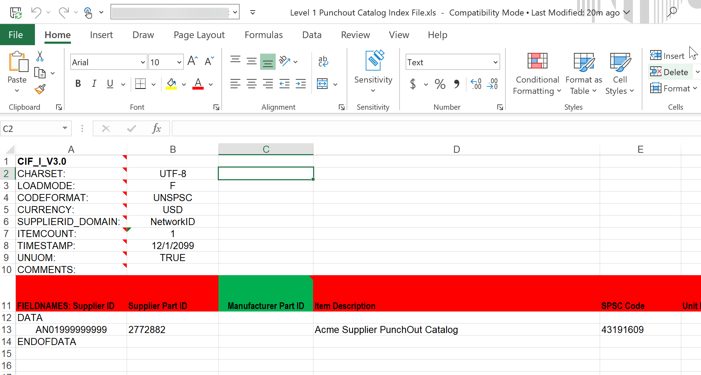
Creating a CIF from an Excel File
Open your Excel Catalog file.

Slide 119
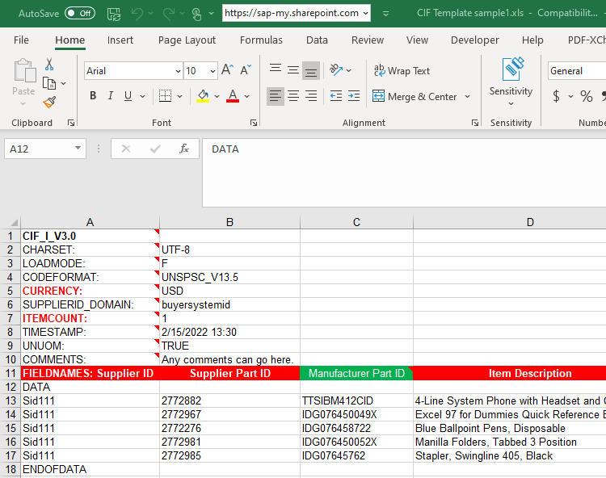
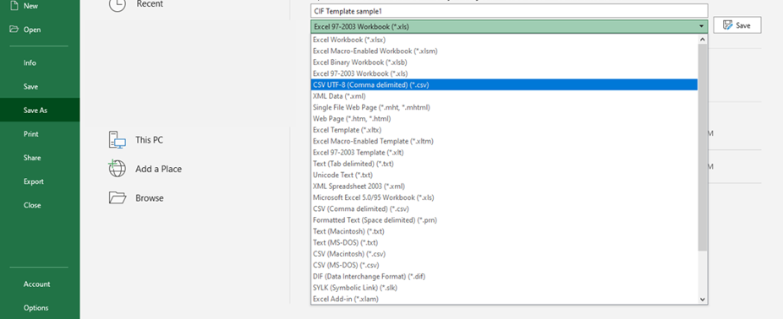
Creating a CIF from an Excel File
Click on the drop down menu and save it as a “.csv” file.

Slide 120
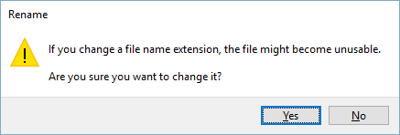
Creating a CIF from an Excel File
You will get a system warning about saving it as a .csv—click “Yes” to continue.
Rename your saved file, by changing the extension to “.cif”.
The system will warn you about changing the extension. Click “Yes” to continue.

Slide 121
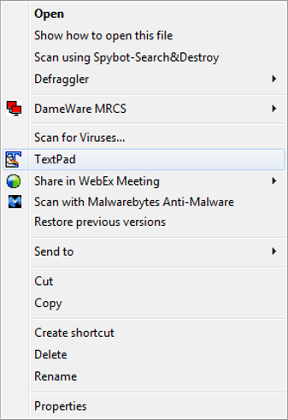
Creating a CIF from an Excel File
Open your CIF Catalog file with Notepad, or your favorite text editor.

Slide 122
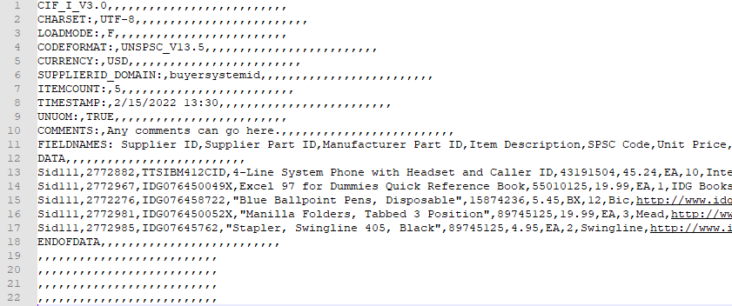
Creating a CIF from an Excel File
Notice that the file has new, added commas in the Header, and after the DATA and ENDOFDATA markers.

Slide 123
Creating a CIF from an Excel File
Remove these extra commas after the Header values and the DATA and ENDOFDATA markers. Be sure to remove any commas in front of the data in the Header as well.
Be careful if you use the “Replace” function—you don’t want to replace any of the commas in the actual Catalog data.

Slide 124
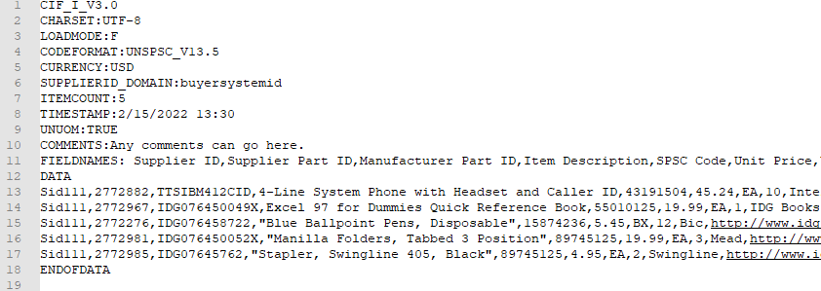
Creating a CIF from an Excel File
Once the commas are deleted, save the CIF Catalog file. It is now ready to be loaded.
Your completed file should look like this.

