Slide 1
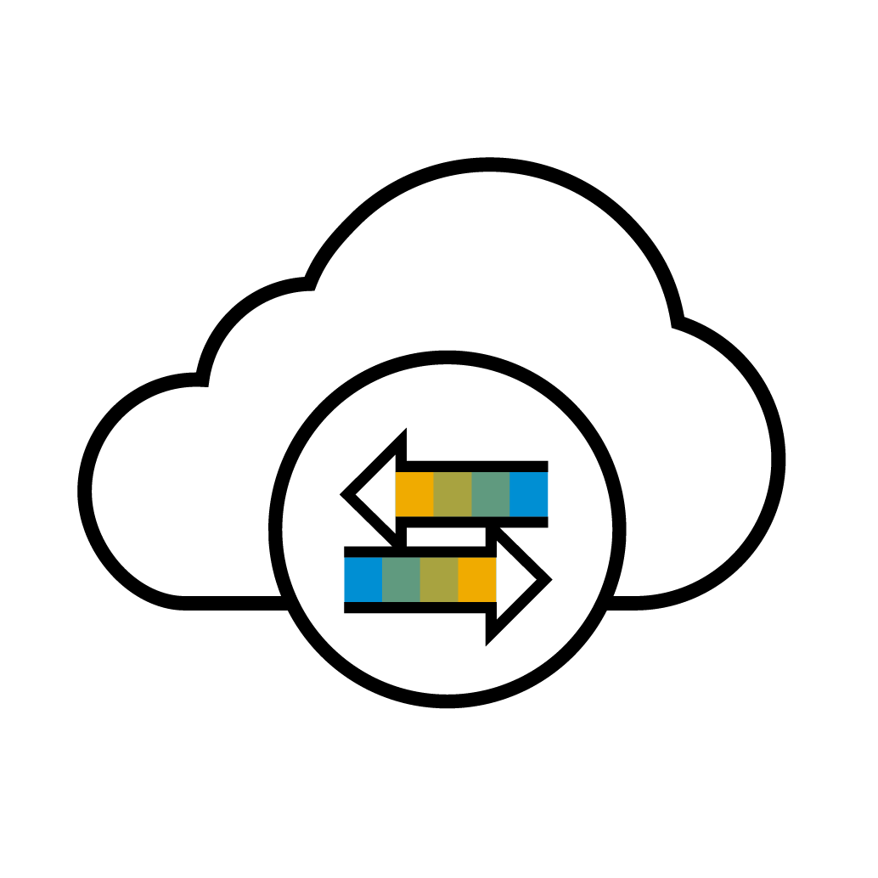
Standard Business Network Cycle
Buyer
Supplier
Notes:
This slide demonstrates a typical procure to pay cycle on SAP Business Network. First, you’ll create your profile on the SAP Business Network through the Trading Relationship Request, sent on behalf of your customer. If in scope, you can also publish catalogs for your customers to place orders through.
After your profile is created, [>] customers can then send purchase orders, which you can access online. From here, you can fulfill the order, create your documents, and send them through the Network back to your customer. Your customer will be able to access the document, advise of status, and finally remit your payment through your normal method.

Slide 2
What is an SAP Business Network, Standard Account?
Basic Account that gives you access to SAP Business Network
Receive interactive email purchase orders
Send electronic documents through SAP Business Network
No fees
Intended for low volume suppliers
Standard Account Management Videos
Notes:
A Standard Account gives you access to SAP Business Network where you can receive interactive email purchase orders and create electronic business documents within seconds. With a Standard Account, you will receive real-time document status notifications and enjoy a single, unified user experience using one account for order fulfillment, selling, and mobile access. Standard Account is perfect for low volume suppliers, and is FREE for all basic transactions.

Slide 3
Standard Account
TRANSACT WITH EASE AND WITHOUT FEES
Designed to make transactions simple, suppliers can stay on top of buyer needs even with limited eCommerce experience.
Standard account is ideal for reviewing and sending documents, publishing electronic catalogs, and more.
FREE FOR ANY SUPPLIER
CENTRALIZED ACCESS
No document related fees or transaction limits
Receive & respond to POs with electronic documents (e.g. Order Confirmations, Ship Notices, Service Sheets or Invoices)
Check document status updates
Manage catalogs
Online portal and supplier mobile app to access all relevant information & documents
Receive real-time notifications from buyers via email and mobile app push notifications
Access other SAP Business Network solutions like Discovery* on one single account
*Although the standard account is free, using additional advanced capabilities and other solutions may incur fees
Notes:
A Standard account is easy to use and gives you centralized access to all relevant documents. The functionality includes online portal access, mobile access, and e-mail notifications. This allows you to easily manage all core documents in one completely digital account.
Standard account is also completely free. There are no document related fees or limits to the number of transactions or relationships you maintain on the network. A Standard account is ideal for suppliers who have low to moderate transactional volume and also those that are new to the network.

Slide 4
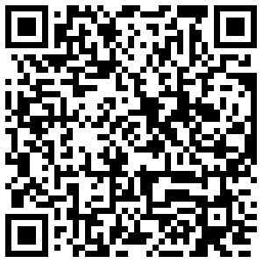
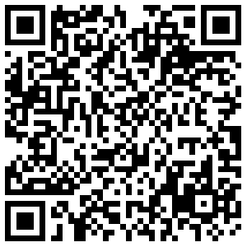
Supplier mobile app
STAY UP-TO-DATE
SAP Business Network Supplier mobile app helps suppliers take their business on-the-go. Regardless of the account type, suppliers can stay connected with their customers on their iPhone or Android devices.
Key mobile app features
Get real-time notifications
Create documents on-the-go
Find documents fast
Improve invoice visibility
App Store
Google Play
With quick and easy biometric login and availability in over 24 languages, the mobile app is the best way to be more responsive and better informed.
LEARN MORE
Notes:
**Optional**
The SAP Business Network Supplier Mobile App gives you access to your account and documents anywhere at anytime all while receiving important alerts for key activities. Just use your smart phone or tablet to stay up to date on business transactions – even when you are out of the office. The mobile app is available instantly through the Apple App Store and also on Google Play for Androids. You can click the learn more button on this slide to be taken to the app download screen.

Slide 5
Enterprise Account
GROW AND AUTOMATE YOUR BUSINESS
For suppliers with more advanced needs, an enterprise account may be a better fit.
Enterprise accounts are paid accounts based on usage.
ADVANCED CAPABILITIES
IDEAL FOR
Automate specific processes with machine-to-machine integration
Priority support, enablement, and educational training courses
Archive invoices
Sales and transaction reporting
Lead generation capabilities
Suppliers who are more experienced with eCommerce
Are looking to grow or strengthen their business on SAP Business Network
Have buyer specific needs that are not supported by standard account
Notes:
Now that we have discussed what a Standard Account is, let’s look at the other account type we offer. An Enterprise account is a great option for suppliers who have higher transaction volume, multiple customer relationships, or simply those who need more automation. Enterprise accounts are paid accounts based on usage.
One of many key features of the Enterprise account is the ability to automate your transacting process. You can do this by integrating your internal ERP system with SAP Business Network. You can also use your Enterprise account to set up electronic catalogs for enhanced PO accuracy. Full reporting is available, and you will also have access to long term invoice arching.
Enterprise accounts also get priority support. They have full access to our customer support team 24/5 and enablement experts will guide you through your onboarding process. Other technical experts are also available to support various processes such as integration or catalogs.

Slide 6
Account Capabilities Comparison
Features | Standard Account | Enterprise Account
Access | Email notifications/workbench | Online dashboard/workbench
Company Profile |  | 
Purchase Order, Order confirmation (full & partial), Ship Notice, Service Entry Sheet, (Non-PO) Invoice, Credit Memo |  | 
Electronic Catalogs |  Self-service only | 
Document status | Email notifications/workbench | Workbench with easy access from any browser Topical tabs
Legal Archive | Email notification and online download | Long-term archiving for global compliance (Regional restrictions apply) Capability to mass download invoices for local archiving
Support | Online Help Center Documentation Training videos User recommendations or tips | Support via phone, chat, or email Direct access to enablement experts for onboarding assistance Technical support for configuration and integration assistance Online educational training courses
Integration |  | 
Reporting |  | 
Multiple customer relationships |  | 
Multi users |  | 
Mobile App |  | 
Discovery |  Fees may apply to respond to leads. Click here for more information. |  Fees may apply to respond to leads. Click here for more information.
Fees | FREE | Fees may apply, See complete details.
Notes:
The image on your screen now shows a side by side comparison of a Standard Account and an Enterprise Account. Both account types include using the workbench to manage documents, and both allow for multiple users and customer relationships. You will also be able to access the mobile app regardless of what account type you have.
It is important to note that an Enterprise account will give you access to long-term invoice archiving, reporting, integration protocols for a more automated user experience, and 24/5 global support.

Slide 7
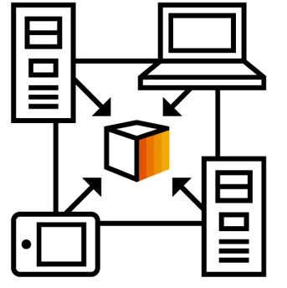
Already have an Enterprise Account?
Manage two separate Accounts Create a new Standard Account for this relationship once you receive the first PO The relationship with your customer will remain free of charge.
Add Customer to your Enterprise Account Log in to your Enterprise Account once you receive the first PO of your customer Adding the customer to your existing Enterprise Account may incur fees.
7
Notes:
If you already have an Enterprise account, you have two options. You can manage your existing Enterprise account separately from your new Standard Account. You can also choose to add the standard account relationship to your existing Enterprise account. A standard account is free so please note that if you do merge the standard relationship into your existing Enterprise account, you may have additional fees based on usage.
If you would like to merge the standard relationship into your existing Enterprise account, you will simply click the Process Order button within your first interactive purchase order email. You will then click Log In and enter your account admin’s credentials. After you hit ok, the trading relationship will be established within your Enterprise account, and any existing customer POs will be merged over.

Slide 8
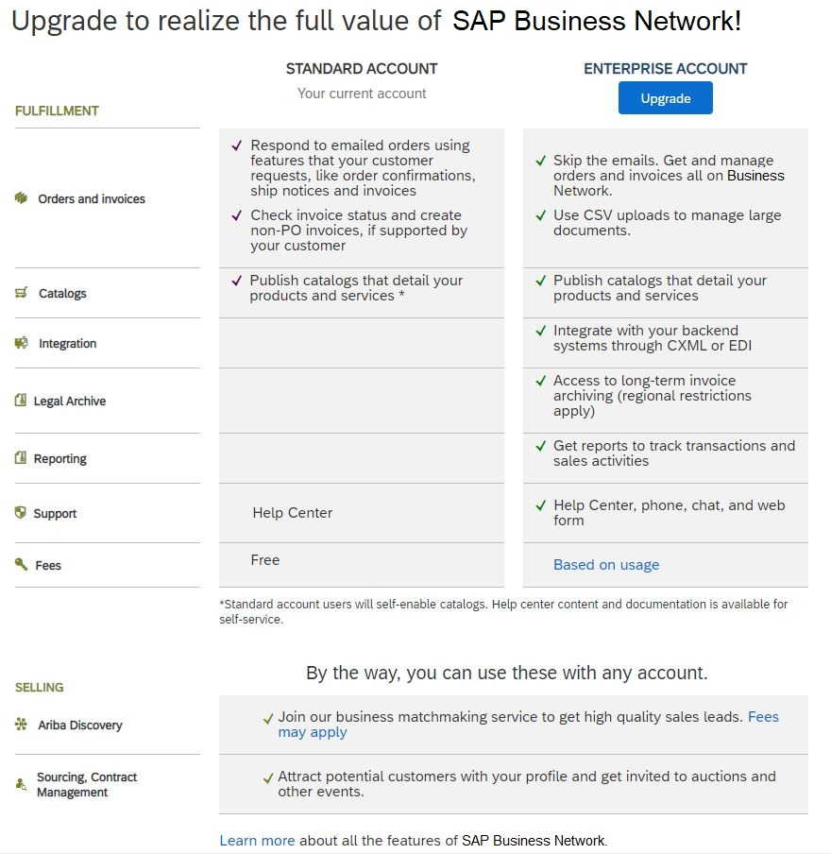
How to upgrade from Standard Account to Enterprise Account
Notes:
If you start transacting from a Standard account and later decide you would like an Enterprise account, you can upgrade at any time in just a few clicks.
Start by clicking on the “Get Enterprise Account” button at the top of your Standard account home page. When you click this button, you will be taken to a new page where you can review the differences between both types of accounts. It is important to note if you do decide to upgrade, you may be subject to fees based on usage. If you would like to learn more about SAP Business Network fees, simply click on the “based on usage” hyperlink under the Enterprise account to learn more. If you accept the terms of use, you will now have an Enterprise account.

Slide 9
Configure Email Notifications Purchase Orders & Invoices
Review how to configure email notifications for Purchase Orders & Invoices
Notes:
**PO/INV Projects**
***Placeholder slide to be deleted before uploaded to ON24 – only for supplier PDF version***

Slide 10
Configure Remittance Information
Review how to configure your remittance information
Notes:
**Only used if Remittance is required by buyer**
***Placeholder slide to be deleted before uploaded to ON24 – only for supplier PDF version***

Slide 11
Contact & Support
Business Related Questions
SupplierEnablement@T-Mobile.com
SAP Business Network Related Questions
Help Center – access via account or click here
Standard Account Specific Documentation
SAP Business Network Supplier Training Page
Supplier Information Portal
https://support.ariba.com/item/view/206290
Notes:
Now that we’ve discussed next steps and seen a system demonstration, let’s discuss the different support options available to you. You can always reach out to your customer with any questions at <<buyer email>>.
We also have a few different online support resources available. You can check out our help center which will provide you access to product documentation and best practices. Our standard account support page summarizes standard account features, upgrade details, and has demo videos for your review. If you require additional training materials or information, you can visit our SAP Business Network Supplier Training Page as well.
**DELETE IF SIP ISN’T LINKED** If you would like to view Hp Inc.’s best practices, you can visit their Supplier Information Portal via the link shown on this slide.

