Slide 1
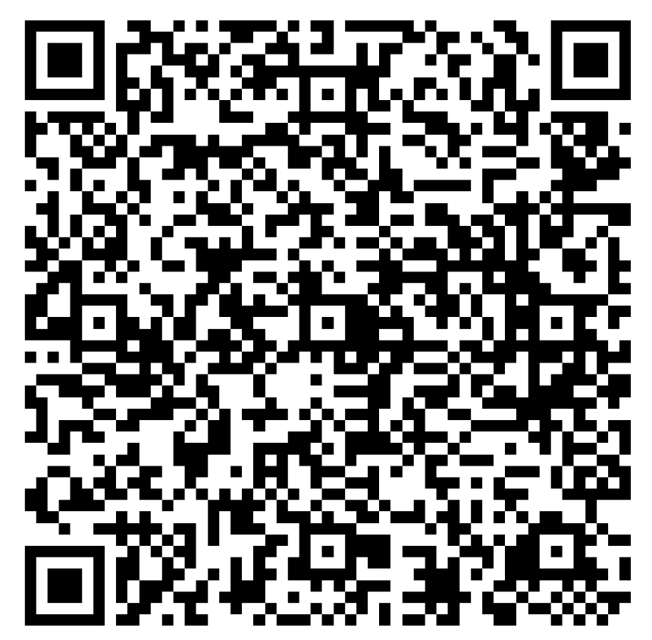
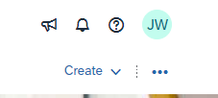
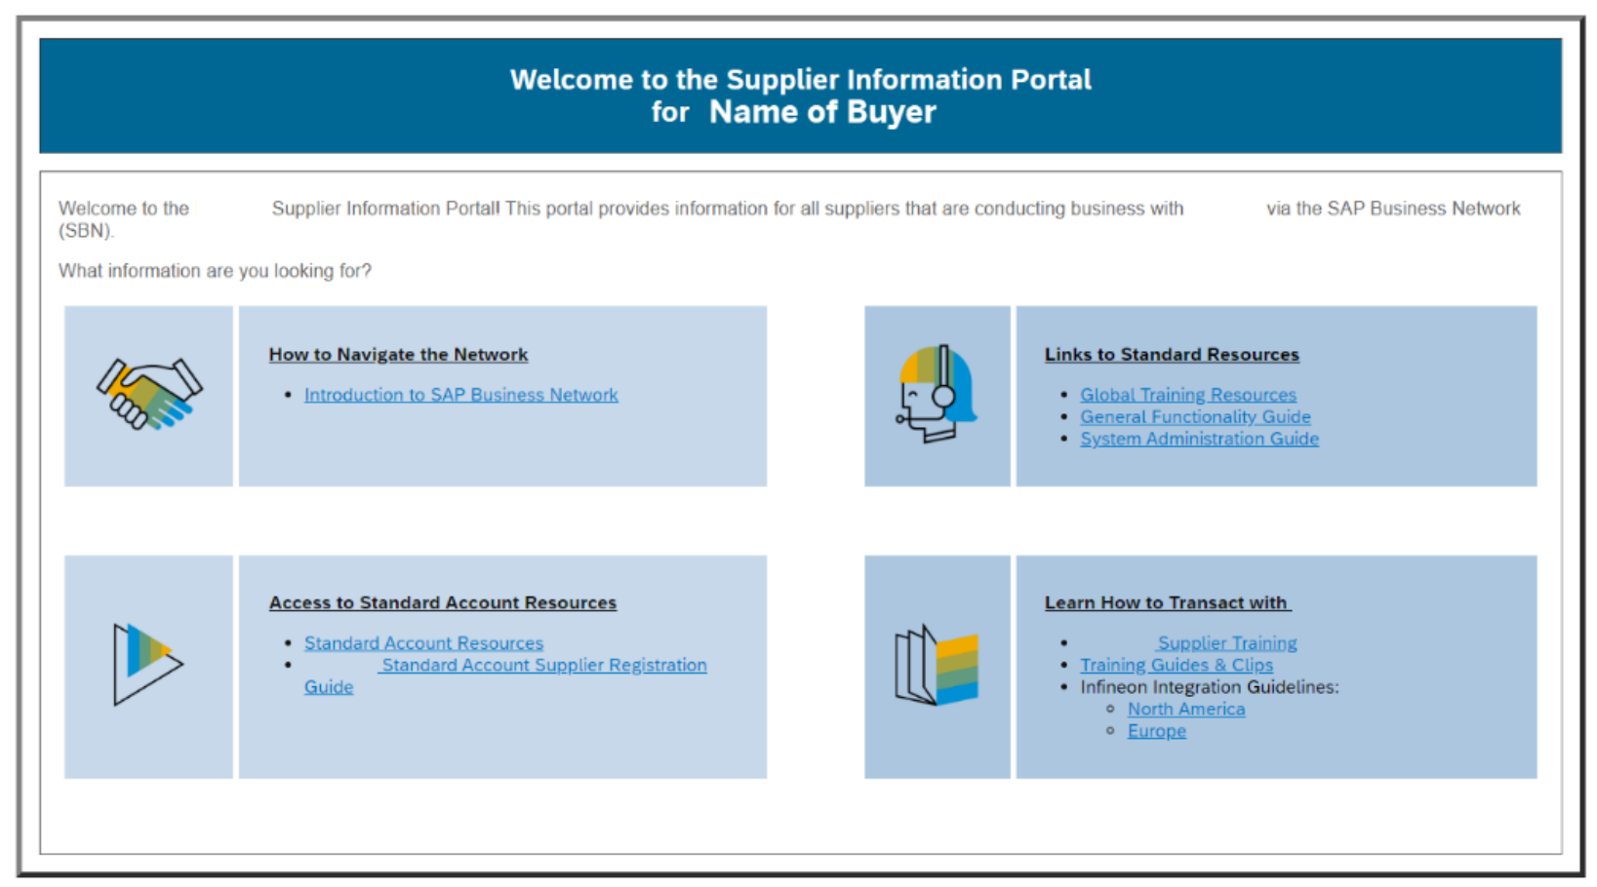
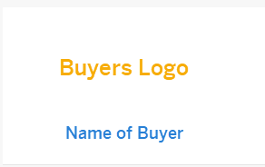
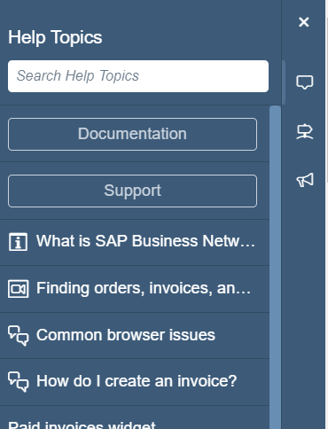
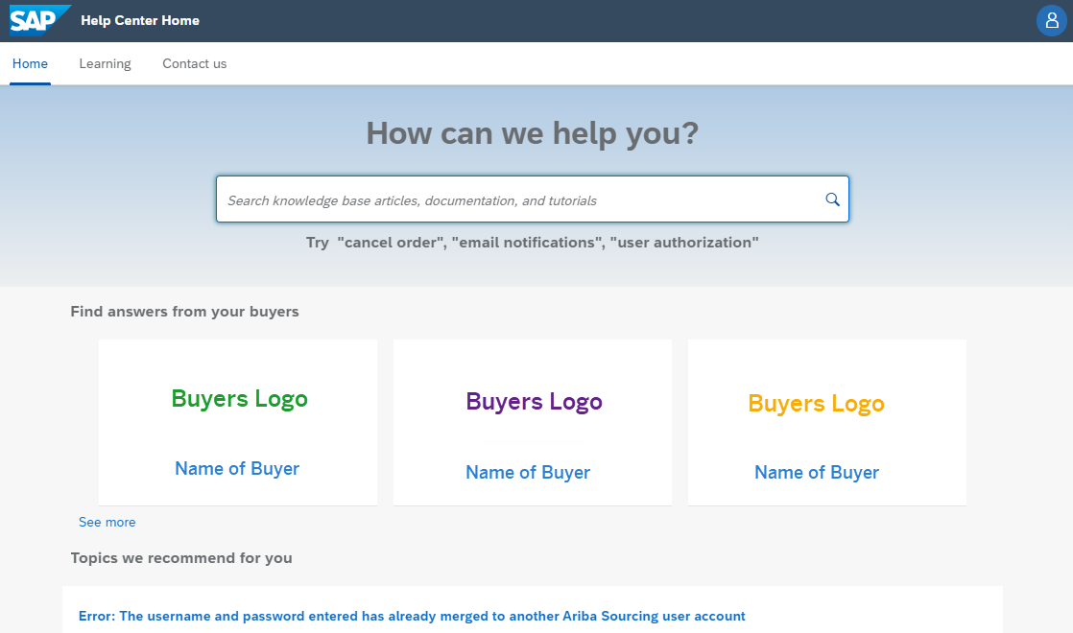
Anonymous 5-question Survey QR code or Click Me
SAP Business Network – Accessing Buyer Supplier Information Portal/s
Step 1: Click on the Question Mark next to your initials
Step 4: Click on the required Buyer tile
Step 5: The SIP is shown, locate the information required and access it
Step 2: Select Support
Step 3 : The Help Centre screen is shown, and all Buyers that are transacting with you on this ANID are displayed
Note: The content held in the SIP may differ regionally and may contain different information based on the requirement of the Buyer
Supplier Information Portal = SIP
Buyer-Supplier Information Portals (SIPs) can only be seen after logging in as it accesses the portals based on the Buyer Relationships you have on the account.
Buyers will have content specific to transacting with Suppliers using the SAP Business Network. The Project Notification Letter and the Summit clip will usually be accessible via the Buyers Supplier Information Portal
The content on the SIP can be generic or specific relating to the processes the Buyer uses to transact with their Buyer.
Use “See More” if the Buyer SIP you are looking for is not displayed
If a Buyer is not displayed the information may be linked to a different user ANID
2024 SAP SE or an SAP affiliate company. All rights reserved.
Version 1

