Slide 1
Guided Sourcing for SAP Ariba Sourcing Toolkit / Transition Deck

Slide 2
Toolkit Objective and Mission
Guided Sourcing Capability Overview
The objective of this toolkit and transition deck is to provide SAP Ariba Sourcing customers with the pertinent information to enable and adopt the guided sourcing capability through a persona based lens. This deck is designed for self-service and to act as a resource in a customers transition and adoption journey.

Slide 3
Content Menu
Guided Sourcing Capability Overview
CPO Persona
Guided Sourcing Essentials
Guided Sourcing Overview
Guided Sourcing Value
Enabling Guided Sourcing
Admin User Persona
How to enable Guided Sourcing
What to do if Guided Sourcing is already enabled
How to setup Guided Sourcing Templates
Guided Sourcing Changes
Guided Sourcing User Persona
Team Member Persona
Supplier User Persona
What has changed in Guided Sourcing
Guided Sourcing Integration & Roadmap
Guided Sourcing Integration
Guided Sourcing Roadmap

Slide 4
Guided Sourcing Capability Personas
Team &
Evaluators
CPO
Admins
Sourcing User
Suppliers

Slide 5
Guided Sourcing Personas & Changes CPO
What Has Changed
The new For You dashboard is available
Enhanced in-system approvals
In-app document preview is now available
What Has Not Changed
Email approvals remain in the system
Email notifications will remain the same
System generated reports remain the same
Need to Know
Guided Sourcing Capability is the next-gen user interface that provides a streamlined and intuitive user experience for managing strategic sourcing processes and RFx events.
Features are being continuously delivered into Guided Sourcing since Nov. 2020
Innovations are only delivered into Guided Sourcing
Guided Sourcing Capability is not a 1:1 copy of SAP Ariba Sourcing. The long-run growth of it is influenced and driven by our innovation themes for Guided Sourcing
No cost to adopt, available as part of SAP Ariba Sourcing solution
Sourcing Events created before the Guided Sourcing Move will have the option to continue that event in the Classic Sourcing UI. All new Sourcing Projects & Events will be created via Guided Sourcing

Slide 6
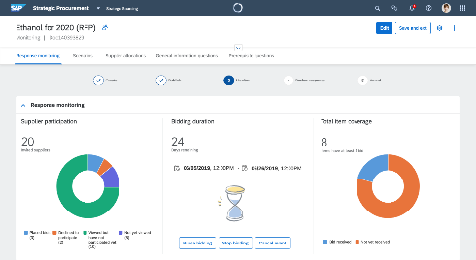
Guided Sourcing Overview
New functionalities:
Intelligent recommendations on content and suppliers via AI/ML
Single-page event creation and single-page project management
Autonomous procurement features like Smart Excel Import to automate RFx event creation
On-screen messaging capabilities within projects and events
Multi-round bidding to facilitate the process from a long list to Best And Final Offer
Pre-Award Contract Negotiation
WalkMe – AI powered guidance and automation
Advanced Bid Analysis engine
Advanced Category planning with Category Management Integration

Slide 7
Guided Sourcing Realize the Value
Price Reduction
Bottom-line results – Help achieve savings of up to 9.7%*
Increase spend under management & savings opportunities
Lower total cost of ownership – Software-as-a-service delivery with faster time to value and faster innovation
50% improvement in time to create an event
Create sustainable organizational knowledge using analytics for in-context intelligence
Improved usability
Rapid event creation, enhanced search, and contextual help
Faster Execution
50% improvement in time to create a Sourcing event
Guided Sourcing Benefits
Intuitive User Interface
Faster adoption and increased user satisfaction
Project & Event Management
Intuitive management of the Strategic Sourcing and RFx event process
*Source: SAP Ariba Benchmark Data

Slide 8
Guided Sourcing Personas & Changes Sourcing Administrator
What Has Changed
New Sourcing Templates need to be managed
Additional parameters available compared to classic sourcing
SAP Enable Now
SAP WalkMe
Pre-Award Negotiation
Guided Sourcing AI/ML maintenance
Guided Sourcing Integration with other systems will need to be reviewed
Sourcing Project and Event layout and functionality has changed
What Has Not Changed
Master Data management remains the same
Users/groups
Material Master
All other sourcing master data
Team helper rule file remains the same
Custom fields/enumerations management remains the same
Template conditions remain the same
Approval management remains the same

Slide 9
Enable Guided Sourcing

Slide 10
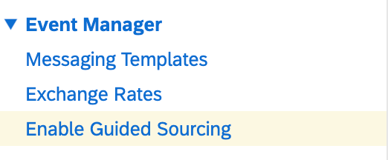
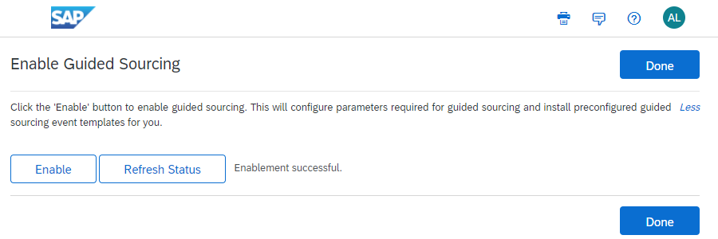
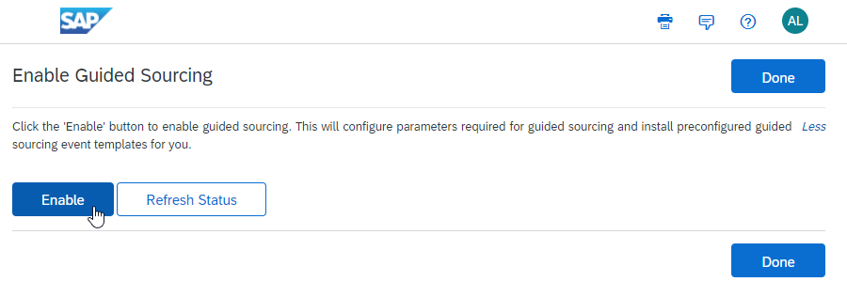
How to enable Guided Sourcing
Guided Sourcing can be enabled in your site without the need of SAP support or a support ticket - Customer Administrator access is required
Step 1: Click Manage > Administration > Event Manager > Enable Guided Sourcing
Step 3: The Task will automatically run and enable Guided Sourcing and out-of-the-box Guided Sourcing templates. After a few minutes, you will see an Enablement Successful next to the Refresh Status button.
Step 2: Click the Enable button
Step 4: Once Guided Sourcing is enabled you are required to setup Guided Sourcing Event & Project templates.
View the complete documentation on how to Enable Guided Sourcing

Slide 11
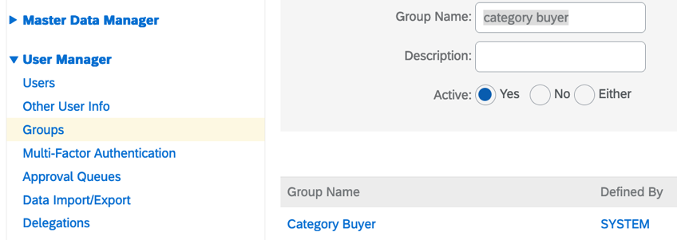
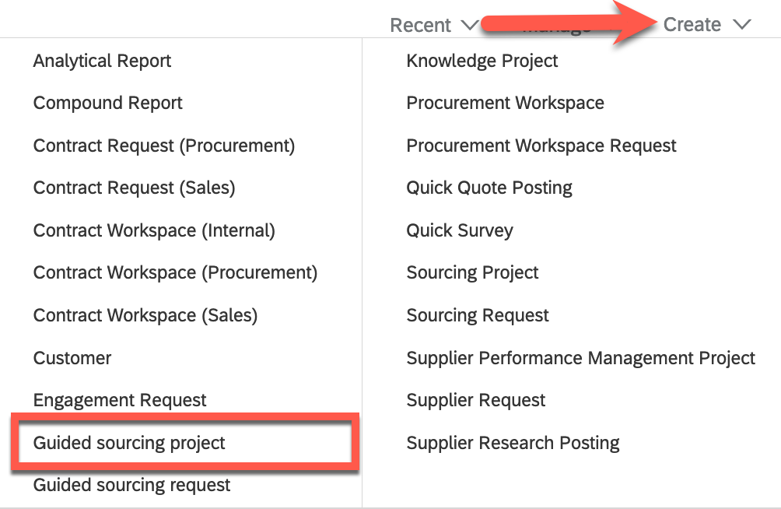
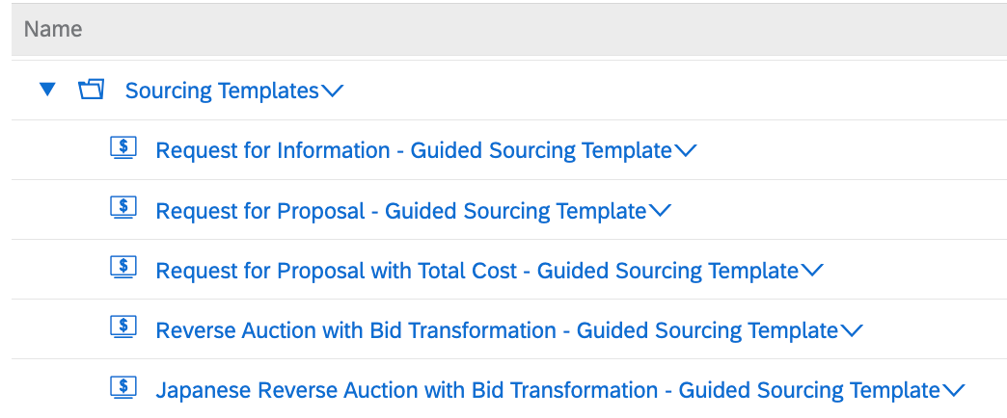
What to do if Guided Sourcing is already enabled?
Guided Sourcing may already be enabled in your site therefore, review the following steps to assign groups and update templates - Customer Administrator Access is required
Step 1: Assign the “Category Buyer” group to the Sourcing Users
Step 2: Ensure the Sourcing Project / Event templates are setup accordingly - template setup instructions are further in the deck
Step 3: To validate if access to Guided Sourcing is enabled, from the Home-page click Create and Guided Sourcing Request and Guided Sourcing Project options should be visible

Slide 12
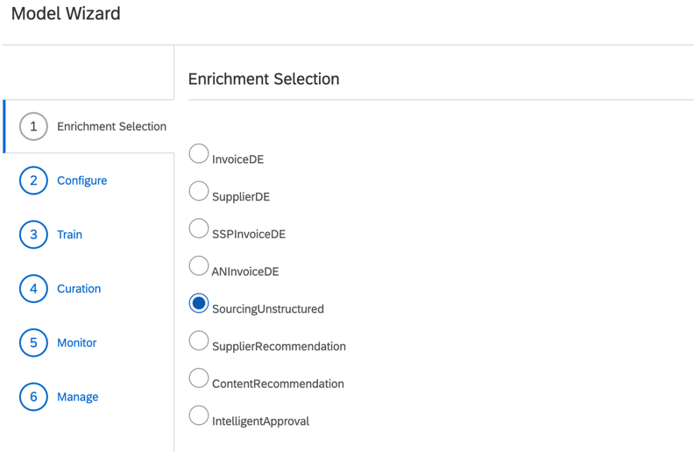
How to enable Guided Sourcing AI/ML recommendation Engine
Guided Sourcing may already be enabled in your site therefore, review the following steps to enable Machine Learning and AI features - Customer Administrator Access is required
Step 1: Enable two parameters via Intelligent Configuration Manager (within Sourcing and Contracts menu -> Parameters):
Enable GuidedSourcing.ContentRecommendations.Enabled
Enable GuidedSourcing.SupplierRecommendations.Enabled
Step 2: Execute steps as per Enablement of ML-powered Features - Video Guide
Details available also in SAP documentation
Configuration of Recommendations for Suppliers and Content in Guided Sourcing (SAP Help)
Enabling Smart Import and Intelligent Supplier Recommendations

Slide 13
Template Management

Slide 14
How to Create Guided Sourcing Templates
Guided Sourcing requires updated and / or edits to existing templates to reflect the sourcing process
Each event template now has a “Guided Sourcing Template” radio-button that defines the template as a guided sourcing specific template
There are 3 options to create Guided Sourcing Templates:
Option 1: Leverage the system generated Guided Sourcing templates, ensure the-out of the box templates are adopted as a basis for your templates
Option 2: Use your existing template setup process in Classic Sourcing, copy the existing templates and convert to a Guided Sourcing template
Option 3: Convert all your Classic Sourcing event templates by running the scheduled task ConvertToGuidedSourcingTemplateTask.
(As a “Customer Administrator” you can navigate to Manage->Administration->Site Manager->Scheduled Tasks. Search for the above task and Run it.)
The recommended approach is to copy each desired template instead of editing the existing out-of the box templates –
Applicable to both Classic and Guided Sourcing templates.
If you have multiple event templates and you want to convert all of them, follow the option 3.
Once templates are copied ensure the radio-button is set to Guided Sourcing Template = Yes
How to convert classic event template into a Guided Sourcing event template

Slide 15
Guided Sourcing Personas & Changes Sourcing User
What Has Changed
New Guided Sourcing Project & Event UI
The new For You dashboard is available
In system approval UI has changed
In-app document preview now available
Sourcing event content and line items have been split into 2 sections
Multi-round events
Supplier & Content recommendations
Messaging app has been added to communicate with users
SAP Companion to assist with learning
Pre-Award Contract Negotiation
WalkMe – AI powered guidance and automation
Integration with Supplier Risk*
Integration with SAP Category Management*
What Has Not Changed
Email approvals remain the system
Email notifications will remain the same
System generated reports remain the same
Your sourcing process will remain the same (if template are migrated like for like)
Guided Sourcing End-to-End Overview
*Supplier Risk and SAP Category Management require separate licenses

Slide 16
What’s Changed With Guided Sourcing? Single Page Event Creation
Benefits
Improved usability – event creation is visible on a single page
Time reduction – almost 50% improvement in time to create an event compared to current Classic Sourcing UX
Intuitive user interface for faster adoption
Watch this video to learn about Guided Sourcing Single Page Event Creation

Slide 17
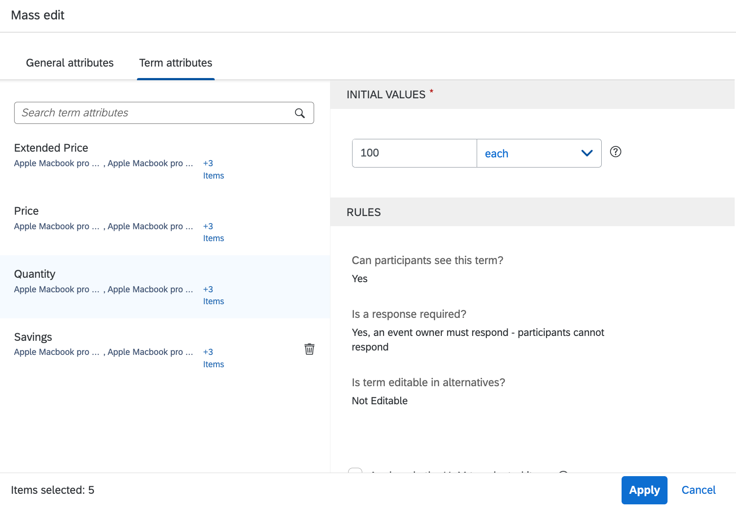
What’s Changed With Guided Sourcing? Enhanced Item Management
Benefits
Enhanced search capabilities
Bulk edit capabilities reduces the need to export data to excel to make changes
Reduced scrolling when in Full Screen mode resulting in less ‘clicks’
Watch this video to learn about Guided Sourcing Enhanced Item Management

Slide 18
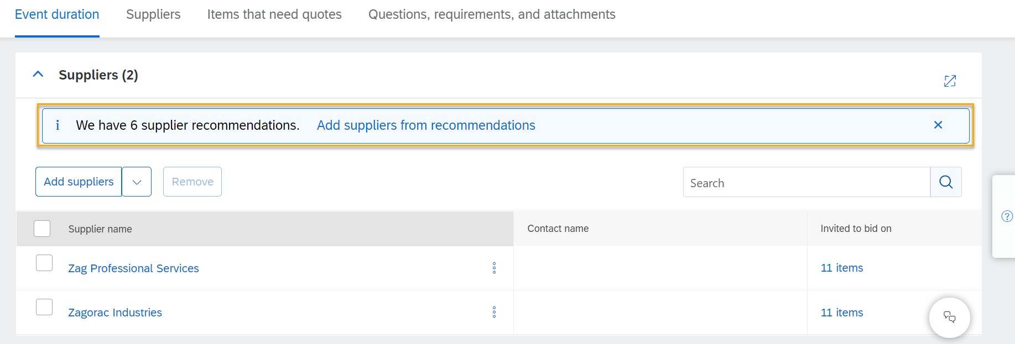
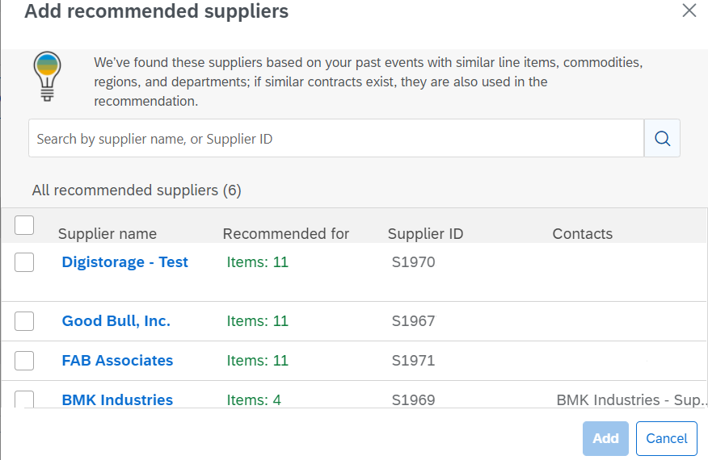
Benefits
Guided Sourcing allows users to efficiently add suppliers to the sourcing events
Machine learning intelligently suggests suppliers to add to the event by learning your organization's sourcing event tendencies including commonly sourced goods and previously selected suppliers – Capability does not eliminate or affect the current ‘traditional’ method of adding suppliers
Reduction in time searching for suppliers
What’s Changed With Guided Sourcing? Intelligent Supplier Recommandation & Supplier Information
Watch this video to learn about Intelligent Supplier Recommendations

Slide 19
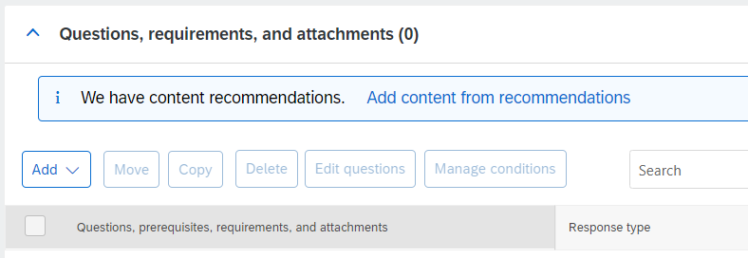
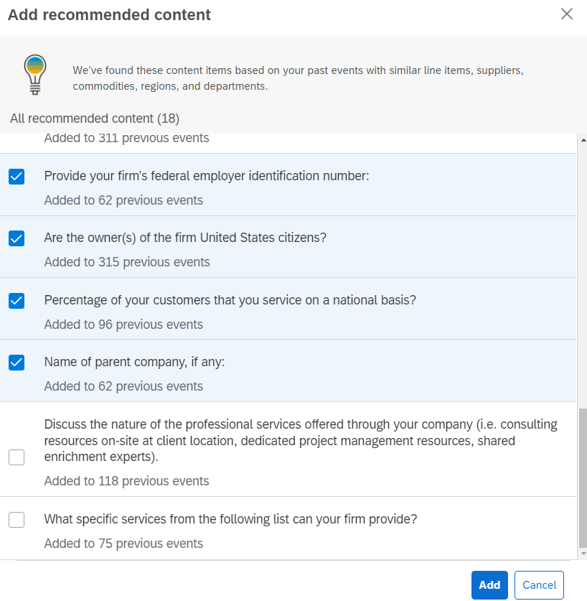
Benefits
Similar with recommendations on suppliers, system is able to actively suggest also content
Guided Sourcing can recommend the inclusion of questions / content in the Sourcing Event based on event items and suppliers from similar and / or past events.
Intelligent recommendations can be based on item names, event names, department, commodity, region, invited suppliers
What’s Changed With Guided Sourcing? Intelligent Content Recommandations
Watch this video to learn about Intelligent Content Recommendations

Slide 20
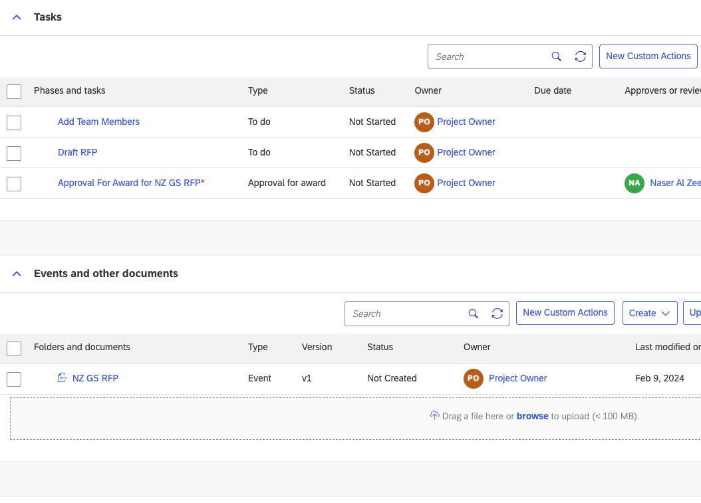
Benefits
Improves workflow efficiency and user experience by providing convenient access to specific actions
Defining the placement and appearance of the custom actions menu allows for a customized navigation experience
Integration of internal and external application URLs streamlines workflow management by directly linking users to relevant tools or resources
What’s Changed With Guided Sourcing? Custom Actions Menu
Learn how to configure Custom Actions Menu in Guided Sourcing Full Project Templates

Slide 21
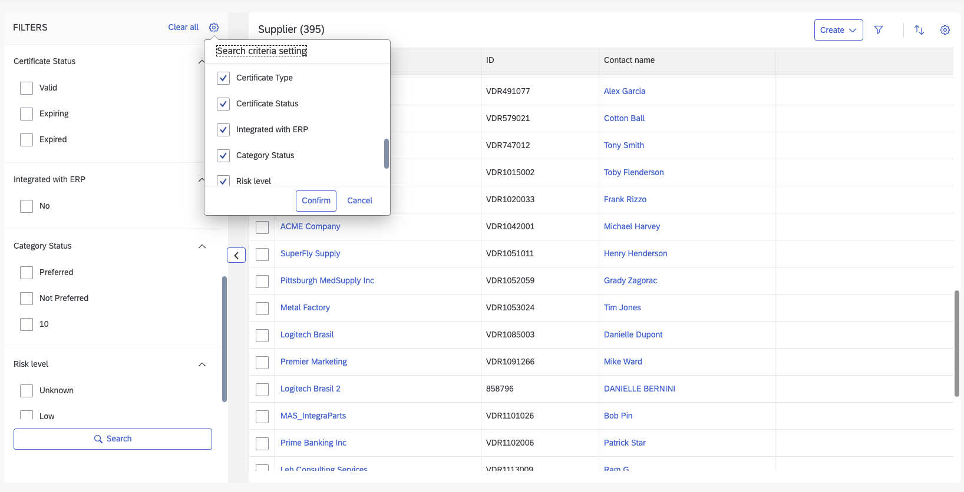
Benefits
Integration of custom filters from SAP Ariba Supplier Lifecycle and Performance enhances search and filtering capabilities in guided sourcing.
Various filter types are supported, catering to a wide range of data types and criteria, offering flexibility in filtering options.
Users can activate and prioritize search filters seamlessly, ensuring a tailored and efficient filtering experience within guided sourcing events.
What’s Changed With Guided Sourcing? Custom Supplier Search Filters
Custom Filters from SAP Ariba Supplier Lifecycle and Performance in Guided Sourcing

Slide 22
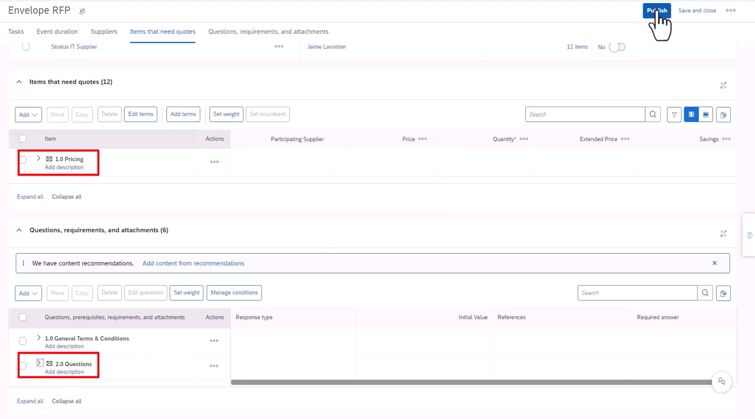
Benefits
Authorize certain Teams to Open Envelopes, ability to keep the Rejected Envelope Bid
Allow Rejected Envelope Bids to Be Opened
Prevent opening the last envelope until consensus grades are submitted for previous envelopes
Allow terms of an item to be in separate envelopes
Send Notifications to project team members when they can open their assigned envelope
What’s Changed With Guided Sourcing? Enhanced Envelope Bidding
Documentation on Envelope Bidding in Guided Sourcing Events

Slide 23
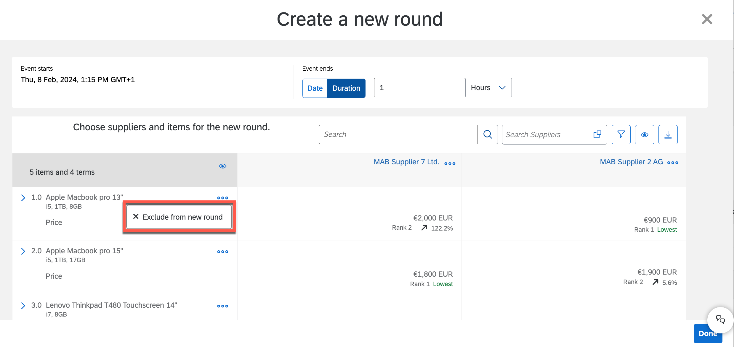
Benefits
Run multiple rounds of the same event to receive the best prices from suppliers
Add and exclude suppliers and items between rounds
New configurable bid comparison report
What’s Changed With Guided Sourcing? Multi-Round Events
Watch this video to learn about Multi-Round Bidding in Guided Sourcing

Slide 24
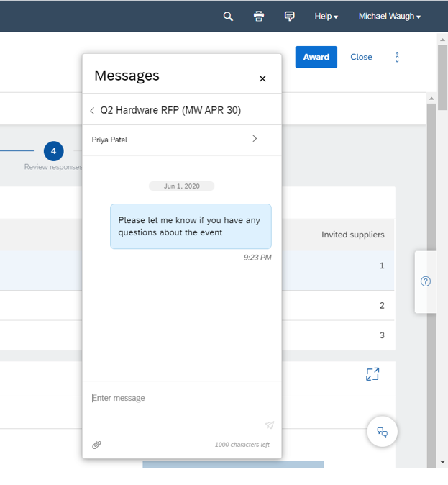
Benefits
Event level messaging functionality
Collaborate with both internal and external stakeholders
Supports attachments
Messages can be responded to from Ariba or via email
Leave notes for team members when working collaboratively
What’s Changed With Guided Sourcing? Collaboration and Messaging
Watch this video to learn about Messaging in Guided Sourcing

Slide 25
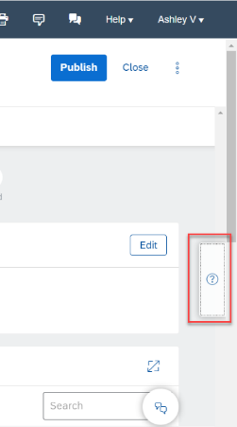
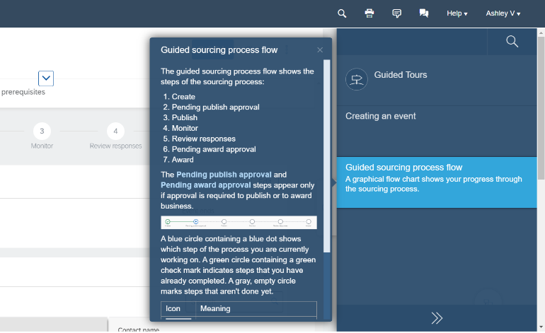
Benefits
Guided Tours walk the user through process flows for key tasks within a screen
Contextual help tiles provide users with information about capabilities, based on the particular screen
Less time looking for documentation and more time creating events
What’s Changed With Guided Sourcing? Support – SAP Companion (Enable Now)
The help button that triggers the Web assistant
Watch this video to learn about Enable Now for End Users
Watch this video to learn about Enable Now Admins

Slide 26
What’s Changed With Guided Sourcing? Pre-Award Negotiation
Benefits
Engage and negotiate contractual terms in a guided sourcing project
Create baseline and supplier contracts in a guided sourcing event
Suppliers can download the contract before submitting their response
View product documentation on Pre-Award Negotiation in Guided Sourcing
*for customers who also have SAP Ariba Contract Management licensed and implemented

Slide 27
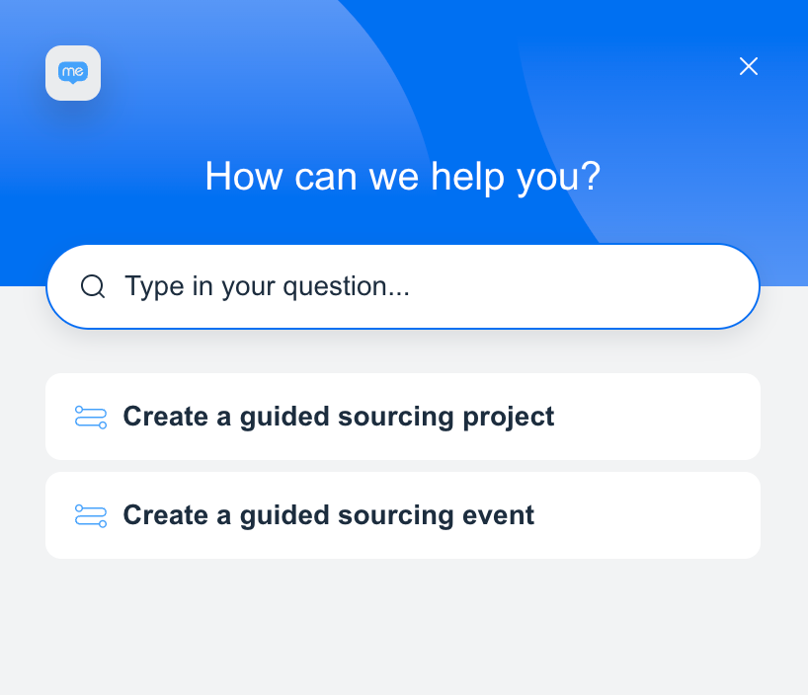
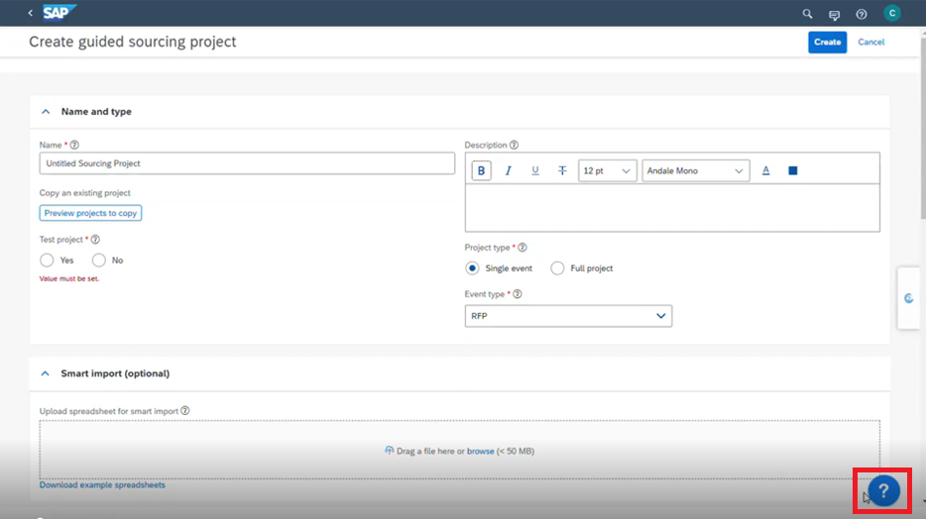
What’s Changed With Guided Sourcing? WalkMe – AI powered guidance and automation
Benefits
Easy-to-understand guidance powered by WalkMe.
Accelerate user adoption
Boost productivity
Maximize value
This button triggers WalkMe
View product documentation on WalkMe in Guided Sourcing

Slide 28
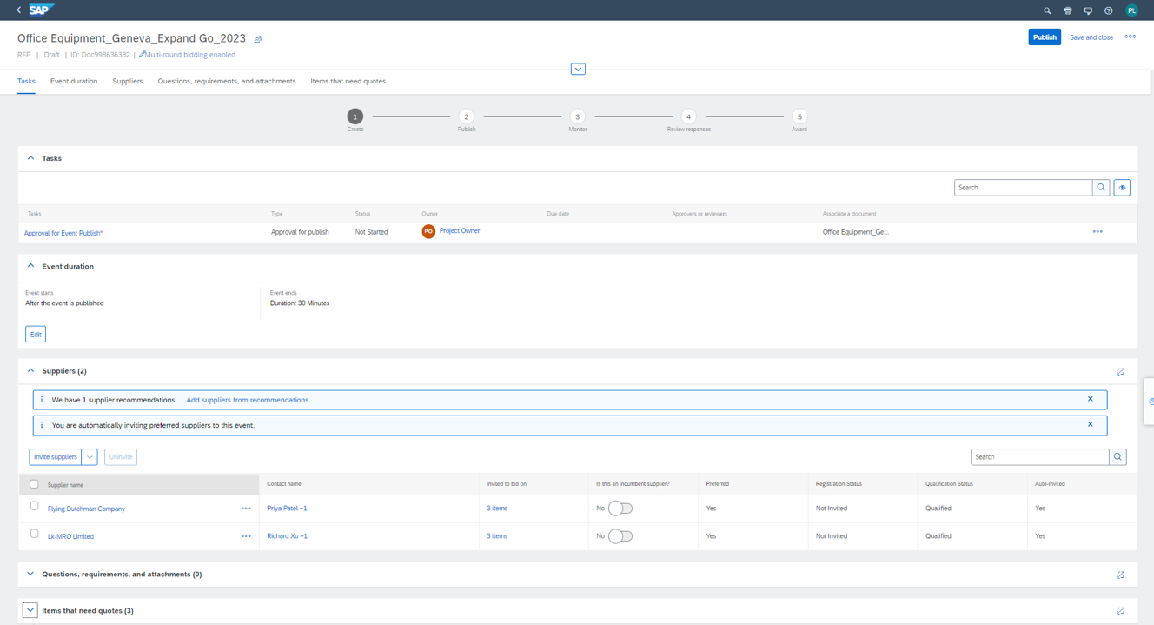
What’s Changed With Guided Sourcing? Auto invite preferred suppliers*
Benefits
Leverage the benefits of SAP Ariba Supplier Lifecycle Management / Strategic Sourcing Suite
Expedite the tender creation process
Watch this video to learn about automatically inviting Preferred Suppliers
*for customers who also have SAP Ariba Supplier Lifecycle Management licensed and implemented the preferred supplier setting

Slide 29
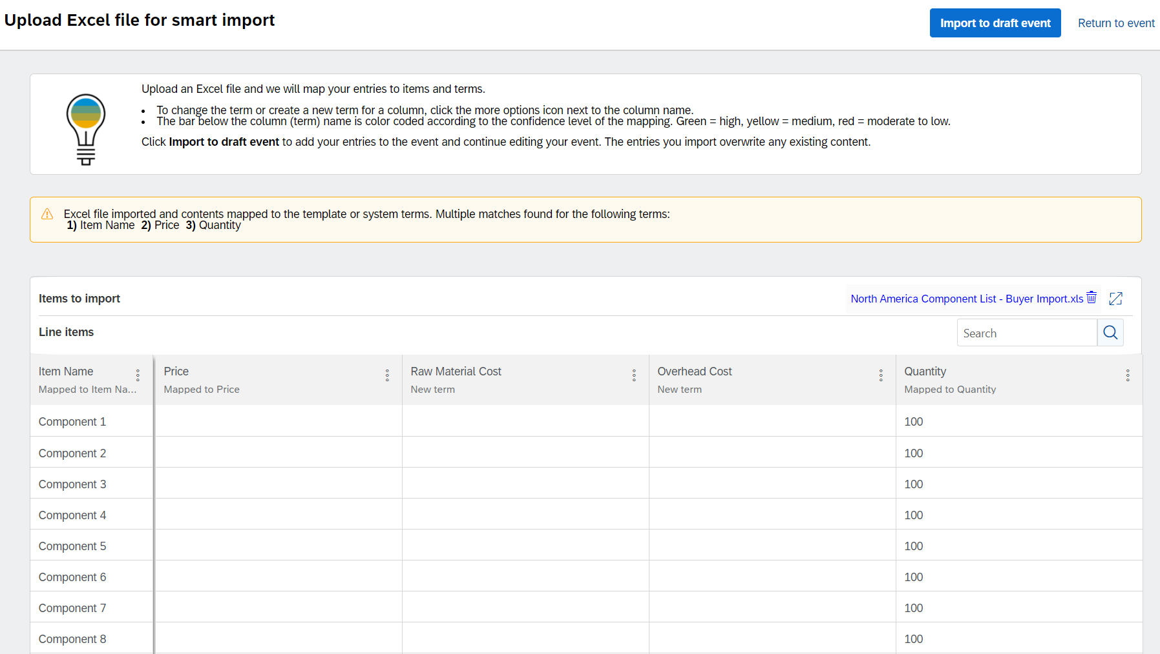
What’s Changed With Guided Sourcing? Smart Excel Import
Benefits
Speed up event creation by using your own Excel-based bid sheet to create line items
Guided Sourcing interprets the data from unstructured Excel and maps to global or template items and item terms
AI-suggested mappings can be reviewed and revised by user
Watch this video to learn about Smart Import from Excel

Slide 30
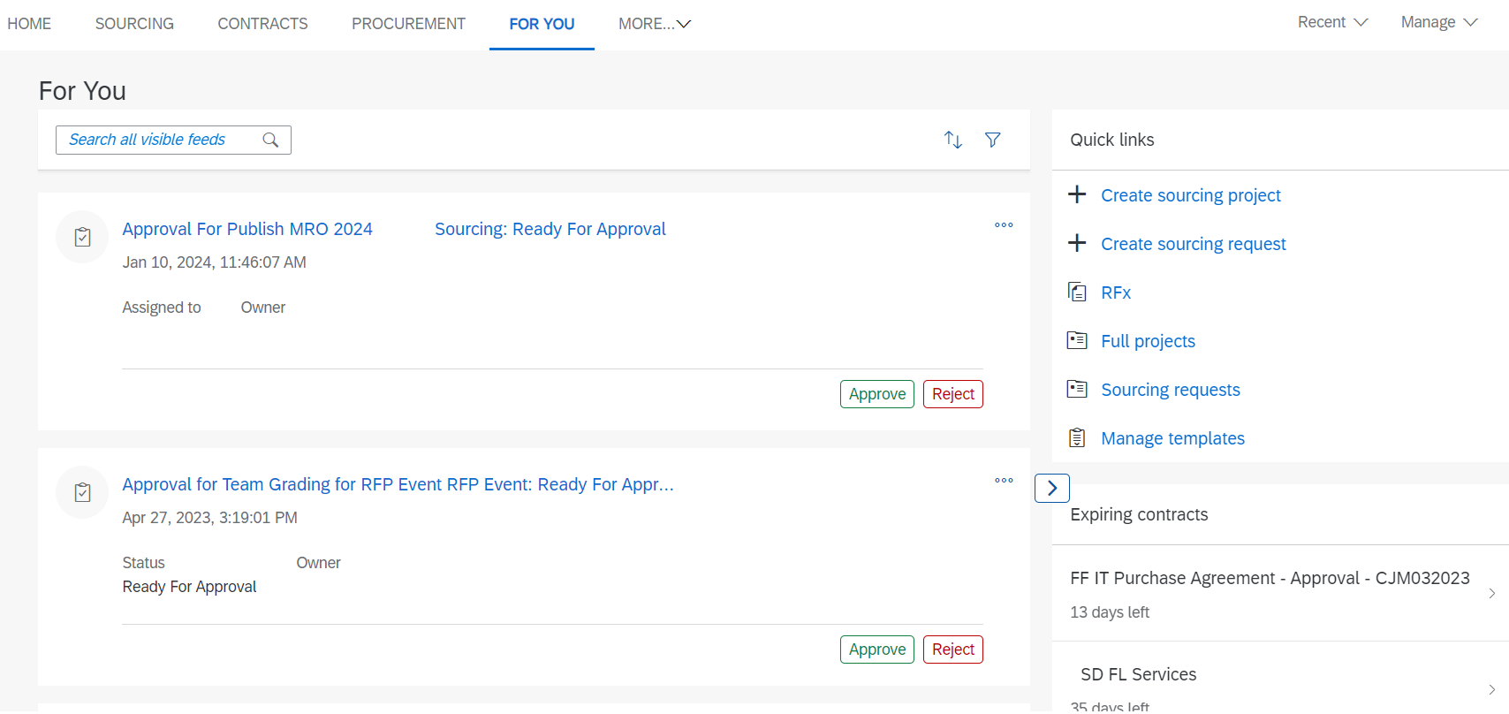
What’s Changed With Guided Sourcing? ‘For You’ dashboard
Benefits
Efficiently view Sourcing activity throughout the organization
Approvers can approve or reject directly from the ‘For You’ tab or click into the project for more information
Initiate project searches, new Sourcing Requests or kick off a new project from the ‘For You’ tab
Watch this video to learn about the new ‘For You’ tab in Guided Sourcing

Slide 31
What’s Changed With Guided Sourcing? Process and Project Insights in Full Project
Benefits
The Process panel provides a simple visual way to track the progress of a project
Project Insights provides a visual summary of the status of different project components, such as event or associated contract.
Customizable by administrator on a template level
Documentation on Guided Sourcing Full Project Process Panel
Documentation on Guided Sourcing Insight Tiles

Slide 32
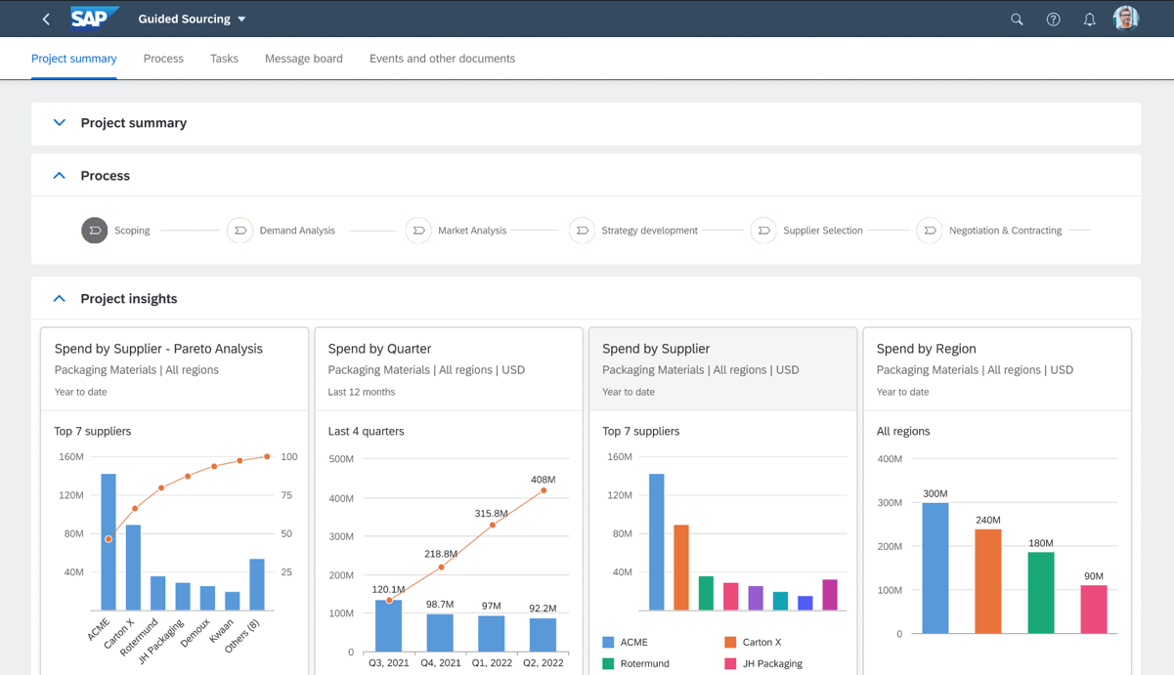
What’s Changed With Guided Sourcing? Category Management Integration
Benefits
Automated Category Spend Profile
Guided process for Strategy and Plan Development
Monitor Strategy Execution
Integration to Guided Sourcing: Ability to trigger projects from category management initiatives
Prerequisites:
License
Customer must be hosted in a EU or US Datacentre
Available now for EU + US Datacenter *subject to license
Watch this video to learn about Category Management

Slide 33
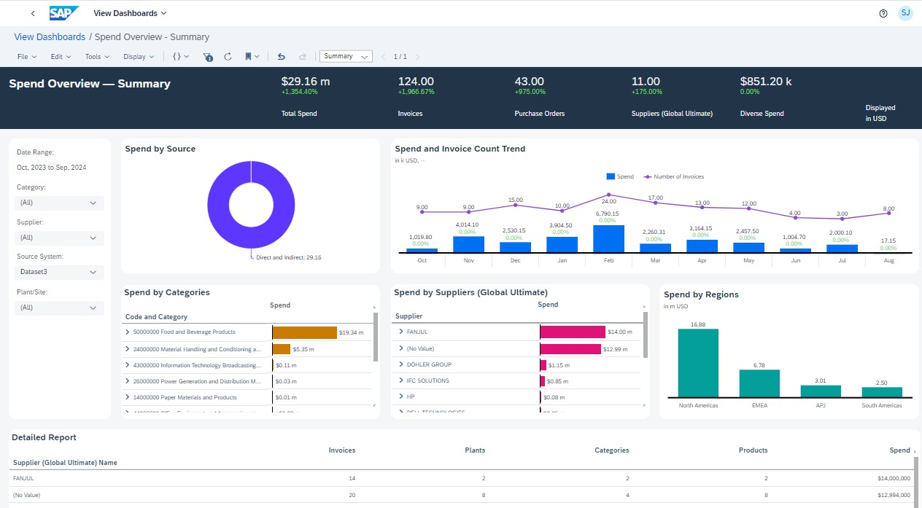
What’s Changed With Guided Sourcing? Spend Control Tower Integration
Benefits
Intuitive, preconfigured spend performance dashboards with relevant KPIs
Spend categories analyzed and optimized by machine learning models
SAP and non-SAP source data captured and merged into a single source
Prerequisites:
License
Watch this video to learn about Spend Control Tower

Slide 34
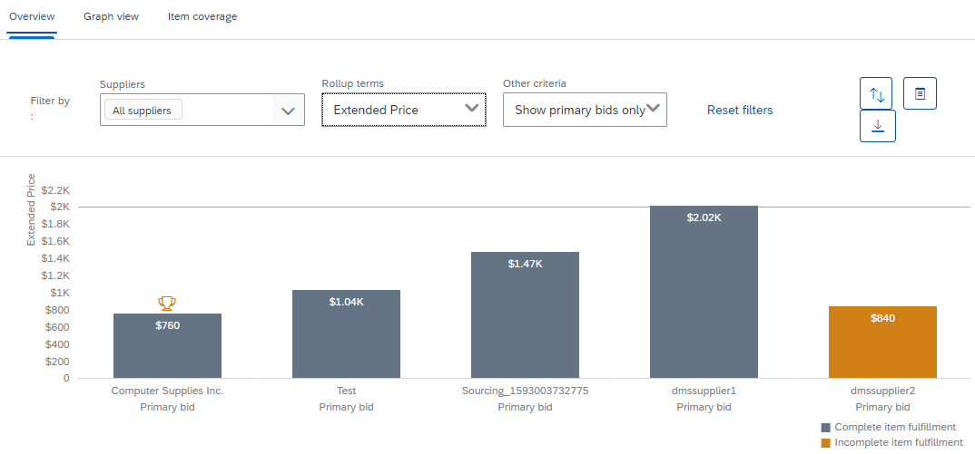
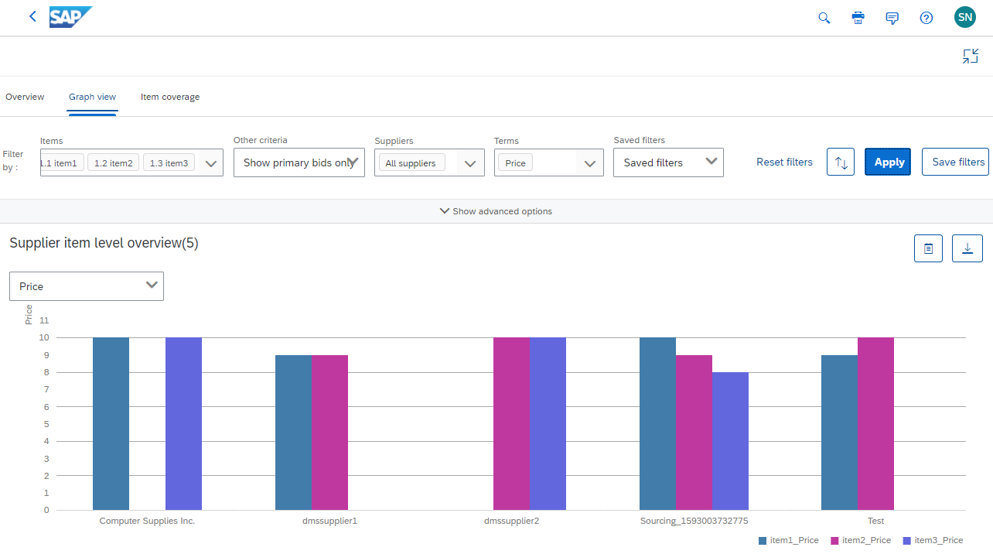
What’s Changed With Guided Sourcing? Advanced Bid Analysis
Benefits
Analysis of offers based on multiple criteria
Item coverage analysis
Graphical and tabular views
Advanced filtering capabilities
Outlier identification
Term and supplier selection
Primary and alternative bids
Watch this video to learn about Guided Sourcing Advanced Bid Analysis
*at this stage only available for single round events

Slide 35
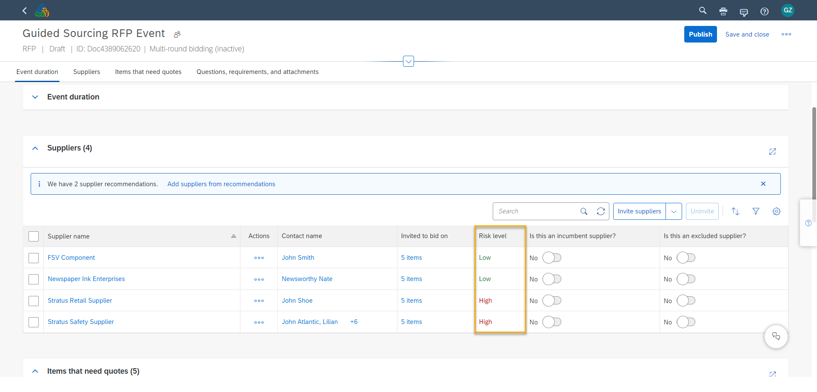
What’s Changed With Guided Sourcing?
Benefits
Real-time supplier risk information embedded within Guided Sourcing events
Visibility on supplier risk profile break down and risk status categorization
Prerequisites:
Your site must be integrated with SAP Ariba Supplier Risk and SAP Ariba Supplier Lifecycle and Performance solutions
Integration with Supplier Risk
Watch this video to learn about Guided Sourcing integration with Supplier Risk
Guided Buying Tactical Sourcing + Guided Sourcing Integration

Slide 36
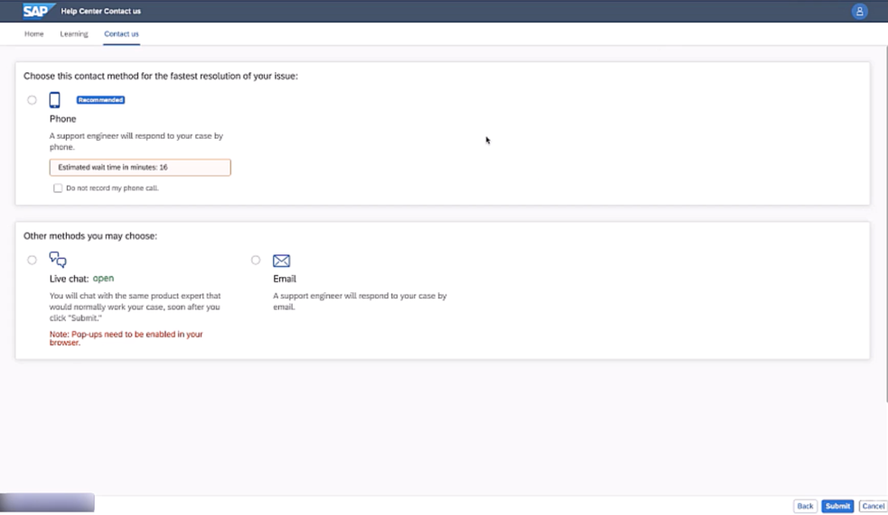
What’s Changed With Guided Sourcing?
Benefits
SAP Ariba offers a service called “Event Day Management” as part of the Sourcing license. This service applies for non-test competitive RFP and Auctions.
Event Day Management received major improvements by SS-40648: Expedited Support Requests on Sourcing Auctions and Competitive RFPs
Event Day Management
SAP Ariba Event Day Management (EDM): Advantages and Restrictions

Slide 37
Guided Sourcing Personas & Changes Team Members & Evaluators
What Has Changed
New Sourcing Project & Event UI
The new For You dashboard is available
In system approval UI has changed
In-app document preview now available
Messaging app has been added to communicate with users
SAP Companion to assist with learning
Sourcing Evaluation UI has been updated
What Has Not Changed
Email approvals remain the system
Email notifications will remain the same
System generated reports remain the same
Your sourcing process will remain the same (if template are migrated like for like)
Watch this video to learn about Team Members, Reviewers, Approvers

Slide 38
Guided Sourcing Personas & Changes Supplier Experience
What Has changed
Suppliers will experience no impact with the use of Guided Sourcing
Suppliers require no additional change management or training
What Has Not Changed
Email notifications will remain the same
Sourcing event participation (RFX) will remain the same
Communication with buyers will remain the same
Watch this video to learn about Supplier experience in Guided Sourcing

Slide 39
Guided Sourcing Integration

Slide 40
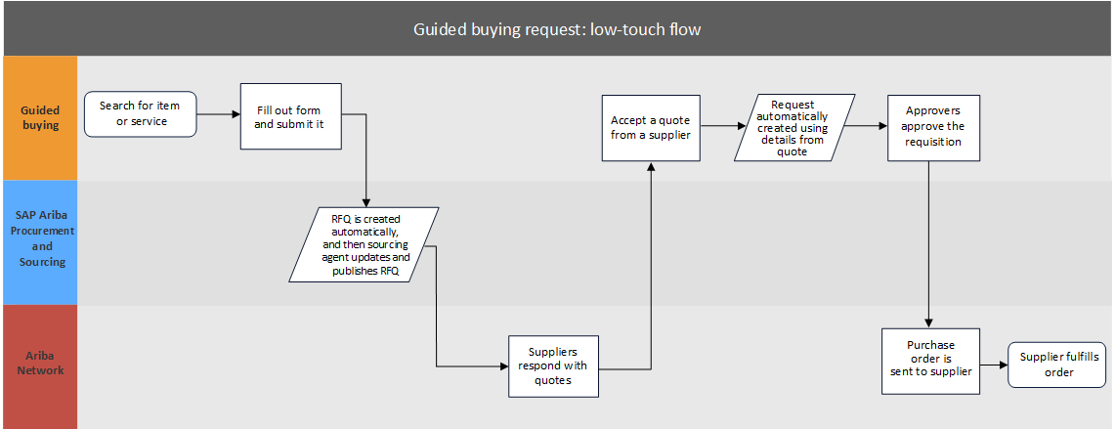
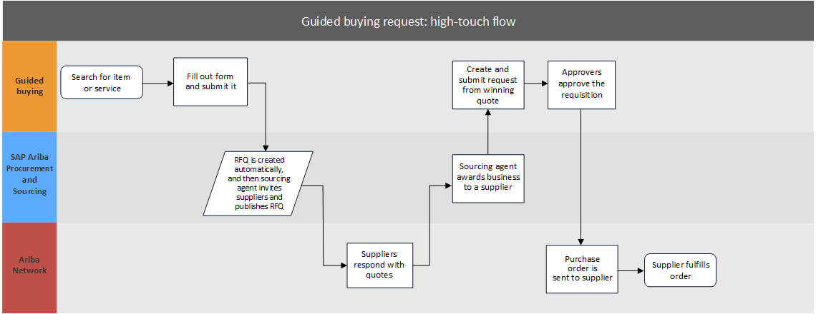
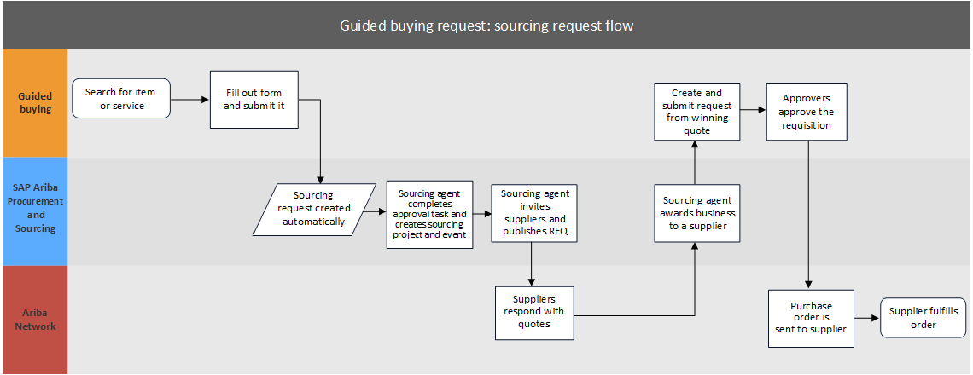
Guided Sourcing Integration Guided Buying Integration
Guided Buying Tactical Sourcing + Guided Sourcing Integration

Slide 41
Guided Sourcing Integration Ariba Buying Integration
SAP Ariba Procurement
Guided Sourcing
SAP Business Network
Create Sourcing Request & Submit
Quotes received and items updated automatically
Sourcing Request created automatically
Sourcing Agent completes approval task and creates sourcing project
Quotes received and evaluated by sourcing agent
Awarding and send quotes to Procurement
Supplier responds with quotes
Prerequisites for the P2P Integration:
Sourcing PO/OA Integration with External System
Ability to Create Follow-On Documents

Slide 42
Guided Sourcing Integration SAP ECC/S4H Integration
SAP Business Network
Suppliers
Supplier
Sourcing request
Approval
Create sourcing project
Create RFQ event
Invite suppliers
Supplier’s response
Award supplier
Export quotes
Update with SAP contract ID
Guided Sourcing
A
B
SAP ERP
Create external RFQ
Publish external RFQ to SAP Ariba Sourcing
Purchase order (NB) / Framework order (FO)
Outline agreement (MK / WK)
Approval
Update SAP Ariba with SAP contract ID
Provide contract as source-of-supply
SAP S/4HANA
SAP ECC + Guided Sourcing Integration
SAP S/4HANA + Guided Sourcing Integration

Slide 43
Guided Sourcing - Roadmap

Slide 44
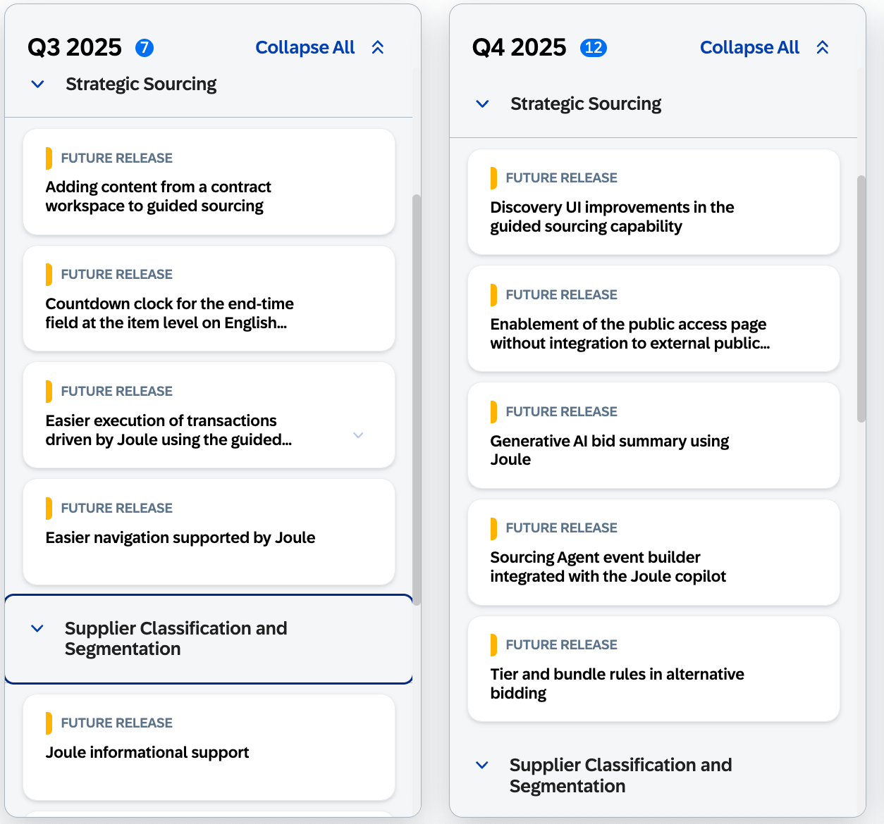
Road Map
The single source of truth for road map information is the SAP Road Map Explorer.
SAP Ariba road map information is accessible through the SAP Road Map Explorer at https://roadmaps.sap.com
Filter by
Processes: Sourcing and Contracts
Products: SAP Ariba Sourcing, cloud edition
Navigating SAP Road Map Explorer
Innovations are grouped by release date
You can click on each innovation to gain insights about it
Road map is subject to change without notice.

Slide 45
FAQ’s & Video Catalogue

Slide 46
What’s Changed With Guided Sourcing?
CPO |  | Administrator |  | Sourcing Users & Team
Single page Project & Event Creation UI |  | Enhanced Envelope functionality |  | Enable Now (SAP Companion)
Enhanced Item Management |  | Multi-round Events |  | Automatically invite Preferred Suppliers
Intelligent recommendations on content and suppliers |  | Collaboration & Messaging capabilities |  | Process and Project Insights areas of Full Project
Smart Excel Import |  | ‘For You’ Tab |  | Category Management Integration
Advanced Bid Analysis |  | Supplier Risk Integration |  | Event Day Management

Slide 47
FAQ’s
Should we switch to Guided Sourcing?
For most customers, Guided Sourcing is a 1:1 replacement for the classic SAP Ariba Sourcing UX as it supports most common functionality. We highly recommended adopting Guided Sourcing now, although both interfaces coexist with the option to use either.
Will projects executed in Guided Sourcing be reportable in the SAP Ariba Spend Analysis solution?
Yes. Reporting on multi-round events is also supported in SAP Ariba Spend Analysis (but not the individual bids).
Do we have to pay a separate fee for Guided Sourcing?
No, Guided Sourcing is available at no additional cost for all licensed SAP Ariba Sourcing customers.
Can we work in both the classic UX and the Guided Sourcing UX?
Yes, as long as you have the correct permissions, you can work in both UXs. You can choose which users access which UX, and they can be in both if needed. Access is controlled by permission.
How can users be given access to Guided Sourcing?
Assign ‘Category Buyer’ group to give users access to Guided Sourcing
How do I enable Guided Sourcing?
We recommend enabling Guided Sourcing in test before you enable it in production. Guided Sourcing enablement is Self Service at no additional cost; you do not need assistance from SAP to do so.
Can we go back to the Classic Sourcing UI if we want to?
Yes. Access to the new UX is controlled via the user group Category Buyer. You can simply remove users from this group and deactivate the Guided Sourcing templates. Any events in progress will need to be completed using the Guided Sourcing UX.
Will this impact my suppliers?
Suppliers will view and respond to events in the same way. This is only a UX change on the buyer side. However, if you use the new functionality in Guided Sourcing, such as multi-round bidding, you'll want to make sure suppliers are aware that you are using it and to expect new rounds.
Will we need to do extensive training to enable our users?
Guided Sourcing is an intuitive, user-friendly UX which increases adoption and makes the creation of events easier and quicker. Extensive training is not necessary. Also, WalkMe in Guided Sourcing and SAP Enable Now for Guided Sourcing helps the user quickly get help if they need it. These are SAP’s in-app guidance and automation tool.
I have more questions. Where can I go?
See the full list of available FAQs at FAQ: Guided sourcing capability for SAP Ariba Sourcing

Slide 48
Additional Adoption Support Implementation Service
Business Outcomes
Boost user adoption and satisfaction through improved usability
Increase negotiated savings potential and process compliance
Execute faster with up to a 50% improvement in time to create a sourcing event
Build internal self-sufficiency to manage systems
Business Relevance
Improvements in organizational agility by introducing sourcing intelligence to streamline and speed the creation, monitoring, and awarding of request-for information and request-for-proposal sourcing events
Ideal for customers that have deployed the SAP® Ariba® Sourcing solution and want to:
Enable guided sourcing to simplify the sourcing process & improve adoption
Improve negotiated savings to meet corporate sourcing objectives
Deliverables and Time Frames
Guided sourcing experts from SAP collaborate on key aspects of your implementation:
Review and demo guided sourcing features and capabilities
Assess and recommend customer sourcing templates for conversion to guided sourcing formats
Convert standard sourcing templates to guided sourcing (up to two full projects and five events)
This service is fixed fee and delivered over two to four weeks. Customers can add one year of guided sourcing adoption support.
Related Products and Services
Services: 50159479: Implementation service for guided sourcing capability for SAP Ariba Sourcing
Products: SAP Ariba Sourcing
Learn More: Reach out to your SAP account executive or services account executive

Slide 49
Additional Adoption Support Education & Support
SAP Ariba is invested in our customer’s success. To support you in your transformation journeys, we have created a number of value accelerators. All playbooks are available on Connect.
Check out these Sourcing-related Value Accelerator playbooks:
Sourcing Maturity Value Accelerator
Auctions Value Accelerator
Measuring Value - Value Accelerator
Guided Sourcing Full Projects Value Accelerator E-Learning
To request more information about the adoption of SAP Ariba solutions, contact SAP_IAC@sap.com
Training Resources
Guided Sourcing Buyer Playbook: Buyer Playbook
Guided Sourcing Enablement Lab (Full Projects): Adopting Guided Sourcing for Strategic Projects
Guided Sourcing Enablement Lab (Sourcing Events): Enabling and Adopting Guided Sourcing
Auction Overview: Auction Types and Best Practices

