Slide 1
Creating and Publishing Static Catalogs for the University of Nebraska

Slide 2
Session Agenda
The Catalog Upload Process
The CIF Catalog Template
Creating a CIF Catalog
The Catalog User Interface
Uploading and Publishing New Catalogs
Replacing Existing Catalogs
Appendix
Questions

Slide 3
The Catalog Upload Process

Slide 4
The Catalog Upload Process
Supplier
Buyer
Notified a new or updated Catalog is published from Supplier
Start
New or Updated Supplier Catalog File (from Template) uploaded and published to the Customer on Ariba Network (AN)
Network validation (errors reported back to Supplier during upload)
Catalog File downloaded from the Network to Buyer-specific Catalog
Catalog File updated or corrected
Buyer Validation Rules audit
FAIL
PASS
Catalog sent for Buyer Approval
Denied
Approved
Catalog Activated and available for Users

Slide 5
The Catalog Upload Process
When you upload a Catalog for your Customer, you are loading the file to Ariba Network (AN)—not directly to your Customer’s Catalog
Once the file is loaded to the Network, your Customer is notified that a Catalog has been loaded
Depending on the configuration of the Customer’s environment:
The Catalog will then be validated, audited and sent for Approval
If Approved, it will be Activated and available for Users
If Rejected, it will be returned to the Supplier for corrections, and the process starts over again

Slide 6
The Catalog Template

Slide 7
The Catalog Template
Both Static and PunchOut Catalogs use Catalog Templates
Static Catalogs are generally created offline and uploaded to the Ariba Network
PunchOut Catalogs can be created offline, but there is also a Wizard on the Network to create PunchOut Catalog files—these are special static files called “Index Files”.
Creating PunchOut Index files is covered in another document, CAT 107 - Creating PunchOut Index Files

Slide 8
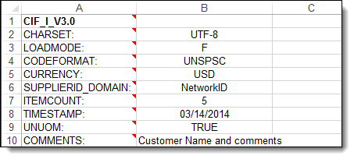
The CIF Catalog Template
CIF Catalogs are the most common type of static Catalogs. For ease of CIF Catalog creation, we provide Suppliers with an Excel template. The Supplier then creates and uploads the Catalog file to Ariba Network. Below is a sample of an Excel CIF Template:
Header section
Data section
Notes:
To make catalog creation easier, we provide Suppliers with an Excel template to help them collect and manipulate their Catalog data. Suppliers create specific Catalogs for their Customers, then load the files on Ariba Network and publish them to their Customers.
The Catalog Template has two sections—the Header Section and the Data Section.
The Header Section sets global information and tells the system that this file is a CIF Catalog. The Data Section is where the individual information about each Catalog item is populated. You’ll notice that the first line of the Data section (line 11 here) lists each field name. Under the field name listing, and before data for each item is populated, the value “DATA” is inserted, and after the last item, the value “ENDOFDATA” is inserted. These data elements are required, and tell the system to process the Catalog data on the rows between these labels.

Slide 9
The CIF Catalog Template
The Template is color coded and has Tool Tips that provide information about how to treat each field.
Each Template includes specific instructions, including custom fields or other requirements set by your Customer.
The CIF Template and instructions are provided to Suppliers as part of this education and can also be found on the Customer’s Supplier Portal page on the AN.
F I E L D C O L O R C O D E S
 | Required
 | Optional
 | Optional, but preferred
 | Do not use

Slide 10
Creating a CIF Catalog

Slide 11
Creating a CIF Catalog
General Rules
All fields marked “Required” must be populated
Supplier Part Numbers must be unique per item
Commodity Codes must be assigned to each item
Best Practices
Data should be submitted in “Sentence case”—using both upper and lower case letters—not in ALL CAPS or all lower case text
Abbreviations should be kept to a minimum—if you have the space, spell it out
Be descriptive in the Description field—all the words are indexed for ease of finding the items
Use Short Names not just Descriptions—it makes it easier for Users, and you get an additional 80 characters to describe your item
Always include images

Slide 12
Ariba Network – File Size Limits
CIF Format : When using the catalog wizard, the catalog file can't exceed 95 MB or 400,000 lines.
Excel Format : The maximum size of zipped Excel file that you can upload is 1 MB (uncompressed). If your Excel files exceed these size, you can convert them to CIF manually and upload the CIF files. Ariba Network uploads the file, unzips it if necessary, converts it to CIF format, and starts validation. Conversion from Excel to CIF can take several minutes depending on the catalog size. As Excel files convert, their status is Validating.
cXML Format: If you use the cXML CatalogUploadRequest transaction, the zipped catalog file cannot exceed 10 MB, and the unzipped CIF file cannot exceed 95 MB (approximately 400,000 line items). To have this default size limit increased to 200 MB, contact SAP Ariba Customer Support.

Slide 13
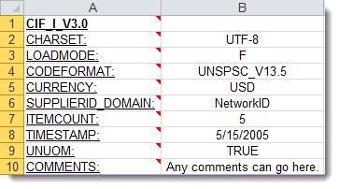
Creating a CIF Catalog
The Header Section
CIF_I_V3.0—Specifies the Catalog format (CIF 3.0). Do not change this value
CHARSET—UTF-8 Specifies the data coding type. Do not change this value, unless instructed by your Catalog Expert
LOADMODE—F (Full) or I (Incremental)
CODEFORMAT—Specifies the commodity coding (UNSPSC: United Nations Standard Products and Services Code) in the field “SPSC Code”
CURRENCY—Specifies the currency used for the prices. The value “USD” (United States Dollar) is here by default and can be changed to a difference currency
SUPPLIERID_DOMAIN—Specifies the Domain used. The preferred value is the Supplier’s Ariba Network ID Number—“NetworkID”. Other values include “DUNS”, “internalsupplierid” or other custom values
ITEMCOUNT—Specifies the number of items of the Catalog. Enter the total number of all items between the DATA and ENDOFDATA markers
TIMESTAMP—Enter the date you created your Catalog.
UNUOM—If set to “TRUE”, the Unit Of Measure is set to UNUOM (United Nations Unit of Measure); if set to “FALSE”, the value is set to ANSI. (Ariba recommends UNUOM)
COMMENTS—This field is optional, but can be used for comments related to your Catalog. It is a good place to enter the Supplier Name, the Customer Name and Catalog Name
Note: The only fields that Suppliers should modify in the Template are indicated in red: CURRENCY, ITEMCOUNT, TIMESTAMP and COMMENTS. All the other fields are predefined in the Template for the Customer and should not be modified, unless instructed by a Catalog Expert.

Slide 14
Creating a CIF Catalog
The Data Section
Supplier ID | Supplier Part ID | Manufacturer Part ID
AN99999999999 | 12345 | CFG 11562
AN99999999999 | 87690 | 87690-12
AN99999999999 | 479-56 | A100-BLK
Supplier ID - Required
Description: If the Header is set to “NetworkID”, then enter the Supplier’s Ariba Network ID, otherwise the appropriate value for the Domain used—DUNS, internalsystem, etc. Ask your Catalog Expert if you have questions
Type of data: String
Maximum length: 255
Example: AN99999999999
Note: If you publish the Catalog in your test account, add a suffix –T to your ANID or DUNS number like this: AN99999999999-T
Supplier Part ID - Required
Description: Part Number used by the Supplier. The Part Number must be unique for each item in the Catalog.
Type of data: String
Maximum length: 255
Example: 2772882
Manufacturer Part ID - Optional
Description: A Part Number that a Manufacturer uses
Type of data: String
Maximum length: 255
Example: TTSIBM412CID

Slide 15
Creating a CIF Catalog
Item Description | SPSC Code | Unit Price
Pens, Bic, Ballpoint, Blue, 1 dozen | 43191504 | 3.48
Stapler, Swingline, Black | 55010125 | 18.72
Post-It, Yellow, 1”x2”, pad of 100 | 15874236 | 6.49
Folders, Letter, Manilla, 100 | 89745125 | 12.98
Item Description - Required
Description: Description of the product or service. Make your descriptions as clear and complete as possible (Item type, brand, model, color, etc.)
Note: To use a special character as a literal value, you need to “escape” it by putting a backslash (\) in front of it. For example, \" lets a double quote be seen as a quote instead of a delimiter for an entry. To escape a quote (") within a quoted field, use two quotes ("")
Type of data: String
Maximum length: 2000
Example: Printer, Laser, A4, Epson Stylus Color 740
SPSC Code – Required
Description: Classification of the product or service. Use a UNSPSC code if the Header specifies “UNSPSC” as the CODEFORMAT
Type of data: String
Maximum length: 40
Example: 45678900 (level 3) and 45678923 (level 4)
Note: Ariba supports UNSPSC Version 13.5. A code list is available in your Customer’s Supplier Information Portal
Unit Price - Required
Description: Customer-specific price
Type of data: Decimal
Example: 4.32 or 1234.78
Note: To separate the integer from the decimal, you must use a ‘dot’ and not a comma. Also, do not use a comma to indicate ‘thousands’. Do not include any currency symbols such as $, £ or ¥.

Slide 16
Creating a CIF Catalog
Unit of Measure | Lead Time | Manufacturer Name
EA | 1 | Intelidata
EA | 1 | IDG Book
DZN | 3 | Bic
EA | 1 | Swingline
Unit of Measure - Required
Description: Unit of measure related to the Unit Price. Use a United Nations UOM if the UNUOM in the Header is set to “True”
Type of data: String
Maximum length: 32
Example: BX
Note: A file containing the Units of Measure is available in your Customer’s Supplier Information Portal
Lead Time - Optional
Description: Number of working days for the product to be shipped from the date you receive the Purchase Order
Type of data: Integer
Maximum length: 40
Example: 1
Manufacturer Name - Optional
Description: Name of the manufacturer
Type of data: String
Maximum length: 255
Example: Epson

Slide 17
Creating a CIF Catalog
Supplier URL | Manufacturer URL | Market Price
http://www.supplier.com | http://www.manu.com | 12.95
http://www.supplier.com |  | 2296.56
http://www.supplier.com |  | 4.86
http://www.supplier.com |  | 12.86
Supplier URL - Optional
Description: A URL that links to a Supplier static page about the item (could be a MSDS, construction info, packaging info, etc.)
Type of data: String
Maximum length: 255
Example: http://www.supply.com/Catalog/product18.htm
Manufacturer URL - Optional
Description: A URL that links to a Manufacturer’s static page about the item (could be a MSDS, construction info, packaging info, etc.)
Type of data: String
Maximum length: 255
Example: http://www.manu.com/Catalog/product18.htm
Market Price – Optional
Description: List or retail price.
Note: Does not show on the Ariba UI—this is an informational-only field for Suppliers
Type of data: Decimal
Example: 4.32 or 1234.78
Note: To separate the integer from the decimal, you must use a ‘dot’ and not a comma. Also, do not use a comma to indicate ‘thousands’. Do not include any currency symbols such as $, £ or ¥.

Slide 18
Creating a CIF Catalog
Supplier Part Auxiliary ID | Language | Currency
1234-75 | en_US | USD
 | en_US | USD
 | en_US | USD
 | en_US | USD
Supplier Part Auxiliary ID - Optional
Description: Uniquely identifies a single item. For example, items in multiple languages or available in multiple units of measure
Type of data: String
Maximum length: 255
Example: 1234 French
Note: If any items have the same reference (Supplier Part ID column), this column allows you to differentiate them
Language – Optional (If blank, defaults to ‘en_US’)
Description: Specifies the language used to describe the item.
Type of data: String
Maximum length: 255
Example: en_US
Note: A listing of language codes is in your Customer’s Supplier Information Portal
Currency – Optional (Set in Header)
Description: Specifies the currency used for the prices
Type of data: String
Maximum length: 32
Example: USD, CAD (Canadian Dollar)
Note: A listing of currency codes is in your Customer’s Supplier Information Portal

Slide 19
Creating a CIF Catalog
Short Name
Soft Drink, Soda, Dr Pepper
Dairy, Milk, 1% milkfat
Coffee, Dark Roast, Starbucks
Soft Drink, Juice, Minute Maid
Short Name - Optional
Description: Short description of the item. The Short Name is displayed first in the UI, and is in a larger type face and blue color. You can use the Short Name to describe a category or Item type, then give the specifics in the Item Description
Type of data: String
Example: Nylon Glove, Blue
Maximum length: 50 characters
Note: If the “Short Name” field is left blank, the first 80 characters of the Item Description column will automatically fill the “Short Name” field

Slide 20
Creating a CIF Catalog
Image | Thumbnail
12354.jpg | http://www.1.com/12354.jpg
http://www.1.com/34.jpg | http://www.1.com/34.jpg
587.jpg | http://www.1.com/587.Jpg
http://www.1.36.jpg | http://www.1.36.jpg
Image - Optional
Description: URL of the item’s image (preferred), or filename of the image (sent in a zip file)
Supported image formats: JPG, JPEG, GIF, PNG, BMP—(JPG preferred)
Type of data: String
Maximum length: 255
Recommended Size: 250 x 250 pixels
Detail: Thumbnail - Optional
Description: URL of an Icon-size image of the item, or filename of the image (sent in the zip file)—can be different from the product’s full-size Image
Supported image formats: JPG, JPEG, GIF, PNG, BMP—(JPG preferred)
Type of data: String
Maximum length: 255
Recommended Size: 85 x 85 pixels
Note: If the “Thumbnail” field is left blank, the file in the “Image” field will be resized and populate the Thumbnail

Slide 21
Creating a CIF Catalog
Special Notes for Images
In the Catalog file, you can refer to a Remote Image—using a URL—or you can refer to a Local Image, and send that image to Ariba to store
Using Remote Images is preferred
Be sure the URL in the Template is complete (including http://) Example: http://server/directory/imagefilename.jpg
Point to the image itself—not a program that serves up images
If you use Local Images
Be sure the filename in the Template is exact—including upper and lower case Example: FileName.jpg -or- lowercasename.jpg
Load images in a zip file format with the Customer Name and Supplier Name on the AN

Slide 22
The Catalog User Interface

Slide 23
The Catalog Interface Item View
This is how a static Catalog item is displayed in the Catalog interface. Clicking on the Short Name takes you to the Details screen for this item.
Short Name (80 characters)
Description (2,000 characters)

Slide 24
The Catalog Interface Detail View
This is a how a static Catalog Item Detail view is displayed in the Catalog interface.
Additional Information, links and custom fields

Slide 25
Uploading and Publishing New Catalogs

Slide 26
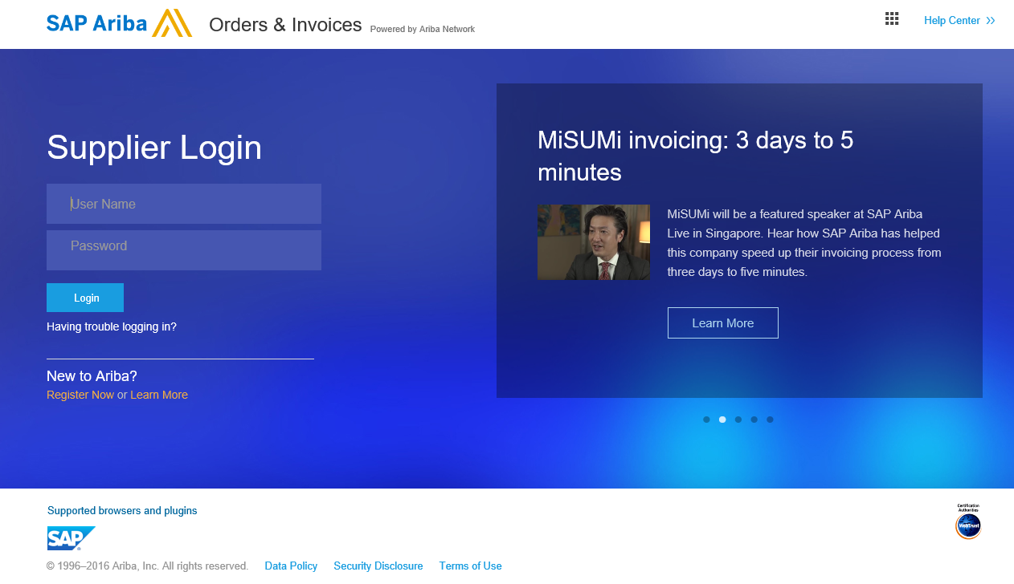
Uploading and Publishing New Catalogs
Login to Ariba Network
Go to: http://supplier.ariba.com
Log in with your Username and Password

Slide 27
Uploading and Publishing New Catalogs
Switch to your Test Account
Your Catalog should be loaded and tested in your Test Account. (Note: If you are instructed to load a Catalog to a Production account, just skip this step)
Find your name and click for the pull down menu, then click “Switch To Test ID”
If you don’t see a “Switch to Test ID” link, your Test account has not yet been set up. Contact your Ariba Network Administrator
You will get a warning. “You are about to switch to Test Mode.” Click “OK”

Slide 28
Uploading and Publishing New Catalogs
When uploading a Catalog on Ariba Network, there are four steps you will follow:
Uploading—Transfers the Catalog file from your local drive to Ariba Network. During the upload process, you enter the Catalog name (this becomes the “Subscription Name” in the Buyer’s local Catalog) descriptive text, and classify it so that buying organizations that are looking for specific products and services can find your Catalog
Setting Visibility—Allows you to specify whether the Catalog version is “Public” or “Private” and determines which of your Customers can access it
Validating—The Network checks the Catalog for errors, checks for zero price values and does a high-level validation of UNSPSC codes and Units of Measure
(Note: Customer-specific validation rules for UNSPSC and UOM codes, and zero price values can be more detailed and much more strict than the high-level Network validations, therefore your Catalog may pass the Network validations but fail the Customer-specific validations for these same items)
Publishing—Freezes the current version and notifies your Customer of the Catalog’s availability

Slide 29
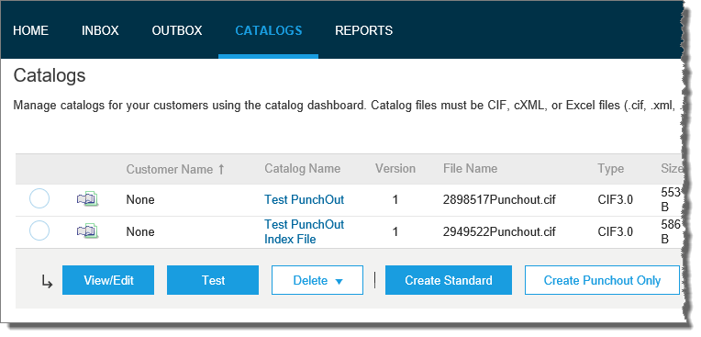
Uploading and Publishing New Catalogs
Navigate to the Catalogs Tab
On the Catalogs screen, click the “Create Standard” button

Slide 30
Uploading and Publishing New Catalogs
You are now on the Create a New Catalog Screen
To create the Catalog, there is a 3-step Wizard:
Details—General information about the Catalog
Subscriptions—Who you are publishing the Catalog to
Content—Uploading the actual Catalog file
Click “Next”

Slide 31
Uploading and Publishing New Catalogs
Details
Catalog Name: This becomes the “Subscription Name” for this Catalog that will not change. The format for this Name is set by The University of Nebraska. Ask for the format to use (no special characters are allowed, you can use a dash (-) or underscore(_)): <SupplierName_CustomerName>
Description: (Optional) Brief description of the content of your Catalog
Commodities: (Optional) The UNSPSC code(s) that corresponds to the items family/ group of your Catalog. Use the “Add” button to find the code
When you complete this screen, click “Next”

Slide 32
Uploading and Publishing New Catalogs
Subscriptions
You determine which Customers subscribe to your Catalog—specific Customer(s) or to all Customers on the Network
Set the Visibility to “Private”. You can select a single customer.
To select your Customer, check the box next to their name in the “Customers” list.
If the Supplier does not appear, it means that they have not established a relationship with your company yet. This is required prior to up- loading a Catalog to them
When you complete this screen, click “Next”

Slide 33
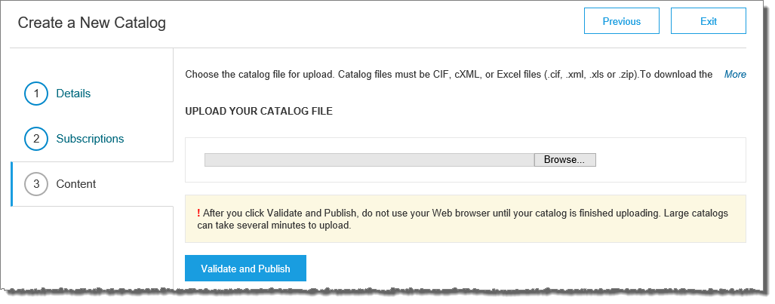
Uploading and Publishing New Catalogs
Content
Select your Catalog File, by clicking “Browse” and pointing to your file
Your Excel file must not exceed 1 Mb, however you can use zip compression
If your Excel file is too large, you will need to convert it to a CIF. See the Appendix—“How to convert an Excel file to CIF”
After you have selected your Catalog file, click the “Validate and Publish” button
As your Catalog loads, the status will read “Validating” Click the “Refresh” button at the bottom of the screen to see the status change

Slide 34
Uploading and Publishing New Catalogs
Network Catalog Validation
After the Network completes validation, it changes the Catalog status from “Validating” to one of the following statuses:
Validated, Published or Pending Buyer Validation—your Catalog is error-free
Errors Found by Ariba Network—the Network detected Catalog content that violates validation rules
Bad Format—your Catalog failed the file validation check. Audit the file for problems in format
A Catalog with an error status means you need to review the error results and correct them before going on

Slide 35
Uploading and Publishing New Catalogs
Correcting Validation Errors
To see the error detail, click on the “Errors Found” hyperlink:

Slide 36
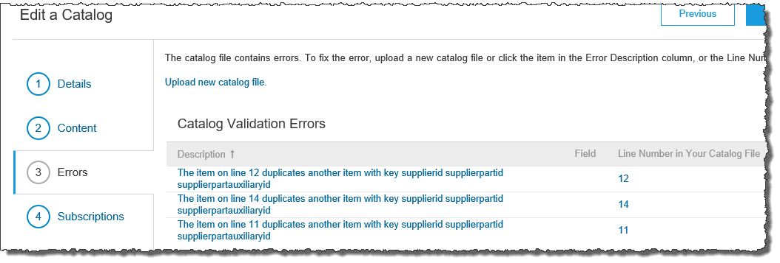
Uploading and Publishing New Catalogs
Viewing Validation Errors
The Network displays Description, Field and Line Number for each error
In this case, the Network is telling us that the Supplier Part Number is not unique on lines 11, 12 and 14
To correct any issues, go back to the original Excel Catalog file, make the corrections, then update the Catalog file, and upload the new version to replace the existing Catalog

Slide 37
Uploading and Publishing New Catalogs
Customer Approval
When your Catalog passes the Network upload validation, your Customer is then notified to audit, validate and approve your Catalog. The Network may show any of these statuses: “Published”, “Validated by Customer” or “Pending Buyer Validation”—note that these are all valid statuses
Each Customer may have specific validation rules—and these rules may be more strict than the standard Network rules. This means that your Catalog could pass the Network validation, but fail the Customer-specific rules and be returned to you
If your Customer finds anything in your Catalog file that requires your attention, you will be notified by e-Mail
Corrections should be made to the original Excel file, then the corrected Catalog file needs to be uploaded to the Network
Each Catalog must pass both the Network validation, and the Customer audit before it can be loaded into the Customer’s buying application and be available for their Users

Slide 38
Replacing Existing Catalogs

Slide 39
Replacing Existing Catalogs
To replace an existing Catalog, the steps are almost the same as uploading a new Catalog for the The University of Nebraska.
Log into your Ariba Network account
Navigate to Catalogs
Update the Catalog—using “View/Edit”
When replacing an existing Catalog, do not Create a new Catalog—it is important to keep the same Catalog Name. The file name can be different:

Slide 40
Replacing Existing Catalogs
Find the existing Catalog you wish to replace with a new version
Click on the radio button to select the existing Catalog
Click “View/Edit”

Slide 41
Replacing Existing Catalogs
You are now taken to the Edit a Catalog Screen
You see the same 3 steps as a New Catalog
Details—Most of the fields are pre-populated with the existing information, but you can add a new Description for the updated Catalog
Click “Next”

Slide 42
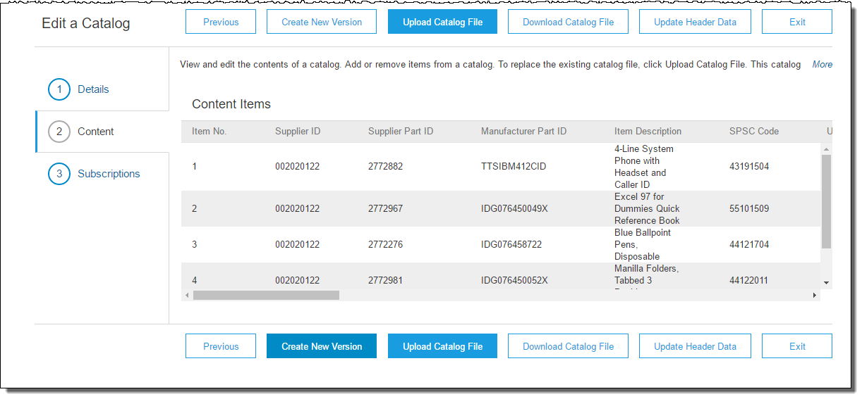
Replacing Existing Catalogs
Content—The Network will display the current Catalog (if it is under 4Mb)
We don’t want to “Create a New Version”—that button will take us back to the beginning as if we are uploading a brand new Catalog
We want to “Upload a Catalog File”—this will replace the existing Catalog File with our updated Catalog. Click the Upload Catalog File button

Slide 43
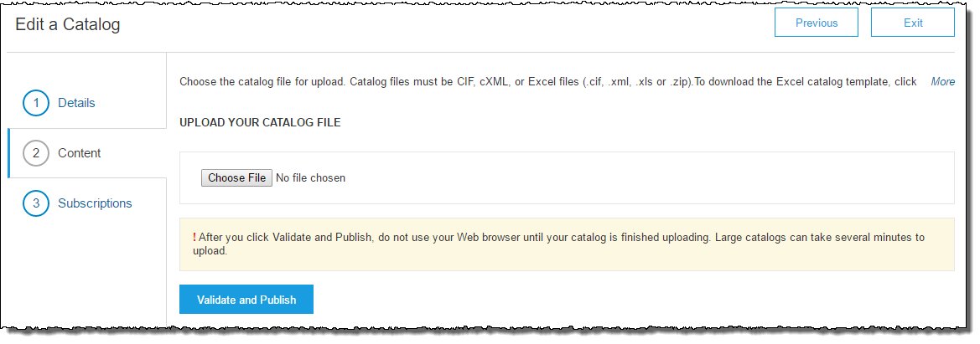
Replacing Existing Catalogs
Select your Catalog file, by clicking the Choose File button, then “Browse” and point to your file
Your Excel file must not exceed 1 Mb, however you can use zip compression
If your Excel file is too large, you will need to convert it to a CIF. See the Appendix—“How to convert an Excel file to CIF”
After you have selected your Catalog file, click “Validate and Publish”
As your Catalog loads, you will be returned to the Catalog Home screen and the status will read “Validating”. Click the “Refresh” button at the bottom of the screen to see the status change. Be sure to wait for the validation to finish

Slide 44
Replacing Existing Catalogs
When your Catalog passes the Network upload validation, the Network may show any of these statuses: “Published”, “Validated by Customer” or “Pending Buyer Validation”—note that these are all valid statuses. The upload is complete
Notice that the Catalog Name stayed the same, but the new File Name we loaded is reflected on the Network
The Network does Catalog version control for you. See that our replacement Catalog is now Version 2, and is active. Note that the radio button has moved up to our new active version

Slide 45
Replacing Existing Catalogs
Customer Approval
When your Catalog passes the Network upload validation, your Customer is then notified to audit, validate and approve your Catalog.
Each Customer may have specific validation rules—and these rules may be more strict than the standard Network rules. This means that your Catalog could pass the Network validation, but fail the Customer-specific rules and be returned to you
If your Customer finds anything in your Catalog file that requires your attention, you will be notified by e-Mail
Corrections should be made to the original Excel file, then the corrected Catalog file needs to be uploaded to the Network
Each Catalog must pass both the Network validation, and the Customer audit before it can be loaded into the Customer’s buying application and be available for their Users

Slide 46
Appendix

Slide 47
Creating a CIF from an Excel File
Open your Excel Catalog file

Slide 48
Creating a CIF from an Excel File
Save it as a “.csv” file. To see the choices, click on the drop down menu

Slide 49
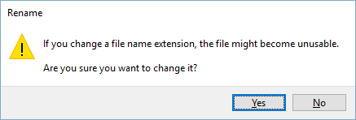
Creating a CIF from an Excel File
You will get a system warning about saving it as a .csv—click “Yes” to continue
Rename your saved file, by changing the extension to “.cif”
The system will warn you about changing the extension. Click “Yes” to continue

Slide 50
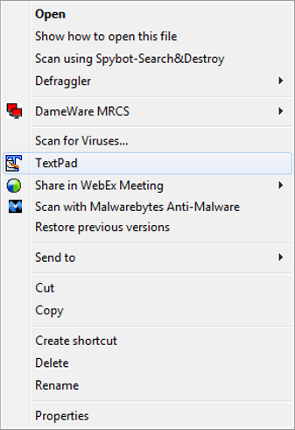
Creating a CIF from an Excel File
Open your CIF Catalog file with Notepad, or your favorite text editor

Slide 51
Creating a CIF from an Excel File
Notice that the file has new, added commas in the Header, and after the DATA and ENDOFDATA markers

Slide 52
Creating a CIF from an Excel File
Remove these extra commas after the Header values and the DATA and ENDOFDATA markers. Be sure to remove any commas in front of the data in the Header as well
Be careful if you use the “Replace” function—you don’t want to replace any of the commas in the actual Catalog data

Slide 53
Creating a CIF from an Excel File
Once the commas are deleted, save the CIF Catalog file. It is now ready to be loaded
Your completed file should look like this

Slide 54
Thank you.
Contact information:
AskAribaCatalogs@sap.com
CAT 101 G R-3 (1/2020)

