Slide 1
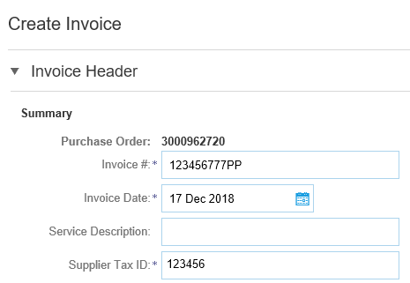
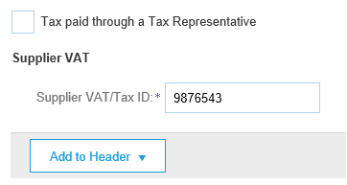
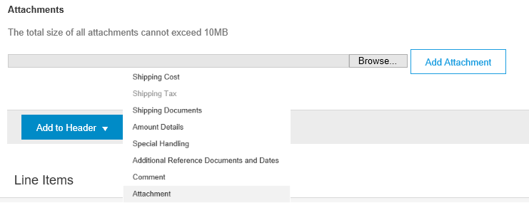
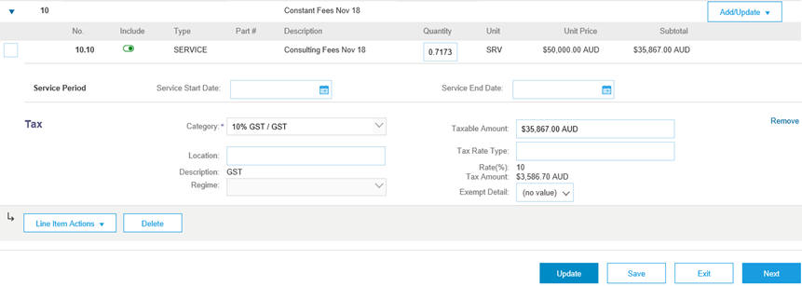
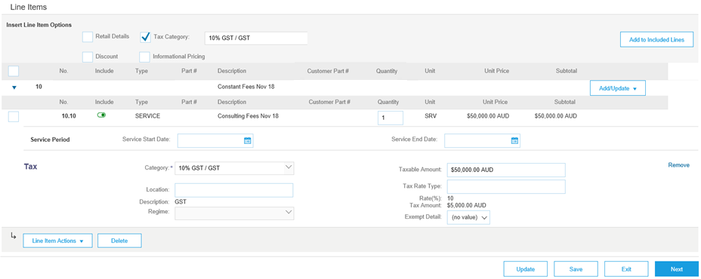
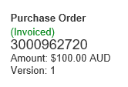
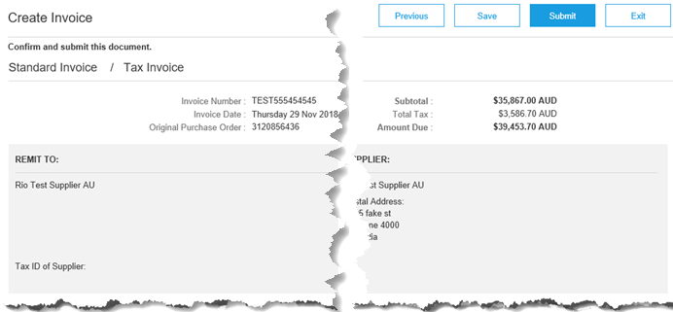
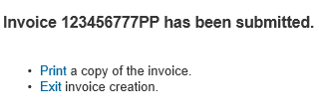
Training Sheet – Completing a Planned Service Invoice
Step 1: Click on “Create Invoice” then “Standard Invoice”
Step 2: Only Complete the Invoice Header fields circled
Step 3: Scroll to Supplier VAT, enter or confirm ABN
Step 4: Add proof of service delivery, click Add to Header, select Attachment, click on Browse, locate file, click open, click Add Attachment
Step 5: Scroll down to Line Items - Add Taxes at Line level, click Tax Category, select the Tax Rate, click Add to Included Lines
Ariba Network Supplier Education Materials Portal for Rio Tinto Suppliers Portal - Click Here
Price Basis Quantity (PBQ) is used to communicate the ‘price per’ and applies for certain products. Only when the PBQ contains a value will you need to review and apply a conversion if necessary. Please see example below:
The Price Unit of Measure (Price UOM) and Ordering Unit of Measure is different, therefore a conversion is required.
Example: 1 Service Unit @ $50,000
Simple Conversion : Where the service invoice is for $25,000 Enter .5 in the Quantity field which is half of the total Unit Price
Complex Conversion: Where the service invoice is for $35,867 Enter .71734 which is the value of the invoice divided by the total Unit Price
Step 6: Determine the type of Service Invoice – Planned, Unplanned (refer to the Unplanned Service Training Sheet) fixed price and quantity or value based - Confirm or enter the Quantity to be invoiced for each item, ensure you have entered the correct quantity based on the unit of measure and unit price, click Next
Step 7: Confirm Tax has been added, click Submit
Step 8: Click Exit

