Slide 1
Ariba Network Purchase Order & Material Order Guide
v2.0

Slide 2
Introduction
The purpose of this document is to provide the information suppliers need to effectively transact with Hindustan Zinc Limited via the Ariba Network. This document provides step by step instructions, procedures and hints to facilitate a smooth flow of procurement between Hindustan Zinc Limited and supplier.
URL for ARIBA – https://hzl.supplier.ariba.com

Slide 3
Purchase Order
The Purchase Order (PO) is the source document for the order and all subsequent documents are created from it.
A PO is a commercial document issued by a buyer to a seller, indicating types, quantities, and agreed prices for products or services the seller will provide to the buyer. Receiving an Order from your buyer constitutes an offer to buy products or services
Any field with an * is a mandatory field and a value is required to be entered

Slide 4
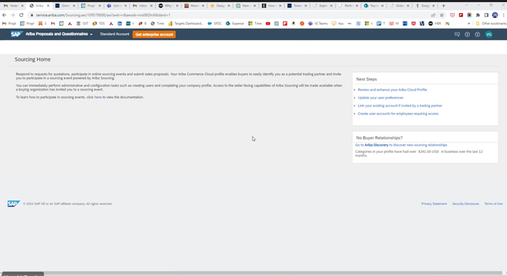

Slide 10
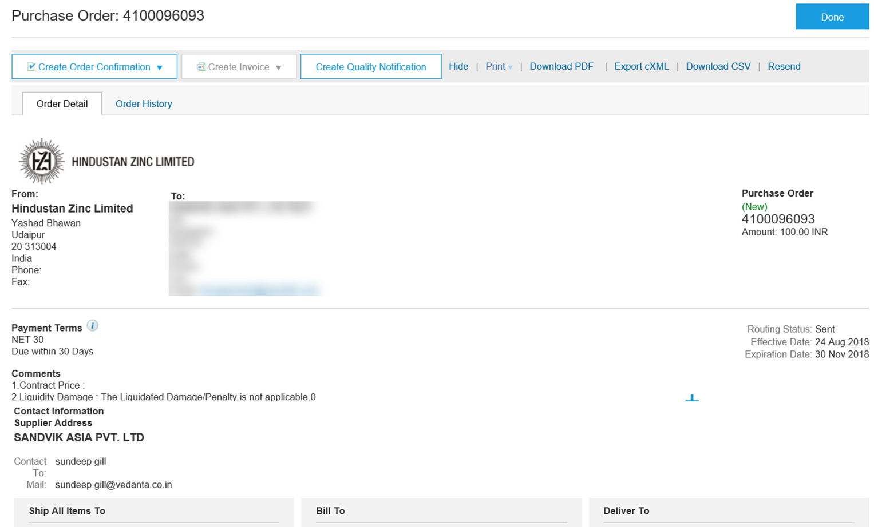
View Purchase Order Details – Header Level
The Purchase Order screen displays:
Purchase Order Number.
Order History tab
Purchase Order Status
Hindustan Zinc Limited address
Payment Terms, Comments and Other Contact Information.
Ship All Items To details.
Bill To details.
Scroll down to view the Line Items section.
Any screen element in blue can be clicked to view more details.

Slide 11
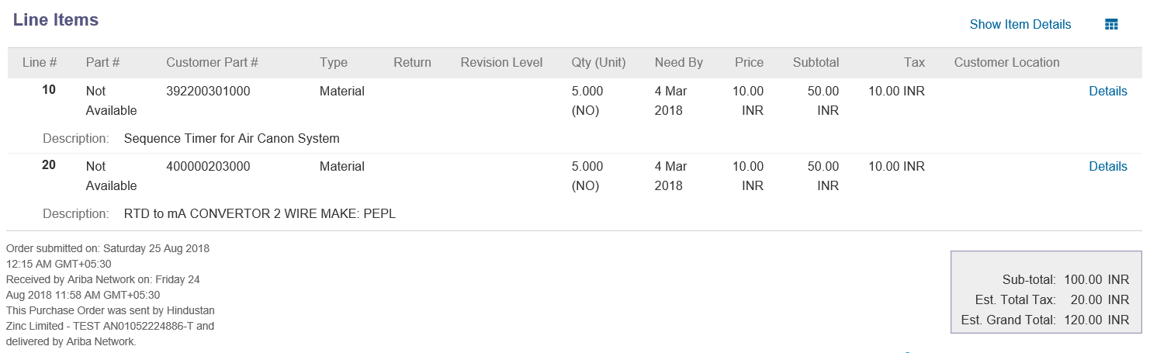
View Purchase Order Details – Line Item Level
Click Show Item Details or Details to see further line level information
Click Done to return to the Inbox.
Reviewing a Purchase Order
Each purchase order should be reviewed to:
Identify the items requested and ensure that the details of items in the order are correct
Determine whether the items are in stock
Validate the information contained within the purchase order
Check the shipping address
Check fields required by the business and any comments

Slide 12
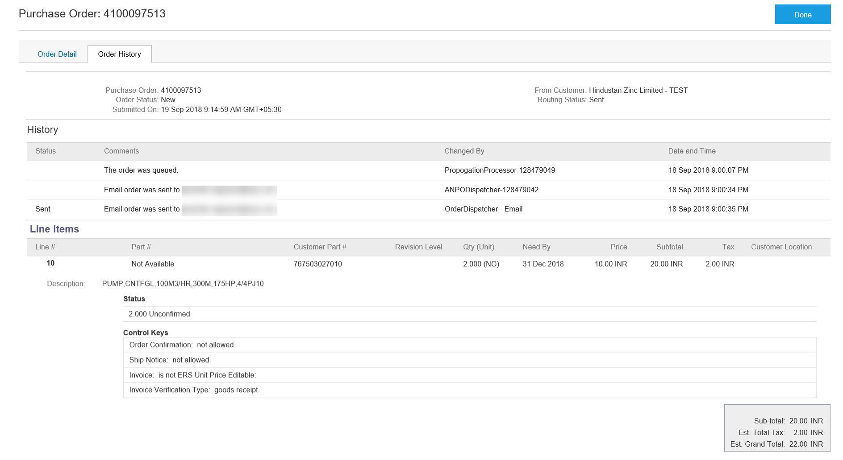
Order History
Order History tab identifies:
Who created the document
The date and time stamps of the various processes that have affected the document
Line Item information

Slide 13
Order Confirmation
When a new order is received into Ariba, you will be required to create an Order Confirmation
There are 3 types of Order Confirmation:
Confirm Entire Order: Used to confirm all line item details of the order (Not applicable for HZL suppliers)
Update Line Items: Used to partially confirm the line item details of the order
Reject Entire Order: Used to reject the order if it cannot be fulfilled (Not applicable for HZL suppliers)

Slide 14
Order Confirmation- Update Line Items – General Information
Order Confirmation > Update Line items is used when there are variations to the items requested by Hindustan Zinc Limited such as short supply. Rather than waiting until all the goods are available to create an order confirmation, this process allows suppliers to provide the goods that are available. An Order Confirmation in Partially Confirmed Status can have multiple Order Confirmations until all items within the purchase order have been confirmed.
Also use Order Confirmation–Update Line Items when there is a price discrepancy on the purchase order received from Hindustan Zinc Limited on an item/s as only Hindustan Zinc Limited can permanently change a purchase order and may send a Change Order with the new Unit Price. The total quantity for each line item in the required variations must not exceed the total amount requested by Hindustan Zinc Limited. When confirming at Line Item Level you are providing confirmation on the items requested in the purchase order. If you have a line item with a Backorder or Rejection quantity, you must provide further information using the Details button.

Slide 15
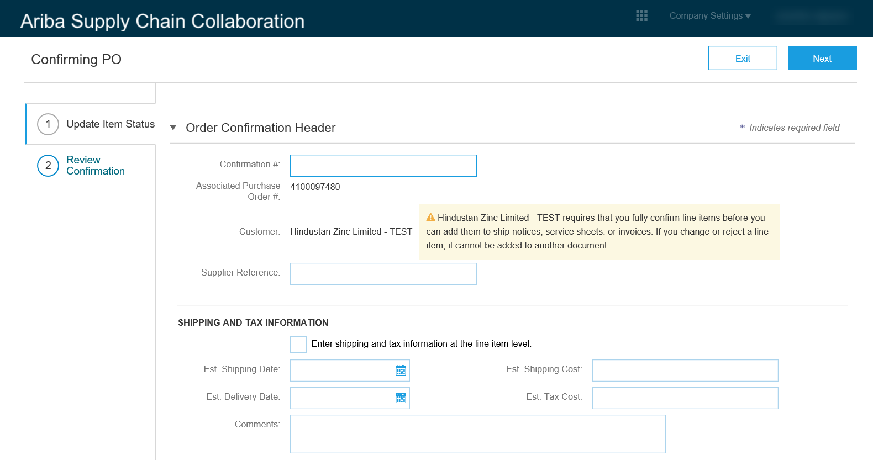
Order Confirmation – Update Line Items – Line Level
Only fields that are marked with an asterisk are mandatory. However, there are other fields like:
Confirmation # – any alpha-numeric reference number you choose to provide Hindustan Zinc Limited.
Est. (estimated) Shipping Date and Est. Delivery Date.
Est. Shipping Cost.
Est. Tax Cost.
Comments can be entered if necessary.
Scroll down to the Line Items section.

Slide 16
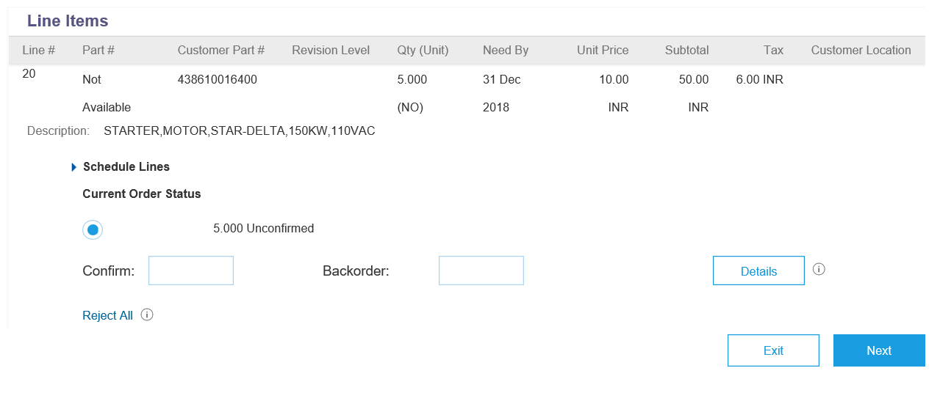
Order Confirmation – Update Line Items – Line Level
Click Confirm where a portion of the goods requested are being confirmed.
When the items requested need to be backordered before supply can occur click Backorder.
To fully reject the line item click Reject All.
If you have a line item with a Backorder or Rejection quantity, you must provide further information using the Details button.
Click Next to proceed. The Confirming PO page will be displayed.
Est. Delivery Date is mandatory for confirmed or backordered items.

Slide 17
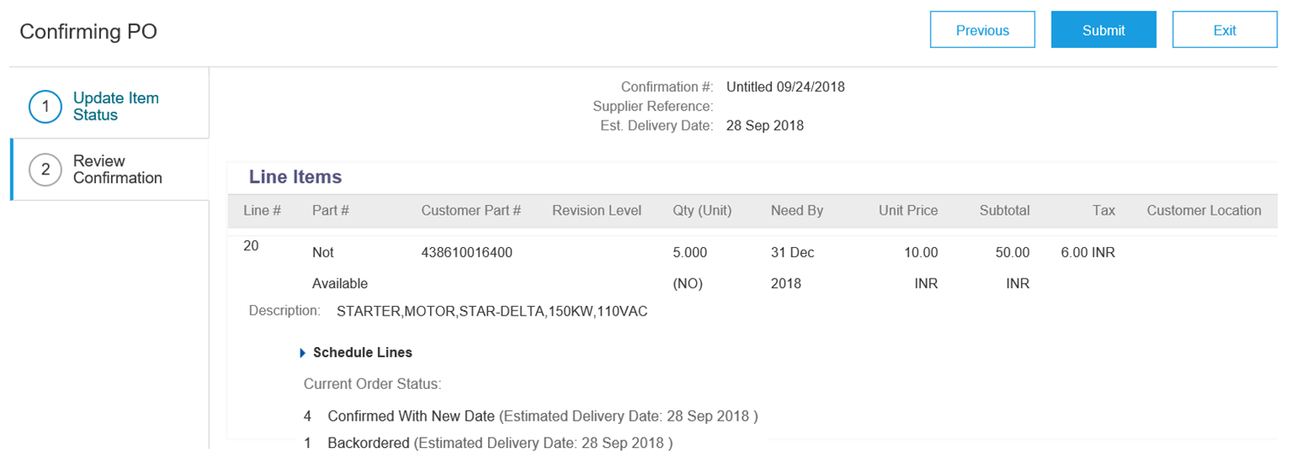
Finalise the Order Confirmation
Review the Order Confirmation.
Click Submit. The Purchase Order details page will be displayed.
Order Status has changed to Partially Confirmed.

Slide 18
Ship Notice
The Ship Notice is the delivery information and is sent to Hindustan Zinc Limited to advise them of the ship date for the materials.
The Ship Notice is an optional document for transacting with Hindustan Zinc Limited
2 methods for creating a Ship Notice
Full Ship Notice
Partial Ship Notice

Slide 19
Begin the Order Confirmation
To create a ship notice:
Click Inbox tab on the Home page. The Orders and Releases page is displayed.
Click the Order Number. The Purchase Order details page is displayed.
View the Purchase Order.
Click Create Ship Notice. Create Ship Notice page will be displayed.

Slide 20
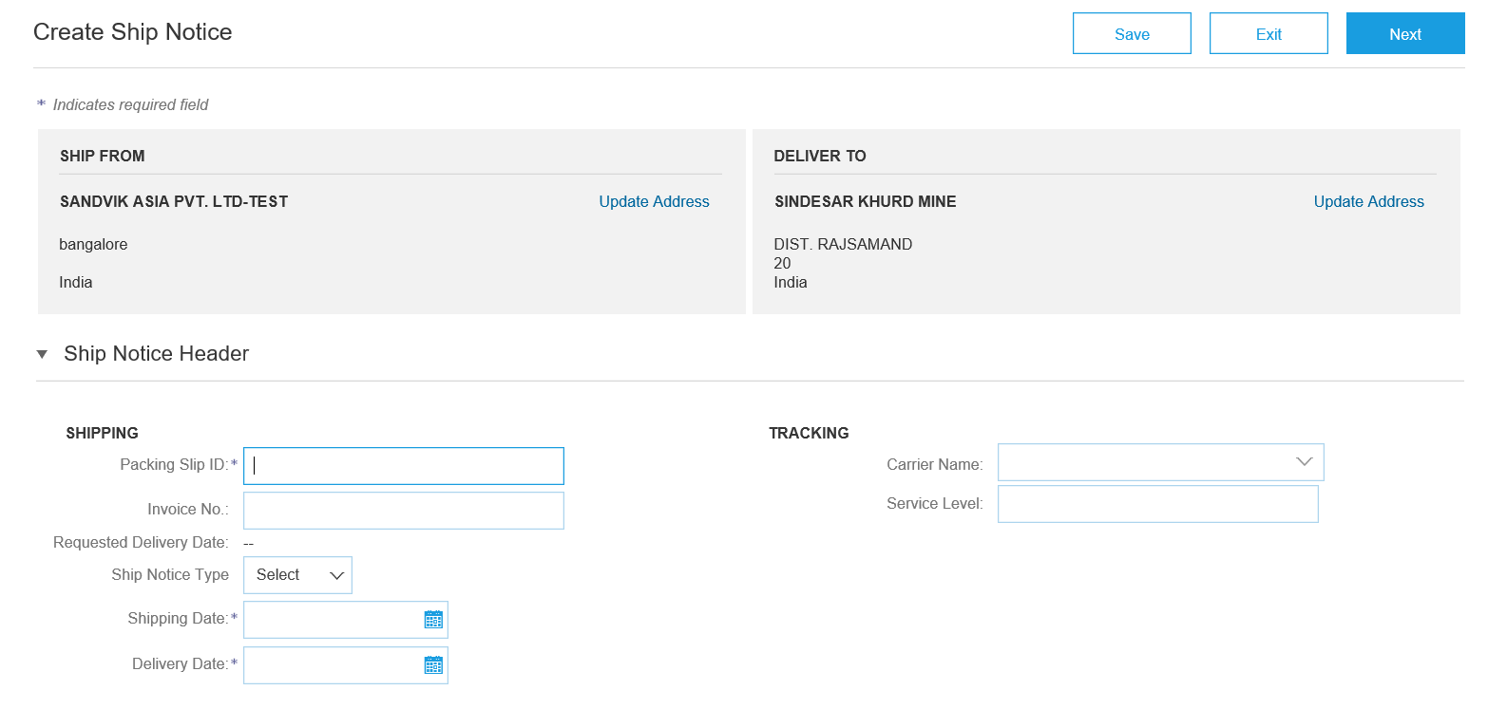
Ship Notice - Header
Enter the Packing Slip ID, this is the alpha-numeric number you provide to Hindustan Zinc Limited.
Enter the Shipping Date and Delivery Date.
Scroll down to Order Items.

Slide 21
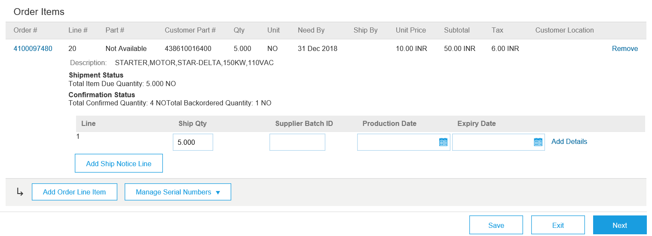
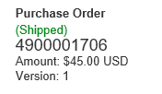
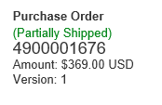
Ship Notice – Order Items
Enter the Ship Qty.
Click Next. The Create Ship Notice confirmation page is displayed.
Click Submit.
The purchase order status will now change to Shipped or Partially Shipped.

Slide 22
Invoicing
Once the material has been shipped out the invoicing process can be done

Slide 23
Begin Invoicing
On the Purchase Order details page, click Create Invoice.
Select Standard Invoice. The Create Invoice page will be displayed.

Slide 24
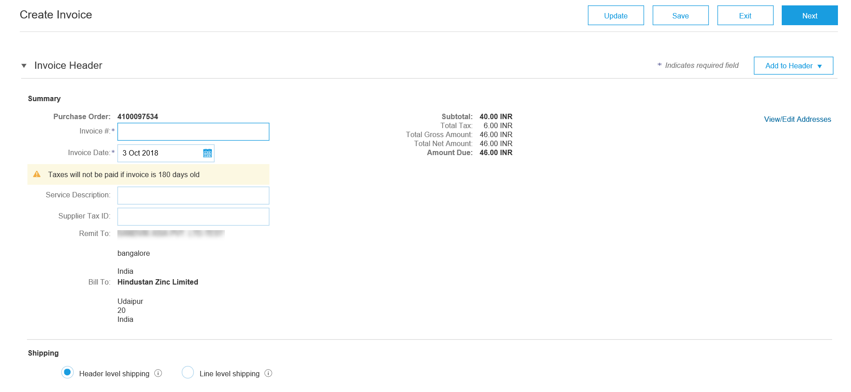
Invoicing cont.
Enter the Invoice number
Confirm or enter the Invoice Date.

Slide 25
Invoicing cont.
Attachments are mandatory. Click Add to Header.
Select Attachments
Attach any supporting documents pertaining to this invoice by browsing for the file and clicking Add Attachment. Scroll down to Line Items

Slide 26
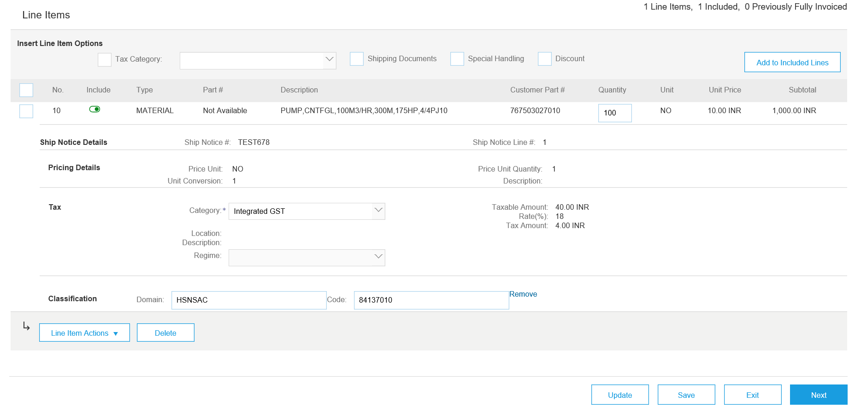
Invoicing cont.
You can edit the Quantity.
Click Update to update the Subtotal.
Click Next.

Slide 27
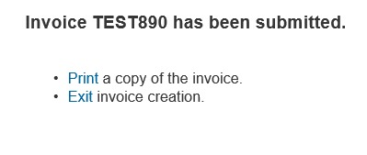
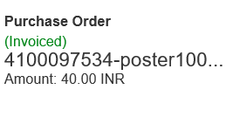
Invoicing cont.
Review the information.
Click Submit.
Click Exit.
Note: The status is displayed accordingly.

Slide 28
Support
Support Type | Description
Help Centre For all your support needs | Types of Support available: User Community Ask questions or view documentation Email/Live Chat Request a call back
Supplier Information Portal (Location of Training Guide/s and Video/s) | On the Home screen Click on Company Settings Click on Customer Relationships Click on Supplier Information Portal
Ariba Network Training Request | E: HZLenablement@ariba.com

