Slide 1
Supplier Registration and Account Access
SAP Ariba Best Practices Center
January 24, 2023

Slide 2
Registration/Account Creation

Slide 3
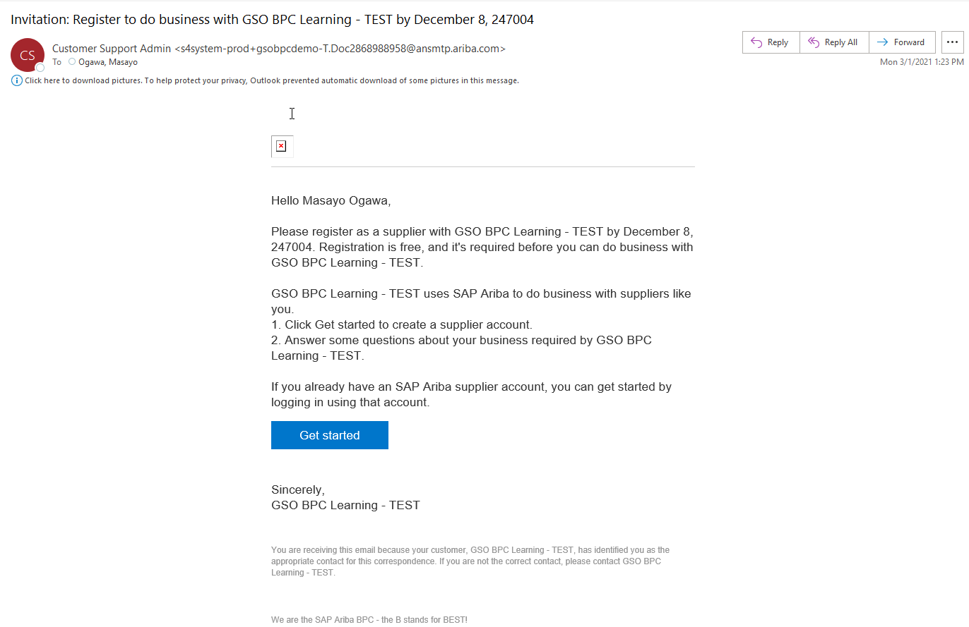
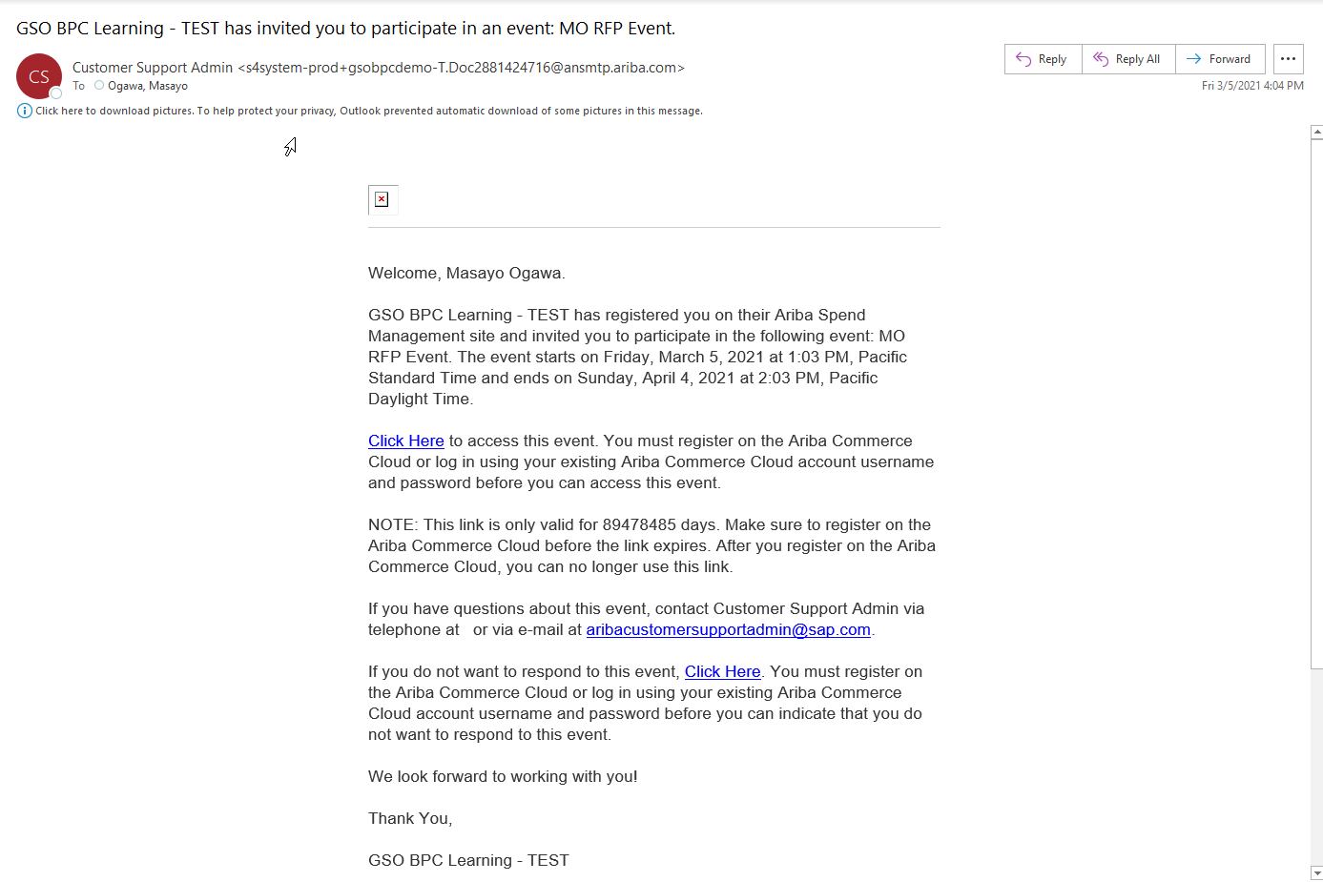
When your buyer invites you to their organization as a supplier, you will receive email invitation to an event or an invitation to register. Use the link in the notification to access SAP Ariba.

Slide 4
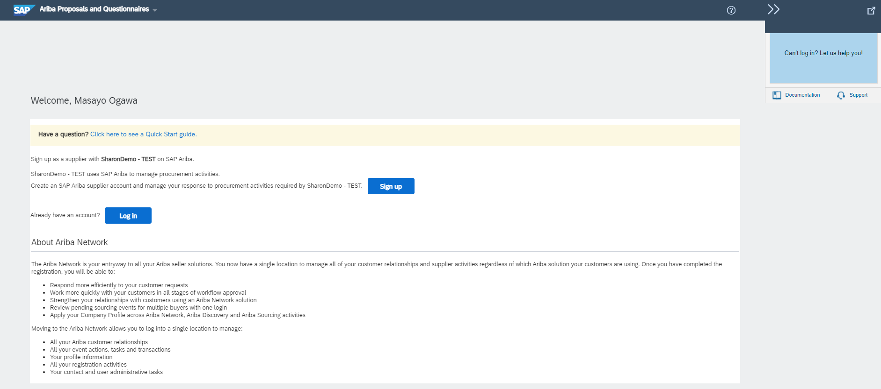
If you have not registered for your buyer organization, registration page will display. If you are already registered with your buyer organization, you will be taken to a login page.
If you have not registered with SAP Ariba (Ariba Network) before, click on “Sign up” button
If you already have an account with SAP Ariba (even with another buyer organization), click “Log in” button
Then Skip to Slide 8 for more information

Slide 5
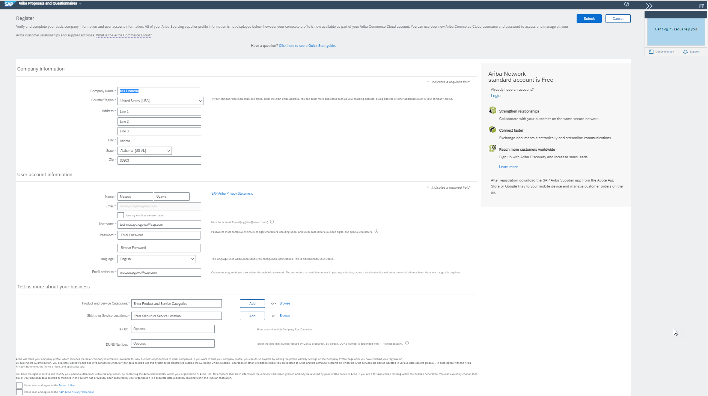
Complete the Ariba Network Account creation process and click on Submit.

Slide 6
Warning for duplicate accounts will show. Click Review accounts button to continue.

Slide 7
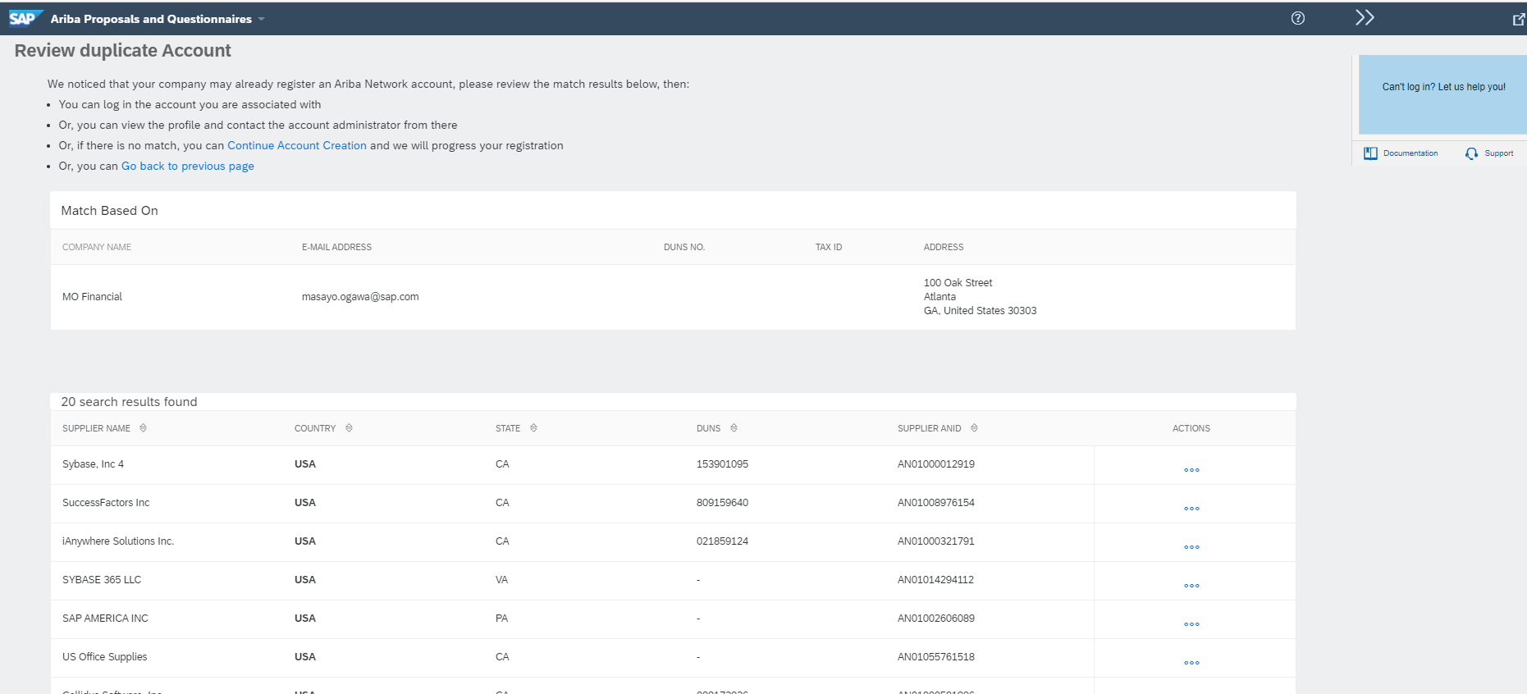
System will show potential duplicate accounts.
If you don’t see any duplicate account, click Continue Account Creation to proceed to your new account.
If you see your company name, click on … icon to view more details and verify the information, then use Contract Administrator option to contact your administrator, so your account will be linked to your company’s main account

Slide 8
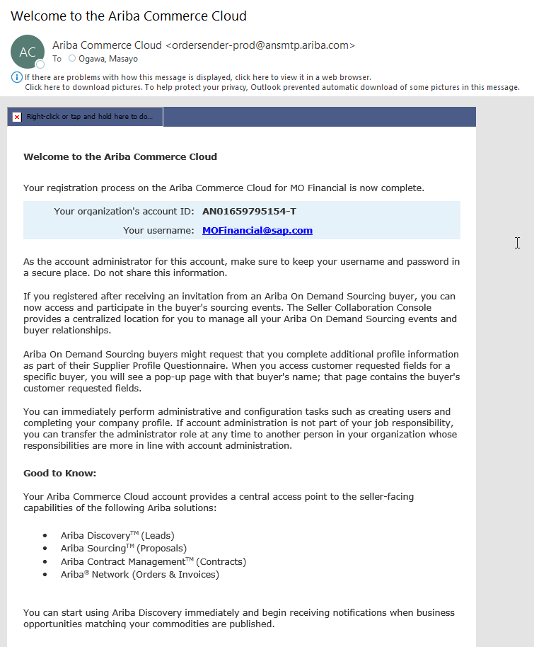
Once account has been created, you will receive a Welcome notification. We recommend you to keep this email.
(If you contact Ariba Customer Support, you will be required to provide your account ID (AN ID) starting with AN…….)

Slide 9
Supplier with Existing AN Account

Slide 10
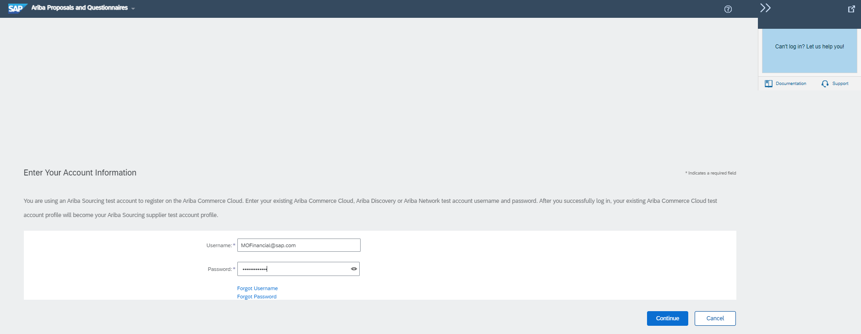
If you click “Log in” button, you will be brought to Ariba Network login screen.
Type in the existing User Name and Password you already have, then click Continue button

Slide 11
Once you log in with your existing login information, in the dashboard, you will see MORE… option. You will be able to switch the buyer organization from this option and access different buyer organizations.

Slide 12
Contact Customer Support

Slide 13
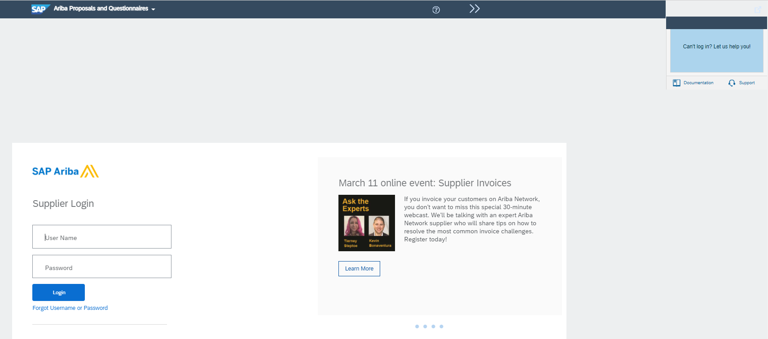
If you have any questions, you may contact Ariba Customer Support from Help section

Slide 14
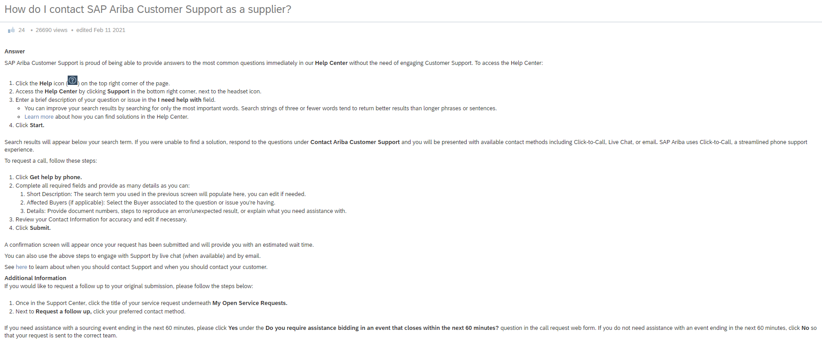

Slide 15
Log In

Slide 16
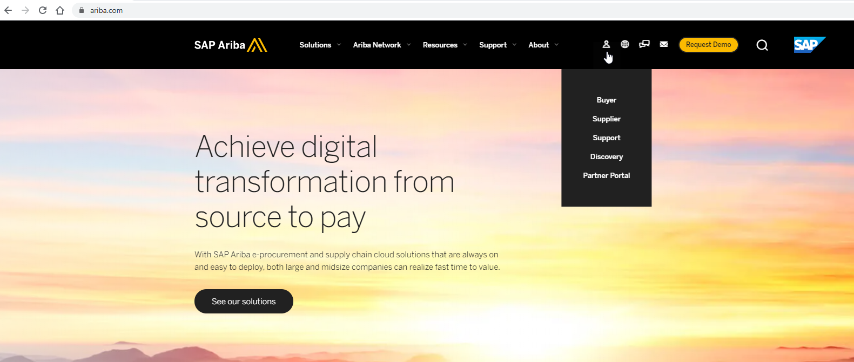
You may use the link in the invitation notification to log onto your account
OR
Go to www.ariba.com, then click on the person icon and select Supplier option

Slide 17
Once you are in your account, you may click on the SAP Ariba product name to access different products. For example, if you are looking for sourcing event or registration questionnaire, select Ariba Proposals And Questionnaires

Slide 18
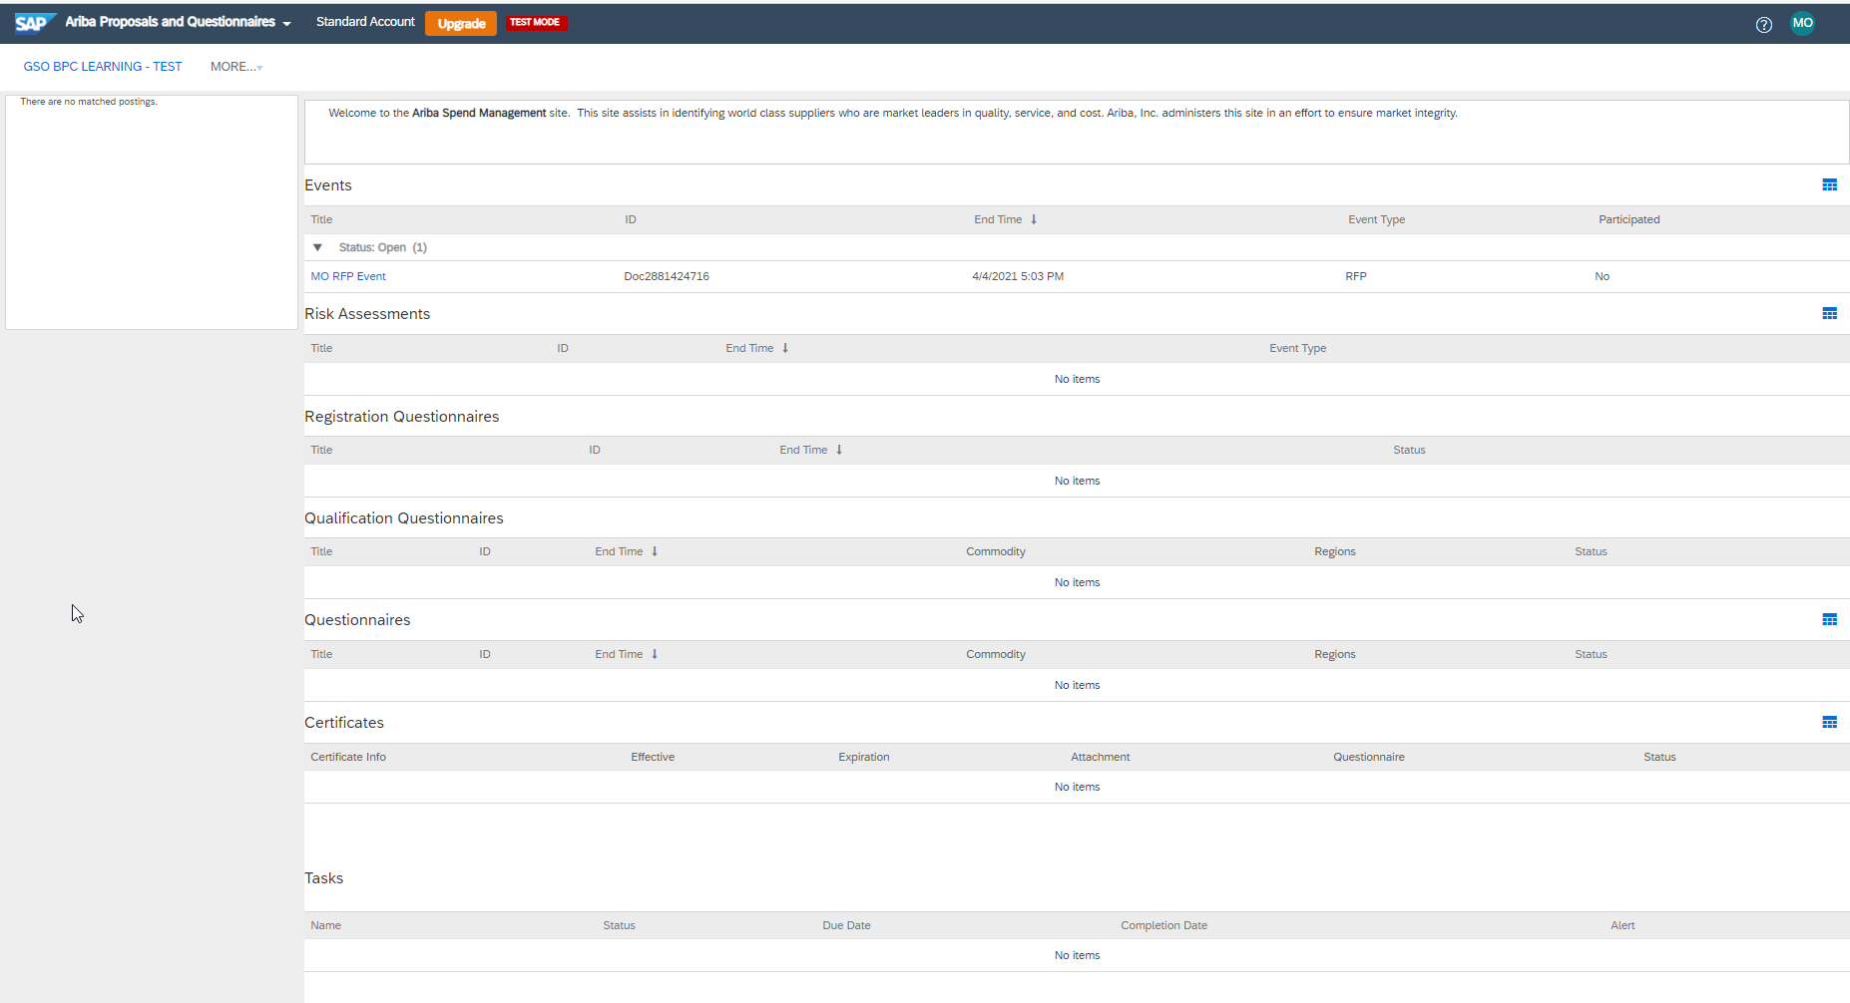
Once you select Ariba Proposals And Questionnaires, you will be taken to a dashboard where events and questionnaires you are invited to. If you do not see your event or questionnaire, please contact SAP Ariba Customer Support.

Slide 19
CPR Enablement Team

