Slide 1
Flex Master Data

Slide 2
Overview
What is Flex Master Data?
A custom-defined data structure designed to meet a specific business need
When to use Flex Master Data?
To house complex data that cannot be stored in a normal header field, such as a text field
A text field can store the names of hospitals
A Flex Master Data field can store the names of hospitals and attributes such as their addresses, phone numbers, and the name of the hospital administrator

Slide 3
Structure of Flex Master Data
The structure of a Flex Master Data element is defined by a configurable template
Every Flex Master Data template is comprised of two default fields:
UniqueName
Name
Custom fields (attributes) are defined by the customer
Who creates the structure of the Flex Master Data template?
The customer documents the attributes that are needed
SAP Ariba configures the Flex Master Data template to include the requested attributes
The customer populates the Flex Master Data template with the necessary data

Slide 4
Flex Master Data File
Default Fields: UniqueName, Name
Custom Attributes: City, State, Administrator

Slide 5
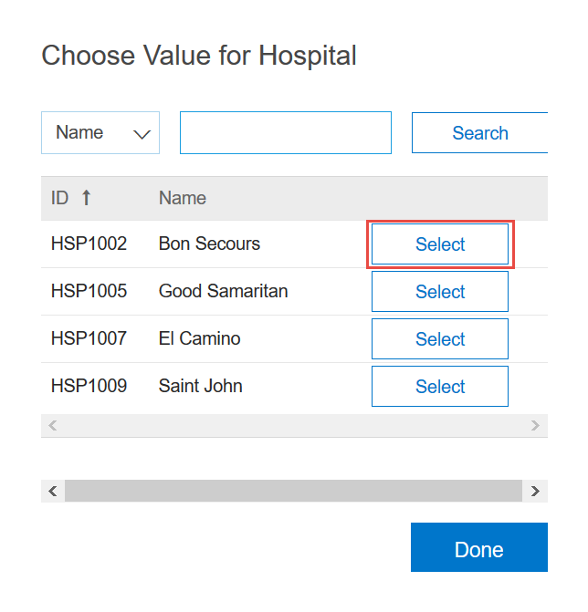
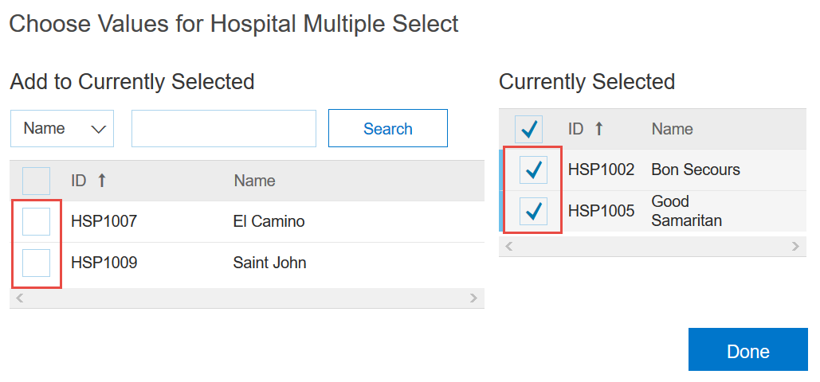
Using Flex Master Data in Projects
Flex Master Data Single Select
Flex Master Data Multiple Select
Users can search for the appropriate value by Name or ID (UniqueName)
Users can search for the appropriate value(s) by Name or ID (UniqueName)

Slide 6
Reporting Limitations
Only Names are reportable
IDs (UniqueName) and custom attributes are not reportable
The Name, UniqueName, and custom attributes are not reportable for FMD fields that are created in Procurement Workspaces and Procurement Workspace Requests

Slide 7
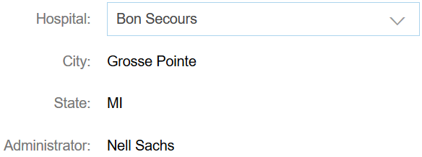
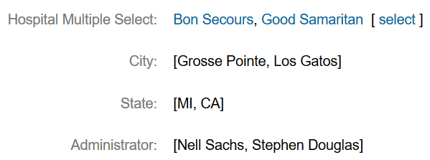
Overcoming Reporting Limitations
Additional, separate Custom Header Fields can be used to “extract” the attributes and make the data reportable
Flex Master Data Single Select
Flex Master Data Multiple Select
Additional, separate Custom Header Fields can be used to “extract” the Name, UniqueName, and custom attributes for FMD fields that are created in Procurement Workspaces and Procurement Workspace Requests

