Slide 1
SAP ARIBA
Guided Buying. Static Catalogs Enablement

Slide 2
INDEX
What is SAP Ariba Guide Buying?
Types of Catalogs
Process to follow with Grifols
Test and Production Environment
Catalog creation and uploading
Uploading Template
Steps to follow
Error Viewing
Catalog Status
Image Uploading
Catalog Maintenance

Slide 3
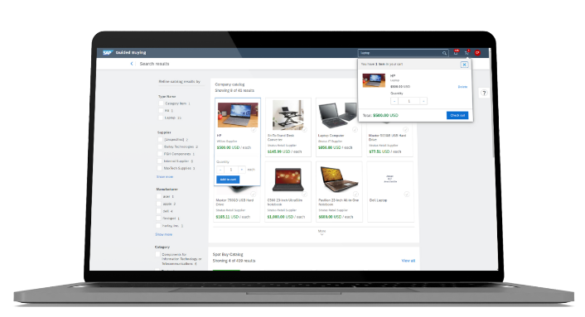
1. What is SAP Ariba Guide Buying?
The Guided Buying module is a SAP Ariba Cloud solution implemented so that Grifols staff can make purchase requests in an agile and intuitive manner.
To prepare this portal, catalogs are defined by provider with the materials and/or services that are purchased most frequently. Through these catalogs, requesters create a purchase request that is transformed into the order you receive as a Grifols supplier.
The catalogs are files stored in SAP Business Network or on your company's website that describe the products and services your organization offers and the prices it charges.
You can create catalogs for any product or service, regardless of how they are measured, priced, or delivered.
These catalogs are loaded and maintained directly from the supplier's environment, saving time on data update waiting times and avoiding discrepancies between orders and invoices.
This manual aims to provide support in the process of loading the catalogs.

Slide 4
2. Types of Catalogs
The SAP Ariba solution accepts the following types of catalog:
Static Catalog
Static catalogs are the simplest form of catalog. A static catalog is an individual text file containing the catalog information. Static catalogs can be created as Excel, CIF or cXML files.
In a static catalog, you simply create a line entry with the desired information for each item.
PunchOut Catalog
PunchOut catalogs (cXML) are direct, interactive catalogs that are hosted on your website instead of being loaded into SAP Ariba Procurement Solutions. PunchOut catalogs allow customers to click on a "PunchOut" link or go to your organization's website.
Based on the customer, the website can offer previously agreed contract products, prices, and other specialized information. If you already have an e-commerce website, you can modify it to accept PunchOut.
Just as the following catalog file formats::
CIF (Catalog Interchange Format)
cXML (commerce eXtensible Markup Language)
BMEcat (Bundesverband Materialwirtschaft, Einkauf und Logistik e. V. catalog)
Microsoft Excel
The present manual explains how to carry out the loading of the static catalogs.

Slide 5
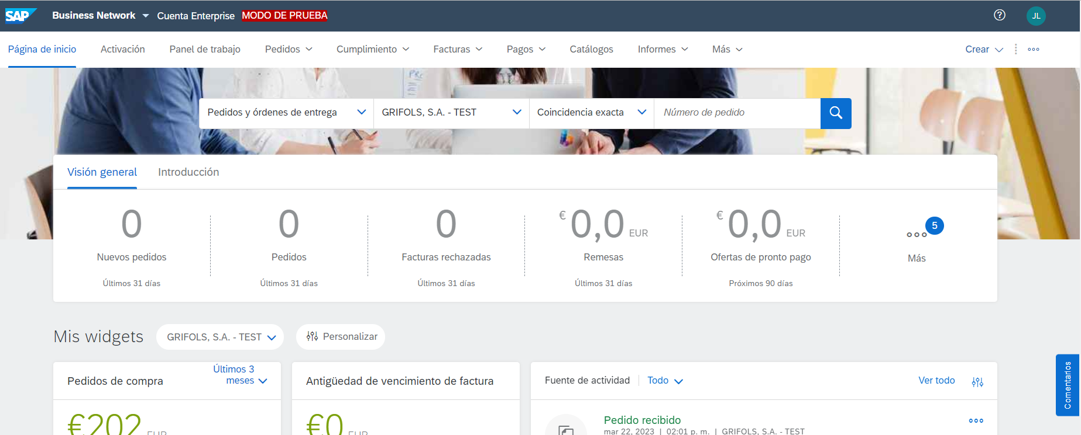
3. Process to follow with Grifols
In the header of the Ariba Business Network, you will be able to see which environment you are working in..
In order to validate that system is functioning correctly, two uploads will be carried out in different environments:
Upload in Test environment where the system will be validated to be working correctly.
Upload in the Production environment.
The actions to carry out both uploads are the same; they will only be performed in test mode or in production mode depending on the environment.
Upload in Test System
SUPPLIER
Approval in Test System
Upload in Production System
SUPPLIER
Sending template for data upload to supplier
Approval in production system
* Grifols has visibility of the entire process in both environments. Once validated in the Test environment, they will be notified to commence the upload to Production.

Slide 6
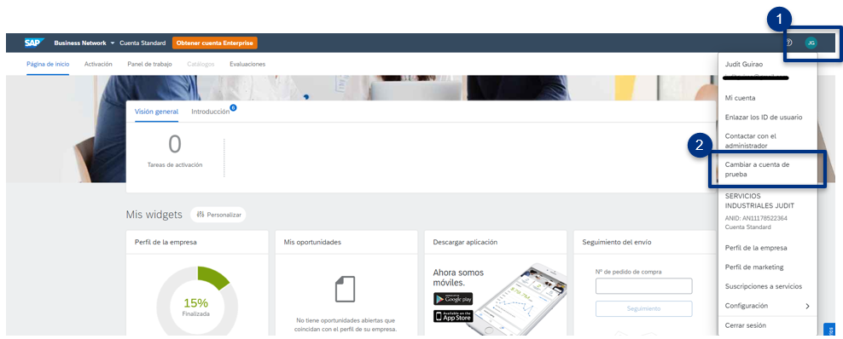
4. Test and Production Environments
With the creation of a SAP Ariba Network account, you will have access to a test environment.
To switch from the production environment to the test environment, you must follow the following steps in your Ariba Network Suppliers.
On the right side of the header, you will find the profile icon with a dropdown menu.
Click and select the option "switch to test ID".
The first time you request to enter the test environment, the tool will ask for a username and password to create the test account.
⬥

Slide 7
5. 1 Catalog Creation and Upload
Loading Document
The catalog upload is performed using an Excel document consisting of columns of information to be filled in by both parties (Grifols and suppliers).
The procurement teams at Grifols have conducted an analysis and subsequent validation of the items supplied to us. Attached to this document, you have been sent the template with the list and essential information for the company.
We appreciate your review of the provided data and kindly request that you add images, as well as any additional information you deem appropriate.
On the next slide, you will find the important fields of the document and how to upload it to the Ariba environment.
If discontinued materials or price discrepancies appear, please contact the procurement team indicated on the last slide.

Slide 8
5.2. Catalog Creation and Upload
Steps to follow on the platform
Considerations for loading catalogs:
1. The "Goods" field is used to classify the products and services included in the catalog.
If you are a supplier of all items at a product and service category level, select the name of the highest-level product and service category instead of adding all lower-level product and service categories. For example, a furniture supplier should select the category "Furniture and Furnishings," not the hundreds of individual items it sells. Customers can search for this information.
2. The Subscriptions page in the catalog assistant only lists the customers for whom the catalog is suitable..
3. You can select who should view the catalog depending on the setting you choose, Private or Public.
Private: SAP Business Network ensures that only the customers you specify can view the catalog. You can select this option for catalogs that contain contract prices. This option automatically creates a subscription to the catalog for all the customers you select.
Public: SAP Business Network allows all customers to view the catalog. To receive a catalog, a customer must establish a relationship with you.
Please follow the instructions explained in the video.
Click to watch the video

Slide 9
5.3. Catalog Creation and Upload
Catalog validation error display
View catalog validation errors to understand why a catalog has failed and to be able to fix it.
Procedure:
In the Catalogs tab, click on the link 'Validation Errors Found by Customer' in the Status column to perform a Punch-out on the customer's site.
The page displays the total number of items that have been imported and the number of items that have not passed the content rules, grouped by the following states: Validation Error, Validation Warning, Debugged, and Enhanced.
Expand all item state groups to see the list of rules that have caused failures and the count of items per rule.
Click on the link of an item state to view the items with that specific state. For example, click on the Validation Error link to see the list of items with validation errors.

Slide 10
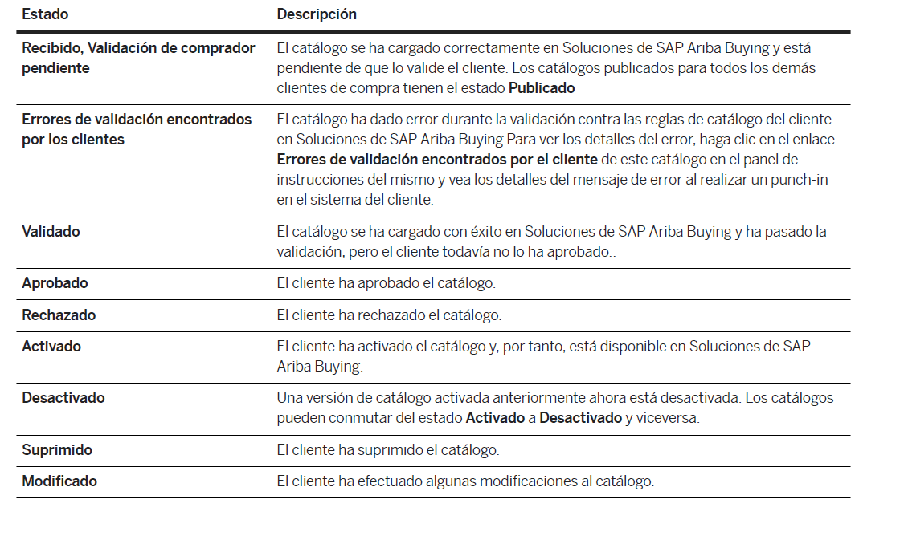
5.4. Catalog Creation and Upload
Catalog Status
Please use the following table to interpret the different subscription states of the catalog.

Slide 11
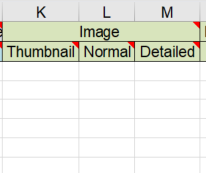
5.5. Catalog Creation and Upload
Images Upload
You can upload images to the catalog in two ways:
Through a URL link
With local images
In both cases, you must fill in the following columns of the template.
Requirements
Recommended image size: 100 x 100 pixels.
Maximum file size: 50KB.
The file cannot contain special characters.
"When using a link, it's necessary:
Start with: https://
Always include the file format extension in the name. (Example: https://myonlineimages.co.uk/image1.jpg)"
The allowed formats are: JPEG/JPG, GIF, PNG, BMP, and TIFF.

Slide 12
5.5. Catalog Creation and Upload
Images Upload
Through a URL link
Click to watch the video

Slide 13
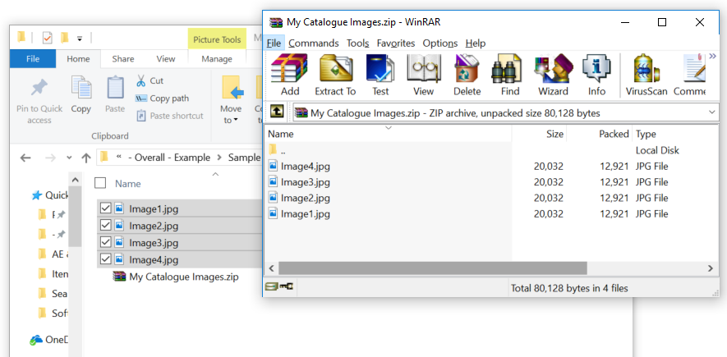
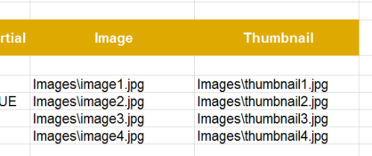
5.5. Catalog Creation and Upload
Images Upload
2. With local images
Paste the link in the previously mentioned columns, considering the requirements.
1
Local images
Add the images to a zip folder.
Enumerate the names of the images. If they are in a folder, that should also be specified. The names must be exactly matching.
Upload the Excel document and the zip folder in Ariba.
2

Slide 14
5.5. Catalog Creation and Upload
Images Upload
Please watch the following video to see the previously explained steps.
Click to watch the video

Slide 15
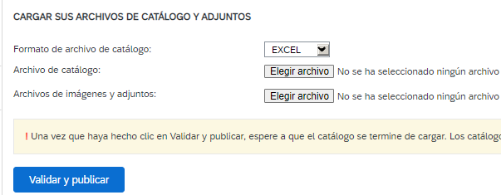
6. Catalog Maintenance
The data loaded in the catalog (prices, delivery dates, references, etc.) will be reflected in the purchase orders. For this reason, it is important that the catalogs always have updated information.
To achieve this, we request that you make updates to the document and upload it following the same procedure as a new version of the existing one
Select the catalog to update and click “View/Edit”.
Choose the file and click “Validate and Publish”.
1
2

