Slide 1
Ariba Network CSV Invoice upload guide
May, 2017
Internal

Slide 2
Agenda
CSV Invoice overview
CSV Invoices scope
Data Requirements
CSV fields mapping
CSV template use
Downloading CSV template
Uploading CSV Invoice
Tracking Invoice status
Troubleshooting CSV Invoices
CSV template Change log
Contacts and Support

Slide 3
CSV Invoice Overview

Slide 4
CSV Invoice Overview
CSV stands for Comma Separated Value/Variable file. It represents structured way of data stored as plain text file.
CSV Invoice Upload Supports the transfer, transformation and loading of comma delimited files (CSV) representing a Supplier’s invoices to be rendered as cXML invoices for their Customers. Provides an effective means for Suppliers with a large number of invoices to submit these to their Ariba customers electronically when they do not have the immediate means to provide these via cXML or EDI directly.

Slide 5
CSV Invoice Scope

Slide 6
CSV Invoice Scope
IAG supports the following CSV invoice types:
PO Invoices: invoices against purchase order where the purchase order was received through Ariba Network.
Contract Invoices : invoice against contract
Invoices submitted through CSV upload have the following requirements:
Cannot be greater than 10,000 lines in total
Cannot be greater than 2500 invoices per file
One invoice can have maximum of 5000 line items.
File cannot exceed 40MB in size.

Slide 7
Data requirements

Slide 8
Invoice Data Requirements
Invoice ID must be always present
date format must be: mm/dd/yyyy
Invoice must contain PO reference
PO based invoices MUST use the orderID field to capture the PO number.
Contract based invoice MUST use agreementID field to capture Contract number.
The flags – isTaxInLine, isSpecialHandlingInLine, isShippingInLine and isDiscountInLine used to represent Tax, Special Handling, Shipping and Discount in line level respectively.
The flag lineItemType - set to either MATERAIL or SERVICE.

Slide 9
Additional Data Requirements
Required fields:
lineItemSubtotal
serviceLineItemSubtotal
Optional fields:
Line level Tax details
Summary level tax details
Line and summary special handling and shipping amount
Line and summary discount amount.
Note: IAG template supports material and Service lines.

Slide 10
CSV File Recommendations
File Requirements
Alterations or updates to the original CSV file format downloaded from the Network will cause the CSV to fail during the upload process.
You must keep the CSV file you download in its native format.
Do not convert to an Excel file, save as a workbook, add macros, delete/add columns or edit the column names in any way.
The application Ron’s editor is an example of a CSV File editor.
You can download a free trial at: http://www.ronsplace.eu/Products/RonsEditor?utm_source=killink
Note that this is not an Ariba software and is not supported by Ariba.

Slide 11
CSV template details

Slide 12
CSV Sample / Field Mapping
The embedded CSV sample template provides:
Data sample of valid CSV invoices processed successfully by the Customer.
The embedded field overview provides:
Mapping information on field content and requirements.
For accounting and payment questions:
Contact IAG: . AribaProgram@iag.com.au
For CSV upload related questions or errors:
Contact Ariba Technical Support

Slide 13
CSV template use

Slide 14
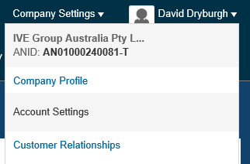
Downloading the CSV Template AN01000240081-T
From the Home Page of your production AN account, Click the Company Settings tab.
Click Customer Relationships.
AN will display a list of all customers that you have a relationship with on the Ariba Network.
Click on IAG link within your list.

Slide 15
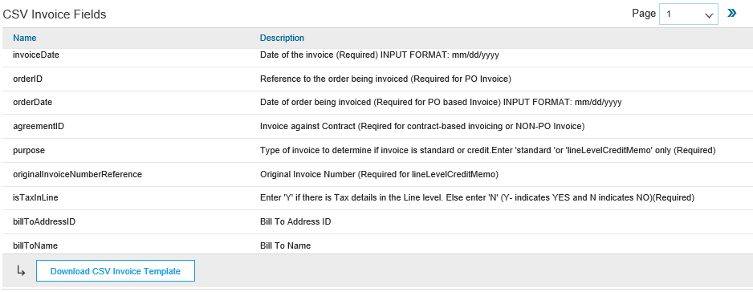
Downloading the CSV Template (continued)
Click the Download CSV Invoice Template button. You will be prompted to Open or Save the file.
Save the file to your local hard drive.
Once you are finished saving the template file, click the Done button to exit this section.
You will be back at your Customer Relationship page.

Slide 16
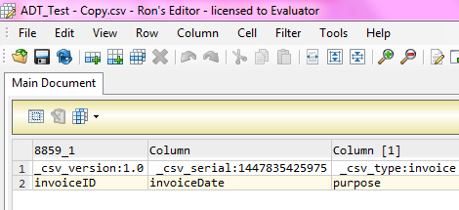
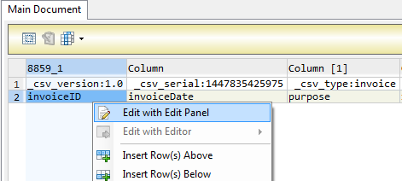
Populate the CSV Invoice Template
Ron’s CSV Editor
Populate each available invoice field as appropriate – starting in Row 3, Cell A
Note that . Rows 1 and 2 are CSV File information rows and cannot be removed or modified in any way. If these fields are changed or removed, the file will fail at upload.
To populate value for each field select that cell, right click and chose option ‘Edit with Edit Panel.
When you have completed populating all fields for your particular invoice, Save the file to your local drive.
Standard Rows – Do Not Change
Begin Invoice Data

Slide 17
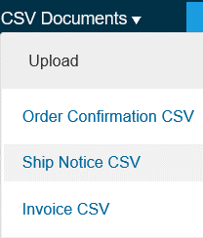
Upload the CSV Invoice
From the Home Page, locate the CSV Documents link on the right side of the page.
Click Invoice CSV.
You will see an Import CSV Invoice box.
Ensure Customer is selected in the Customer drop-down box.
Note: Each customer using the CSV Invoice method has a customized template. You cannot use any other customer's template for Customer .
Click the Choose File button and find the CSV File you have created and saved.
Once the file path is shown, click the Import CSV Invoice button.

Slide 18
Upload the CSV Invoice
Once you click on Import CSV Invoice, the CSV file will be uploaded , click on Submit button.

Slide 19
Upload the CSV Invoice
Once you click on Submit, the CSV Invoice will be successfully imported. Click on Close button

Slide 20
Tracking CSV Invoice status
Checking Invoice Status
From your Home Page, click on the Outbox tab.
You will again, see a listing of all of the invoices you have sent.
Each invoice number is a link to open and view that invoice.
There are two status types provided:
Routing Status: show the routing status of the invoice through the Ariba network to IAG.
Invoice Status: shows the status of the invoice itself specifically through it’s payment process.

Slide 21
Tracking CSV Invoice status
Routing Status
Obsoleted: You canceled the invoice.
Failed: The invoice failed the IAG invoicing rules as set within their Ariba Network account.
Queued: Ariba Network received the invoice from a suppliers Network account, but has not sent it to the IAG network account.
Sent: Ariba Network sent the invoice to IAG Ariba Network account. The invoice is awaiting download into the IAG invoicing application.
Acknowledged: The invoice has been sent from the IAG network account into their invoicing application.

Slide 22
Tracking CSV Invoice status
Invoice Status
Sent : IAG has received the invoice.
Rejected: IAG has rejected the invoice. If IAG subsequently accepts the invoice or approves it for payment, invoice status updated to Sent indicating invoice was accepted .
Failed: Ariba Network experienced a problem routing the invoice.
Approved: IAG has approved the invoice for payment.

Slide 23
Troubleshooting CSV Invoices

Slide 24
Troubleshooting CSV Invoices
General Checks
Be sure that the application that is being used to create the file is a true CSV editing application.
Be sure that all value fields such as unit price, tax, subtotal, gross, etc., are entered properly, (for example 2.25 or .58).
Ensure that the file does not contain any special characters, (dollar sign, asterisk, quotation marks, etc.).
Ensure that none of the file data within the first three rows of the template sample has been modified from its original state.
Ensure you are using the correct version of the CSV template for IAG.
IMP - Once the invoices are uploaded using the CSV channel , Supplier will see the message saying –‘ csv file uploaded successfully’ but may not immediately see the invoice on the Network GUI .This is because the server may take sometime to update the UI screen . In case the Supplier need to refer the invoice immediately but doesn’t find it on the UI , they may use the invoice search option to find the uploaded CSV invoice. The server will process the request and fetch the invoice from the Database.

Slide 25
Troubleshooting CSV Invoices
When is the problem occurring?
Is it at the point of uploading the file?
Is it after the file is uploaded and invoices show a failed status?
Is it after the file is uploaded and invoices show a rejected status?
If the problem happens at #1
The file itself does not meet the basic CSV requirements. You will see specific error messaging on the screen to help identify which field needs to be reviewed/changed. This could be:
Missing header information or missing data in a required field
Incorrect formatting in any field
The problem within the file must be corrected and the entire file must be uploaded again – nothing was loaded from the CSV file.
If the error happens at #2
The invoices (as opposed to the file) failed the invoice rule validation. When the invoices are converted from the .csv file to actual individual invoice documents on the AN, they are then validated based on the Invoice Rules set in Customer Ariba Network account.
Check the ‘History’ tab on the individual invoice to see which rule was violated and caused the invoice to fail.
The problem within the file must be corrected BUT only those invoices that failed need to be resent.
If the error happens at #3
The invoices passed .csv validation and Ariba Network validation but were rejected by Customer (either by their invoicing system automatically or by an end user manually).
Check the History tab on the individual invoice for additional details.
The problem with the individual invoices must be corrected and only those invoices that were rejected need to be resent. Invoice numbers must be modified.

Slide 26
CSV template Change log

Slide 27
Moving from one version to another
Important notice: Whenever new version of csv template is released or mapping rules are modified there is new unique template serial number generated by Ariba Network. This number is part of the template and being sent back with upload (sample: _csv_serial:1423025640524). If csv template header’s are not changed it is still possible to use the old version of the template however supplier is notified every time outdated version is used.
In case csv template change consists of headers update or add of new columns suppliers have to download new version and start using this one.
Otherwise upload will fail with mapping failure message.

Slide 28
Contacts and Support

Slide 29
Training and Resources
IAG Supplier Information Portal
Supplier Information Portal contains specific documentation and training material.
From the home page of your account, click the Company Settings and then click the Customer Relationships tab.
The portal link is located next to your customers name in the middle of the screen
Review the presentations to learn more about transacting with Customer
Remove if portal will not be rolled out

Slide 30
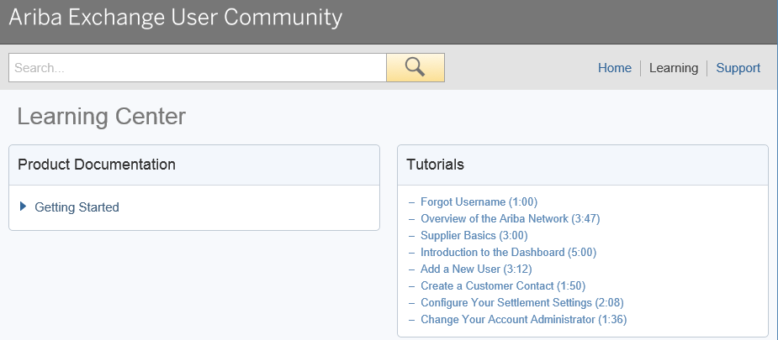
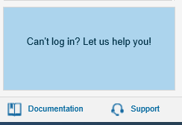
Ariba Network Standard Documentation
Go to: http://supplier.ariba.com
Click on the Help Center in the upper right hand corner of the page.
Bottom right hand corner has access to Documentation. Click to view Product Documentation.

Slide 31
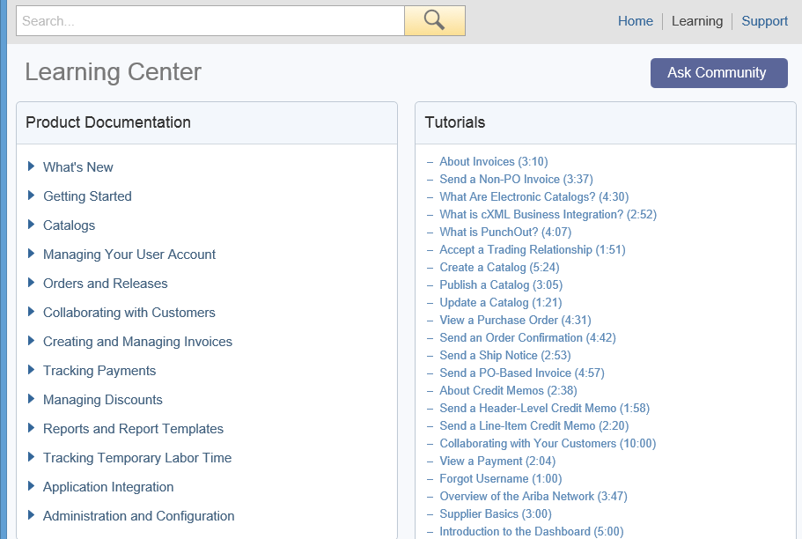
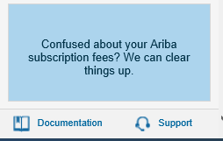
Ariba Network Standard Documentation
Standard Documentation can also be accessed from your account. Click on Help Center button on Home page of your account,
Click Documentation on bottom right hand corner to view Ariba Network Administrator’s documentation.

Slide 32
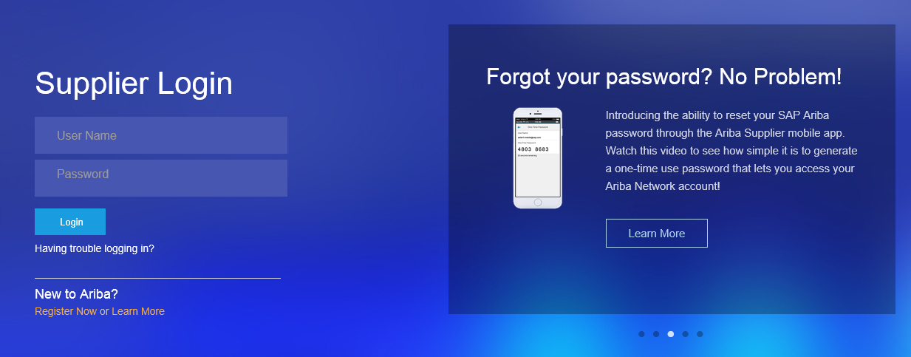
Supplier Support
Go to http://supplier.ariba.com
If you forgot your username or password click on the link Having trouble logging in?

Slide 33
Supplier Support
Upon clicking the link Having trouble logging in? , new page opens up where you can choose from one of the options and click on Continue.

Slide 34
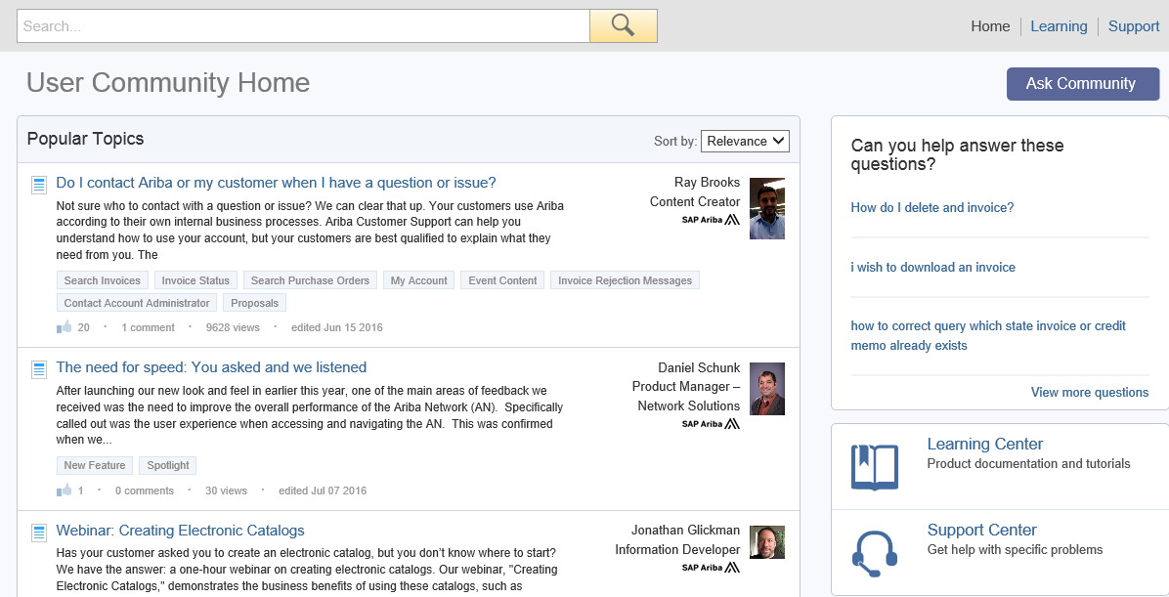
Supplier Support
Log into your account.
Click Help Center, View More.
You will find lists of Popular Topics FAQ’s and link to contact Support Center.

Slide 35
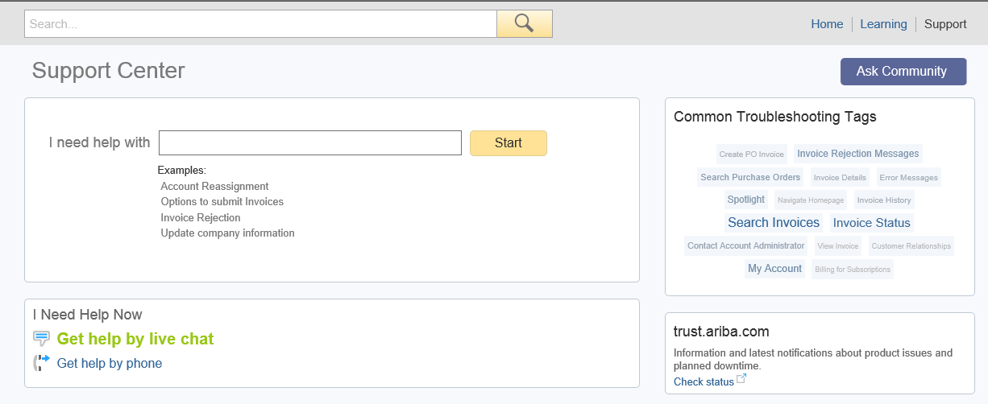
Supplier Support
Ariba Network Support by Web – Get help by phone
Click on the Support link from the Help Center Page.
Click on I Need Help Now, Get help by phone link.
You will be brought to a page listing all Ariba customer support numbers. Have your account information (ANID) ready and customer’s name when you call.

Slide 36
Who Should You Contact?
Supplier Support During Deployment
IAG Business Process Support
Please contact the IAG Supplier Enablement team at TBD for business-related questions.
Email Address : AribaProgram@iag.com.au
Supplier Support Post Go-Live
Ariba Network Support for Actively Transacting Suppliers
Have your Ariba Network ID (ANID) available. It is located at the top right corner of your account home
page.
Call the specified number for your region as noted below:
For any other location please check the phone number at https://connect.ariba.com/help/1,,contact,00.html
Region | Contact Number
US/Canada Toll Free: | 1-866-31ARIBA (1-866-312-7422)
North/South America | +1-412-222-6170
Europe, Middle East and Africa | +44 (0) 20 7187 4185
Asia Pacific | +65 6311 4585

Slide 37
Thank you

